Slide 1
Large Flexible Loads in SSWG

Slide 2
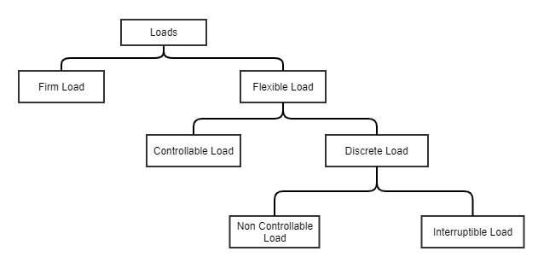
Load Definitions and Modeling
Large flexible loads (LFLs) in planning will be defined as any load registered as a CLR, NCLR, or Interruptible load
In the planning cases will be classified into two buckets
Controllable and Discrete
Operational and planned LFLs will be modeled by ERCOT according to ERCOT registration information

Slide 3
Load Functionality in SSWG Planning Cases
Controllable loads should be SCED dispatched over a continuous range utilizing a price curve
Will be used to alleviate congestion, contingency violations, and capacity issues in SCOPF
Discrete loads will be removed in blocks taking out either a portion of the load or the entire load minus station service
Will be used to alleviate capacity issues as a measure of last resort prior to utilizing reserves at ERCOT discretion

Slide 4
Software Upgrades
The desired functionality will be dependent on changes to power system simulators
We will need to engage vendors to implement new load types in software
Controllable and Discrete
Some simulators already have a way to assign price benefit curves to loads
The OPF/SCOPF methodology in power flow simulators will need to be updated to dispatch the new load types
To identify these loads prior to software updates, initial attempts will use PSSE IDs to identify them

Slide 5
Concept
We need to have a trigger where the projects get included at a stage where the load is no longer speculative.
Similar to Planning Guide section 6.9 we would want to include loads which have reached a particular milestone of development.
We want to capture the type of load registration in the speculative stage for initial studies for interconnections.
We then want those projects to be included in the studies using this registration at the milestone.
We need to include future increases as well but those future amounts need to have some credible supporting information.

