Slide 1
Credit Exposure Update
Credit Work Group
ERCOT Public
October 19, 2022

Slide 2
Monthly Highlights Aug 2022 – Sep 2022
Market-wide average TPE decreased from $2,726.6 million in August to $1,611.8 million in September.
  TPE decreased mainly due to lower RT and DA Settlement Point prices as well as lower RT & DA adjustment factors
  Discretionary Collateral is defined as Secured Collateral in excess of TPE,CRR Locked ACL and DAM Exposure
  Average Discretionary Collateral was relatively flat at $3.252.4 million in September vs. $3,222.5 million in August
No unusual collateral call activity

Slide 3
TPE and Forward Adjustment Factors Sep 2021- Sep 2022
*TPE adjusted to exclude short pay entities eliminating data skew

Slide 4
TPE/Real-Time & Day-Ahead Daily Average Settlement Point Prices for HB_NORTH September 2021- September 2022
* TPE adjusted to exclude short pay entities eliminating data skew

Slide 5
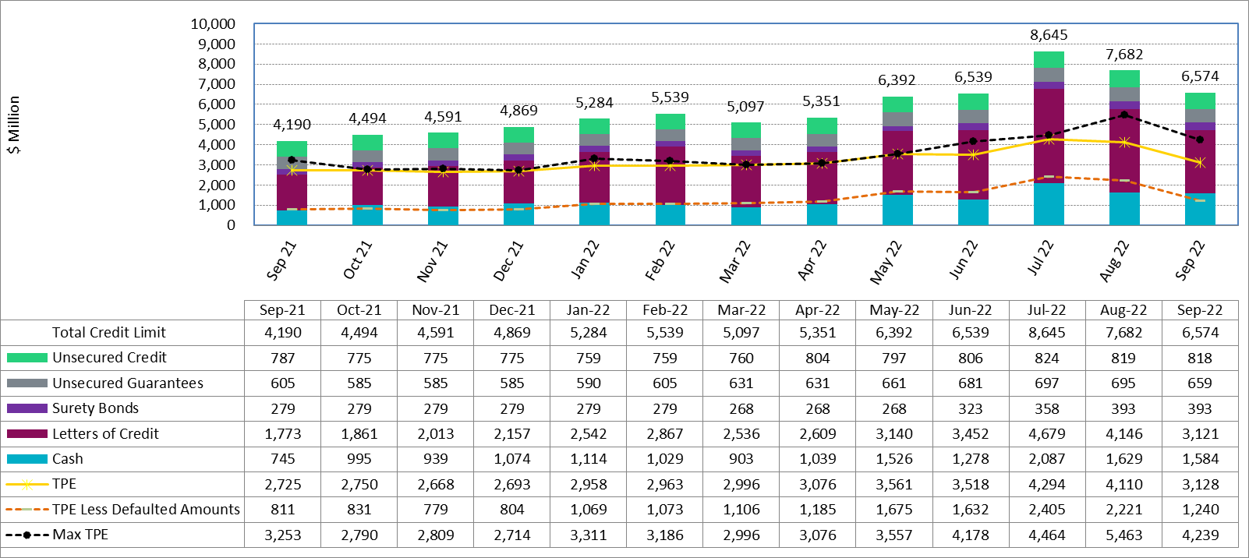
Available Credit by Type Compared to Total Potential Exposure (TPE) Sep 2021- Sep 2022
Numbers are as of month-end except for Max TPE
Max TPE is the highest TPE for the corresponding month
TPE less Defaulted Amounts: TPE – Short-Paid Invoices

Slide 6
Discretionary Collateral August 2022 - September 2022
* Discretionary collateral doesn’t include Unsecured Credit Limit or parent guarantees
* TPE adjusted to exclude short pay entities eliminating data skew

Slide 7
Discretionary Collateral by Market Segment September 2020 - September 2022
* Discretionary Collateral adjusted to exclude short pay amounts eliminating data skew

Slide 8
TPE and Discretionary Collateral by Market Segment- September 2022*
Load and Generation entities accounted for the largest portion of discretionary collateral
*Discretionary collateral doesn’t include Unsecured Credit Limit or parent guarantees
* TPE adjusted to exclude short pay amounts eliminating data skew

Slide 9
TPEA Coverage of Settlements August 2021– August 2022
*TPEA closely approximates actual/invoice exposure
*TPEA adjusted to exclude short pay entities eliminating data skew

Slide 10
TPEA Coverage of Settlements August 2021– August 2022
*TPEA exceeds invoice exposure
*TPEA adjusted to exclude short pay entities eliminating data skew

Slide 11
TPEA Coverage of Settlements August 2021– August 2022
*TPEA generally exceeds invoice exposure

Slide 12
TPEA Coverage of Settlements August 2021– August 2022
Invoice exposure generally exceeds TPEA
TPEA adjusted to exclude short pay entities eliminating data skew

Slide 13
TPEA Coverage of Settlements August 2021– August 2022
* TPEA generally exceeds Invoice exposure

Slide 14
TPES Coverage of Settlements August 2021– August 2022
*TPES exceeds actual/invoice exposure

