Slide 1
ERCOT EV ALLOCATION STUDY
METHODOLOGY FOR DETERMINING EV LOAD IMPACT AT THE SUBSTATION LEVEL
Presented By
  Sanem Sergici
  Julia Olszewski
  Grace Kortum
  Goksin Kavlak
  Mike Hagerty
Presented For
  ERCOT
10/13/2022

Slide 2
Table of Contents
Executive Summary
Forecasting ERCOT EV Adoption
Allocation of EV Adoption to Substations
Load Impact Analysis

Slide 3
Executive Summary

Slide 4
Introduction
Executive summary
  The Brattle Group was retained by ERCOT to develop a repeatable process for forecasting electric vehicle load impacts at the substation level out to 2029, for use in their System Planning Assessment
  ERCOT requested that Brattle provide an interactive “tool” that could be used to easily replicate and update the analysis in the future
  Brattle has conducted a thorough review of ERCOT’s existing electric vehicle assumptions, allocated those forecasts to ERCOT substations using Texas-specific and publicly accessible data, and generated representative 24-hour load profiles at each substation for 8 years, 4 seasons, and 2 day types
  Brattle has also corresponded at length with several of ERCOT’s Transmission and Distribution Service Providers to leverage their existing work and experience in understanding local impacts of EVs
  This presentation details Brattle’s approach in carrying out the analysis from start to finish, and includes a summary of the final results
  The Excel-based interactive tool will be passed off to members of ERCOT’s Transmission Planning team at the conclusion of the engagement

Slide 5
Methodology Overview
Executive summary
Brattle applied a 3-step approach to its analysis of EV load impacts at the ERCOT substation-level:
1
Establish Light, Medium, and Heavy-Duty EV Adoption Forecasts for 2022-2029
Allocate Adoption Forecasts to ERCOT Substations
Calculate Load Impacts at the Substation-Level
2
3
Calculate 64 representative load profiles for each substation, showing load throughout 4 seasons, 2 day types, and 8 years.
Develop interactive tool that generates profiles for each substation and can be easily updated in the future.
Update and improve upon ERCOT’s existing adoption assumption for LDV penetration.
Build out adoption forecast for a more granular list of Medium and Heavy-Duty (MHDV) EVs
Separate methodologies for LDV and MHDV allocation
Vehicles first allocated to the zip-codes and then to the substations using data from ERCOT, the Census, and Moody’s.

Slide 6
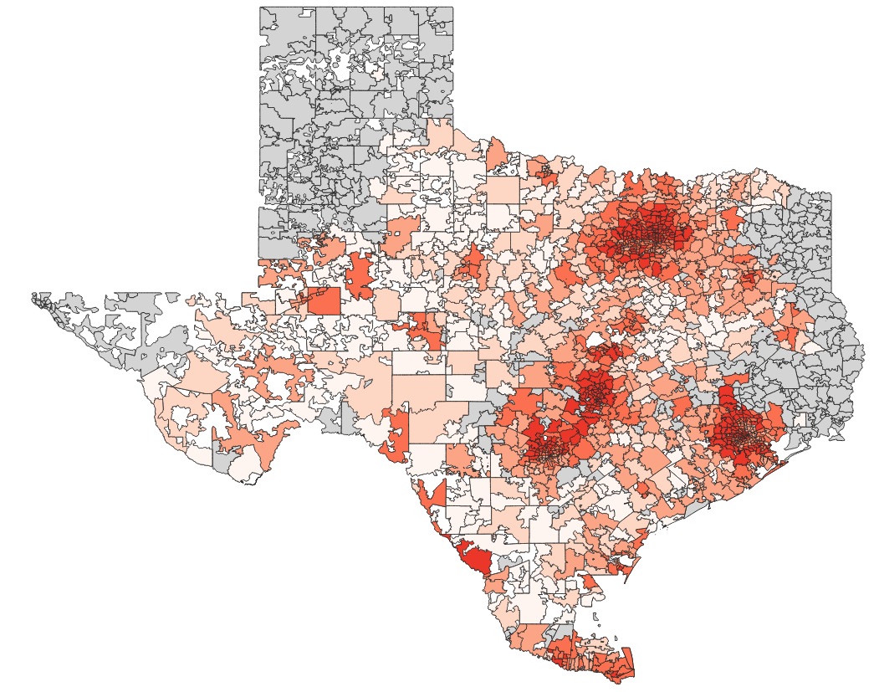
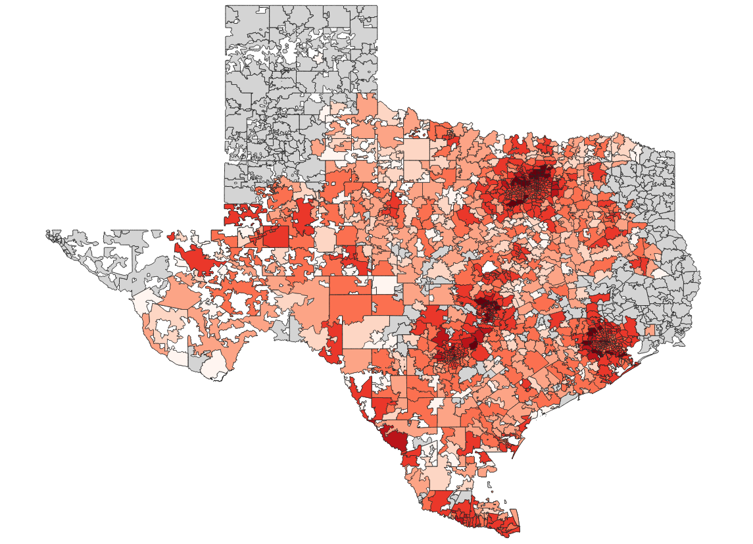
Summary of Results
Executive summary
  System-wide adoption and load impacts:
    ~770,000 LDVs and ~160,000 MHDVs are projected to be electric in Texas by 2029, representing about 4% of LDV stock and 4% of MHDV stock and therefore 4% of all vehicles on the road. Approximately 96% of these electrified vehicles will be registered within ERCOT’s service territory.
    The total EV charging load in 2029 is approximately 6 TWh, adding 1.25% of load to ERCOT’s electric load forecast in 2029 up from 0.2% in 2022
  Allocation to substations:
    LDV allocation is developed based on metrics capturing future propensity for adoption. Allocation is concentrated primarily in urban and suburban zip codes surrounding major cities such as Austin, Houston, DFW, San Antonio.
    MHDV allocation is established by multiple bottom-up models for key use cases. Delivery vehicles and regional and long haul trucks add load to substations in the city outskirts and major highways. Buses, pickup trucks, and certain regional trucks will increase load in urban and suburban areas
2022 EV Adoption
2029 EV Adoption

Slide 7
Step 1: Forecasting ERCOT EV Adoption

Slide 8
Step 1: Forecasting ERCOT EV Adoption
Forecasting EV Adoption
1
Establish Light, Medium, and Heavy-Duty EV Adoption Forecasts for 2022-2029
Allocate Adoption Forecasts to ERCOT Substations
Calculate Load Impacts at the Substation-Level
2
3
Calculate 64 representative load profiles for each substation, showing load throughout 4 seasons, 2 day types, and 8 years.
Develop interactive tool that generates profiles for each substation and can be easily updated in the future.
Update and improve upon ERCOT’s existing adoption assumption for LDV penetration.
Build out adoption forecast for a more granular list of Medium and Heavy-Duty (MHDV) EVs
Separate methodologies for LDV and MHDV allocation
Vehicles first allocated to the zip-code level and then to the substation-level using data from ERCOT, the Census, and Moody’s.

Slide 9
Forecasting Approach
Forecasting EV Adoption
  The results of this analysis rely on carefully developed EV adoption forecasts
  After benchmarking ERCOT’s existing adoption assumption against other jurisdictions around the U.S., Brattle determined that a “refresh” of ERCOT’s existing assumption was needed to ensure that the resulting allocations to substations were accurate
  Brattle performed a thorough review of ERCOT’s existing stock turnover models, which forecast Light-Duty (LDV) and Medium-Heavy-Duty (MHDV) Electric Vehicle adoption out to 2037
    Brattle identified several areas for potential improvement of ERCOT’s LDV stock turnover model and applied these to arrive at a “refreshed” LDV adoption forecast.
    Improvements to the MHDV model were more substantial, as Brattle developed forecasts for more granular MHDV use-cases.

Slide 10
LDV Stock Turnover Methodology Adjustments
Forecasting electric ldV Adoption
LDV Stock
Existing LDV Registrations
New Sales
Retirements
=
+
-
ERCOT Approach:
Actual historical sales data from 2015-2021 sourced from ERCOT.
ERCOT Approach:
Apply market share forecast from 2020 BNEF Electric Vehicle Outlook to a static estimate of Texas-level vehicle sales.
Apply 4-year delay to resulting forecast to match actual sales trajectory.
ERCOT Approach:
Assume 50% of vehicles sold in a given year retire after 10 years.
Brattle Approach:
No change.
Brattle Approach:
Apply annual retirement analysis using Survivability Data from National Highway Traffic Safety Administration.
Brattle Approach:
Apply market share forecast from 2021 BNEF Electric Vehicle Outlook to Passenger Sales Forecast from 2022 EIA Annual Energy Outlook, Table 38 (scaled down to TX-level).
Apply 3-year delay to match actual sales trajectory.

Slide 11
Updated LDV Stock Forecast
Forecasting electric ldV Adoption
  Brattle’s updated LDV stock forecast exceeds ERCOT’s original assumption by about 100,000 vehicles in 2029 for several reasons:
    The AEO forecast of total LDVs sold in 2029 is higher than ERCOT’s static assumption.
    Brattle’s light truck sales forecast exceeds ERCOT’s.
    These increases are somewhat offset by Brattle’s retirement approach, which results in more vehicles retired by 2029 than in ERCOT’s forecast, but the resulting stock forecast is still higher.
Texas LDV Stock Forecasts (Thousands)
Brattle
ERCOT

Slide 12
Electric MHDV Adoption is Currently Low in Texas
Forecasting Electric MHDV Adoption
MHDV electric vehicle adoption is currently much less advanced than LDV adoption.
  There were only 50 registered electric MHDVs in 2021.
  In class 2B, the largest MHDV class in our study, no EVs were registered in 2021.
  This poses a challenge for forecasting the adoption and allocation of vehicles
    There is no historical adoption trend.
    There is a high level of uncertainty about the development of these advanced technologies.

Slide 13
Medium and Heavy Duty Vehicles are Segmented into Classes
Forecasting Electric MHDV Adoption
We group MHDVs into 5 classes, which largely align with the Federal Highway Administration’s gross vehicle weight ratings (FHWA GVWR) and ERCOT’s vehicle class segmentation.
  These classes were selected to align with the classes used for EV sales adoption forecasts in Brattle’s Delphi Survey.
  We add additional granularity to ERCOT’s breakdown by adding more categories to their Local HD class.
  We consider buses and school buses separately from the weight classes.

Slide 14
Forecasting Electric MHDV Adoption
Forecasting Electric MHDV Adoption
We implement a stock turnover model to forecast electric MHDV adoption levels in each class.
  In this model, we use initial vehicle numbers sourced from EV Hub for 2021, which are very few.
  We then project vehicles in subsequent years by assuming a certain number of new vehicles enter, based on the assumed initial sales and sales growth rate projection.
  Vehicles are expected to retire after their expected lifetime (10-12 years for MHDVs), but this is longer than the study period from 2022-2029, so the model assumes no electric vehicles retire.
  The share of new vehicles that are EVs is forecasted based on the forecasted EV sales adoption rate.
Electric MHDV Stock
Existing Electric MHDV Registrations
New Sales
Retirements
=
+
-
Because electric MHDV technology is new, these vehicles are assumed to have age 0 in 2021.
New sales are calculated as forecasted MHDV sales in the class times forecasted EV sales share for the class.
Because vehicle lifetimes are assumed to be longer than the study period (to 2029), retirements are 0.

Slide 15
Forecasting Electric MHDV Adoption
Forecasting Electric MHDV Adoption
Forecasts are based on data from a Delphi Survey conducted by Brattle in late 2020.
  A panel of experts was asked to predict MHDV sales adoption across classes in 2025, 2030, and 2035. Their responses were then aggregated into high, base, and low scenarios.
  We use the base forecast for buses, and the low forecast for other vehicle types.
  We benchmark the stock adoption forecasts derived from these sales adoption forecasts through the stock turnover model against ERCOT’s assumptions, which are less granular.
EV Stock Adoption Forecast: Buses
EV Stock Adoption Forecast:
Local HD
EV Stock Adoption Forecast:
Long Haul HD

Slide 16
Step 2: Allocating EV Adoption to ERCOT Substations

Slide 17
Step 2: Allocate EV Adoption to ERCOT Substations
Allocation
1
Establish Light, Medium, and Heavy-Duty EV Adoption Forecasts for 2022-2029
Allocate Adoption Forecasts to ERCOT Substations
Calculate Load Impacts at the Substation-Level
2
3
Calculate 64 representative load profiles for each substation, showing load throughout 4 seasons, 2 day types, and 8 years.
Develop interactive tool that generates profiles for each substation and can be easily updated in the future.
Update and improve upon ERCOT’s existing adoption assumption for LDV penetration.
Build out adoption forecast for a more granular list of Medium and Heavy-Duty (MHDV) EVs
Separate methodologies for LDV and MHDV allocation
Vehicles first allocated to the zip-code level and then to the substation-level using data from ERCOT, the Census, and Moody’s.

Slide 18
LDV Allocation Methodology
LDV Allocation methodology
  The objective of this step in the analysis is to allocate our Texas-level LDV forecast to each of ERCOT’s substations.
    We first allocate adoption to all zip codes in ERCOT’s service territory, and then further allocate to the substations serving each zip code.
  ERCOT Substations fall into three categories:
    ESIID Substations – Existing ERCOT substations with loads associated with competitive choice areas within ERCOT.
    NOIE Substations – Existing ERCOT substations with loads associated with Non Opt-In entities within ERCOT.
    Planned Substations
  From ERCOT, we received a mapping of ESIID substations to the zip codes they serve, as well as non-coincident peak forecasts (in MW) for each substation. ERCOT does not track the zip codes served by Non Opt-In Entities (NOIE) or Planned substations. For this reason, we applied varying methodologies to allocate adoption to substations with and without zip code data
Step 2
Step 1
Derive separate adoption forecasts for zip codes with zero historical adoption
Step 3
Allocate 75% of vehicles to substations with known zip codes and usable data, based on load ratio share
Distribute zip code-level forecast to substations proportional to non-coincident peak (NCP)
Texas LDV Adoption Forecast
Allocate remaining vehicles to zip codes with historical adoption using propensity score approach
Allocate 25% of vehicles to substations without known zip codes
Distribute forecast to substations proportional to NCP

Slide 19
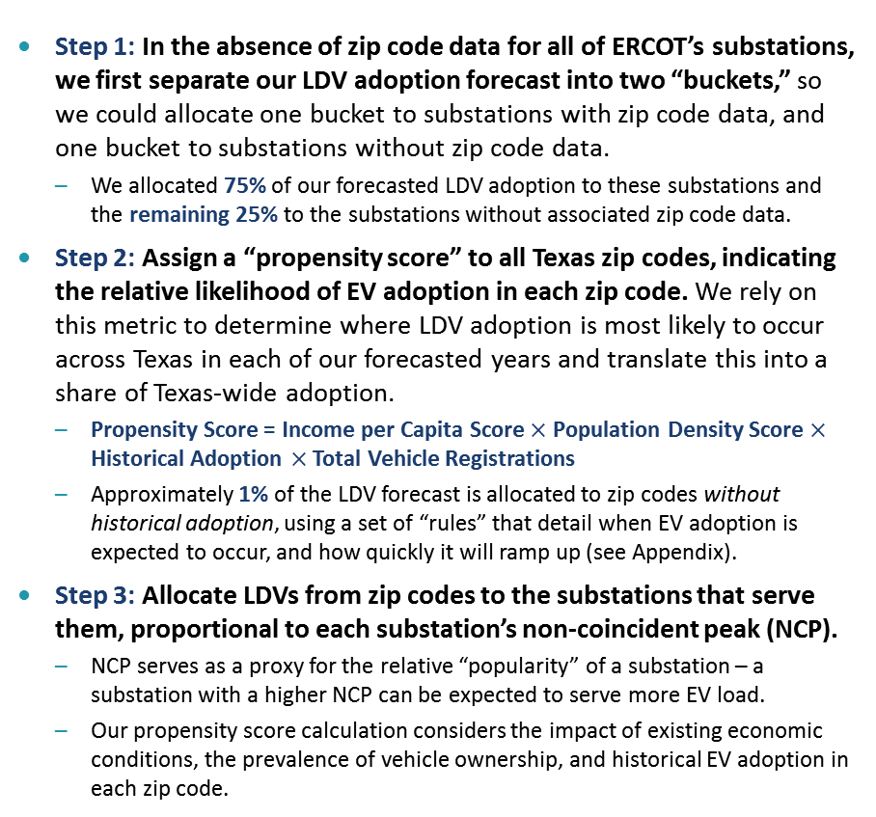
LDV Allocation Methodology
LDV Allocation Methodology
Bucketed LDV Adoption
  Step 1: In the absence of zip code data for all of ERCOT’s substations, we first separate our LDV adoption forecast into two “buckets,” so we could allocate one bucket to substations with zip code data, and one bucket to substations without zip code data.
    We allocated 75% of our forecasted LDV adoption to these substations and the remaining 25% to the substations without associated zip code data.
  Step 2: Assign a “propensity score” to all Texas zip codes, indicating the relative likelihood of EV adoption in each zip code. We rely on this metric to determine where LDV adoption is most likely to occur across Texas in each of our forecasted years and translate this into a share of Texas-wide adoption.
    Propensity Score = Income per Capita Score $×$ Population Density Score $×$ Historical Adoption $×$ Total Vehicle Registrations
    Approximately 1% of the LDV forecast is allocated to zip codes without historical adoption, using a set of “rules” that detail when EV adoption is expected to occur, and how quickly it will ramp up (see Appendix).
  Step 3: Allocate LDVs from zip codes to the substations that serve them, proportional to each substation’s non-coincident peak (NCP).
    NCP serves as a proxy for the relative “popularity” of a substation – a substation with a higher NCP can be expected to serve more EV load.
    Our propensity score calculation considers the impact of existing economic conditions, the prevalence of vehicle ownership, and historical EV adoption in each zip code.
~1% of total vehicles allocated to substations without historical adoption
~25%
~75%
Income per Capita (USD) and Propensity to Adopt
Population Density and Propensity to Adopt
1.3X
1.2X
1.2X
1.5X
1.1X
Source: McFadden et. al., The Impact of Incentives on Electric Vehicle Adoption: National Average Results. EPRI 2019.

Slide 20
Example Allocation to Zip Code with Historical Adoption
LDV Allocation Methodology
  1. 78613 is a zip code located in the Austin metro area, primarily in Williamson County.
    Population 2022: 65,099 (U.S. Census Bureau).
    Land Area: 28 sq. miles (U.S. Census Bureau).
    Population Density: ~2,351 residents per sq. mile (“Urban”).
    Income per capita 2022: $43,375 (U.S. Census Bureau).
    Approx. Total Registered Vehicles 2022: 30,490.
    Current LDV Adoption, as of April 2022: 1,130 vehicles (Atlas EV Hub).
  2. 2022 Propensity Score = (Income Score = 1) * (Pop. Density Score = 1.5) * 30,940 * 1,130 = 51,681,225
  3. Propensity Score Share of Total = 1.9% (Share of forecast allocated to this zip code)
  4. Vehicles Allocated in 2022 = 1,843
  We repeat this process for all Texas zip codes with historical EV adoption.
78613 LDV Adoption Forecast
Note: Adoption ramps up in later years due to increasing forecasted income per capita in this zip code, which increases its Income Score from 1 to 1.05 and boost its propensity score relative to other zip codes.

Slide 21
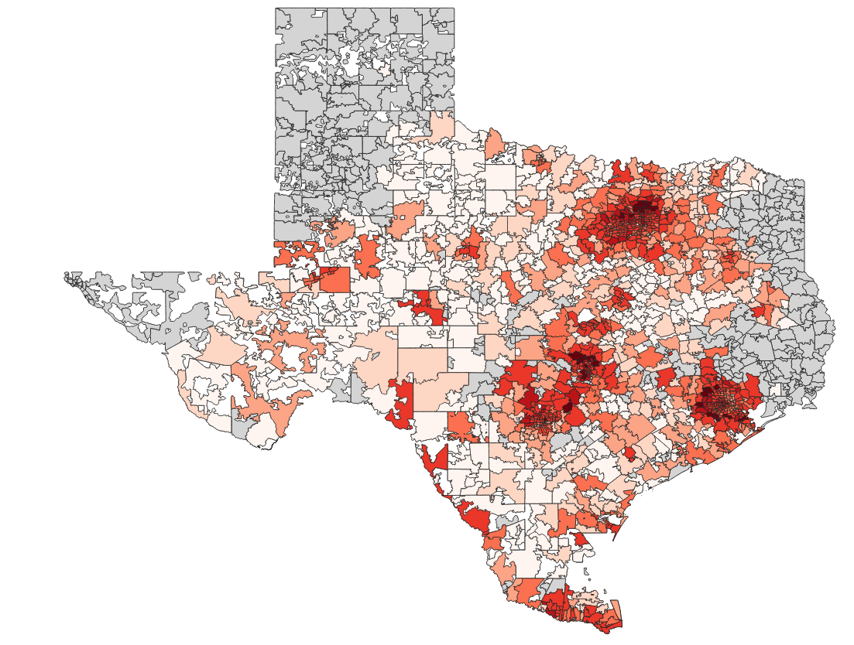
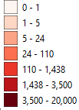
LDV Allocation: Summary of Results
LDV Allocation results
  Our resulting allocation concentrates adoption primarily in urban and suburban zip codes surrounding major cities. The highest adoption zip codes in 2029 all started out with relatively high adoption in 2022.
    Note that these values do not include additional adoption that may be served by NOIE or Planned substations.
    Once the TX zip codes are pared down to just ERCOT zip codes, we find that 95% of LDVs adopted in TX will fall in ERCOT’s service territory.
Top 10 Zip Codes by LDV Adoption in 2029
2029 LDV Allocation by Zip Code
Rank | Zip Code | Current (2022) Adoption Level | 2029 Adoption | Nearest City
1 | 77479 | 1,401 | 15,883 | Houston
2 | 78613 | 1,130 | 11,934 | Austin
3 | 75034 | 959 | 10,792 | Dallas
4 | 75035 | 1,438 | 10,581 | Dallas
5 | 77494 | 1,027 | 9,625 | Houston
6 | 78660 | 892 | 8,344 | Austin
7 | 75070 | 709 | 8,199 | Dallas
8 | 78665 | 642 | 6,997 | Austin
9 | 77584 | 589 | 6,726 | Houston
10 | 78704 | 1,068 | 6,408 | Austin
Texas-Wide EV Adoption
119,000 of 124,000 LDVs allocated to zip codes in ERCOT’s service territory in 2022
ERCOT
Note: Figure is only showing adoption allocated to substations with zip code mappings. Adoption allocated to NOIE and Planned substations is not included, which is likely why some zip codes show 0 adoption.

Slide 22
MHDV Allocation Methodology: Overview
Mhdv allocation methodology
  As in the LDV methodology, we allocate 25% of vehicles directly to the NOIE substations proportionally to the NCP load served by those substations, because ERCOT does not track the zip codes served by these substations.
  For the remaining 75% of vehicles, we developed a 4-step methodology to allocate MHDVs to zip codes and then to substations.
Allocate 75% of vehicles to substations with known zip codes and usable data, based on load ratio share
Allocate MHDVs to zip codes using tailored methodologies based use case
Distribute zip code-level forecast to substations proportional to NCP
Texas MHDV Adoption Forecasts
Allocate 25% of vehicles to substations without known zip codes
Distribute forecast to substations proportional to NCP

Slide 23
MHDV Allocation Methodology: Overview
Mhdv allocation methodology
Step 2:
Identify proxies for number of vehicles at a given location
Step 3:
Allocate system-wide vehicle numbers to locations
Step 1:
Identify primary use cases within each class
Step 4:
Assess results and model limitations
  We developed a 4-step methodology to allocate MHDVs to substations.
  In the first step, we identify the primary use cases of each vehicle weight class.
  Understanding use cases is key to elucidating the economic factors that affect MHDV locations, driving patterns, and electrification likelihood, which is Step 2.
  We develop quantitative metrics to allocate vehicles in each class to zip codes and then substations, by using the proxies and corresponding data sources identified in Step 2.
  Lastly, we produce data visualizations and assess the results in the context of acknowledged model limitations.

Slide 24
Step 1: Composition of Vehicle Classes
Mhdv allocation methodology
By identifying a set of primary use cases in each vehicle class, we group the vehicles into categories that share similar geographic distributions and driving patterns.
  These groups combine vehicle types whose charging locations are expected to depend on common factors and proxies.
  We develop seven “Allocation Methods,” A-G, for these key use case groups.

Slide 25
Step 2: Identify Proxies for MHDV Location and EV Adoption
Mhdv allocation methodology
We identified public data sources that inform estimation of:
  Where MHDVs are located
  Where EV MHDV adoption is likely
  We use these identified proxies to develop a quantitative allocation metric for each method, A-G.

Slide 26
Step 3: Allocation Vehicles to Locations
Mhdv allocation methodology
Step 2:
Identify proxies for number of vehicles at a given location
Step 3:
Allocate system-wide vehicle numbers to locations
Step 1:
Identify primary use cases within each class
Step 4:
Assess results and model limitations
Using the identified proxies, we transform the available data to estimate at a zip code level:
  The current number of vehicles in each class and use case
  The relative rate of EV adoption
These two metrics are then combined to calculate the number of forecasted EVs at a zip code
Lastly, we convert zip code level vehicle projections to substation level projections based on the non-coincident peak load of each substation.
→ In the following slides, we will describe two of the allocation methods (B and F). Our full report will cover all of the methods in detail.

Slide 27
Mhdv allocation methodology
Example: Allocation Method B for Regional Delivery Vehicles
Estimate distribution of 2022 vehicles (all fuel types) at zip code level for each category and class
Develop metric to represent rate of EV adoption in category at a zip code level for 2022-2029
Allocate EV forecast to zip codes
Map forecast from zip codes to substations
  Estimate the number of regional delivery vehicles per zip code by considering employment level in the transportation & warehousing industry as a proxy. Calculate:
  An estimate of transportation & warehousing employment by workplace zip code
    Found by converting census tract level employment data by industry (Census) to zip codes using US Housing & Urban Dev. geographic mapping data.
  A sum of Texas-wide employment in transportation & warehousing
  Divide (a) by (b) to obtain relative estimated shares of 2022 vehicles in each zip code.
  Model high vs low EV adoption zip codes based off whether the zip code has a warehouse of a major company expected to be an early EV adopter.
    Identified warehouse coordinates using Google Maps.
    Mapped coordinates to zip codes using Census zip code locations.
    Flagged zip codes with one of the identified warehouses.
  Zip codes with warehouses: Allocate Brattle base case EV stock adoption forecast proportionally to the zip code’s employment share
  Zip codes without warehouses: Allocate Brattle low case EV stock adoption forecast proportionally to the zip code’s employment share
  Rescale forecasts so that they sum to the Brattle low case forecast across all zip codes.
  Allocate vehicles from zip codes to substations proportionally to substations’ non-coincident peak load.

Slide 28
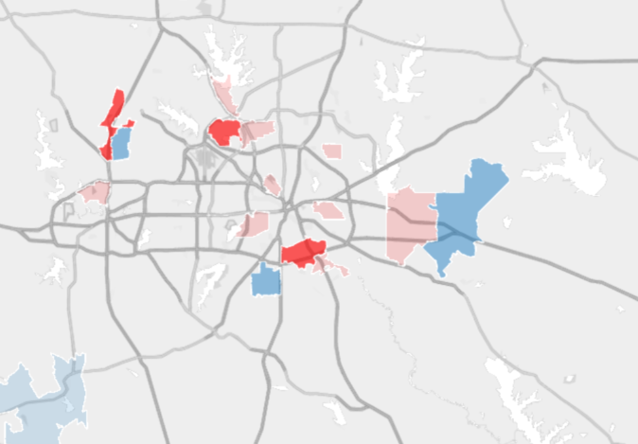
Example: Allocation Method B – Detail on Identifying Zip Codes
Mhdv allocation methodology
  We identified companies in Texas expected to be early or major adopters of EVs based on information from TDSPs and ERCOT.
  For straight truck allocation, we consider the warehouses of Walmart, HEB, Frito Lay, Amazon, UPS, and FedEx. For cargo and step van allocation, we only consider Amazon, UPS, and FedEx locations.
Expected Early or Major Adopters of Electric Trucks by TDSPs
Amazon and Walmart Distribution Center Density in DFW Area
 | CPS | Oncor | TNMP | Austin Energy
Consumer Goods | Walmart, AT&T, Verizon, Ikea | Amazon | Amazon | Amazon, Ikea, Staples, J.B. Hunt
Food | Frito Lay, Pepsi | Frito Lay |  | Frito Lay, Coca Cola, Pepsi, Nestle
Transport | UPS | FedEx, UPS, Ryder |  | DHL, UPS, FedEx, USPS
4
3
2
1
0
Amazon
Walmart
Number of Distribution Centers

Slide 29
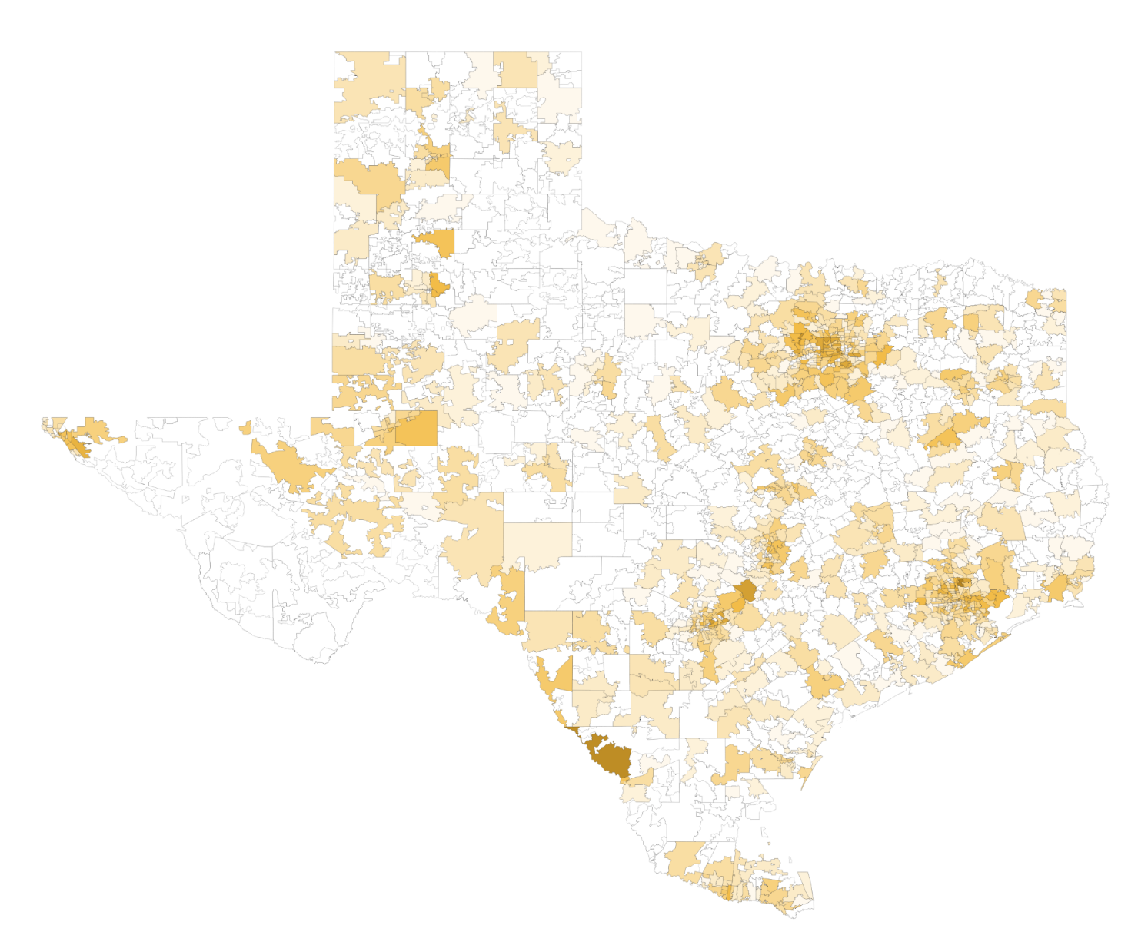
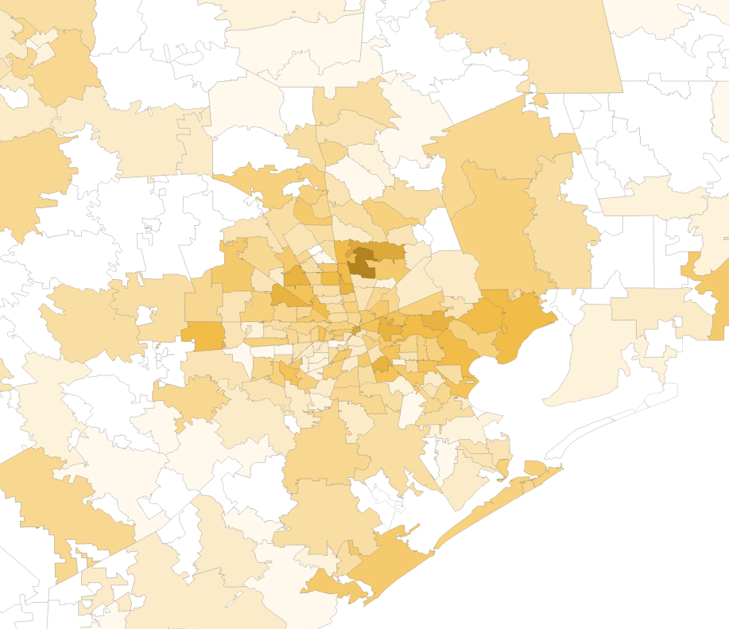
Results: Regional Delivery Vehicles
Mhdv allocation results
Electric regional delivery vehicle adoption is projected to occur around city outskirts and along major highways where distribution centers tend to be located.
Texas Forecasted EVs by Zip Code
2029, Regional Delivery Vehicles
- 10,000
- 1000
- 100
- 10
- 0
Forecasted EVs by Zip Code Detail: Houston
2029, Regional Delivery Vehicles
Number of EVs Adopted

Slide 30
Mhdv allocation methodology
Example: Allocation Method F for Transit Buses
Estimate total 2022 transit buses (all fuel types) at zip code level
Develop metric to represent rate of EV adoption at a zip code level for 2022-2029
Allocate EV forecast to zip codes
Map forecast from zip codes to substations
  Estimate the number of transit buses per zip code through the following steps:
  Obtain number of buses by transportation authority (TX DOT)
  Estimate number of buses by city (urban areas) or county (rural areas) based on transportation authority to county and city mappings (TX DOT)
  Estimate number of buses by zip code based on county to zip code mappings (US Housing & Urban Dev.) and city to zip code mappings (USZip.com), allocating to zip codes based on the relative numbers of addresses in each zip code (US Housing & Urban Dev.)
  Estimate relative likelihood of EV adoption conditional on number of buses in each zip code for 2022-2029 by multiplying (a) and (b):
    Income adoption propensity score (mapped from census zip code income data)
    Population density adoption propensity score (mapped from census zip code population density data)
  Calculate EV transit bus adoption propensity scores for 2022-2029 by multiplying total transit buses per zip code by relative likelihood of EV adoption conditional on number of buses in each zip code
  Allocate Brattle base case EV stock adoption forecast to zip codes proportional to metric calculated in (1)
  Allocate vehicles from zip codes to substations proportionally to substations’ non-coincident peak load.

Slide 31
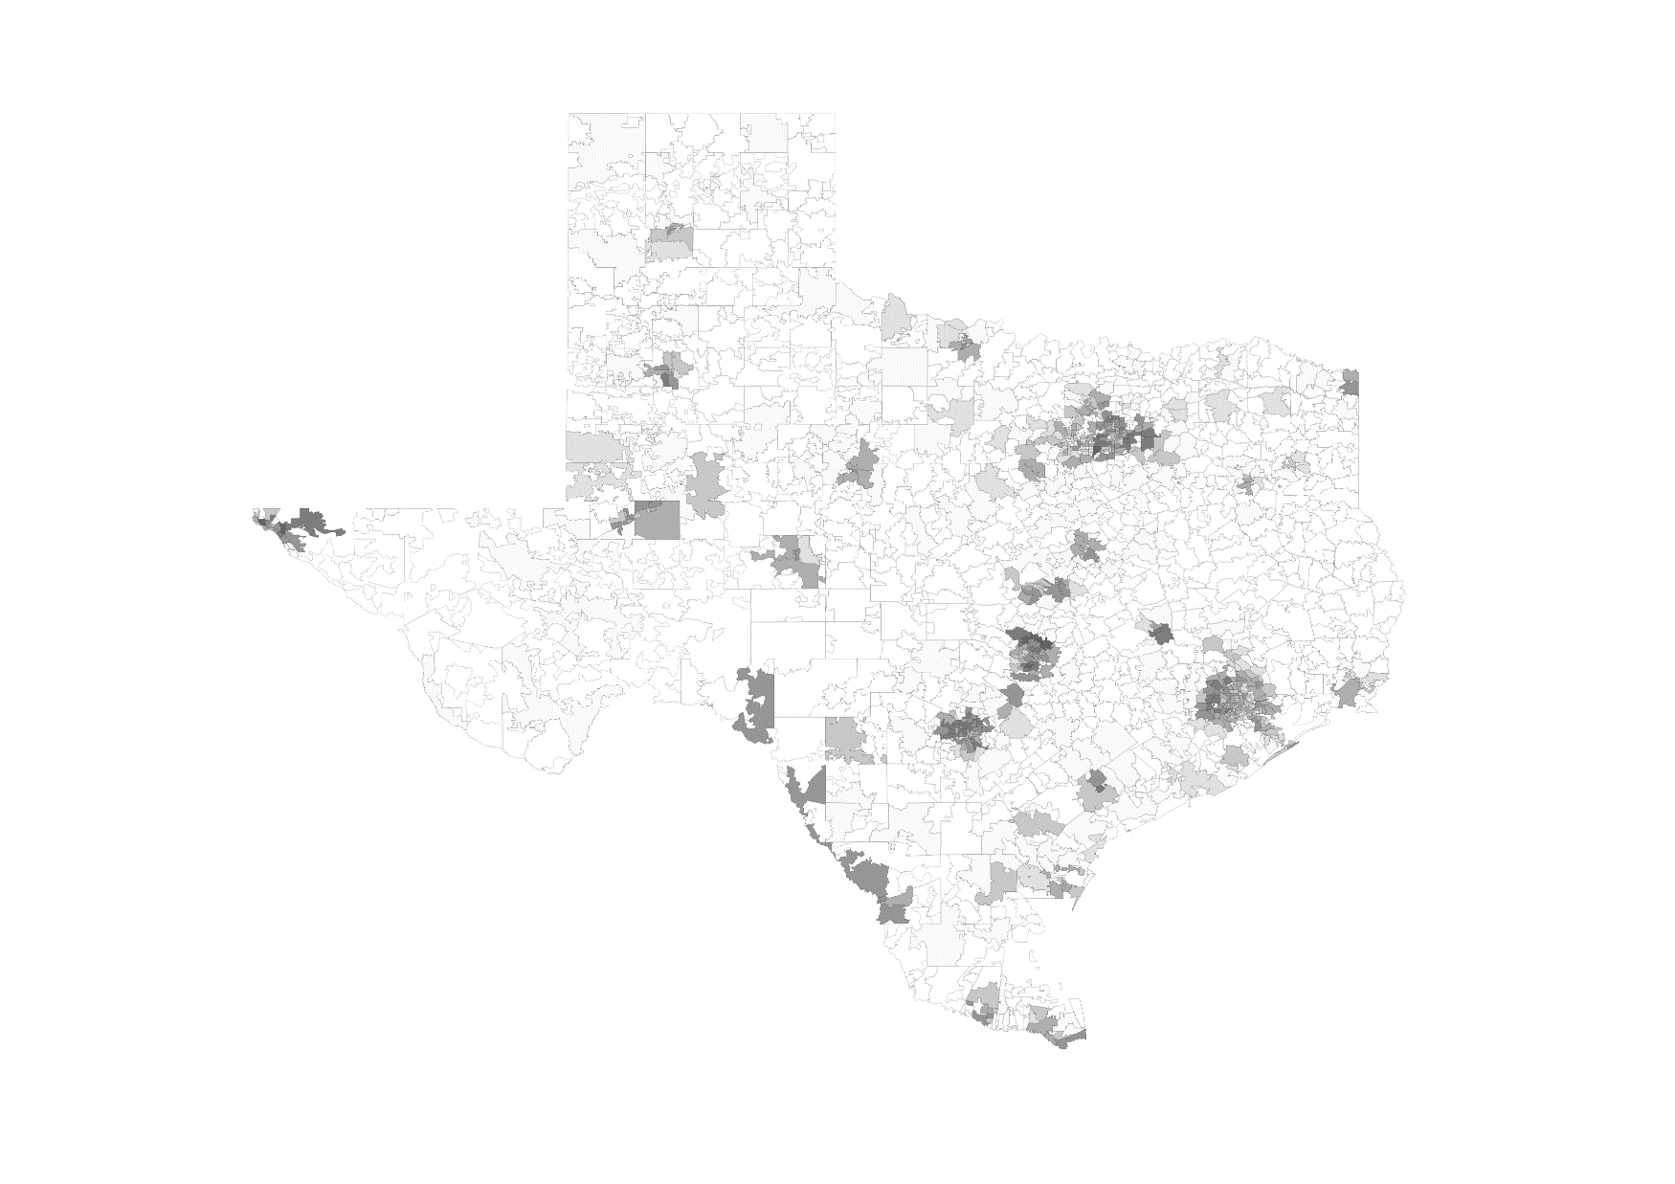
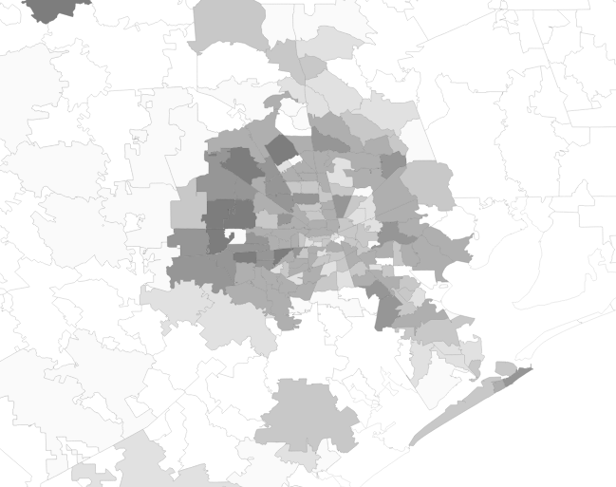
Results: Transit Buses
Mhdv allocation results
Electric transit bus adoption is expected to occur primarily in cities and areas with higher average income. Because depot charging locations were not identified, charging was assumed to occur where bus driving occurs.
Texas Forecasted EVs by Zip Code
2029, Transit Buses
- 100
-
- 10
-
- 0
Forecasted EVs by Zip Code Detail: Houston
2029, Transit Buses
Number of EVs Adopted

Slide 32
Mhdv allocation methodology
Example: Allocation Method G for School Buses
Estimate the relative shares of 2022 school buses (all fuel types) between zip codes
Develop metric to represent rate of EV adoption at a zip code level for 2022-2029
Allocate EV forecast to zip codes
Map forecast from zip codes to substations
  Use number of children who ride the school bus in a zip code as a proxy for the number of school buses (assume equal school bus to child ratio across zip codes).
  Estimate the relative share of school buses per zip code by multiplying (a) and (b):
  An estimate of school bus ridership rate by zip code
    Find by joining data on school bus ridership rate among children reported for different population density ranges within Texas (Census) with population density data by zip code (Census)
  Data on the number of school aged children by zip code (Census)
  Estimate relative likelihood of EV adoption conditional on number of school buses in each zip code for 2022-2029 by multiplying (a) and (b):
    Income adoption propensity score (mapped from census zip code income data)
    Population density adoption propensity score (mapped from census zip code population density data)
  Calculate EV transit bus adoption propensity scores for 2022-2029 by multiplying total school buses per zip code by relative likelihood of EV adoption conditional on number of buses in each zip code
  Allocate Brattle base case EV stock adoption forecast to zip codes proportional to metric calculated in (1)
  Allocate vehicles from zip codes to substations proportionally to substations’ non-coincident peak load.

Slide 33
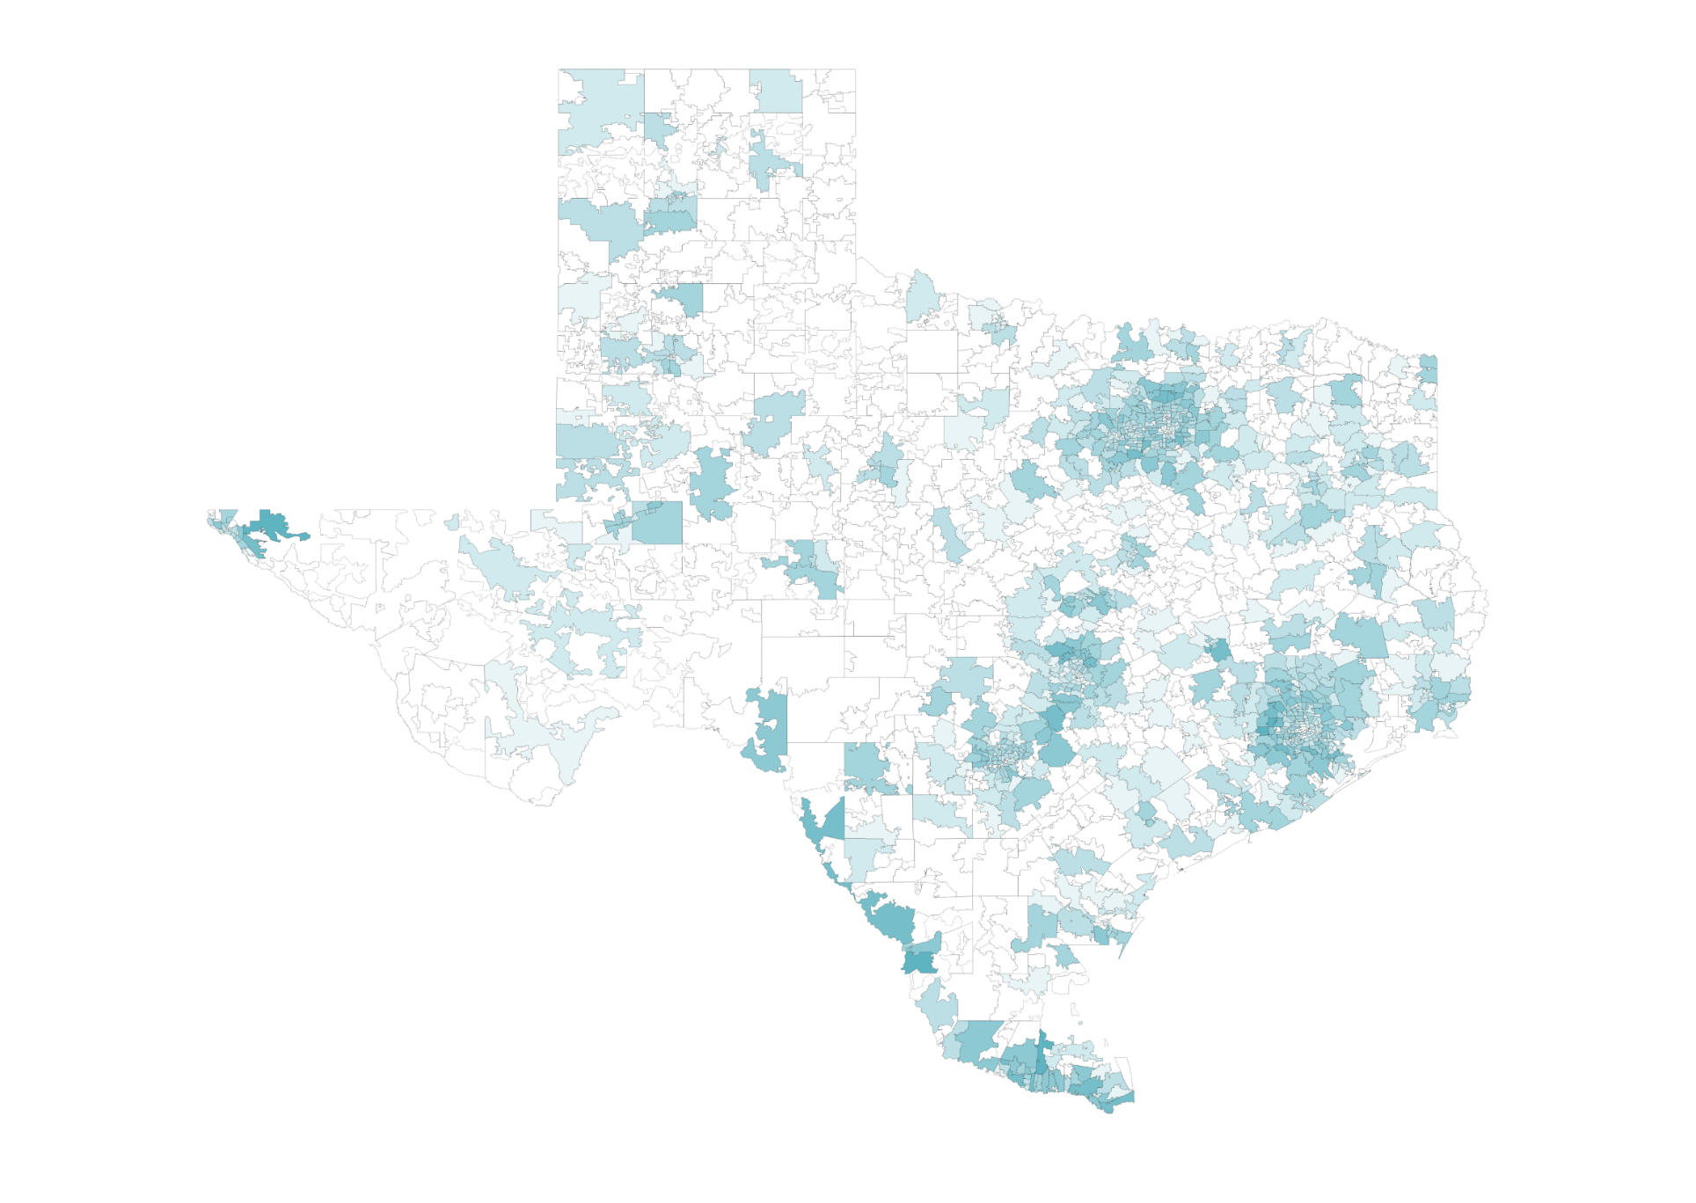
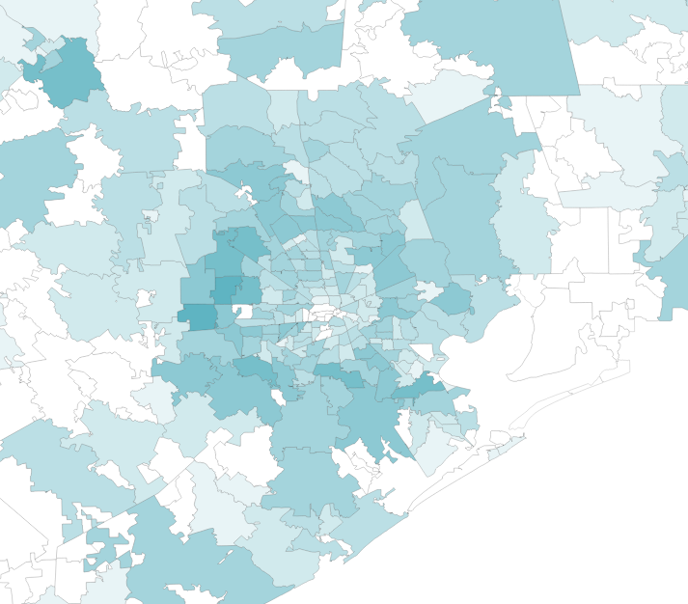
Results: School Buses
Mhdv allocation results
We project the most electric school bus adoption in suburban areas where children are more likely to ride the school bus and where there may be more public support for EV adoption among higher income people living in high density zip codes.
Texas Forecasted EVs by Zip Code
2029, School Buses
- 1000
- 100
- 10
- 0
Forecasted EVs by Zip Code Detail: Houston
2029, School Buses
Number of EVs Adopted

Slide 34
Final Electric Vehicle Allocation to ERCOT Zip Codes
LDV and MHDV Allocation results
2022 Electric Vehicle Adoption
2029 Electric Vehicle Adoption
0
110
Vehicles Adopted
20,000
Note: Showing actual LDV adoption as of April 2022 via Atlas EV Hub. MHDV adoption is currently very low in TX (~50 EVs total) and is not shown on the figure.
Note: Showing modeled LDV and MHDV adoption in 2029. LDV adoption includes only vehicles allocated to ESIID substations (75% of forecast). Due to data limitations we cannot show the location of LDVs allocated to NOIE/Planned substations serving these zip codes.

Slide 35
Step 3: Load Impact Analysis

Slide 36
Step 3: Load Impacts at the Substation-Level
Load Impacts
Establish Light, Medium, and Heavy-Duty EV Adoption Forecasts for 2022-2029
Allocate Adoption Forecasts to ERCOT Substations
Calculate Load Impacts at the Substation-Level
1
2
3
Calculate 64 representative load profiles for each substation, showing load throughout 4 seasons, 2 day types, and 8 years.
Develop interactive tool that generates profiles for each substation and can be easily updated in the future.
Update and improve upon ERCOT’s existing adoption assumption for LDV penetration.
Build out adoption forecast for a more granular list of Medium and Heavy-Duty (MHDV) EVs
Separate methodologies for LDV and MHDV allocation
Vehicles first allocated to the zip-code level and then to the substation-level using data from ERCOT, the Census, and Moody’s.

Slide 37
EV Load Profile Model Flow
Load Impacts
Primary Texas-specific inputs:
Total EVs
Mix of EV types (Battery Electric (BEV)/Plug-in Hybrid (PHEV), sedan/SUV, battery size)
Output:
Total hourly EV demand at each substation by season/day
Can break down load by location/charging type
Daily Electric Vehicle Miles Traveled (VMT)
(per vehicle, quarter, day)
Daily Energy Demand
(per vehicle, quarter, day)
Daily Energy Charger Demand
(per vehicle, quarter, day)
24-hr Energy Charger Demand
(per vehicle, season, day)
Inputs:
Vehicle average efficiency
Seasonal ambient temperature by Weather Zone
Efficiency vs temperature
Inputs:
% electric miles for PHEV
Daily VMT for TX LDV drivers
Seasonal VMT (% of annual)
Weekday vs weekend VMT
Inputs:
% of demand by location, for each vehicle, season, and day
Inputs:
24 hour normalized demand by charger type for each vehicle and day

Slide 38
Example Load Profiles
Load Impacts
Takeaways: Our load profiles assume that substations will serve high levels of evening and overnight load due to charging from Long Haul trucks and LDVs plugging in at Home L2 chargers.
Spring Weekday LDV Load (kWh)
Spring Weekday Total EV Load (kWh)
kWh
kWh
Spring Weekday MHDV Load (kWh)
kWh
kWh

Slide 39
Comparison to ERCOT Load Forecast
Load Impacts
  Brattle’s annual EV load forecast aligns closely with ERCOT’s original load impact assumption at the system level.
  ERCOT’s assumption reports an annual total system load impact of approximately 5.1 TWh in 2029, while Brattle’s approach comes in slightly higher at 6 TWh.
EV Load Forecast Comparison
ERCOT
Brattle

Slide 40
ERCOT EV Load Forecast Impacts
Load Impacts
  EV adoption across all ERCOT substations is expected to add about 0.2% of load to ERCOT’s electric load forecast in 2022 and about 1.25% of load in 2029.
    By 2029, EV load will add approximately 6 TWh of load to ERCOT’s base load forecast.
    This is the combined charging load estimated to come from ~750,000 LDVs and ~130,000 MHDVs.
  ERCOT’s electric load will grow at a rate of 2.1%/year without EV load, and 2.3%/year with EV load.
Vehicle Type | Annual MWh
Passenger BEV | 3.4
Passenger PHEV | 2.0
Passenger Light Truck | 3.9
MHDV Pickup Truck | 7.4
Transit Bus | 188
School Bus | 17
Regional Delivery Truck | 25
Dump Truck | 6
HD Regional Truck | 106
HD Long Haul Truck | 488
ERCOT Electric Load Forecast Plus Added EV Load
2022 vs. 2029 EV Load Impact Comparison
1.25% Load Impact
6 TWh of load from EVs in 2029
490 TWh forecasted 2029 base load
0.2% Load Impact
2022
2029

Slide 41
Peak Load Impacts
Load Impacts
  According to 2021 4-CP calculation, ERCOT’s coincident peak occurred on Tuesday, August 24th at Hour Ending 17.
    We see that at the system level, CP impacts are quite similar to total load impacts, totaling roughly 1% of the annual coincident peak in all years.
    With EV load, ERCOT’s peak load cumulative annual growth rate (CAGR) will increase from 1.4%/year to 1.6%/year.
EV Peak Load Impacts
900 MW of load from EVs during 2029 peak
86,000 MW forecasted 2029 peak load

Slide 42
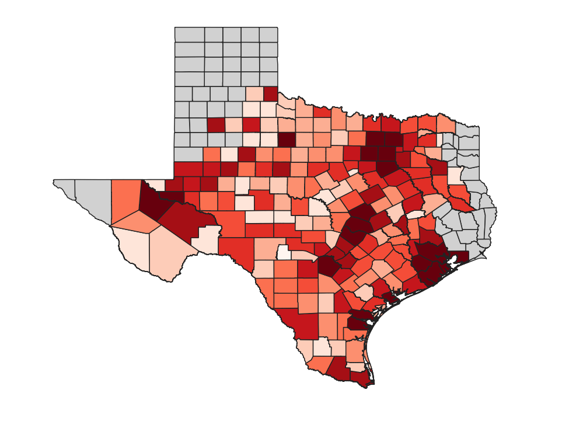
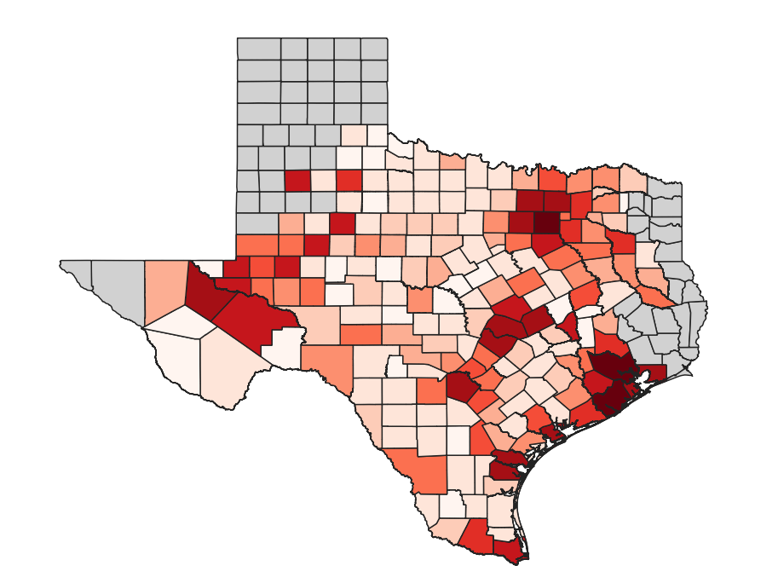
Total EV Load Distribution by County
Load Impacts
2022 (Modeled) EV Load Impacts
2029 (Modeled) EV Load Impacts
0
45
EV Load (GWh)
982
Note: Based on modeled 2022 adoption of LDVs and MHDVs. Historical load impacts unavailable.

Slide 43
Recap
  Brattle team developed a new methodology to allocate light, medium and heavy duty vehicles to ERCOT substations to understand the extent of additional load on substation peaks
  We utilized the most recent and best available information to guide our methodology, largely relying on publicly available data sources
  We took into account the characteristics as well as use cases for each vehicle category for defining an allocation method for that category
  This is still a very nascent research area, and there are not publicly available precedents to the allocation of EVs to more granular locations
  While our allocation method resulted in allocations consistent with a priori expectations (i.e. higher LDV allocations to urban and suburban zip codes surrounding major cities such as Austin, Houston, DFW and higher allocations of delivery vehicles and regional and long haul trucks add load to substations in the city outskirts and major highways), the accuracy of the approach should be evaluated periodically and adjusted as more data becomes available

Slide 44
Key Limitations
  Lack of zip code data for all substations causes us to make approximations for load at substations for which we do not know the associated zip code
  Approximation of adoption at zip codes with no historical adoption is speculative and assumes no-historical-adoption zips will experience adoption at a faster rate than zips with historical adoption
  List of active zip codes in TX and appropriate mappings to counties, census tracts, etc. has had inconsistencies across sources
  Propensity score approach could capture more economic variables in future iterations to produce more granular and diverse results across zips

Slide 45
MHDV Analysis Key Limitations
Mhdv allocation results
Allocation Method | Limitations and Areas for Future Development
Pickup Trucks | Did not have pickup truck registrations at a county or zip code level- estimated based on a population density relationship.
Regional Delivery Vehicles | In the future, could consider additional companies, distribution center size, and the specifics of expected announced adoption timelines.
Dump Trucks | Did not identify centers where dump trucks are likely to charge In the future, could add differentiation of EV adoption rates of dump trucks by zip code
Heavy Duty Trucks | Assumed charging stations will be deployed as forecasted by the Texas DOT charging plan. Assumed MHDV chargers will be deployed at the same rate and in the same locations as LDV chargers – MHDV report will be released this fall. Assumed regional trucks will charge 50% along roads where they travel and 50% at distribution centers. Assumed long haul vehicles will only charge along major highways.
Transit Buses | Did not have information on bus depot and charging locations. In the future, could incorporate information about which areas have announced electric bus adoption plans.
School Buses | Did not have data on actual school bus registrations by zip code- estimated based on population density relationship. Did not identify school bus charging locations or depots.

Slide 46
Appendix

Slide 47
Zip Codes with No Historical EV Adoption
LDV Allocation methodology
  Approximately 1% of our LDV vehicle forecast in each year is allocated to zip codes with 0 historical adoption. These zip codes require a different allocation method, since there is little precedent to be able to predict adoption here.
  A primary limitation of the propensity score approach is that it assigns a score of 0 to the 428 zip codes with zero historical EV adoption.
    Excluding the historical adjustment from the propensity score equation results in an unrealistic ramp-up rate for zip codes with 0 EVs.
  We derive standardized adoption forecasts for each of these zip codes separately, using the following “rules”:
1. Identify most common level of EV entry using EV Hub historical data
  - We find it is most common for 1 EV to enter at a time across one year and ramp up from there
2. Identify a “rule” that will dictate the first year of entry for the first EV
  - We find that the majority of zip codes with existing EV adoption in 2022 had propensity scores over 1,000. So we assign each no adoption zip code with a propensity score over 1,000 one EV in 2022. We work backwards from there, zip codes with prop scores from 500-1000 see adoption starting in 2023, and prop scores from 0-500 start in 2024.
3. Set a limit on the maximum number of EVs that can be electrified in a given no adoption zip code in 2029
  The system-wide electrification level we forecast with our ERCOT-wide forecast is 5% of total registrations by 2029.
  We cut this in half to account for delayed adoption in these zip codes.
4. Calculate linear growth from the year that the first EV comes online to the maximum adoption level

Slide 48
Example Allocation to Zip Code without Historical Adoption
LDV Allocation methodology
  79512 is a zip code located in the Abilene – Sweetwater metro area, primarily in Mitchell County.
    Population: 8,197 (U.S. Census Bureau).
    Land Area: 599 sq. miles (U.S. Census Bureau).
    Population Density: ~14 residents per sq. mile (“Rural”).
    Income per capita 2022: $21,658 (U.S. Census Bureau).
    Approx. Total Registered Vehicles 2022: 3,872.
  2022 Propensity Score = 1 * 1 * 3,872 = 3,872
    Propensity score exceeds 1,000, so we assign 1 EV to be adopted in this zip code by end of 2022.
  Forecasted total registered vehicles in 2029 = 3,960
  3,960 * 2.5% EV penetration = 99 EVs adopted by 2029
  We use this approach for all 428 zero-adoption zip codes and add up the total number of EVs forecasted to be adopted in each year.
    We find that this results in roughly 1% of LDVs being allocated to these zip codes by 2029.
Zip Code 79512 LDV Adoption

