Slide 1
Monthly Review of Reliability Unit Commitment Market Impacts – September 2022
Wholesale Market Working Group
ERCOT Staff
October 21, 2022

Slide 2
RUC Resource-Hours
September 2022 | Total | Opt-Out | Non-Opt-Out
Instructed Resource-Hours
Total Count | 1392.9 | 226.0 | 1166.9
Effective Resource-Hours*
Total Count | 1349.0 | 225.5 | 1123.6
Average LSL | 60.2 | 65.4 | 59.2
Average LDL | 72.7 | 140.3 | 59.2
Average BP | 75.7 | 158.1 | 59.2
Average HSL | 270.2 | 341.4 | 255.9
* The difference between “Instructed” and “Effective” values is a result of Resources starting up, shutting down, receiving partial hour instructions, or otherwise not being dispatchable by SCED.

Slide 3
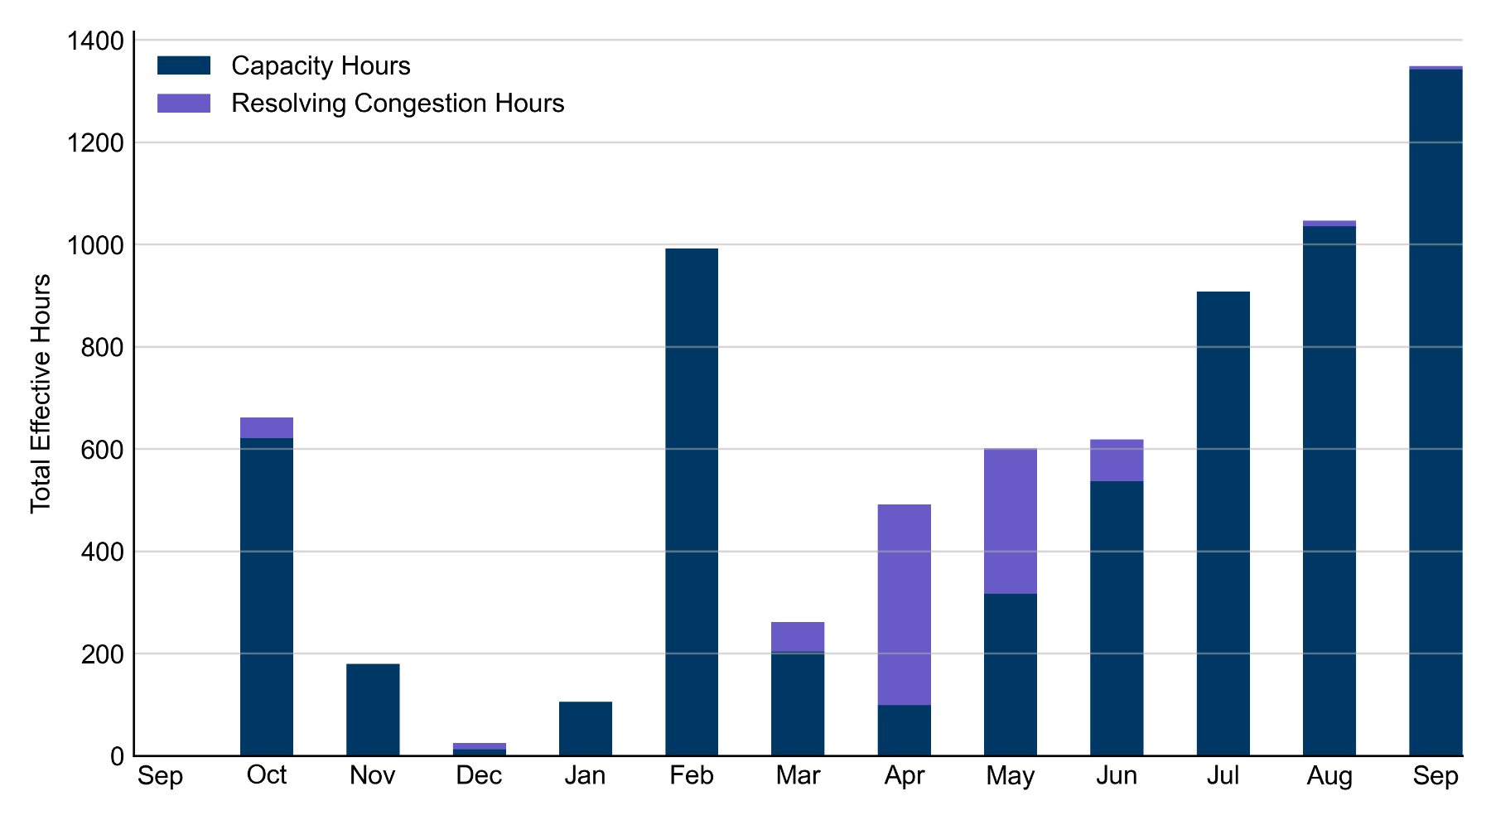
RUC Instruction Reasons: Last 13 Months RUCs in September 2022 were primarily driven by system-wide capacity concerns.

Slide 4
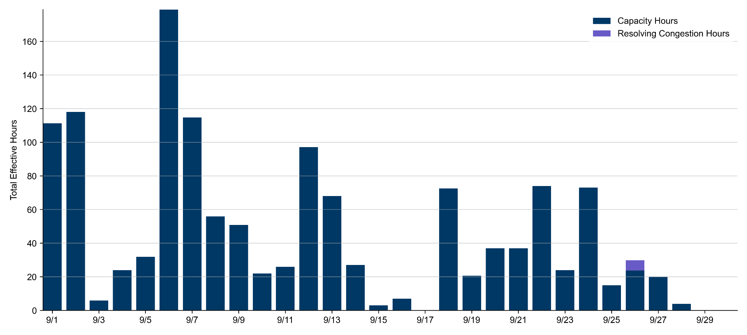
RUC Instruction Reasons
September 2022
1349.0 effective RUC Resource-hours.
1343.0 hours (99.56%) for capacity concerns.
6 hours (0.44%) for resolving congestion concerns.

Slide 5
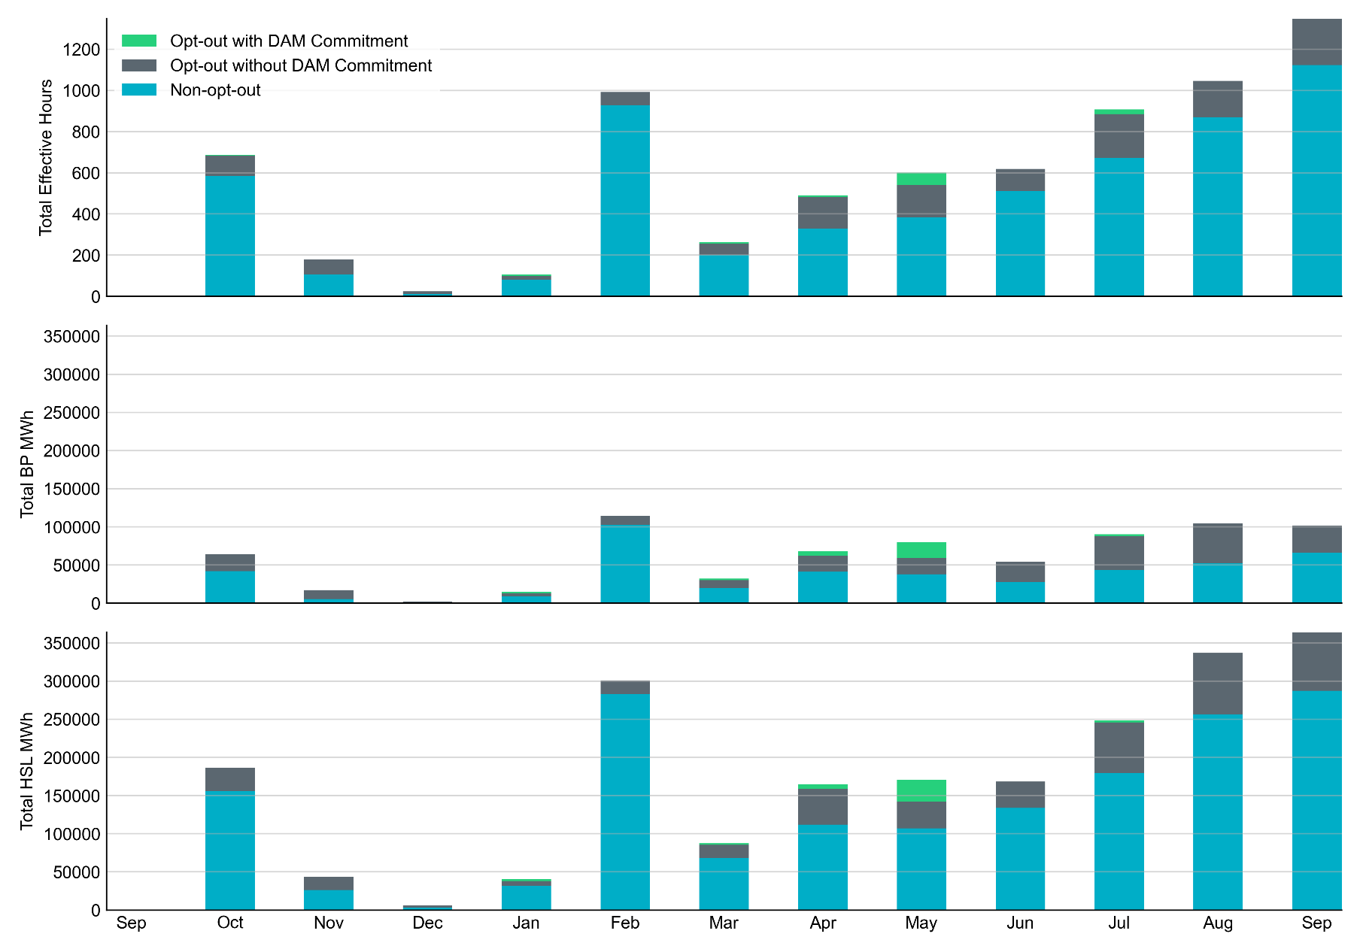
Non-opt-out and Opt-out Totals: Last 13 Months September 2022 had a total of 1123.6 non-opt-out effective Resource-hours (83.29%) and 225.5 opt-out effective Resource-hours (16.71%).

Slide 6
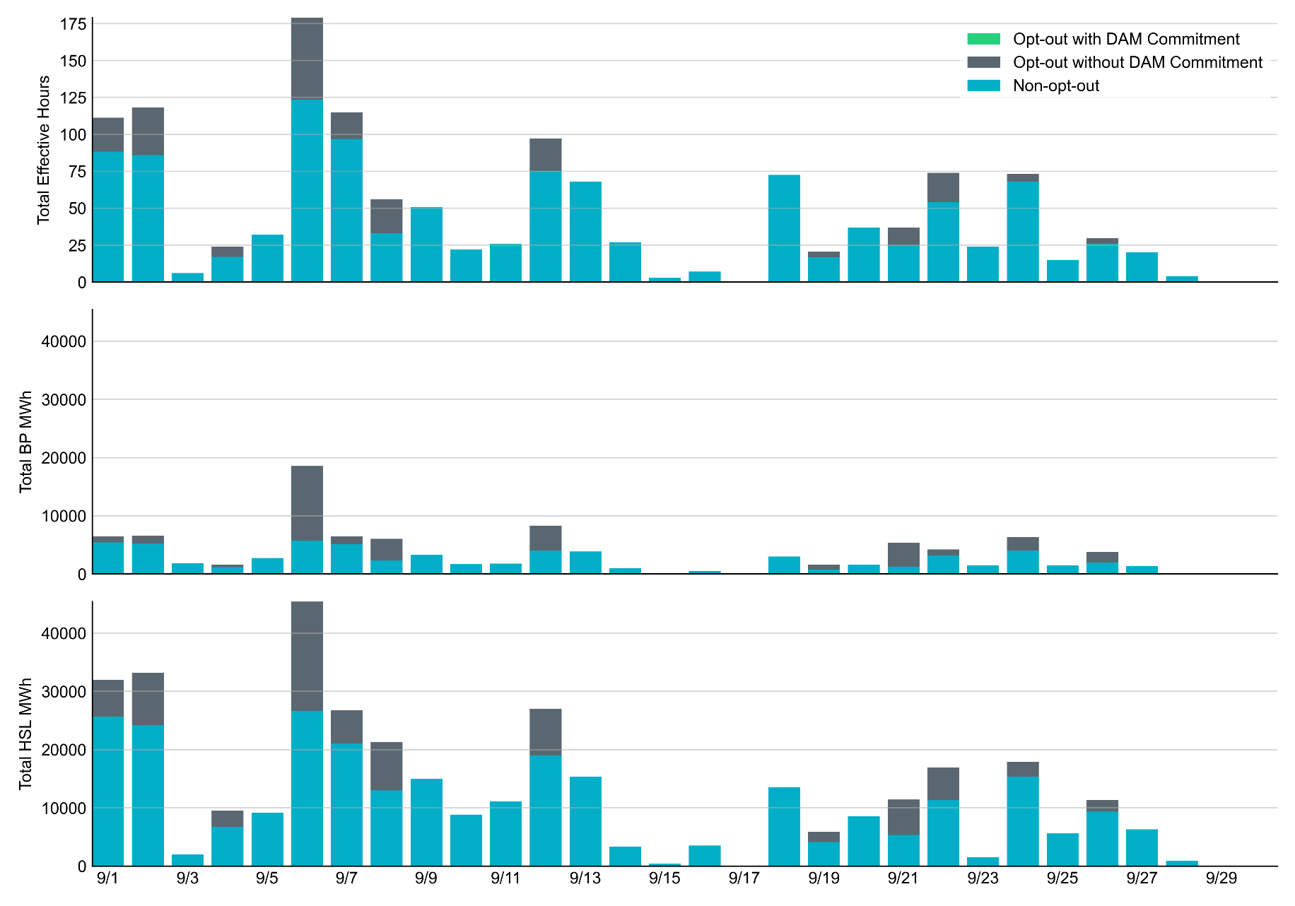
Non-opt-out and Opt-out Totals: September 2022

Slide 7
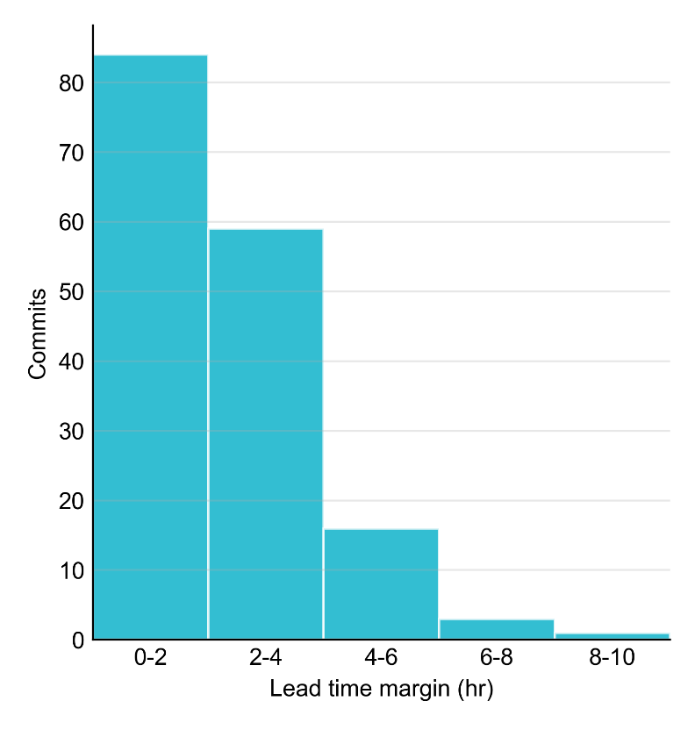
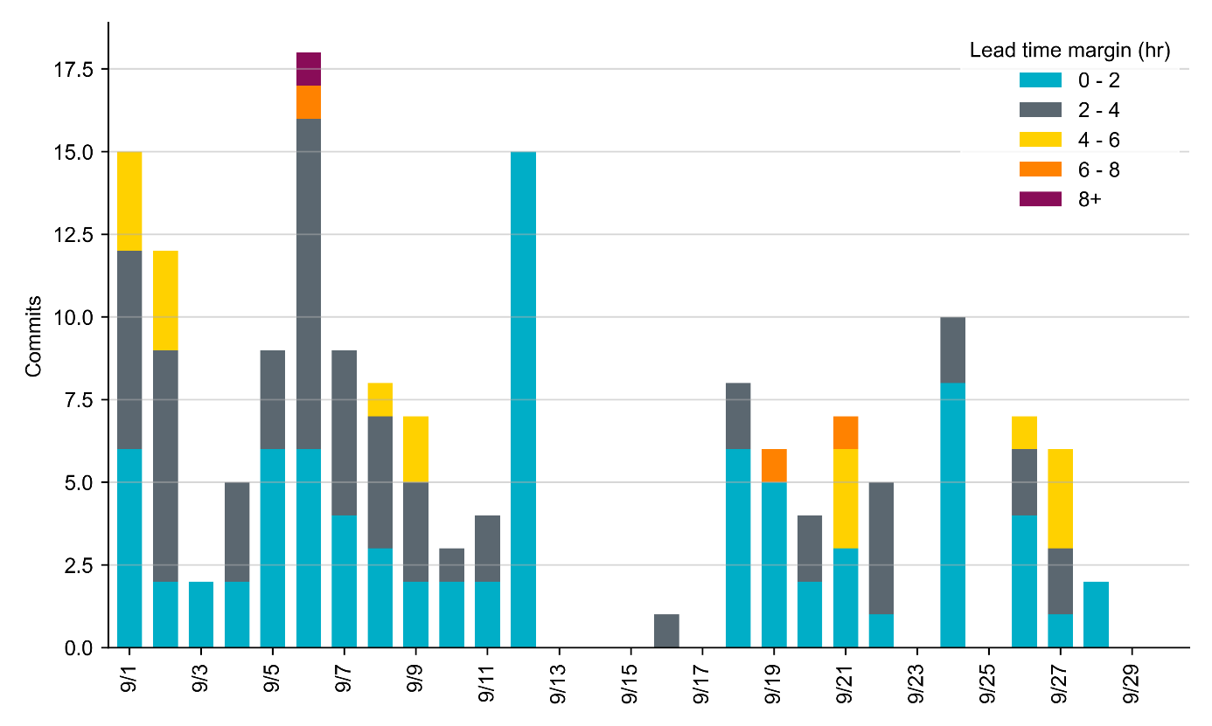
RUC Lead Time Margin: September 2022
Most RUC commit windows had lead time margin at or below 4 hours.
Lead time refers to the length of time between a RUC instruction and the start of the commitment window.
Lead time margin is the difference between lead time and the Resource’s startup time.
In cases where a Resource is committed for multiple back-to-back time blocks, lead time margin is calculated from the first instruction.
Notes:
The first bin is both-inclusive (i.e. [0, 2] ), while subsequent bins are left-inclusive (i.e. [2, 3), [3, 4), etc.).

Slide 8
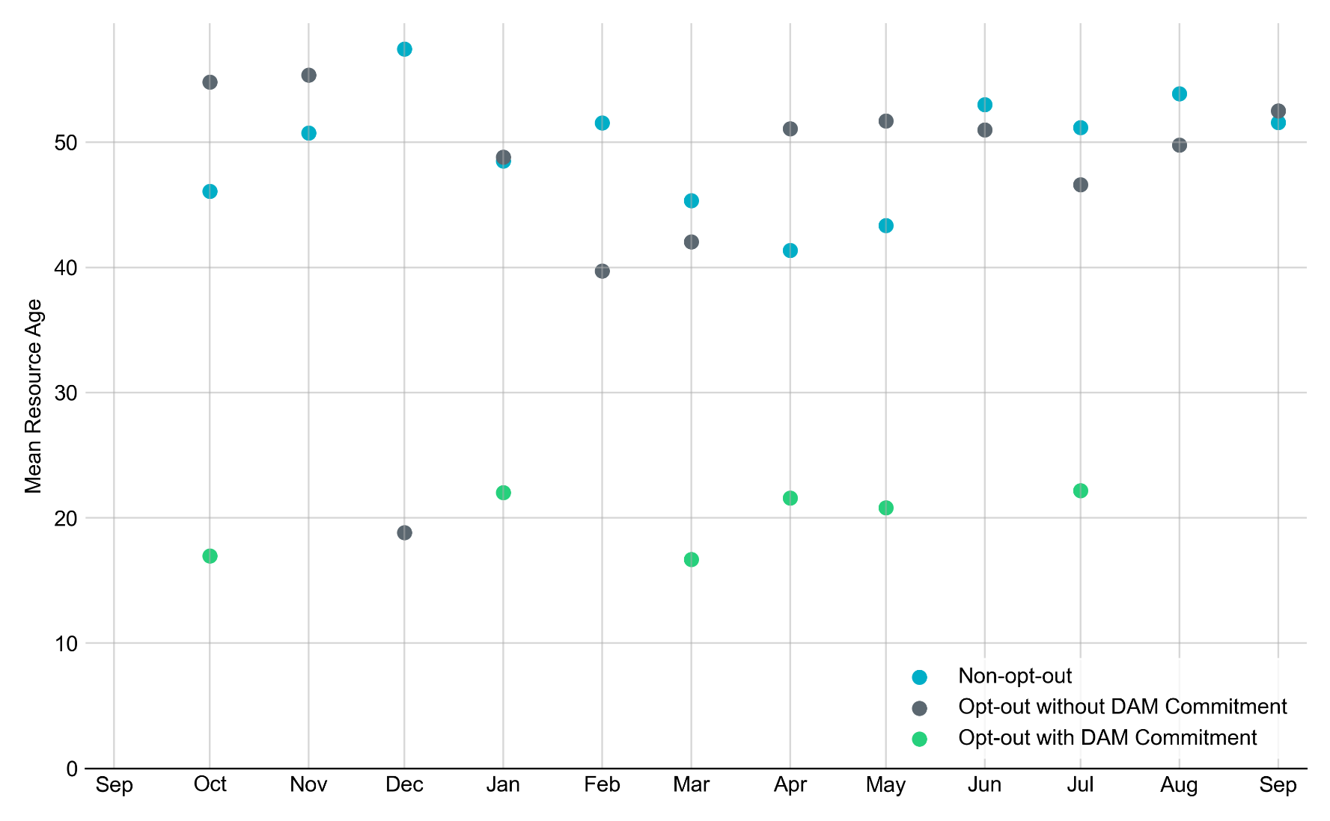
Average Resource Age In September 2022, the mean age of RUC-committed Resources was 53.9 years for Non-Opt-Out Resource-hours, 49.8 years for Opt-Out Resource-hours without DAM Commitments.
Note: For Resource configurations with multiple physical generators, the age of the oldest generator is used.

Slide 9
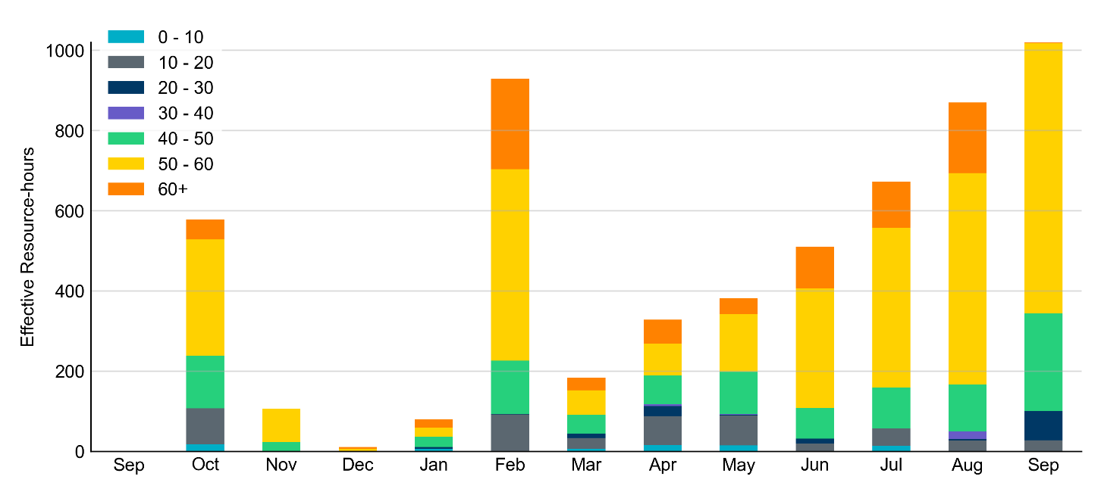
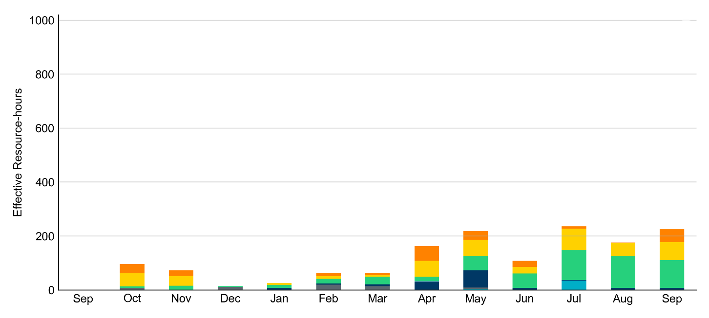
Age Category Most RUC-Committed Resources in September 2022 were older than 40 years.
Non-opt-out
Opt-out

Slide 10
RUC-Instructed Resource Dispatch above LDL
September 2022
When Resources did not successfully opt out, there were 5.1 effective Resource-hours for which the Resource was dispatched above its LDL.
For 0.7 of these Resource-hours, the LMP for the RUC-instructed Resource was above the RUC offer floor.
For 4.4 of these Resource-hours, the LMP for the RUC-instructed Resource was below the RUC offer floor.
For all these Resource-hours, the RUC-instructed Resource was mitigated.
There were Exceptional Fuel Cost submissions for 3 unique RUC-Committed Resources in September 2022.

Slide 11
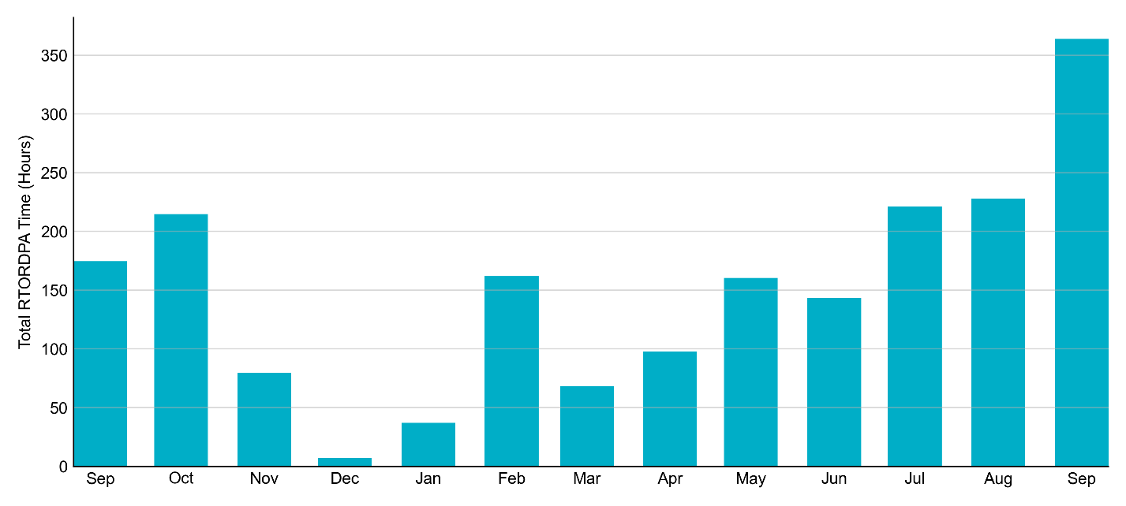
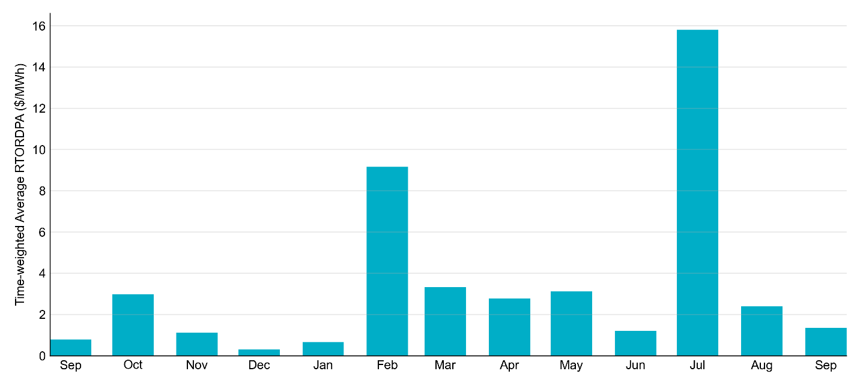
Reliability Deployment Price Adder: Last 13 Months September 2022 had a total of 363.90 RTORDPA hours with an average value of $1.35/MWh.

Slide 12
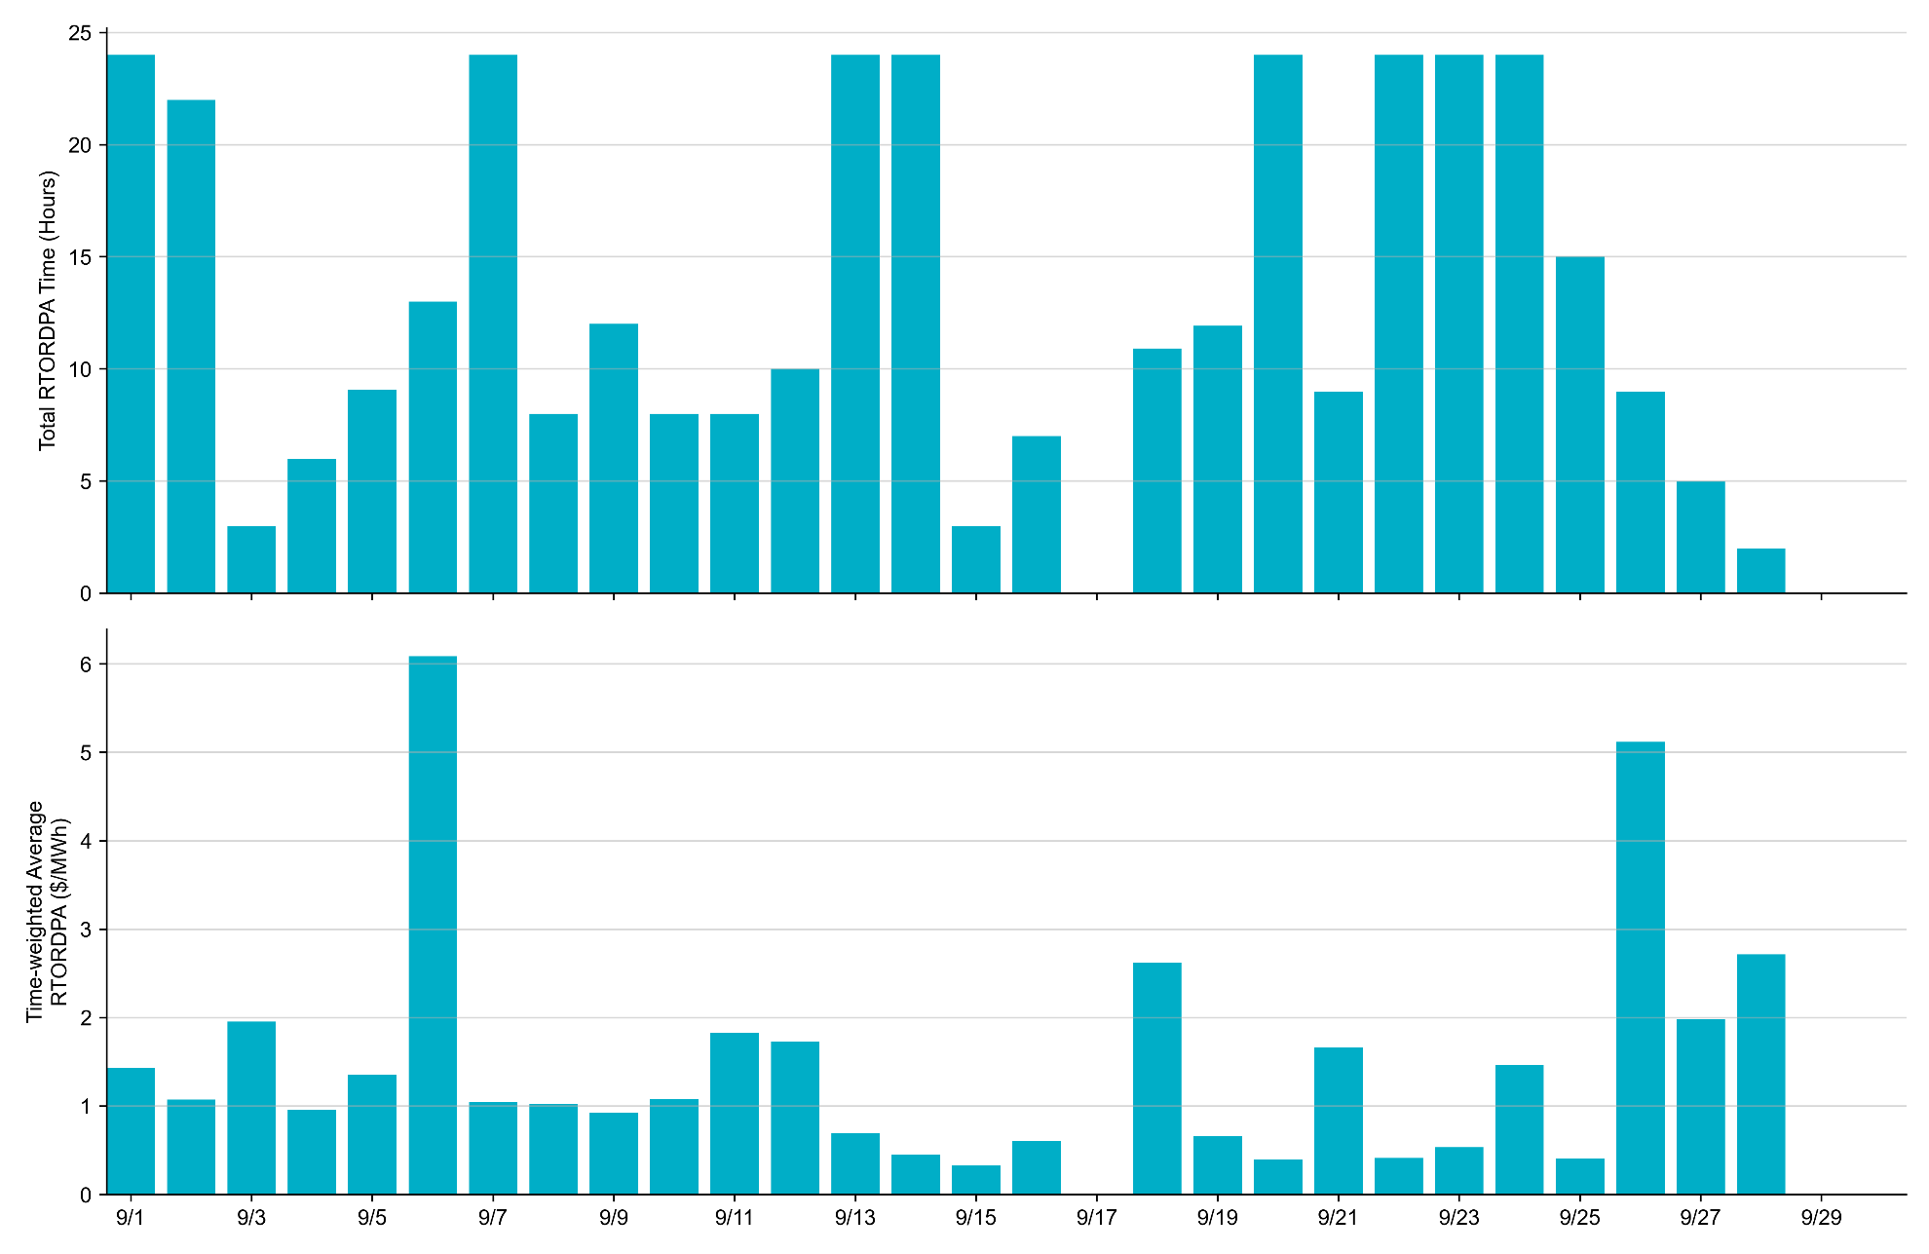
Reliability Deployment Price Adder: September 2022 OD 9/6 had the highest daily time-weighted average RTORDPA: $6.09/MWh.

Slide 13
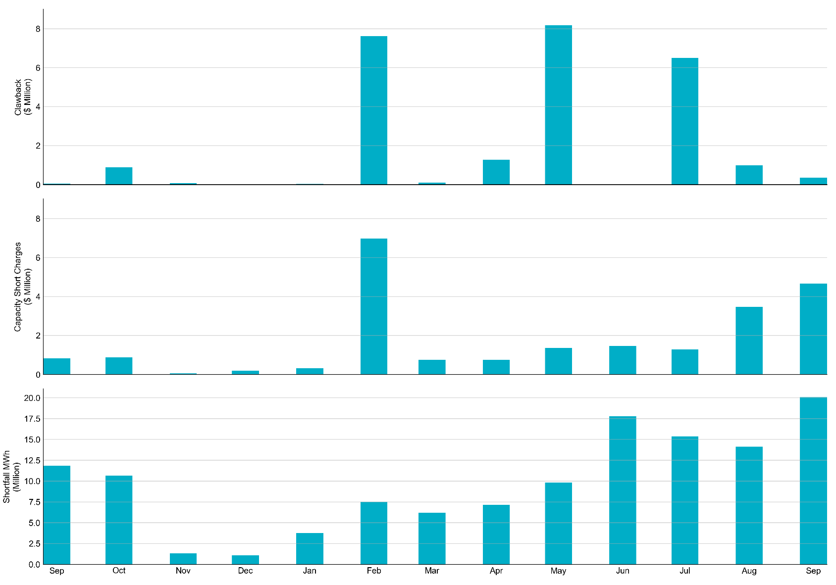
RUC Clawback, Capacity Short Charges, and Shortfall For September 2022, the total Clawback charge was $0.364M. The total Make-Whole payment was $4.666M, which was almost entirely covered through capacity-short charges.
In September 2022, $4.666M in Make-Whole was paid out. There was a total amount of $8,626 uplifted to load this month. This stemmed from a manual process that incorrectly captured the timing of a verbal dispatch instruction for OD 9/5. This will be corrected for the final settlement run and we expect this amount will be refunded to load.

