Slide 1
Public API Capabilities
Presented by: Omar Soberanis and Ajay Mannepalli.
Date: 3/31/2022

Slide 2
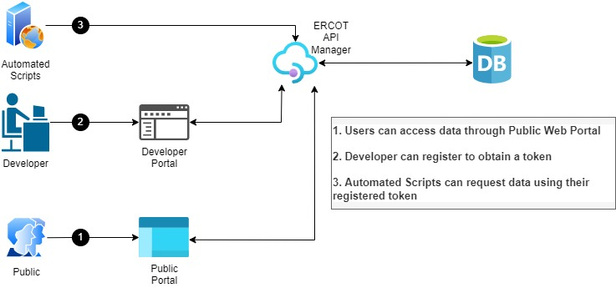
ERCOT Public API Capabilities
Public can download all expired data reports
Search capabilities that will return results based on JSON/XML/CSV
Digital certificate will no longer be required only a registration and easy to use token
Modernized Open API protocol based on industry standard (REST/HTTPS)
Autogenerated documentation that will be widely accessible and easy to consume
Portal to create issues and share knowledge on API usage
API request rate limiting
You feedback!!!

