Slide 1
Project Update
September 15, 2022
Troy Anderson
ERCOT Portfolio Management

Slide 2
Project Update Agenda
Recent / Upcoming Project Highlights
2022 Release Targets
In-Flight Strategic Projects
Fast-Frequency Response (FFR) Advancement
NPRR1120 Create Firm Fuel Supply Service
Additional Project Status Information
Potential Outage Scheduler (OS) Enhancement
Impact Analysis Statistics
Priority/Rank Options for Revision Requests with Impacts
NPRR1139 – Adjustments to Capacity Shortfall Ratio Share for IRRs
NPRR1140 – Recovering Fuel Costs for Generation Above LSL During RUC-Committed Hours
SCR820 – Operator Real-Time Messaging During Emergency
Technology Working Group
Next meeting – TBD
Appendix
BES Combo Model Implementation
Location of Revision Request Project Information: http://www.ercot.com/services/projects

Slide 3
Recent / Upcoming Project Highlights
2022 August Release – Off-Cycle – 8/16/2022 Complete
NPRR1108(b) – ERCOT Shall Approve or Deny All Resource Outage Requests
Remainder of NPRR – see 8/5/2022 market notice
2022 October Release – R5 – 10/4/2022-10/6/2022 In Flight
None (items moved to off-cycle release on 10/13/2022)
2022 October Release – Off-Cycle – 10/13/2022 In Flight
FFR Advancement (FFRA portion of NPRR863)
NPRR1120 – Create Firm Fuel Supply Service
OBDRR039 – ORDC Changes Related to NPRR1120
NPRR987(a) – BESTF-3 ESR Contribution to Physical Responsive Capability portion
NPRR1002(a) – BESTF-5 Charging Restrictions in Emergency Conditions portion
2022 November Release – Off-Cycle – 11/2/2022 In Flight
NPRR1063 – Dynamic Rating Transparency
2022 December Release – Off-Cycle – 12/1/2022 In Flight
NPRR1142 – ERS Changes to Reflect Updated PUCT Rule Changes re SUBST. R. 25.507
2022 December Release – R6 – 12/6/2022-12/8/2022 In Flight
NPRR1096(a) – Require Sustained Four-Hour Capability for Non-Spin portion
NPRR1097 – Create Resource Forced Outage Report
SCR812 – Create Intermittent Renewable Generation Integration Report
Note: Projected Go-Live dates are subject to change. Please watch for market notices as the effective dates approach.

Slide 4
2022 Release Targets – Board Approved NPRRs / SCRs / xGRRs
R1
R3
R5
February Various Dates | April 4/5 – 4/7 | May 5/24 – 5/26 | July 7/26 – 7/28 | October 10/4 – 10/6 | December 12/6 – 12/8
LPGRR068 NPRR1054(a) NPRR1005 NOGRR210 RRGRR025 NPRR917 NPRR1052 NPRR1065 NPRR1073 NPRR1016 PGRR082 NOGRR212 | None NPRR1092(a) | NPRR939 NPRR1093 NPRR1101 NPRR1113 NOGRR191 NOGRR198 NOGRR232 OBDRR032 OBDRR033 OBDRR035 SCR800 SCR809 SCR814 MarkeTrak User Interface Refresh | NPRR1108(a) NPRR935(b) NOGRR239 NPRR1129 NPRR1108(b) | NPRR987(a) NPRR1002(a) FFR Advancement (NPRR863 FFR) NPRR1120 OBDRR039 NPRR987(a) NPRR1002(a) | NPRR1096(a) NPRR1097 SCR812 NPRR1063 NPRR1142
R2
R4
R6
ü
ü
ü
ü
ü
ü
ü
ü
ü
ü
ü
ü
ü
ü
ü
ü
ü
ü
E
E
E
E
E
P
P
P
E
E
ü
ü
ü
ü
7/1
ü
ü
10/13
Securitization Subchapter N March Go-Live
7/15
DGR/DESR
ü
ü
11/2
8/16
ü
12/1
1/1
ü
ü
ü
ü
5/13
6/4 – 6/6
ü
NPRR1120 Firm Fuel Supply Serv.
Issue RFP no later than 8/1/2022
Contracts start in November
ü
EMS Freeze
May 2023 – Jan. 2024
TBD | NPRRs: 484,825(b),826,829,841,857,879,885,904,918,930,936,941,945,962,963,965,975,987,995,1004,1006,1007,1019,1023,1026,1030,1032,1034,1057, 1077,1090,1092(b),1105 SCRs: 799,805,807,810,813,816,818,819 PGRRs: 066,076,088,091,094,099 Other: OBDRR009,OBDRR017,RRGRR028
Go-live dates can differ from Protocol effective dates – Please refer to market notices for more details
APPENDIX
Red Text: New additions and target release changes
Strike-Through Text: Previous target release
(a), (b), etc.: Multiple phase release
Project Status Codes
NS = Not Started
I = Initiation
P = Planning
E = Execution
H = On Hold
NPRR935(b) – New solar forecasts and reports
NPRR987(a) – ESR Contribution to PRC
NPRR1002(a) – Charging Restrictions in Emergency Conditions
NPRR1054(a) – Portion of gray box
NPRR1092(a) – RUC offer floor change
NPRR1096(a) – Non-Spin portion
Release targets are subject to change

Slide 5
In-Flight Strategic Projects
PR325-01 Fast-Frequency Response (FFR) Advancement (gated to Execution on 6/22/2021)
Off-cycle go-live scheduled on 10/13/2022
NPRR863, NPRR1015, NPRR1079, NOGRR187
FFRA readiness meeting on July 25
Reminder of market submission impacts
All AS Offers affected by changes
Testing/MOTE dates Aug 15 – Oct 7 (publish metrics for submissions for QSEs with AS)
Continuing discussion at Market Readiness meetings
PR394-01 NPRR1120 Create Firm Fuel Supply Service (gated to Execution on 7/13/2022)
Off-cycle go-live scheduled on 10/13/2022
Market submission impacts:
QSEs with FFSS will need to submit Availability Plans with new Availability Type (FFSS)
XSD specifications were posted 7/6/2022
Changes will be in MOTE with FFRA (Aug 15 – Oct 7)

Slide 6
Additional Project Status Information
Revision Request | Description | Project Phase | Additional Detail
NPRR863 | ECRS portion of NPRR863 | Execution | Go-Live Target = 2023-R3
NPRR1096 | Require Sustained Two-Hour Capability for ECRS | Execution | ECRS portion of NPRR1096 Go-Live Target = 2023-R3 w/ECRS
NPRR1020 | Allow Some Integrated Energy Storage Designs to Calculate Internal Loads | Execution | EPS Metering portion of NPRR1020 Go-Live Target = Early 2023
SCR789 | Update NMMS Topology Processor – Phase 2 | Execution | Go-Live Target = Early 2023
NPRR1040 | Compliance Metrics for Ancillary Service Supply Responsibility | Planning | Go-Live Target = 2023-R1
NPRR1095 SCR817 | Texas SET V5.0 Changes MarkeTrak Validation Revisions Aligning with Texas SET V5.0 | Planning | Expected completion in 2024
SCR807 SCR816 | Increase CRR Transaction Capability CRR Auction Bid Credit Enhancement | Not Started | Initiates in September
NPRR1004 | Load Distribution Factor Process Update | Not Started | Early 2023 candidate
NPRR1092 | Limit RUC Opt-Out Provision | Not Started | Early 2023 candidate
Red Text: New additions and updates
Sorted by Project Phase

Slide 7
Potential Outage Scheduler (OS) Enhancement
Items considered for OS changes
User interface
Allow modification of outage causes and other fields as needed
Linking outage extensions and deratings; managing overlap outages
Flexibility to support group recurring outage requests
Easier reporting and analysis of outages
Retaining original outage type
Others
Need stakeholders’ feedback and comments on the changes to the OS
Send to OCSupv@ercot.com by October 14, 2022

Slide 8
Variance from IA Cost Range – Revision Request Projects
5
34
Exceeds IA Range
10 Projects
Actual $ Variance from IA Range
31
Within IA Range
21 Projects
2
37
21
32
3
4
6
7
8
10
12
14
15
16
19
20
22
23
24
25
26
27
35
36
38
13
29
1
9
11
18
28
30
33
17
Below IA Range
7 Projects
2019
33 Projects
19 Revision Requests
2020
26 Projects
9 Revision Requests
2021
18 Projects
9 Revision Requests
2022
4 Projects
1 Revision Request
If actual spend falls within the IA range the variance is 0
Note: Graph compares the posted IA cost range with the actual project spend

Slide 9
Variance from IA Duration Range – Revision Request Projects
25
32
31
Exceeds IA Range
17 Projects
5
21
Number of Months from IA Range
26
36
2
Within IA Range
15 Projects
12
18
23
1
6
16
17
34
4
8
10
11
13
15
24
27
33
35
38
3
7
9
14
19
20
22
30
37
28
29
Below IA Range
6 Projects
2019
33 Projects
19 Revision Requests
2020
26 Projects
9 Revision Requests
2021
18 Projects
9 Revision Requests
2022
4 Projects
1 Revision Request
If actual duration falls within the IA range the variance is 0.
Note: Graph compares the posted IA duration range with the actual project duration

Slide 10
Revision Request Project Legend
NOGRR174, AVR and PSS Testing Requirements
NPRR809, GTC or GTL for New Generation Interconnection
NPRR817, NPRR847, VCMRR021, Create a Panhandle Hub
NPRR821, Elimination of the CRR Deration Process
NPRR833, NPRR749, Modify PTP Obligation Bid Clearing Change
NPRR842, Study Area Load Information
NPRR845, RMR Process and Agreement Revisions
NPRR858, Provide Complete Current Operating Plan (COP) Data
NPRR865, NPRR880, Publish RTM Shift Factors for Hubs, Load Zones, and DC Ties
NPRR866, RRGRR017, RRGRR Related to NPRR866, Mapping Registered Distributed Generation and Load Resources to Transmission Loads in the Network Operations Model
NPRR877, Use of Actual Interval Data for IDR ESI IDs for Initial Settlement - Phase 2
NPRR899, Digital Certificate and User Security Administrator Clarifications and Opt Out Procedure
NPRR901, NPRR90, OBDRR010, Switchable Generation Resource Status Code
NPRR914, Addition of Controllable Load Resources to 60-Day Reports
NPRR925, SCR798, PTP Obligation Bid ID Limit
SCR793, SSR Related Telemetry for Transmission Service Provider (TSP) Operators
SCR794, Update SCED Limit Calculation
SCR796, OBDRR003, OBDRR014, Change Validation Rules to Preclude Certain Transactions at Resource Nodes within Private Use Networks
VCMRR022, Determination of Fuel Adder Price for Coal and Lignite Resources
NPRR856, NPRR884, Treatment of OFFQS Status in Day-Ahead Make Whole and RUC Settlements
NPRR873, Posting of the ERCOT Wide Intra-Hour Wind Power and Load Forecast on the MIS Public
NPRR929, PTP Obligations with Links to an Option DAM Award Eligibility
NPRR935, Post All Wind and Solar Forecasts
NPRR951, Active and Inactive SCED Constraint Reporting
PGRR057, Responsibilities for Performing Geomagnetic Disturbance (GMD) Vulnerability
SCR797, Provide IRR Current Operating Plan (COP) to TSPs
SCR802, Enhance Communications of System Inertia
SCR803, Enhance Wind Integration Report and Create Solar Integration Report and Solar Dashboard
NOGRR195, NOGRR195 Generator Voltage Control Tolerance Band
NPRR1081, NPRR1081 Revisions to Real-Time Reliability Deployment Price Adder to Consider Firm Load Shed
NPRR902, NPRR902 ERCOT Critical Energy Infrastructure Information
NPRR905, NPRR905 CRR Balancing Account Resettlement
NPRR974,NPRR978, NPRR1048, SCR806, NPRR974 NPRR978 NPRR1048 SCR806 - Alignment w Amendment PUCT Substantive Rule 25_505_Schedule
NPRR986, NPRR971, NPRR1043, Implementation of NPRR986 BESTF-2 and NPRR971
NPRR998, NPRR998 ERS Deployment and Recall Messages
SCR8004, SCR804 ERCOT GridGeo Access for Transmission Operators
SCR811, Integrate Solar Forecasts and SCR811 Implementation
SCR800, SCR809, SCR800 and SCR809 Implementation

Slide 11
Impact Analysis Statistics Summary
Cost Range RR PROJECTS | Below IA Range | Within IA Range | Exceed IA Range | Total
2019 | 6 | 10 | 3 | 19
2020 | 0 | 7 | 2 | 9
2021 | 1 | 3 | 5 | 9
2022 (½ yr.) | 0 | 1 | 0 | 1
Total | 7 | 21 | 10 | 38
Duration Range RR PROJECTS | Below IA Range | Within IA Range | Exceed IA Range | Total
2019 | 0 | 10 | 9 | 19
2020 | 3 | 2 | 4 | 9
2021 | 3 | 2 | 4 | 9
2022 (1/2 yr.) | 0 | 1 | 0 | 1
Total | 6 | 15 | 17 | 38

Slide 12
Priority / Rank Options for Revision Requests with Impacts
Options for…
Revision Request | Description | Priority | Rank | Comments
NPRR1084 | Improvements to Reporting of Resource Outages, Derates, and Startup Loading Failures | N/A | N/A | $40k-$60k O&M effort Targeting 2022-R6 go-live
NPRR1128 | Allow FFR Procurement up to FFR Limit Without Proration | TBD | TBD | Additional month needed to complete IA
NPRR1139 | Adjustments to Capacity Shortfall Ratio Share for IRRs | 2023 | 3740 | $15k-$30k, 3-5 months Impacted Systems: S&B August PRS edits eliminated EMS impacts
NPRR1140 | Recovering Fuel Costs for Generation Above LSL During RUC-Committed Hours | 2023 | 3750 | $20k-$30k, 3-4 months Impacted Systems: S&B Manual process prior to system implementation
SCR820 | Operator Real-Time Messaging During Emergency | 2023 | 3730 | $750k-$1.25M, 16-26 months (3 phases) Impacted Systems: Grid Ops Support Systems
SCR821 | Voltage Set Point Target Information for DGR / DESR | TBD | TBD | Additional month needed to complete IA
PPL Rank Information
Next available 2023 Rank in Business Strategy = 3730
Next available Rank in Regulatory = 340

Slide 13
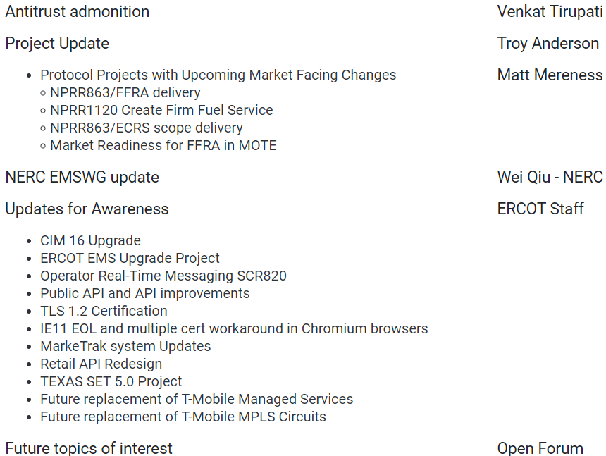
ERCOT Technology Working Group (TWG)
Next meeting date is TBD (likely in late September)
Prior meeting discussion points:

Slide 14
Appendix

Slide 15
BES Combo Model Implementation
ESR: Energy Storage Resource
BES: Battery Energy Storage
PR353-01 BES Combo Model Implementation – decoupled into separate efforts below
NPRR987 – BESTF-3 ESR Contribution to Physical Responsive Capability and RT On-Line Reserve Capacity Calcs
TARGETING IMPLEMENTATION IN 2022-R5
NPRR1002 – BESTF-5 ESR Single Model Registration and Charging Restrictions in Emergency Conditions
TARGETING IMPLEMENTATION IN 2022-R5
NPRR989 – BESTF-1 ESR Technical Requirements
NPRR1038 – BESTF-8 Limited Exemption from Reactive Power Requirements for Certain ESRs
POTENTIAL IMPLEMENTATION IN 2022
NPRR1002 – BESTF-5 ESR Single Model Registration and Charging Restrictions in Emergency Conditions
RUN IN PARALLEL WITH RARF REPLACEMENT – TARGET GO-LIVE 2023
NPRR963 – Base Point Deviation Settlement & Deployment Performance Metrics for ESRs (Combo Model)
NPRR987 – BESTF-3 ESR Contribution to Physical Responsive Capability and RT On-Line Reserve Capacity Calcs
NPRR1069 – Align Ancillary Service Responsibility for ESRs with NPRR987
EXPECTED IMPLEMENTATION AFTER ECRS IN 2023 (re-assessment of delivery options is pending)
NPRR1026 – BESTF-7 Self-Limiting Facilities and Self-Limiting Resources
IMPLEMENTATION TIMELINE TBD

