Slide 1
ERCOT Technology Working Group (TWG)
September 29, 2022

Slide 2
ERCOT TWG – Venkat Tirupati
WELCOME

Slide 3
ERCOT TWG

Slide 4
ERCOT TWG Agenda
Item # | Item Description | Presenter
1 | Antitrust admonition | Venkat Tirupati
2 | Protocol Projects with Upcoming Market Facing Changes FFRA, FFSS and ECRS | Matt Mereness
3 | MIS URL change in the data product links | Priyanka Parthasarathy Amy Lofton
4 | Public API Update | Omar Soberanis
5 | ERCOT SCED Failure Event | Venkat Tirupati
6 | NERC EMSWG update & EMS Event LL | Wei Qiu - NERC
7 | Project Update | Troy Anderson
8 | TEXAS SET 5.0 & MarkeTrak Project Updates | Vikram Gupta
9 | NMMS Upgrade - Update | Joel Koepke
10 | Updates for Awareness CIM 16 Upgrade ERCOT EMS Upgrade Project Operator Real-Time Messaging SCR820 | Venkat Tirupati
11 | SCR for MOTE Enhancements | Venkat Tirupati
12 | Future topics of interest | Open Forum
 | Adjourn | Venkat Tirupati

Slide 5
ERCOT TWG – Matt Mereness
Projects with Interface Change Requirements
NPRR863/Fast Frequency Response
NPRR1120 Create Firm Fuel Service
NPRR863/ECRS scope delivery
Market Readiness for FFRA in MOTE
Go-Live Plan

Slide 6
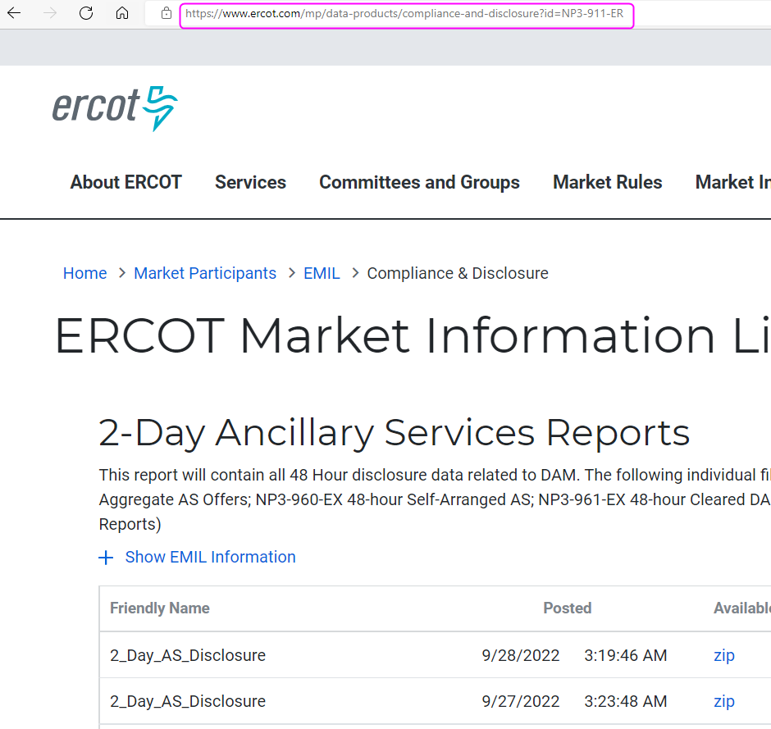
TWG - Public Reports & Extracts on MIS – Priyanka/Amy

Slide 7
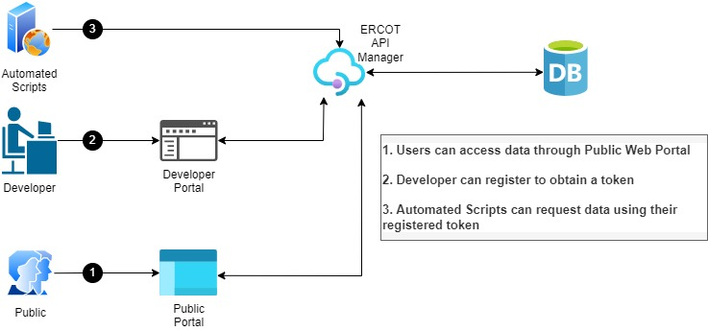
ERCOT TWG - Public API Capabilities – Omar
Public can download all expired data reports
Search capabilities that will return results based on JSON/XML/CSV
Digital certificate will no longer be required only a registration and easy to use token
Modernized Open API protocol based on industry standard (REST/HTTPS)
Autogenerated documentation that will be widely accessible and easy to consume
Portal to create issues and share knowledge on API usage
API request rate limiting
Your feedback!!!

Slide 8
ERCOT TWG – Wei Qiu
NERC Update

Slide 9
ERCOT TWG – Troy Anderson
Project Update

Slide 10
ERCOT TWG – Vikram Gupta
MarkeTrak system Updates
TEXAS SET 5.0 Project

Slide 11
ERCOT TWG – Joel Koepke
NMMS – Tech Health Project

Slide 12
ERCOT TWG – Venkat Tirupati
CIM 16 Upgrade
ERCOT EMS Upgrade Project
Operator Real-Time Messaging SCR820

Slide 13
ERCOT TWG – Venkat Tirupati
SCR for MOTE enhancements

Slide 14
ERCOT TWG – Open Forum
Q & A

Slide 15
ERCOT TWG
Thank You

