Slide 1
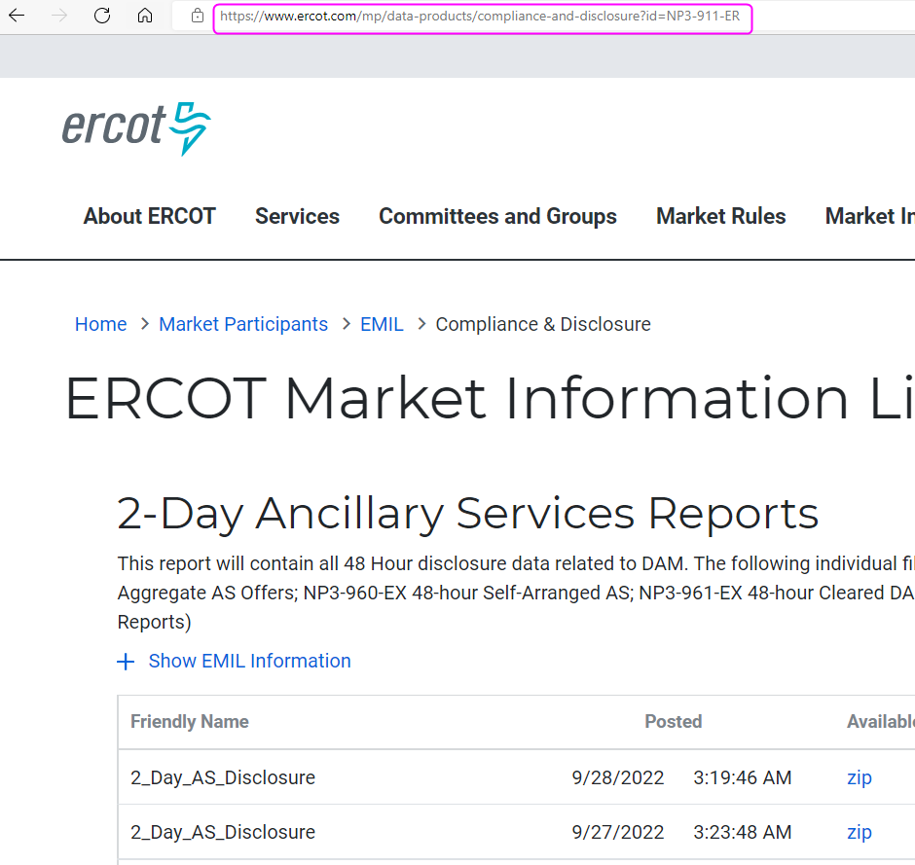
Public Reports & Extracts on MIS

