Slide 1
Lessons Learned: EMS Pausing During Database Deployment
Wei Qiu, NERC
ERCOT TWG Conference
September 29, 2022

Slide 2
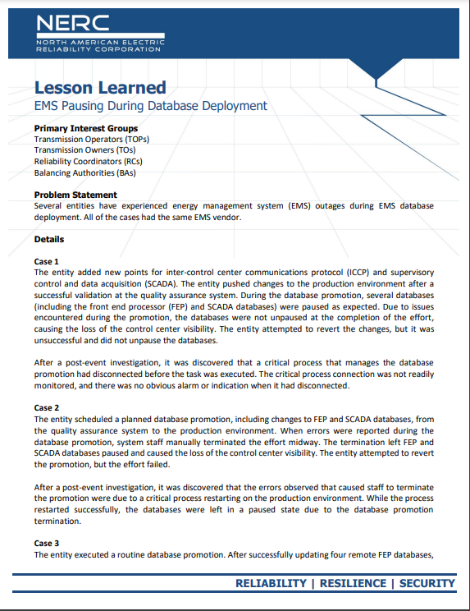
EMS Pausing during Database Deployment
Please scan:
Please click:
https://www.nerc.com/pa/rrm/ea/Lessons%20Learned%20Document%20Library/LL20220801_EMS_pausing_during_database_deployment.pdf

Slide 3
Problem Statement
Database
Deployment
Production
Update

Slide 4
Case Description
Case 1
FEP, ICCP, and SCADA
Validation at QAS
Case 2
FEP, ICCP, and SCADA
Validation at QAS
Case 3
FEP, ICCP, and SCADA
Validation at QAS
Paused (as expected)
Errors were reported
Paused (as expected)
Hung…
System staff manually terminated the process
Hung…
Hung…
Failover Attempted
Failover Attempted
Failover Attempted

Slide 5
Corrective Actions
Case 1
Contacted the vendor
Synced the SCADA databases
Case 2
Contacted the vendor
Reverted to the pre-updated conditions
Case 3
Contacted the vendor
Un-paused the databases
Restarted an FEP service
Rebuilt the FEP database
Rebuilt the FEP database

Slide 6
Lessons Learned
Pre Deployment
Test pre-effort checks, promotion steps and post-effort checks in a non-production environment(s)
Build and implement a list of checks to ensure all processes
During Deployment
Develop and implement alarming/indications to monitor the process
Restoration
Build detailed documents that institute an effective process for troubleshooting and rolling back to previous system conditions
Consider prioritizing the restoration of the FEP and ICCP links
Post Deployment
Build and implement a list of checks to review functionality to ensure all critical functionality is confirmed or issues identified quickly
In-house expertise !!!

Slide 7
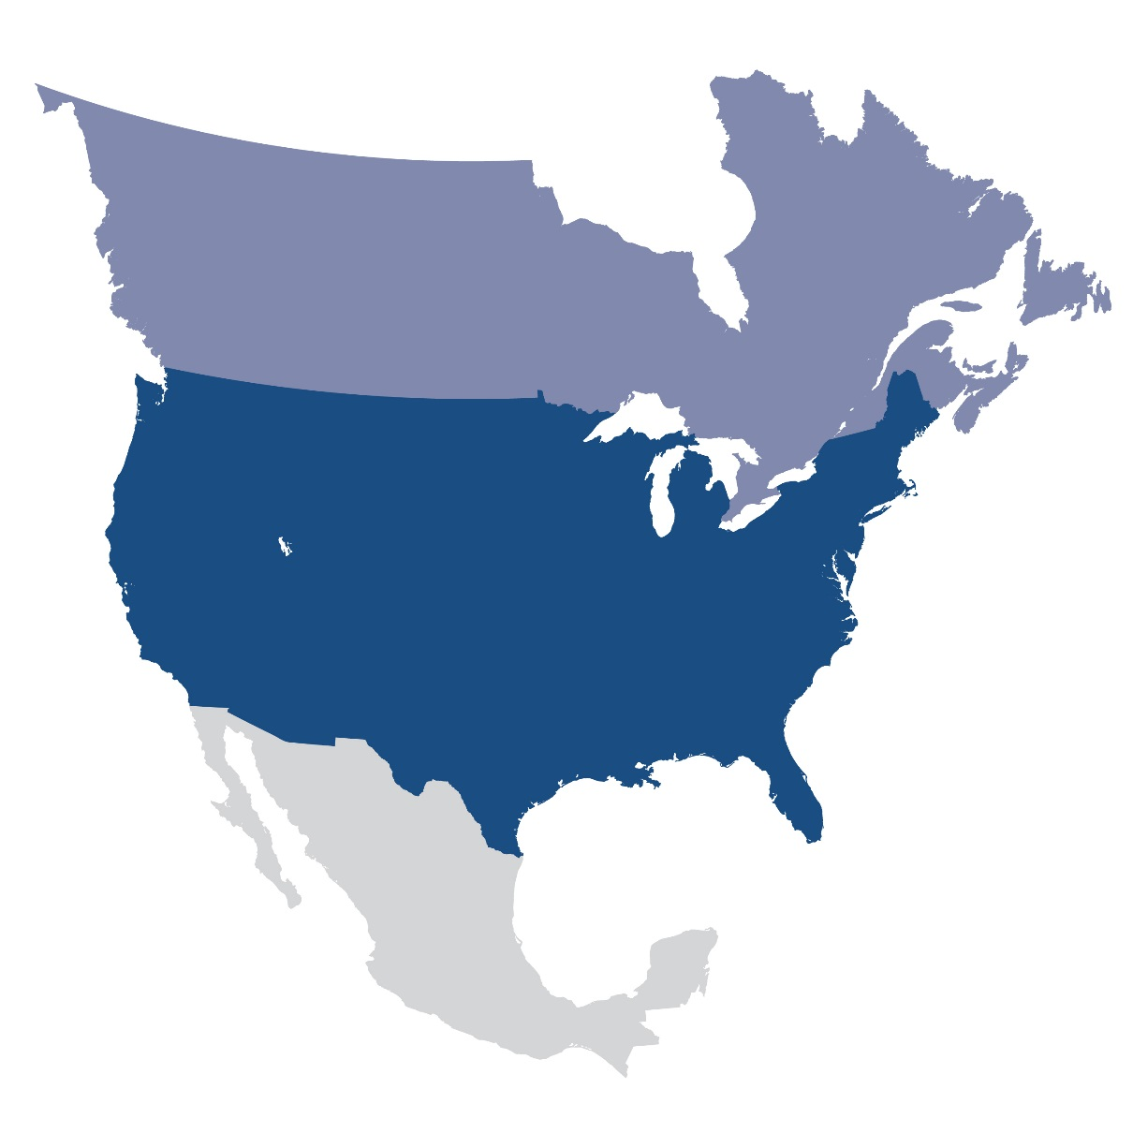
Questions and Answers
Contact Information:
wei.qiu@nerc.net

