Slide 1
PDCWG Report to ROS
Chair: Jimmy Jackson, CPS
Vice Chair: Vacant
ROS
Sep 29th, 2022

Slide 2
Report Overview & Notes
Report Overview
Meeting Minutes
BAL-001-TRE-2 FMEs and IMFR
0 FME in the month of August
Frequency Control Report

Slide 3
Meeting Minutes
PDCWG Meeting 9/14/2022
Review of 2023 A/S Methodology
Review of NOGRR226
Discussion of NPRR1433
ERCOT Reports
TRE Report
BAL-001-TRE-SAR Overview

Slide 4
Frequency Measurable Events Performance

Slide 5
Frequency Measurable Events
There were 0 FME’s in August

Slide 6
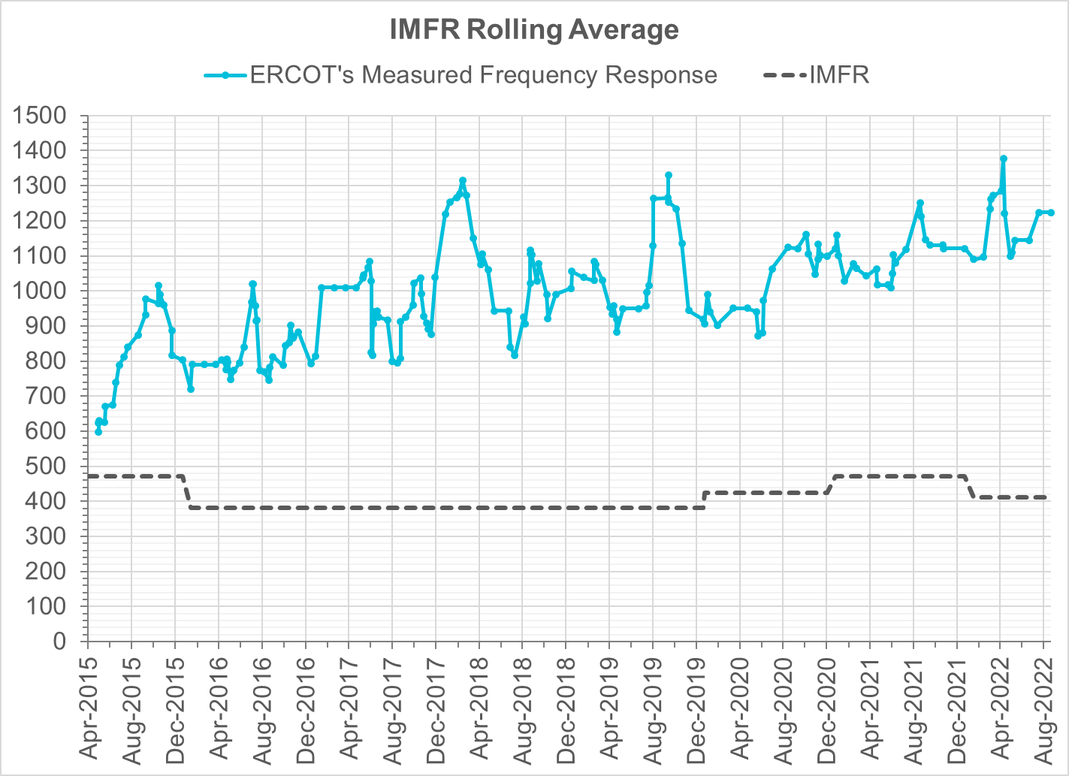
Interconnection Minimum Frequency Response (IMFR) Performance
IMFR Performance currently
1223.77 MW/0.1HZ
Frequency Response Obligation (FRO): 412 MW/0.1 Hz

Slide 7
Questions?

Slide 8
Frequency Control Report
Aug 2022

Slide 9
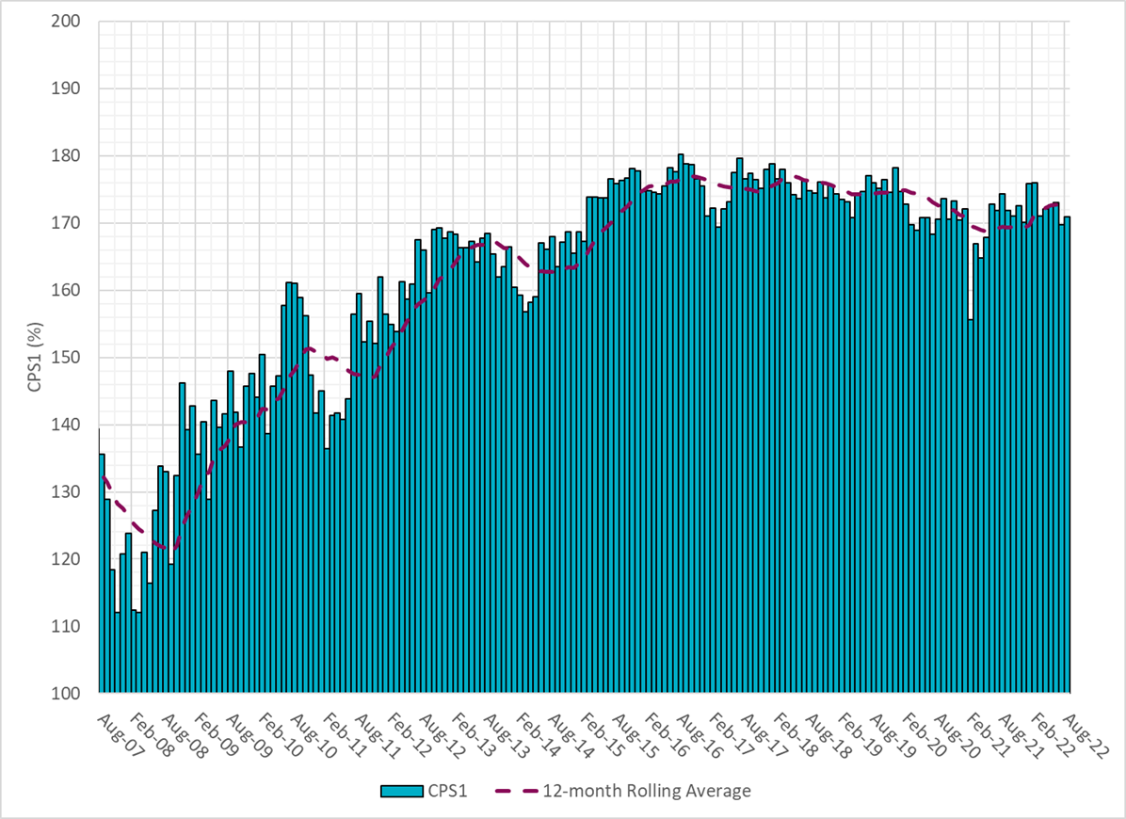
CPS1 Performance

Slide 10
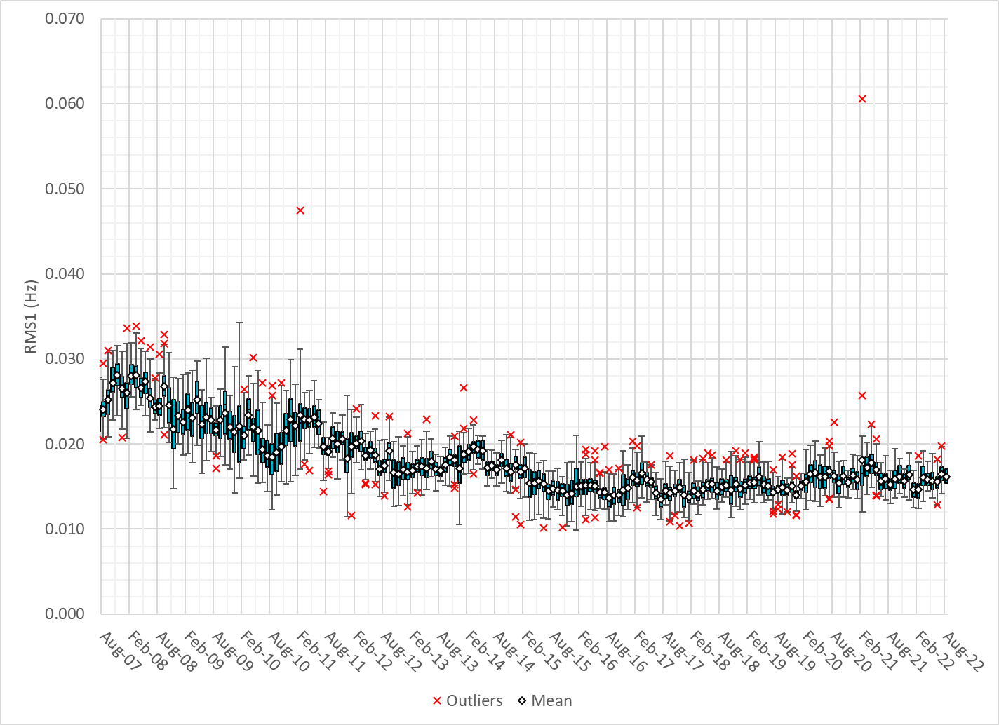
RMS1 Performance of ERCOT Frequency
Notes:
16.48Mhz on avg for July 2022

Slide 11
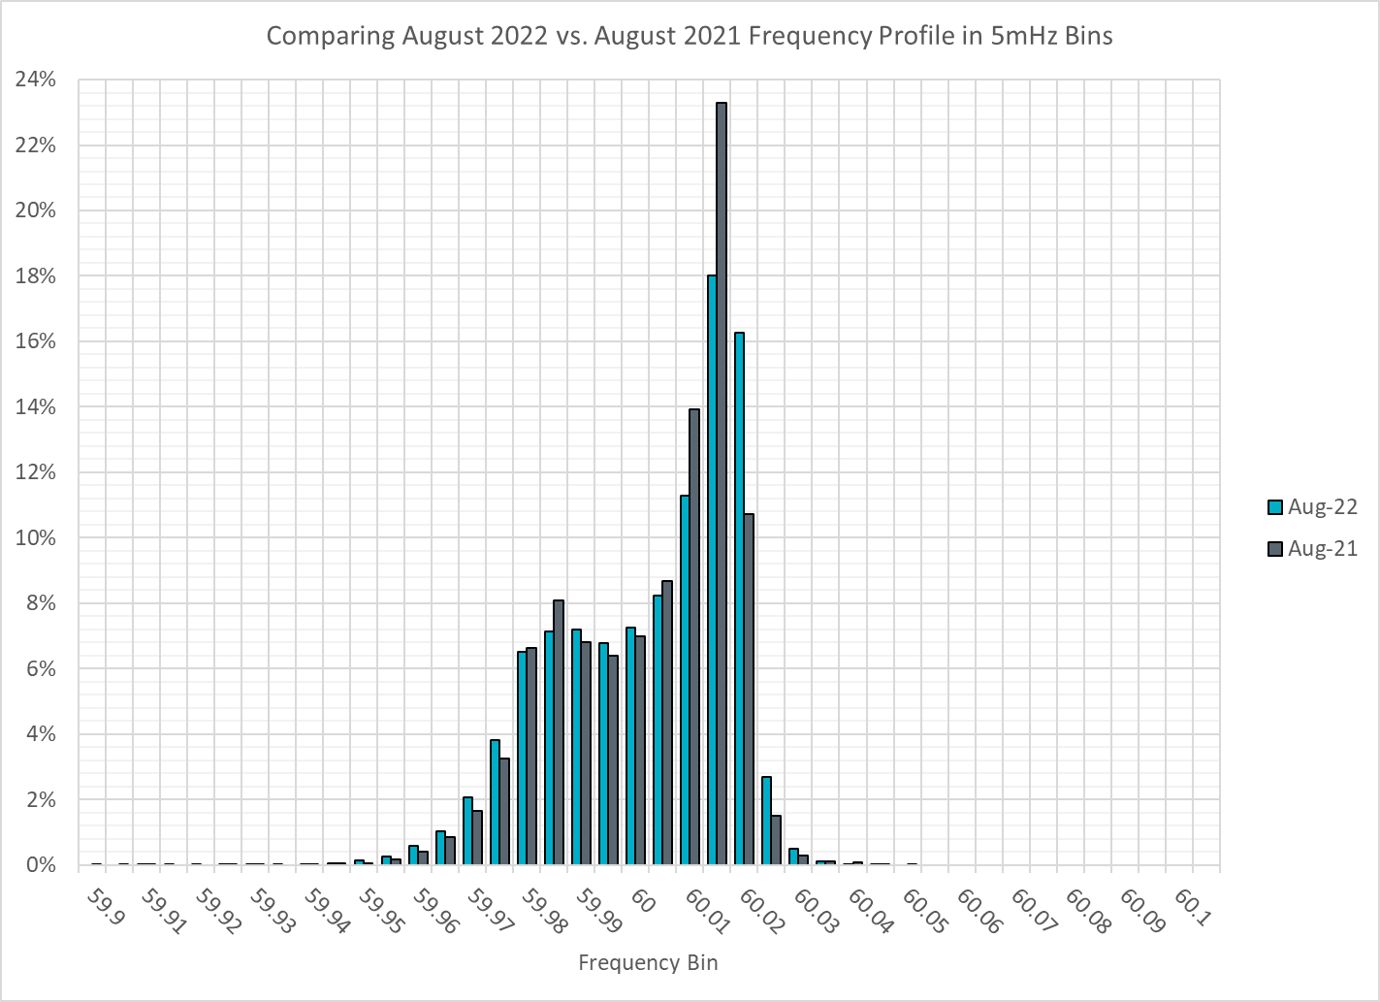
Frequency Profile Analysis

Slide 12
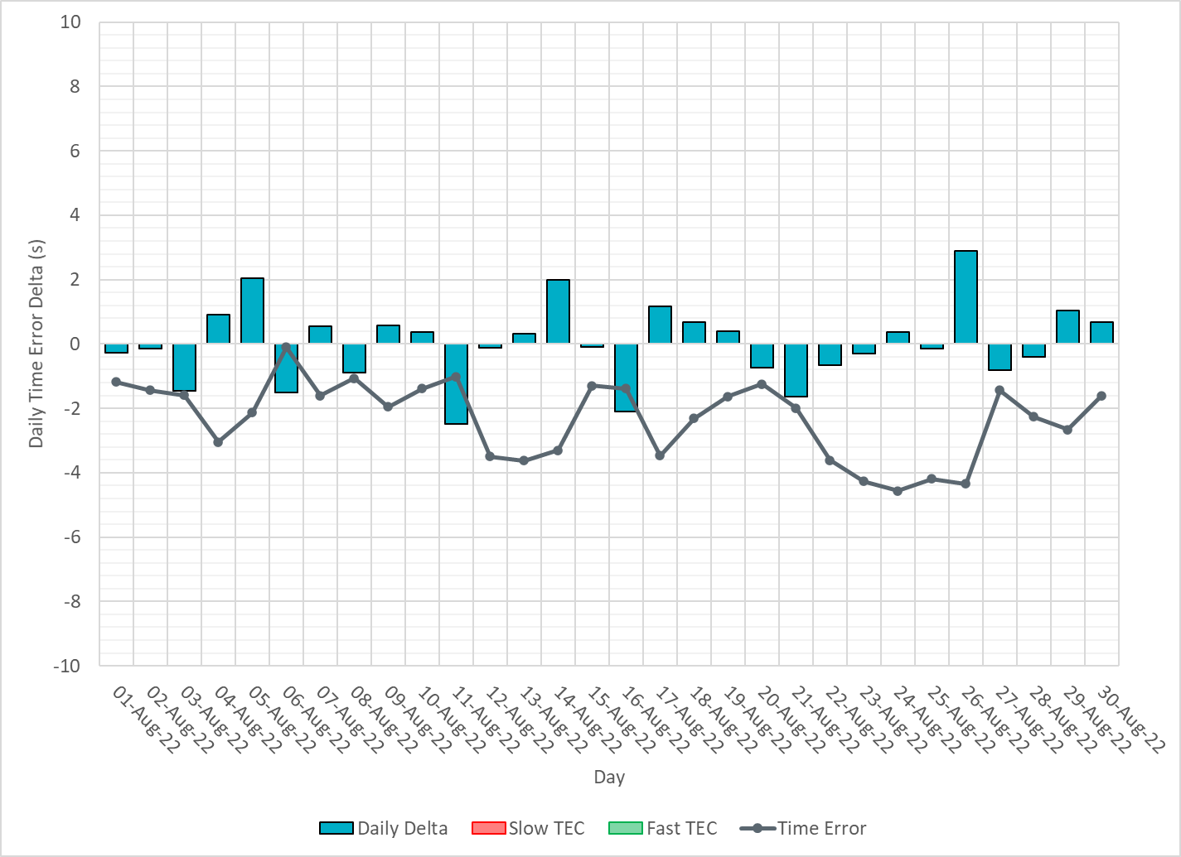
Time Error Corrections
Notes:
Time error started to go down around the 7th due to significant IRR ramps and heatwave. Several GTBD changes were made later in the month to recover time error.

Slide 13
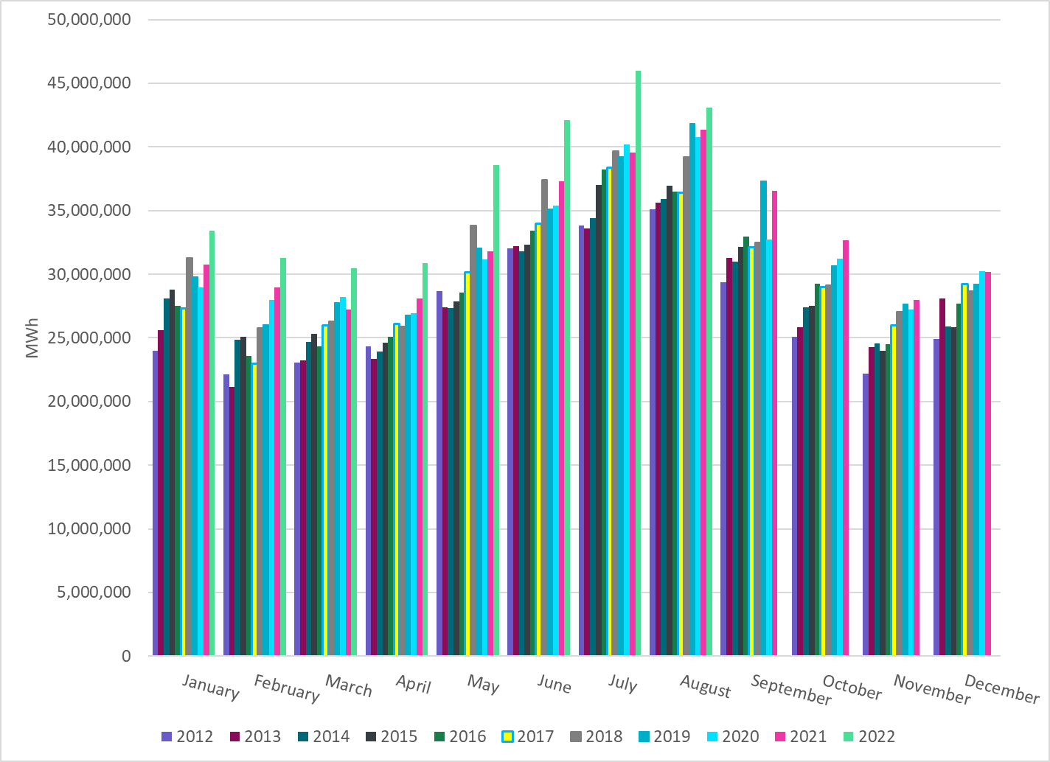
Total Energy
Notes:
43,067,150 MWh

Slide 14
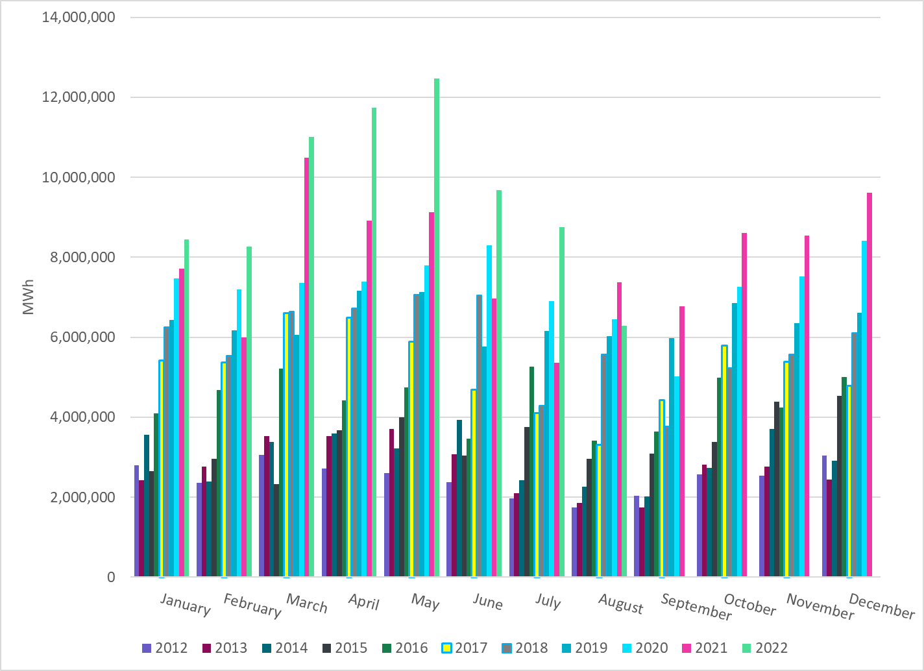
Total Energy from Wind Generation
Notes:
6,279,388 MWh

Slide 15
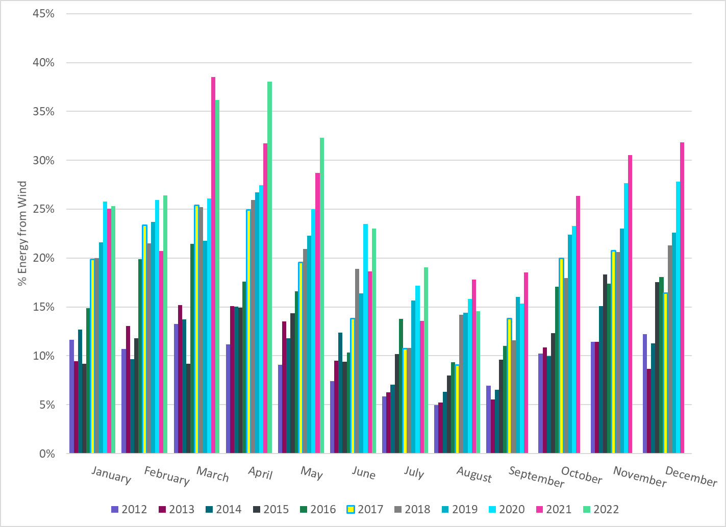
% Energy from Wind Generation
Notes:
14.58%

Slide 16
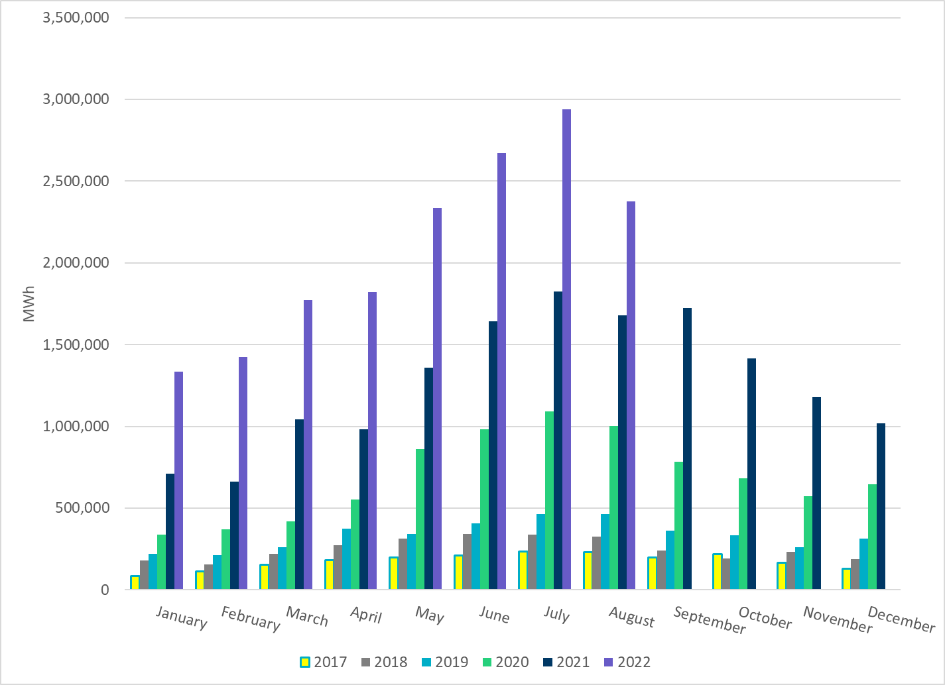
Total Energy From Solar Generation
Notes:
2,374,549 MWh

Slide 17
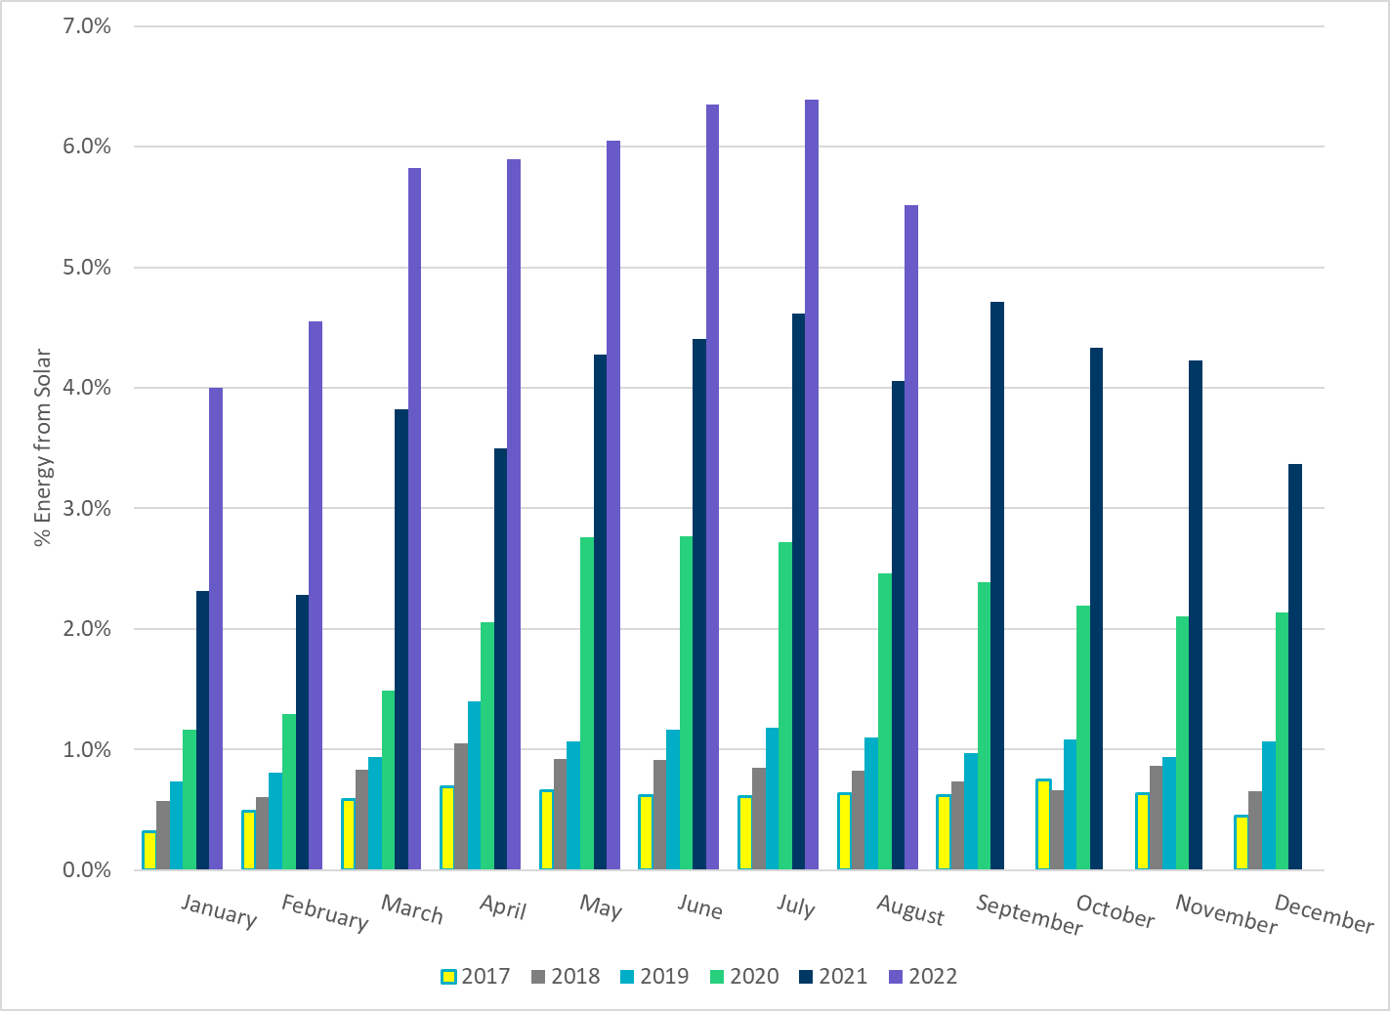
% Energy from Solar Generation
Notes:
5.51%

