Slide 1
ERCOT Updates
September NDSWG
Network Modeling Group
9/20/2022

Slide 2
NMMS Project – Tech Health Project
Scope:
Update backend hardware
Upgrade database version
No changes to “grid” data
(due to the above) Upgrade SGEM
Notes:
Joel

Slide 3
NMMS – Tech Health Project Update
Date Migration
Friday, 11-04-2022, @ 5pm Stop using Current NMMS
On Monday, 11-07-2022 @ 8am Start using New NMMS
No Changes on Migrated Active CRs
Same Statuses
All Attachments
Same history
No Changes on Migrated Archive CRs
Users will be Prompted to Install the Update
Notes:
Joel

Slide 4
SGEM New Feature
Submitter’s Email Address will be listed on Summary Screen
Notes:
Trisha

Slide 5
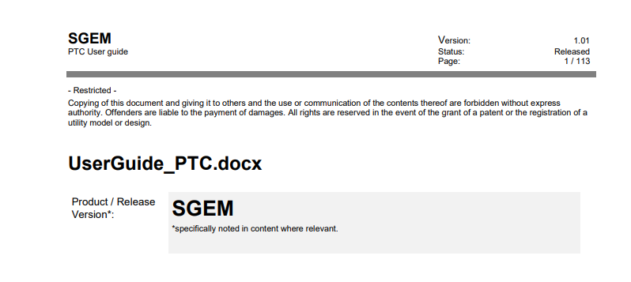
SGEM New Feature
Siemen’s Provided User Guide
Notes:
Trisha

Slide 6
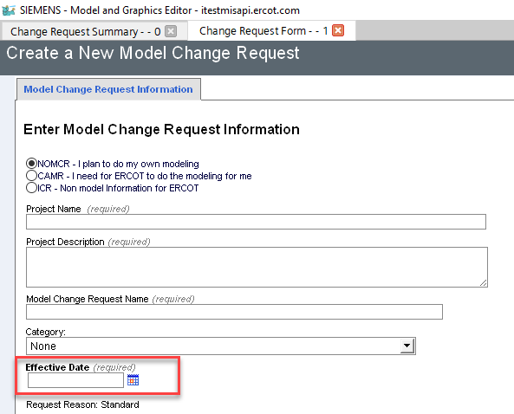
Difference Between Current SGEM/New SGEM
Notes:
Trisha

Slide 7
Difference Between Current SGEM/New SGEM
Notes:
Trisha

Slide 8
MAGE updates
Minor changes from current MAGE
Requires no additional training
Diagrams
No validation errors when diagrams are opened
No validation errors when changes are saved after opening diagrams
Notes:
Sujatha

Slide 9
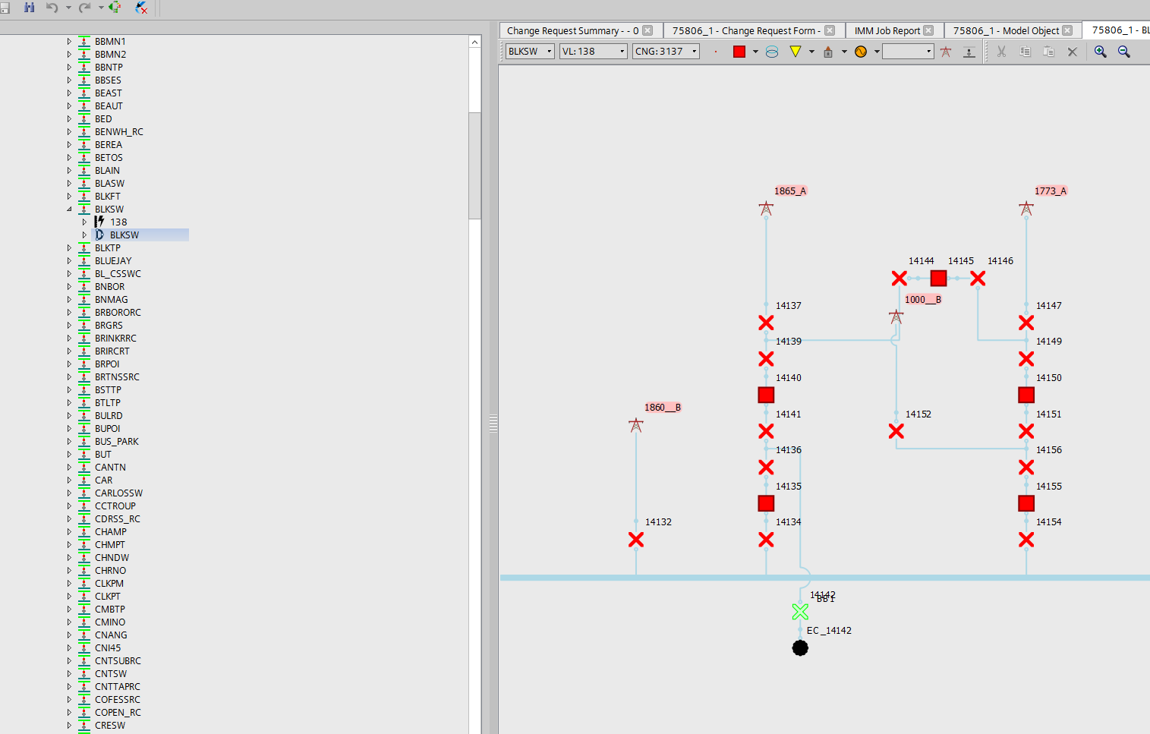
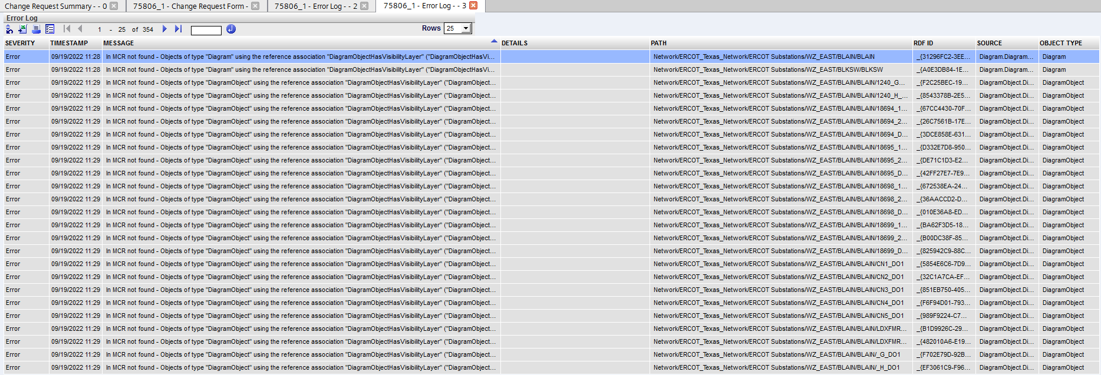
Diagrams – Current MAGE
Validation errors when diagram objects are newly created (on existing or a new substation)
NOMCR can only be submitted if the diagram object is deleted
Visibility layer and style validation errors when making new diagrams objects on an existing substation or newly created substations
Notes:
Sujatha

Slide 10
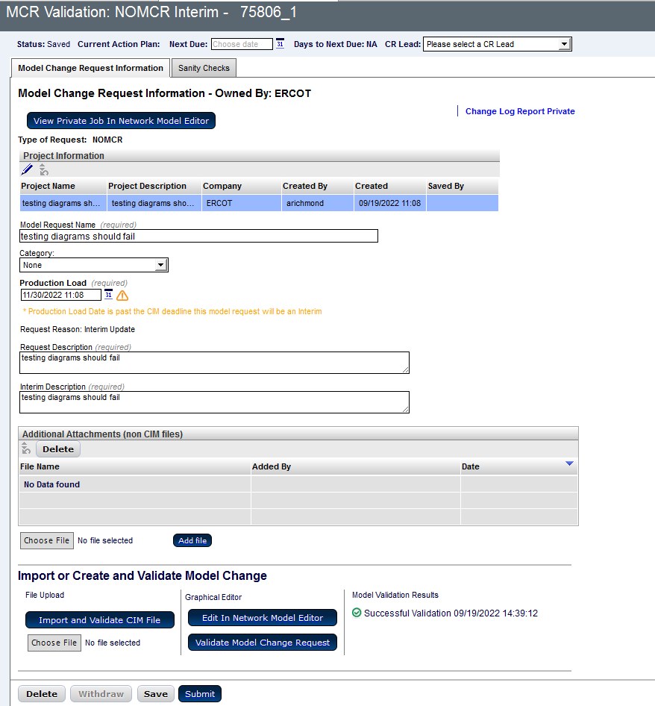
Diagrams – MAGE upgrade
Upgraded MAGE
Successful submission of the NOMCR after viewing or modifying diagrams
Successful validation after creating a diagram object
Notes:
Sujatha

Slide 11
Other updates
Topological coloring improved on diagrams
Notes:
Sujatha

