Slide 1
Refresher on Jointly-Rated Branches
9/19/2022

Slide 2
Topics
Terminology
Incorporating Limiting Elements in Branch Ratings
Jointly-Rated Branches
Jointly-Rated Complications
Key Takeaways

Slide 3
Terminology for This Presentation
Jointly-Rated Branch
  Line or transformer with more than one company providing ratings
Jointly-Owned Branch
  Line or transformer which has ownership associations to more than one company
  Ownership, in this discussion, refers to the mechanism giving permissions to the data instance. Associated “owners” of the data instance can provide ratings.
A line must have multiple ownership associations in order to have multiple ratings sets

Slide 4
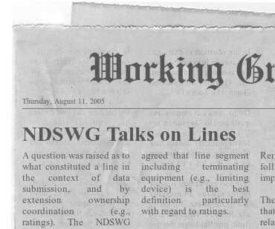
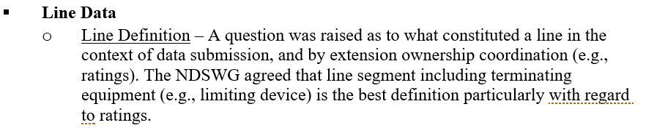
Branch Ratings as a Proxy for Other Equipment Ratings
ERCOT systems only consider ratings on lines and transformers when performing analysis
As such, applicable limiting equipment ratings must be “baked into” the line and transformer ratings
NDSWG Meeting Notes, ROS 8/11/2005
https://www.ercot.com/calendar/event?id=1421263490400
Reporting pulled from archival microfiche

Slide 5
Example #1 – Equipment Ratings Incorporated in Facility Rating
Devices within the green box are part of the facility.
SUBA
DSCA1 478 MVA
CBA1 478 MVA
DSCA2 478 MVA
DSCB2 478 MVA
CBB1 478 MVA
DSCB1 478 MVA
SUBB
A_B_1
700 MVA
Buswork 287
MVA
PT
478 MVA
WT
478 MVA
WT
478 MVA
PT
478
MVA
Buswork478
MVA

Slide 6
Example #1 – Equipment Ratings Incorporated in Facility Rating
DSCA1 478 MVA
CBA1 478 MVA
DSCA2 478 MVA
DSCB2 478 MVA
CBB1 478 MVA
DSCB1 478 MVA
Substation A
  Buswork – 287 MVA
  DSCA1 – 478 MVA
  CBA1 – 478 MVA
  PT – 478 MVA
  DSCA2 – 478 MVA
  WT – 478 MVA
Substation B
  Buswork – 478 MVA
  DSCA1 – 478 MVA
  CBA1 – 478 MVA
  PT – 478 MVA
  DSCA2 – 478 MVA
  WT – 478 MVA
SUBA
SUBB
A_B_1
700 MVA
Buswork 287
MVA
PT
478 MVA
WT
478 MVA
WT
478 MVA
PT
478
MVA
Buswork478
MVA
Line - A_B_1
  700 MVA

Slide 7
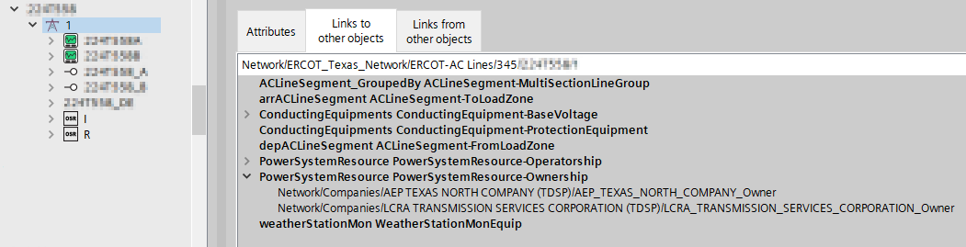
Jointly-Rated Branches
An individual branch can have separate ratings for each company that is denoted as an “owner”
One OwnerShareRating Per Company
Multiple Ownership associations
Downstream systems will use the most conservative value per rating type and temperature

Slide 8
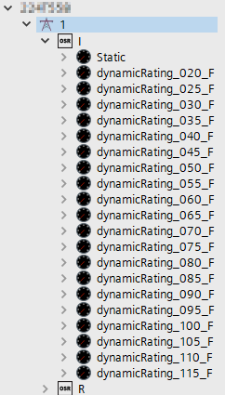
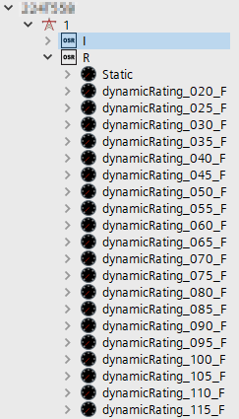
An OwnerShareRating (OSR) for Each Company
Jointly-rated lines should have an OwnerShareRating (OSR) for each company
Static ratings are required but dynamic ratings are optional
ERCOT applications will extend static-only OSR values across all temperatures when paired with a dynamically rated OSR

Slide 9
Example #2 – Jointly-Rated Facility
Assuming the boxed devices are the facility.
Determine the Normal Rating for the Static Rating for each Company.
SUBA
DSCA1 478 MVA
CBA1 478 MVA
DSCA2 478 MVA
DSCB2 478 MVA
CBB1 478 MVA
DSCB1 478 MVA
SUBB
A_B_1
700 MVA
Buswork 478
MVA
PT
478 MVA
WT
478 MVA
WT
478 MVA
PT
191
MVA
Buswork478
MVA
Company X Owned
Company Y Owned

Slide 10
Example #2 – Jointly-Rated Facility
SUBA
DSCA1 478 MVA
CBA1 478 MVA
DSCA2 478 MVA
DSCB2 478 MVA
CBB1 478 MVA
DSCB1 478 MVA
SUBB
Company X Normal Rating
  Buswork – 478 MVA
  DSCA1 – 478 MVA
  CBA1 – 478 MVA
  PT – 478 MVA
  DSCA2 – 478 MVA
  WT – 478 MVA
  Line – 700 MVA
  Normal Rating: 478 MVA
Company Y Normal Rating
  Buswork – 478 MVA
  DSCB1 – 478 MVA
  CBB1 – 478 MVA
  PT – 191 MVA
  DSCB2 – 478 MVA
  WT – 478 MVA
  Line – 700 MVA
  Normal Rating: 191 MVA
A_B_1
700 MVA
Buswork 478
MVA
PT
478 MVA
WT
478 MVA
WT
478 MVA
PT
191
MVA
Buswork
478
MVA
Company X Owned
Company Y Owned

Slide 11
Example #3 – Jointly-Rated Facility
Assuming the boxed devices are the facility.
Assuming 138 kV operating voltage.
Determine the Normal Rating for the Static Rating for each Company.
SUBA
DSCA1 478 MVA
CBA1 717
MVA
DSCA2 717
MVA
DSCB2 717
MVA
CBB1 717
MVA
DSCB1 717
MVA
SUBB
A_B_1
700 MVA
Buswork 717
MVA
PT
717
MVA
WT
717
MVA
WT
717
MVA
PT
717
MVA
Buswork717
MVA
Company X Owned
Company Y Owned

Slide 12
Example #3 – Jointly-Rated Facility
SUBA
DSCA1 478 MVA
CBA1 717
MVA
DSCA2 717
MVA
A_B_1
700 MVA
DSCB2 717
MVA
CBB1 717
MVA
DSCB1 717
MVA
SUBB
Company X Normal Rating
  Buswork – 717 MVA
  DSCA1 – 478 MVA
  CBA1 – 717 MVA
  PT – 717 MVA
  DSCA2 – 717 MVA
  WT – 717 MVA
  Normal Rating: 478 MVA
Company Y Normal Rating
  Buswork – 717 MVA
  DSCB1 – 717 MVA
  CBB1 – 717 MVA
  PT – 717 MVA
  DSCB2 – 717 MVA
  WT – 717 MVA
  Line – 700 MVA
  Normal Rating: 700 MVA
Buswork 717
MVA
PT
717
MVA
WT
717
MVA
WT
717
MVA
PT
717
MVA
Buswork717
MVA
Company X Owned
Company Y Owned

Slide 13
Jointly-Rated Complications
It can be difficult to identify – and then keep up to date – all scenarios where your equipment interfaces with another company’s equipment
Ratings change over time due to equipment upgrades and methodology adjustments
  Did the CR submitted by your neighbor just make your equipment limiting?
What other complications are there?

Slide 14
Key Takeaways
OSR (OwnerShareRating) = An individual company’s ratings set
Branch ratings must consider all equipment ratings from “bus to bus”
  Companies must provide an OSR incorporating the ratings for their equipment following their Ratings Methodology
  Multiple companies must provide OSRs when ownership changes occur along or at the ends of a facility
A company should submit an OSR whenever their equipment’s ratings must be considered (although it may not currently be limiting) for the facility rating
Interfacing companies must coordinate to ensure all equipment is considered in the provided OSRs
Interfacing companies should not, as a practice, provide matching OSRs
  OSRs should be submitted with values determined by each company’s Ratings Methodology
Interfacing companies must coordinate to ensure OSRs are reevaluated when CRs, representing the end of a project, are submitted to ERCOT

Slide 15
Appendix

Slide 16
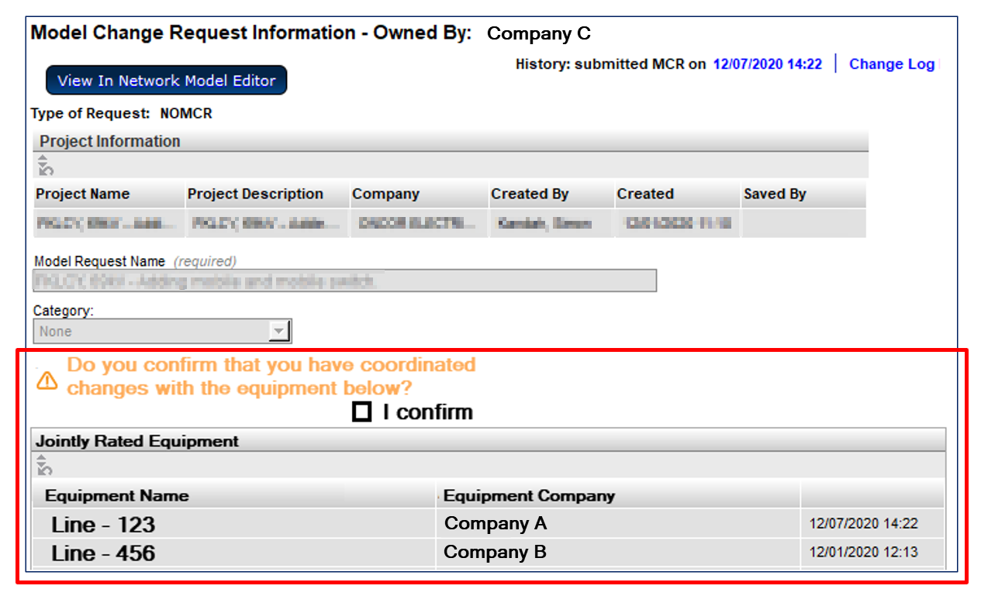
SCR813 - Submitter Shown Jointly-Rated Equipment and Coordination Confirmation Requested

Slide 17
SCR813 - Enhanced Notifications – “Walking the Tree”
Add functionality to send notifications to model-instance owners when “nearby” changes are made.
Currently notifications are only sent to owners of modified instances
Ratings sets are only owned by one company
  Each company will have their own ratings set if jointly owned
Example
  A notification would be sent to Company B if Ratings Set #1 were modified by Company A
Changing the impedance will send a notification to Company A and Company B
Changing the ratings in Ratings Set #1 will only send a notification to Company A
Changing the ratings in Ratings Set #1 will only send a notification to Company B

Slide 18
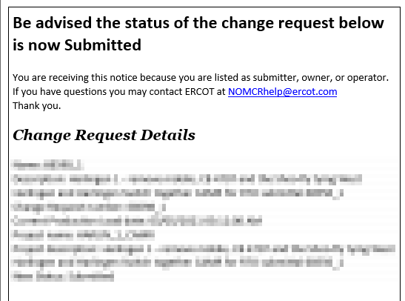
SCR813 - Additional Notification
The notification currently sent when a NOMCR is submitted would also be sent to all associated companies

