Slide 1
DGR/DESR Outages and Market Considerations
9/20/2022

Slide 2
Agenda
Review of “old-style” and “new-style” DGR/DESR modeling
“Old-style” are modeled on the distribution system
“New-style” are modeled on the transmission system
Outage considerations for TSPs and REs
Market impacts of transmission outages for DGR/DESRs

Slide 3
Transitioning to Simplified Modeling of DGR and DESRs
TSP Station
Old-Style
Transmission Network
New-Style
Transmission Network
DGR Station
TSP Station
Single substation with load and generator modeled at transmission voltages
CIM Load
CIM Load
Line
Multiple substations with load and generator modeled at distribution voltages

Slide 4
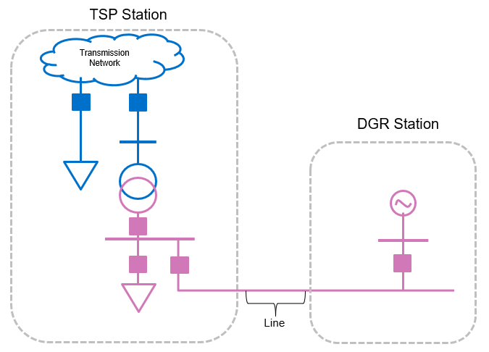
Key Issues of Distribution-Modeled DGRs and DESRs
Distribution-level equipment is needed to show the generator’s path to the transmission system
The pink equipment represents distribution equipment not typically modeled in ERCOT systems.

Slide 5
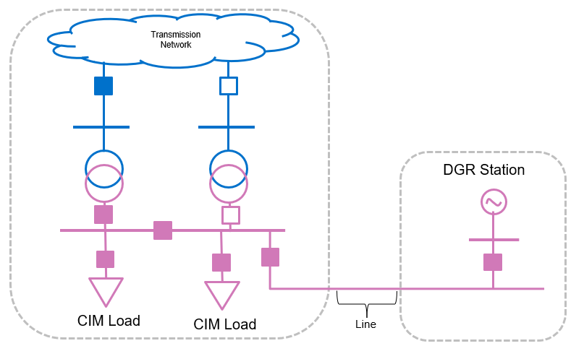
Key Issues of Distribution-Modeled DGRs and DESRs
Additional modeling may be needed to depict alternative paths to the grid caused by outages or switching
Coordination is required between the TSP, DSP, and RE to ensure alternative paths are modeled prior to outages.

Slide 6
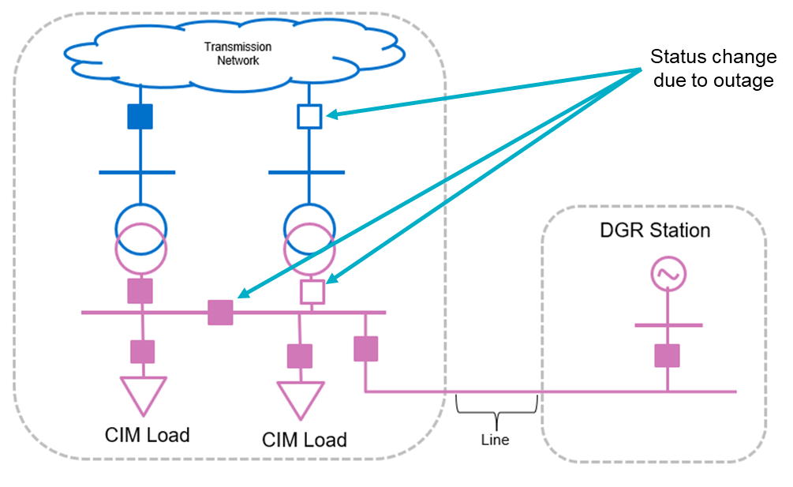
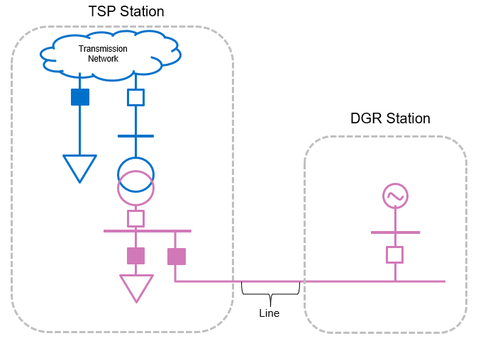
Key Issues of Distribution-Modeled DGRs and DESRs
DGR/DESRs cannot participate in the ERCOT market unless a path to the transmission system is modeled
ERCOT’s EMS will see the generator as de-energized even if an alternative path is present in the field

Slide 7
Outage Considerations for TSPs and Resources

Slide 8
Enhanced Logic for Transmission-Modeled DGRs and DESRs
ERCOT systems have been updated to include special logic for transmission-modeled DGRs and DESRs.
When de-energized in network applications:
Market systems will “trust” the real-time and COP statuses provided by the generator
DGR/DESR’s will be dispatched using the EMS’s “nearby” shift factor logic

Slide 9
Scenario 1 – Transmission Outage on Primary Path - Less Than 60 Days
TSP Action
Provide the typical transmission outage information to ERCOT.
Resource Action
Generator QSEs must send accurate resource information (telemetry and COP) reflecting their ability to connect to the grid.
Scenario 1: DGR/DESR connected to the transmission system via an alternate path

Slide 10
Scenario 2 – Transmission Outages Disconnecting DGR/DESR
TSP Action
Provide the typical transmission outage information to ERCOT.
Resource Action
Generator QSEs must:
Submit outage on Resource
Send accurate resource information (telemetry and COP) reflecting their inability to connect to the grid.
Scenario 2: DGR/DESR unable to connect to the grid due to transmission outages

Slide 11
Scenario 3 – Distribution Outages Disconnecting DGR/DESR
TSP Action
No action needed
Resource Action
Generator QSEs must:
Submit outage on Resource
Send accurate resource information (telemetry and COP) reflecting their inability to connect to the grid.
Scenario 3: DGR/DESR unable to connect to the grid due to distribution outages

Slide 12
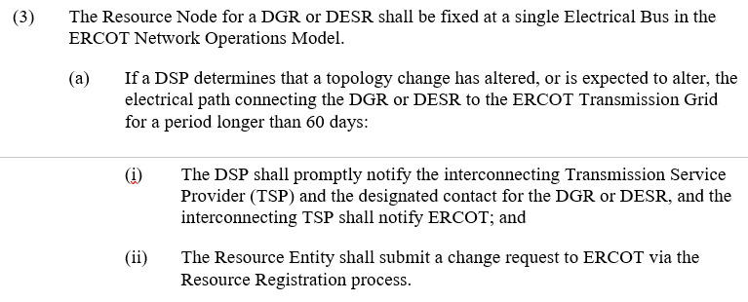
NP3.8.6(3)(a)
3.8.6

Slide 13
TDSP/DSP and RE Coordination – Alternative Path > 60 Days
Resource Entities are required to submit registration updates if a DGR/DESR will use an alternative path for longer than 60 days.
A registration submission is needed to change the associated CIM Load of the distribution resource
REs will require advanced notice to ensure registration timelines are met

Slide 14
Market Impact of Outages on Transmission-Modeled DGR/DESRs
The following scenarios are only accurate for transmission-modeled (aka “new-style”) DGR/DESRs

Slide 15
Recap: Transmission-Modeled Representation of DGR and DESRs
TSP Station
Distribution-Modeled
Transmission Network
Transmission-Modeled
Transmission Network
DGR Station
TSP Station
Single substation with load and generator modeled at transmission voltages
CIM Load
CIM Load
Line
Multiple substations with load and generator modeled at distribution voltages

Slide 16
Enhanced Logic for Transmission-Modeled DGRs and DESRs
ERCOT systems have been updated to include special logic for transmission-modeled DGRs and DESRs.
When de-energized in network applications:
Market systems will “trust” the real-time and COP statuses provided by the generator
DGR/DESR’s will be dispatched using the EMS’s “nearby” shift factor logic

Slide 17
Scenario 0: No Outages
Primary connection with no outages
Alternate connection with no outages
No indication to ERCOT systems that the load has moved from primary connection
DAM:
Energy dispatched using original CIM load shift factor
Can participate in AS market
RUC:
Energy dispatched using original CIM load shift factor if on-line in COP
AS in COP accounted as being provided if on-line in COP
SCED:
Energy dispatched using original CIM load shift factor if on-line in telemetry
AS accounted as being provided if on-line in telemetry

Slide 18
Scenario 1: Resource Node De-Energized
Resource Node de-energized
DGR available
no outage and
on-line COP status
Load de-energized
DAM:
Cannot participate in energy market
Can participate in AS market
RUC:
Energy dispatch to 0
AS in COP accounted as being provided if on-line in COP
SCED:
Energy dispatched using EMS-calculated “nearby” shift factor
AS accounted as being provided if on-line in telemetry
Same Outcome as Scenario 2
18

Slide 19
Scenario 2: Resource Node Energized & Load De-Energized
Resource Node energized
DGR available
no outage and
on-line COP status
Load de-energized
DAM:
Cannot participate in energy market
Can participate in AS market
RUC:
Energy dispatch to 0
AS in COP accounted as being provided if on-line in COP
SCED:
Energy dispatched using EMS-calculated “nearby” shift factor
AS accounted as being provided if on-line in telemetry
Same Outcome as Scenario 1
19

