Slide 1
Monthly Review of Reliability Unit Commitment Market Impacts - August 2022
Wholesale Market Working Group
ERCOT Staff
September 23, 2022

Slide 2
RUC Resource-Hours
August 2022 | Total | Opt-Out | Non-Opt-Out
Instructed Resource-Hours
Total Count | 1086.0 | 183.0 | 903.0
Effective Resource-Hours*
Total Count | 1046.6 | 176.2 | 870.4
Average LSL | 57.4 | 67.5 | 55.4
Average LDL | 94.4 | 273.8 | 58.5
Average BP | 99.9 | 297.9 | 60.3
Average HSL | 321.4 | 458.7 | 293.9
* The difference between “Instructed” and “Effective” values is a result of Resources starting up, shutting down, receiving partial hour instructions, or otherwise not being dispatchable by SCED.

Slide 3
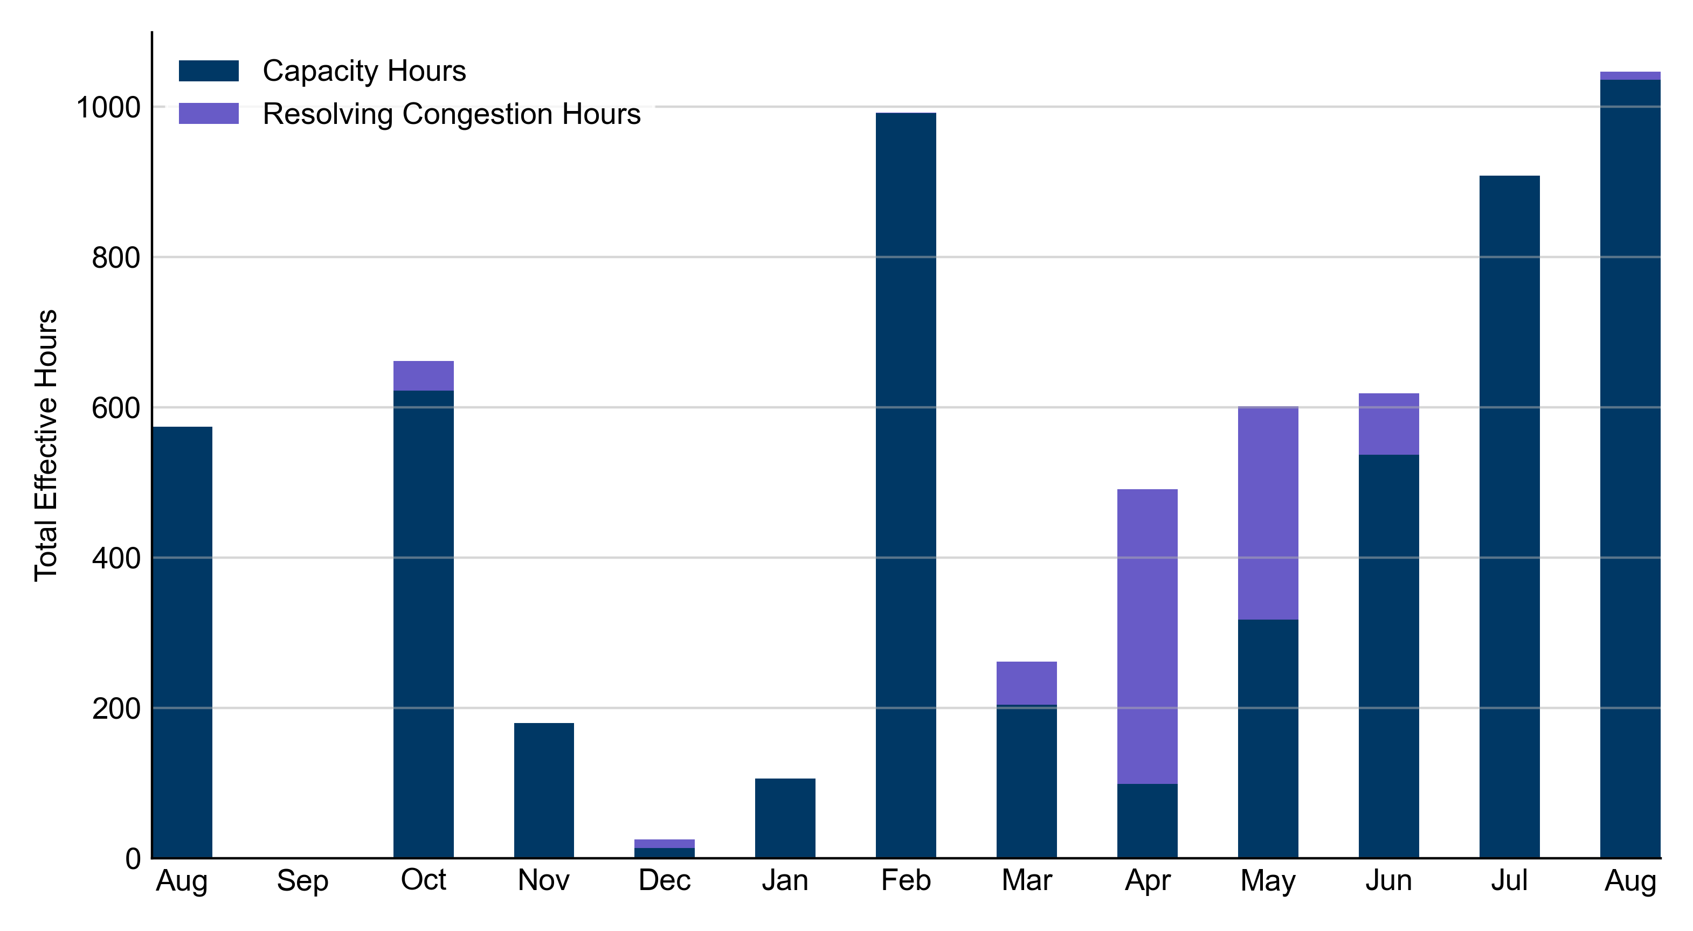
RUC Instruction Reasons: Last 13 Months RUCs in August 2022 were primarily driven by system-wide capacity concerns.

Slide 4
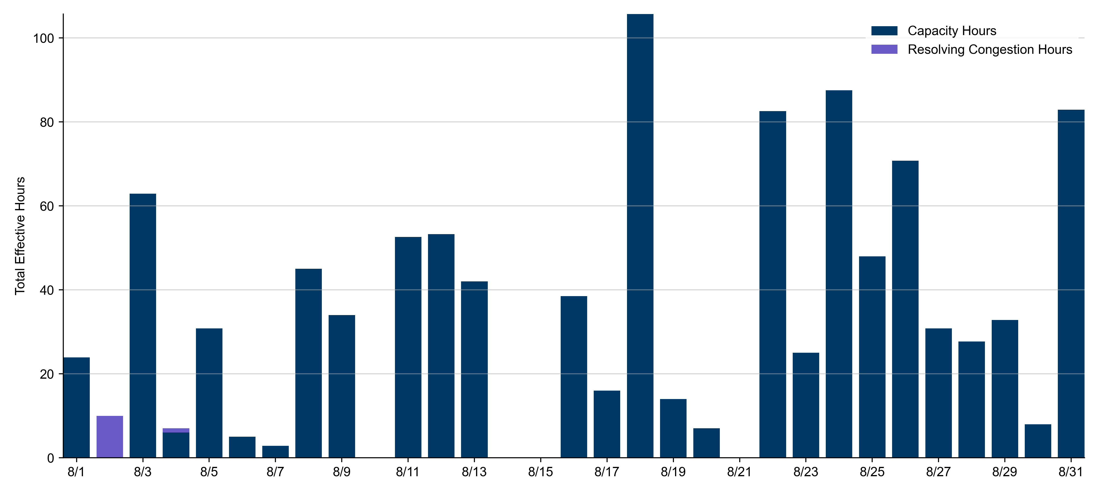
RUC Instruction Reasons
August 2022
1046.6 effective RUC Resource-hours.
1035.6 hours (98.95%) for capacity concerns.
11 hours (1.05%) for resolving congestion concerns.

Slide 5
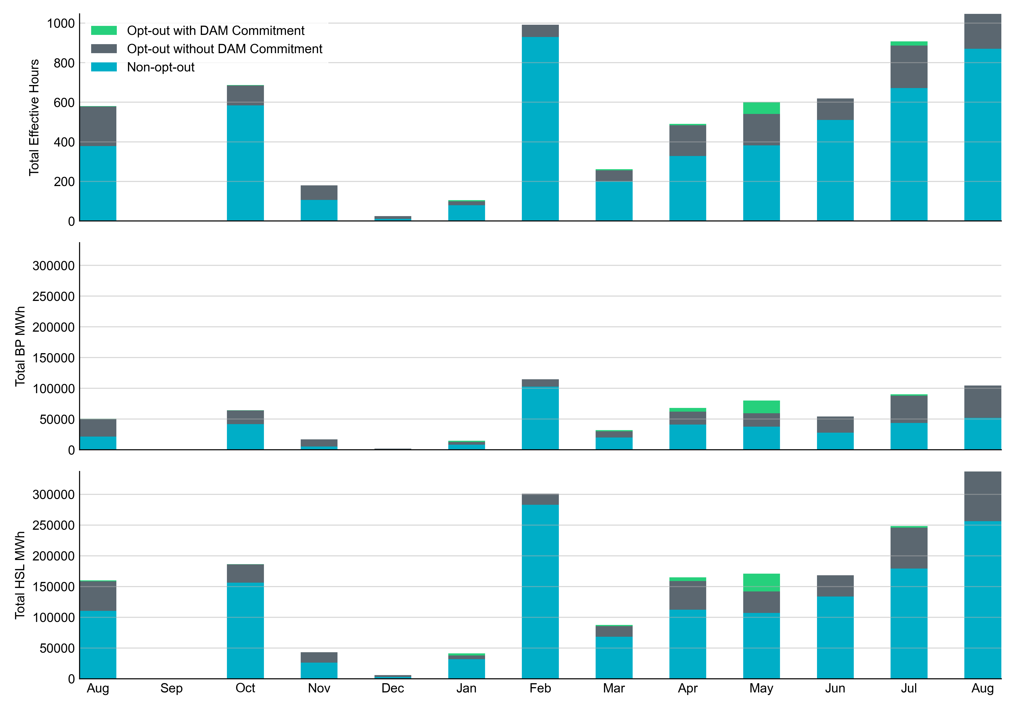
Non-opt-out and Opt-out Totals: Last 13 Months August 2022 had a total of 870.4 non-opt-out effective Resource-hours (83.17%) and 176.2 opt-out effective Resource-hours (16.83%).

Slide 6
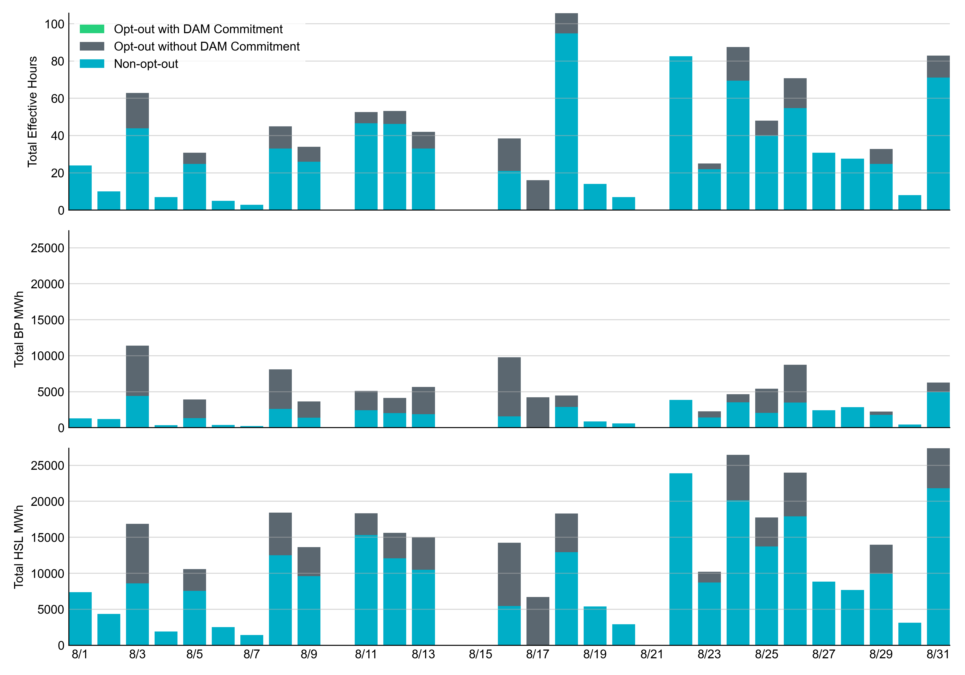
Non-opt-out and Opt-out Totals: August 2022

Slide 7
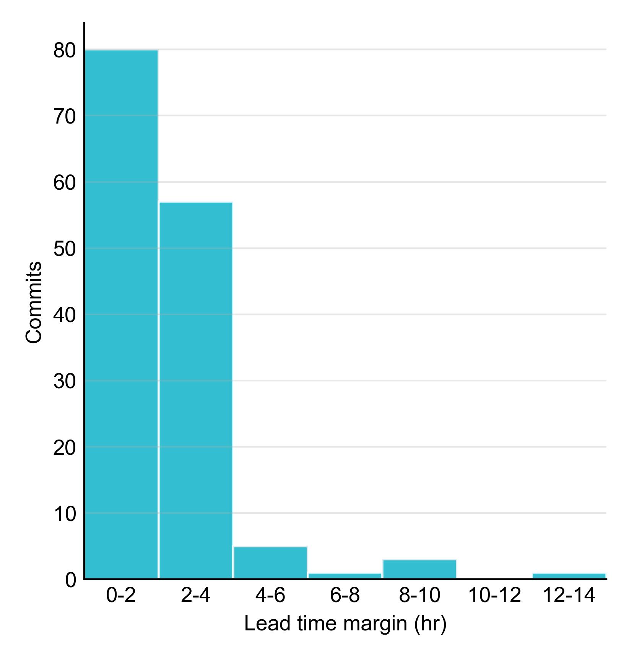
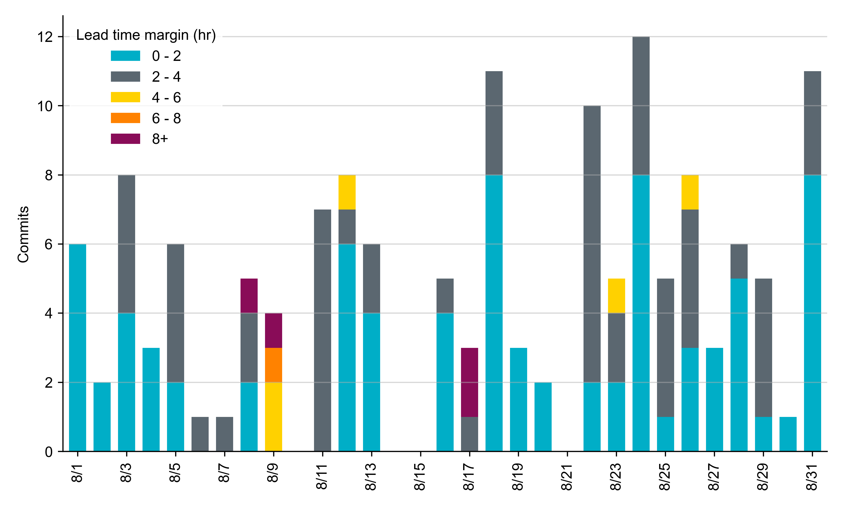
RUC Lead Time Margin: August 2022
Most RUC commit windows had lead time margin at or below 4 hours.
Lead time refers to the length of time between a RUC instruction and the start of the commitment window.
Lead time margin is the difference between lead time and the Resource’s startup time.
In cases where a Resource is committed for multiple back-to-back time blocks, lead time margin is calculated from the first instruction.
Notes:
The first bin is both-inclusive (i.e. [0, 2] ), while subsequent bins are left-inclusive (i.e. [2, 3), [3, 4), etc.).

Slide 8
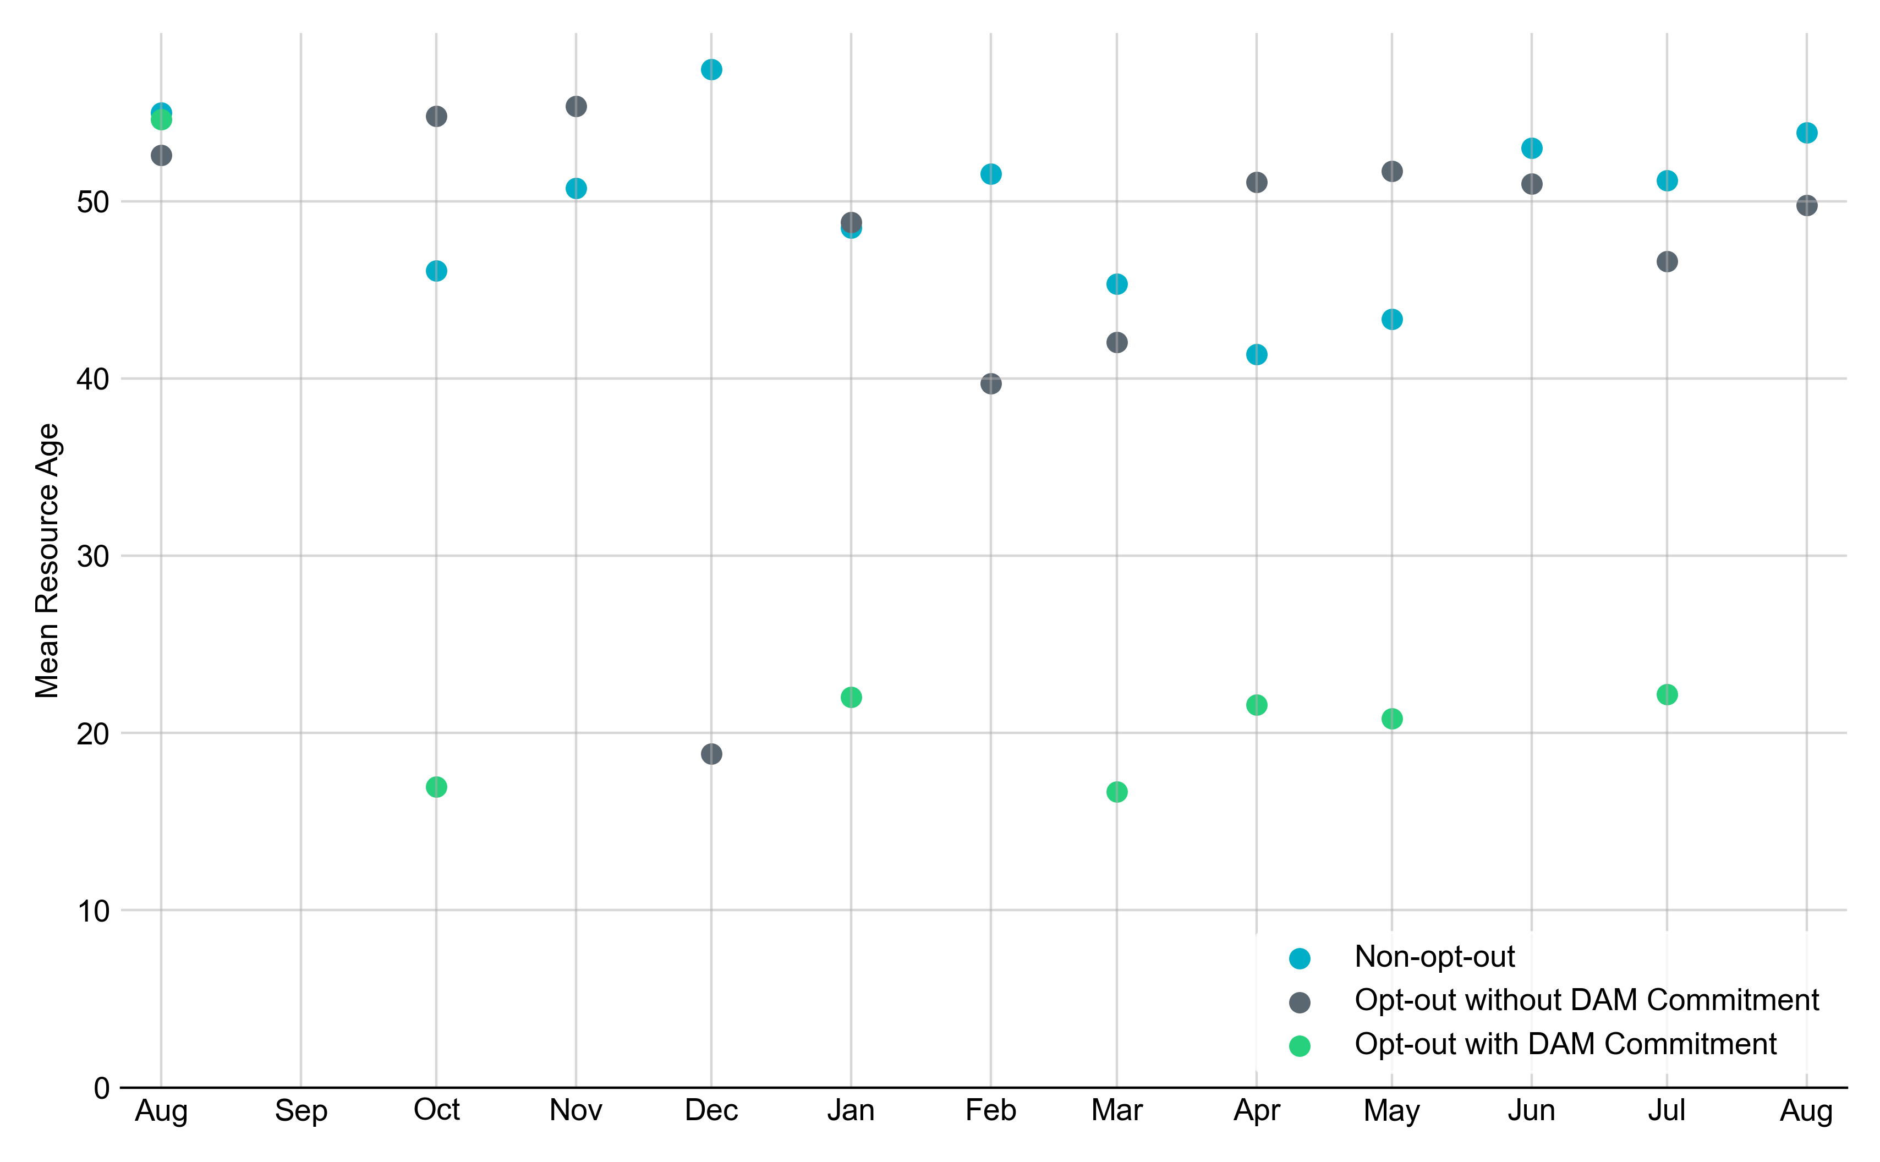
Average Resource Age In August 2022, the mean age of RUC-committed Resources was 53.9 years for Non-Opt-Out Resource-hours, 49.8 years for Opt-Out Resource-hours without DAM Commitments.
Note: For Resource configurations with multiple physical generators, the age of the oldest generator is used.

Slide 9
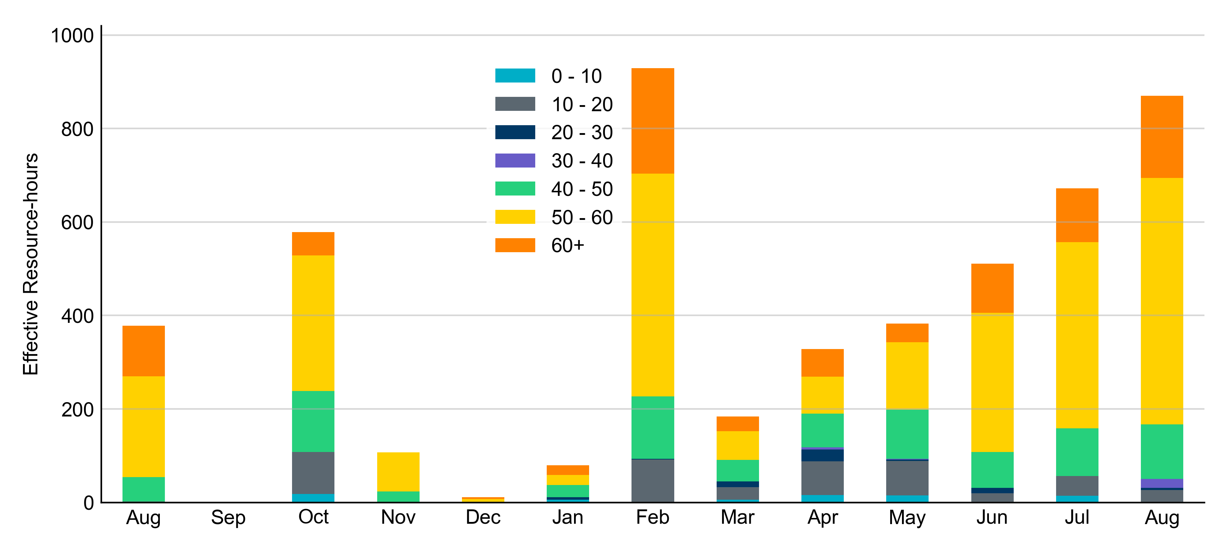
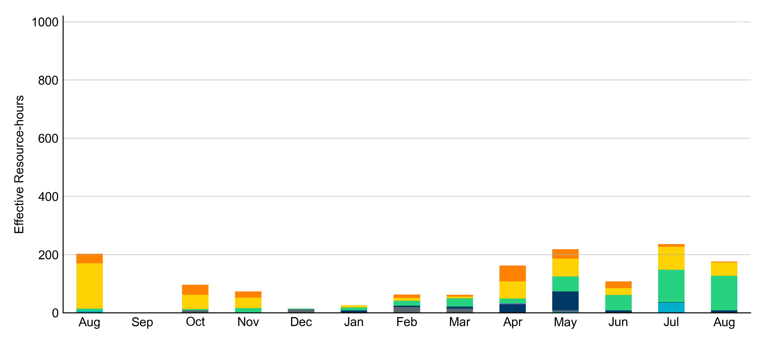
Age Category Most RUC-Committed Resources in August 2022 were older than 40 years.
Non-opt-out
Opt-out

Slide 10
RUC-Instructed Resource Dispatch above LDL
August 2022
When Resources did not successfully opt out, there were 33.4 effective Resource-hours for which the Resource was dispatched above its LDL.
For 11.4 of these Resource-hours, the LMP for the RUC-instructed Resource was above the RUC offer floor.
For 22.0 of these Resource-hours, the LMP for the RUC-instructed Resource was below the RUC offer floor.
For all these Resource-hours, the RUC-instructed Resource was mitigated.
There were Exceptional Fuel Cost submissions for 3 RUC-Committed Resources in August 2022.

Slide 11
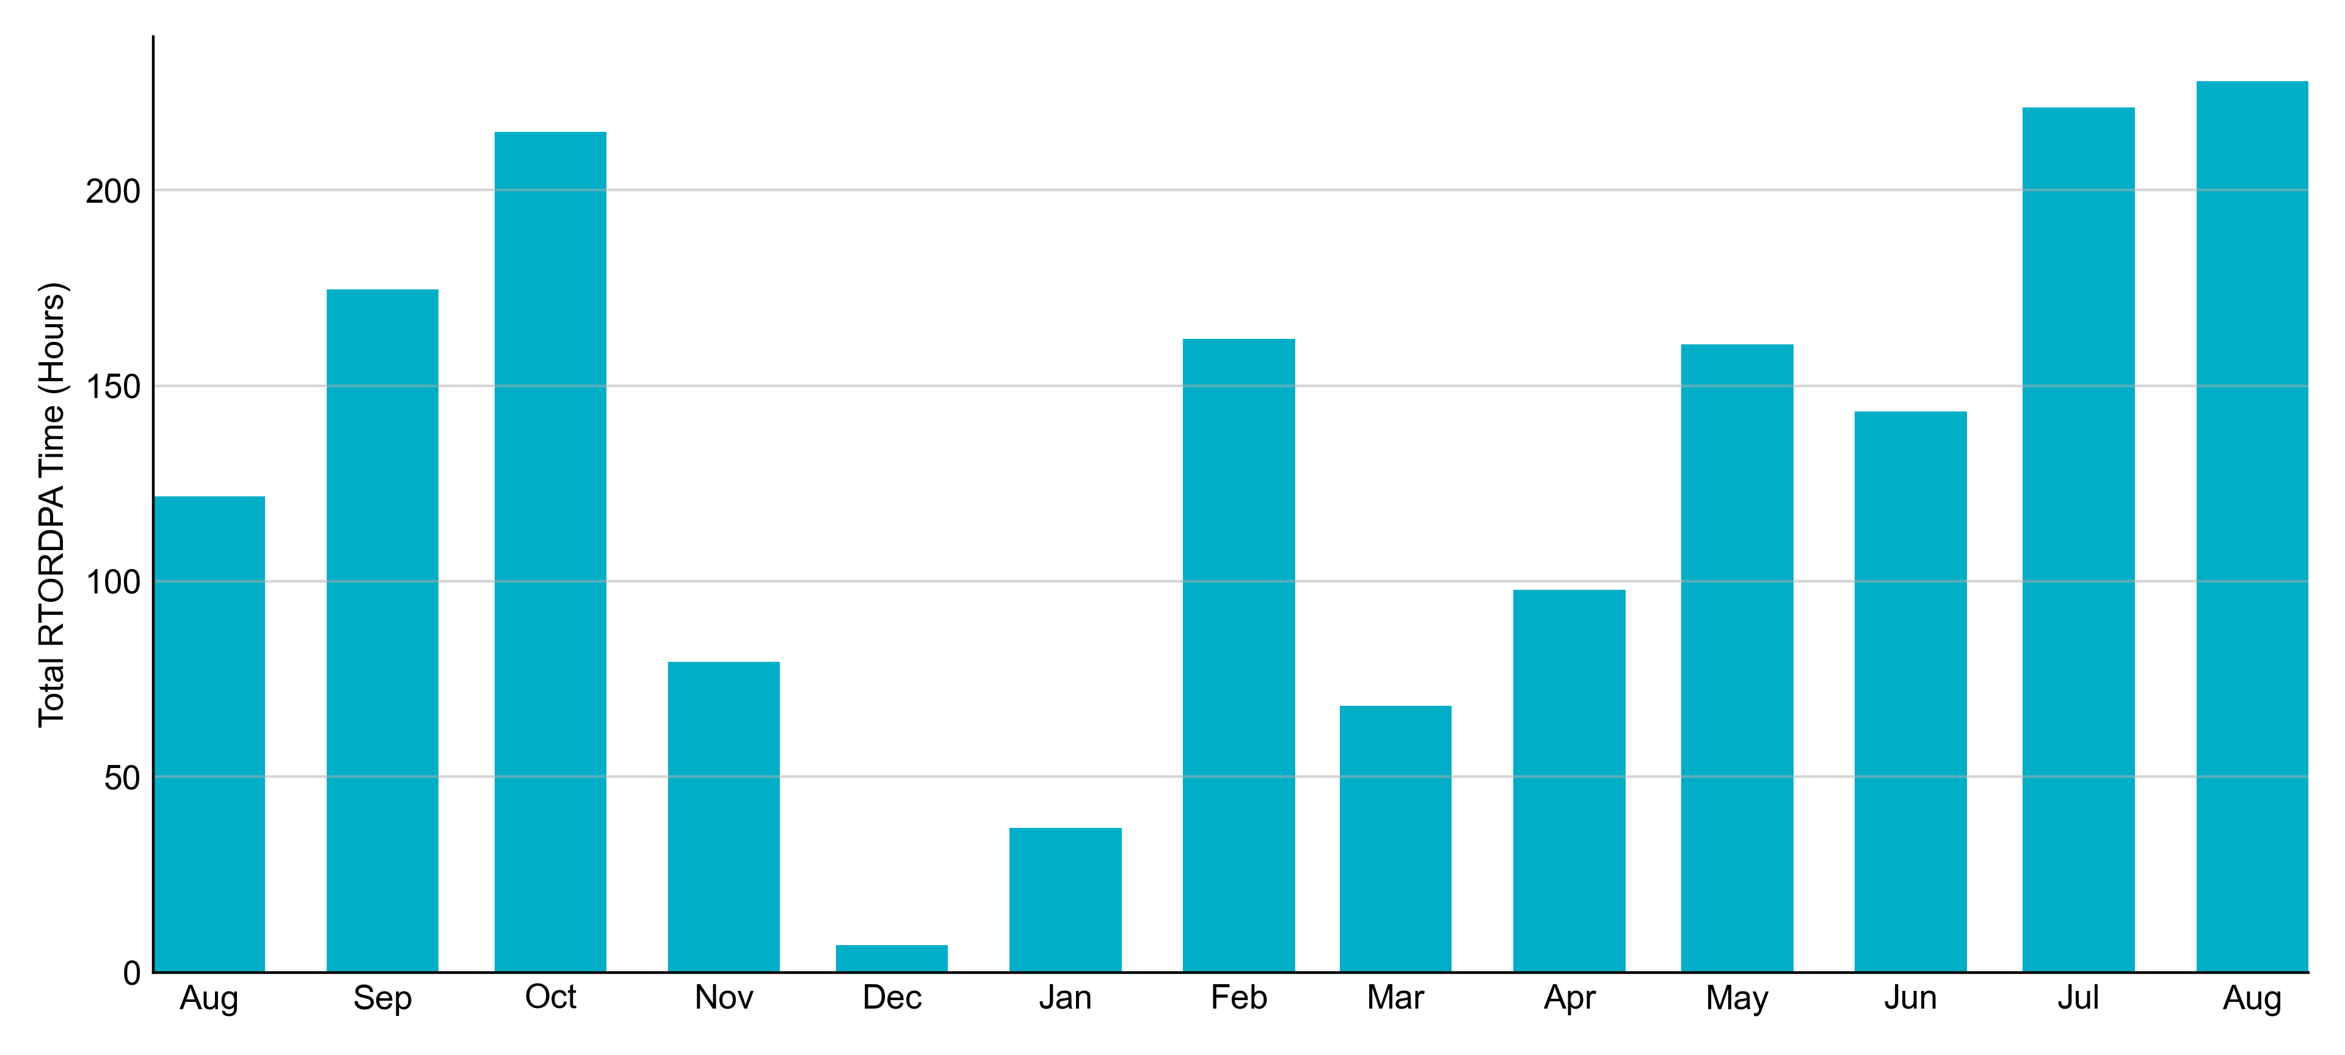
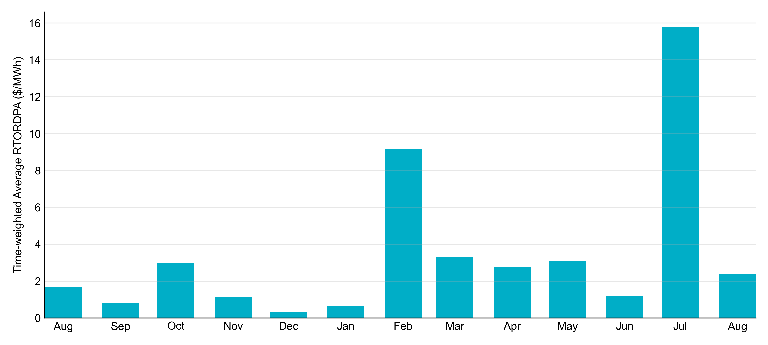
Reliability Deployment Price Adder: Last 13 Months August 2022 had a total of 227.84 RTORDPA hours with an average value of $2.39/MWh.

Slide 12
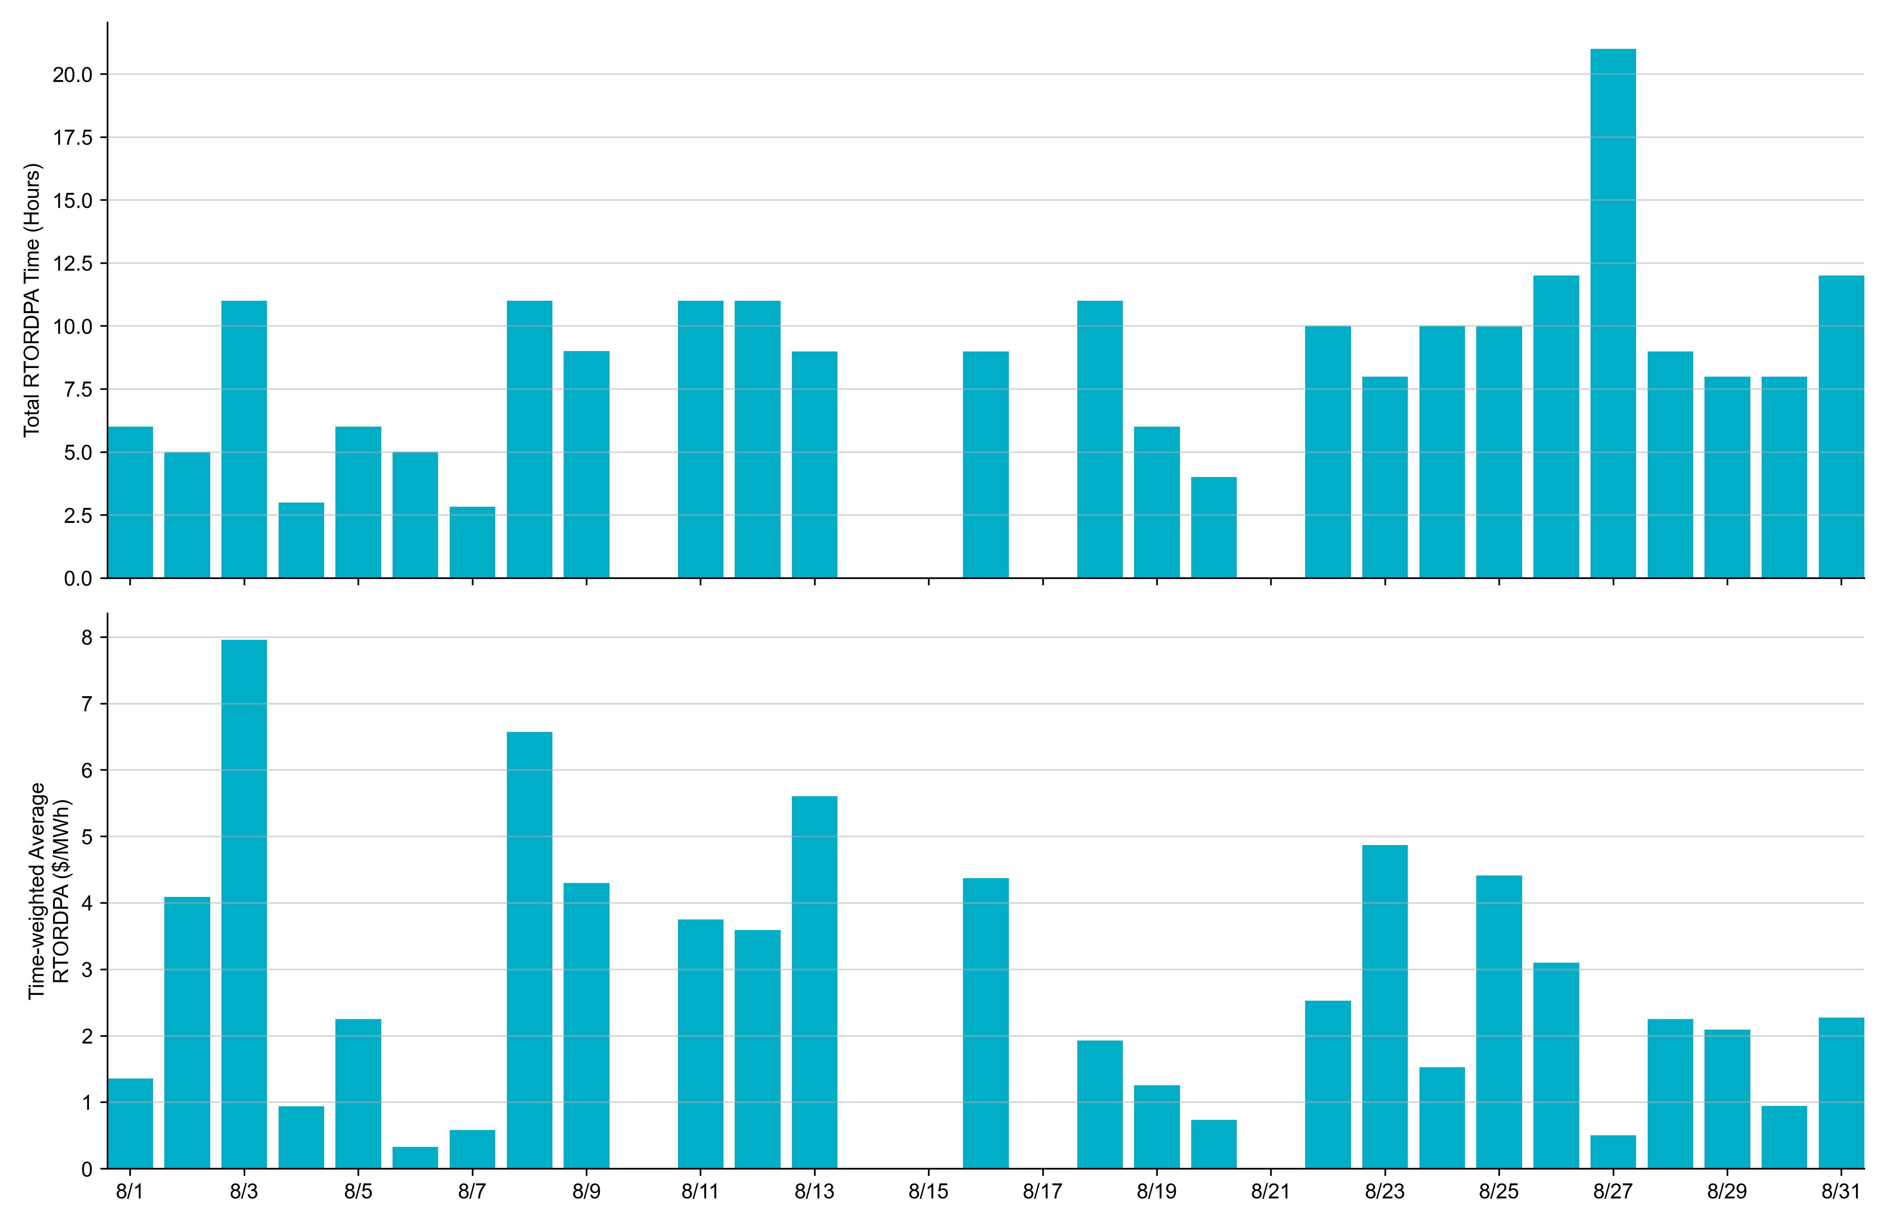
Reliability Deployment Price Adder: August 2022 OD 8/3 had the highest daily time-weighted average RTORDPA: $7.96/MWh.

Slide 13
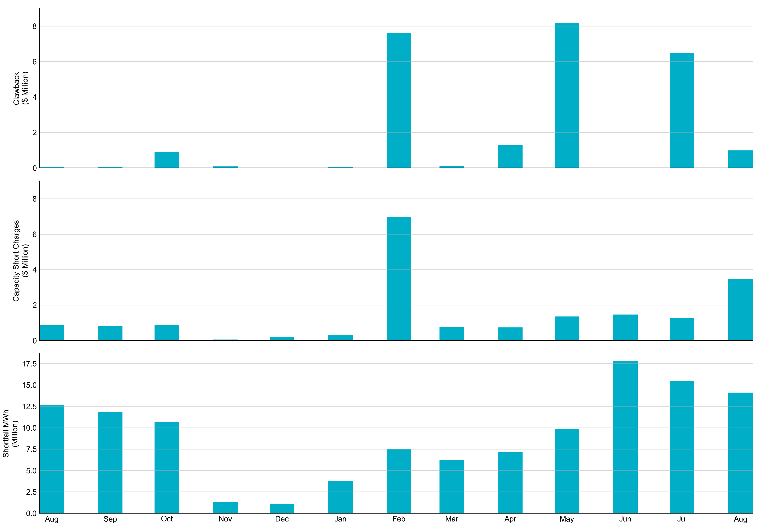
RUC Clawback, Capacity Short Charges, and Shortfall For August 2022, the total Clawback charge was $0.986M. The total Make-Whole payment was $3.464M, which was almost entirely covered through capacity-short charges.
In August 2022, $3.464M in Make-Whole was paid out. Only $2.68 was uplifted to load due to rounding.

