Slide 1
System-wide vs Local RDPA Comparison
Pricing Run Ramp Rate Relaxation
Thomas Urquhart
Engineer, Market Analysis & Validation
ERCOT
Congestion Management Working Group (CMWG)
September 19, 2022

Slide 2
Recap

Slide 3
Background
This analysis provides supplemental info for the discussion of RDPA on 7/18/2022.
Five Operating Days with RUCs were previously analyzed:
9/21/2021 – high wind, high curtailment that quickly turned into moderate wind, low curtailment around settlement interval 75
2/24/2022 – stressed grid conditions; low wind, very low curtailment, high RDPA
3/29/2022 – high wind, high curtailment
4/22/2022 – discussed on 6/13/2022; high wind, high curtailment
5/13/2022 – low wind, low curtailment

Slide 4
Background
For each OD, we compared:
BP and LMP deltas between the pricing and dispatch runs during the SCED interval with the highest total calculated *indifference payment
Current RTRDASIAMT (reliability component of AS imbalance payment) to calculated indifference payments
Indifference payments by fuel type
*Calculation as proposed by Shams Siddiqi here
Indifference payment = ΔLMP * ΔBP; only consider positive values
We do not consider the change to energy payments
Only RUCs can be modeled locationally. All other reliability actions are system-wide.
Notes:
Reliability actions such as ERS and load shed

Slide 5
There are competing factors that influence LMPs
LMP is lower in Pricing Run
Ramp rate relaxed to 60 minutes
LMP is higher in Pricing Run
Removal of RUCed MW
Notes:
LSL, LASL, and LDL to zero for ONRUC resources

Slide 6
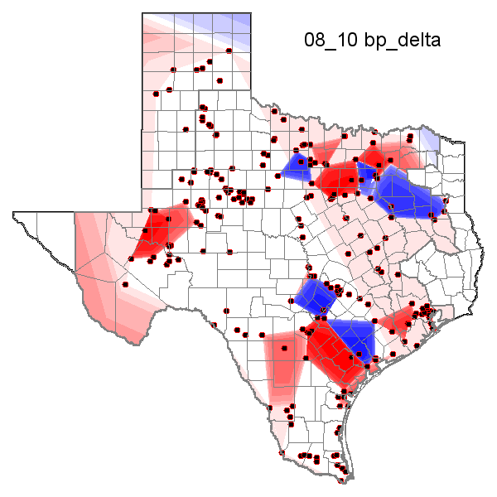
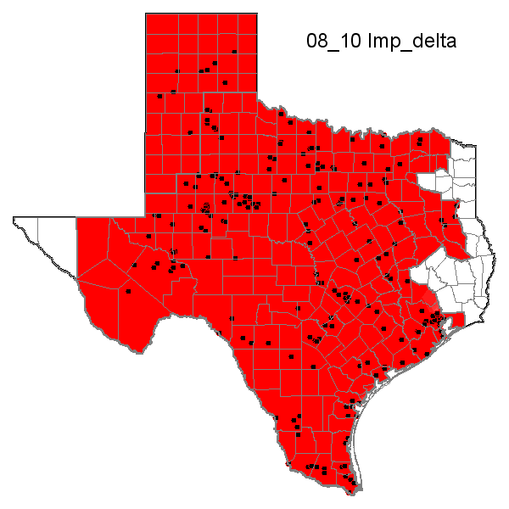
2/24/2022 08:10, RDPA = $1,391.63/MWh
Red, positive values represent pricing run value > dispatch run value
stressed grid conditions; low wind, very low curtailment, high RDPA

Slide 7
stressed grid conditions; low wind, very low curtailment, high RDPA

Slide 8
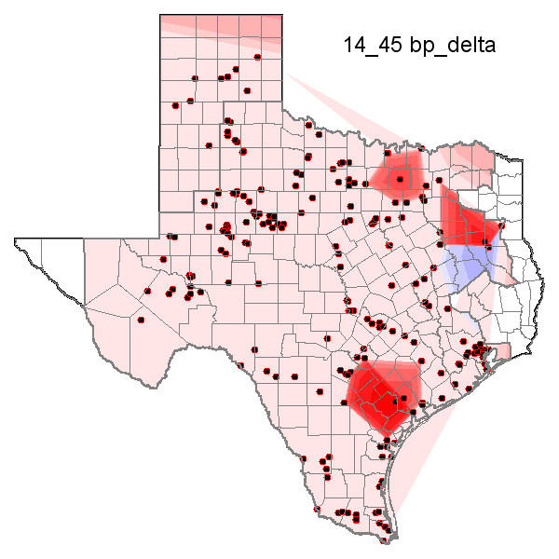
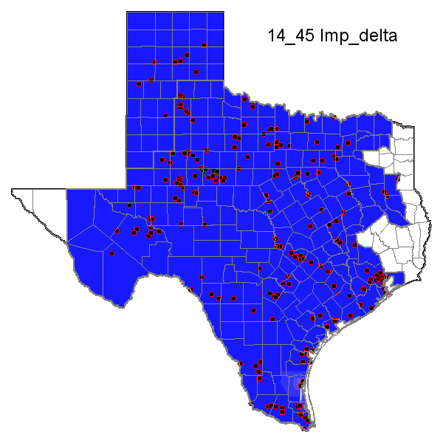
5/13/2022 14:45, RDPA = $0.00/MWh
Red, positive values represent pricing run value > dispatch run value
low wind, low curtailment

Slide 9
low wind, low curtailment

Slide 10
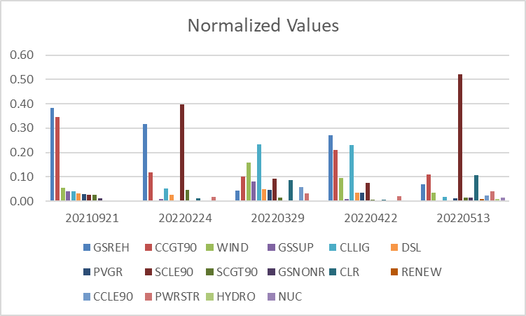
Calculated Indifference Payments by Fuel Type

Slide 11
Updated work

Slide 12
Overview
Market Participants were interested in how the local RDPA would change if the Pricing Run Ramp Rate Relaxation parameter was changed.
Reran all SCED intervals for the previously analyzed days using the following ramp rate minutes:
5
10
20
30
60
Calculated new *indifference payments for each relaxation time.
*Calculation as proposed by Shams Siddiqi here
Indifference payment = ΔLMP * ΔBP; only consider positive values
We do not consider the change to energy payments

Slide 13
There are competing factors that influence ramp rate relaxation’s affect on indifference payments
RDPA is lower with 5 minute ramp rate relaxation
A shorter ramp caps changes in base points
RDPA is higher with 5 minute ramp rate relaxation
A shorter ramp may drive prices higher
ΔBP
ΔLMP

Slide 14
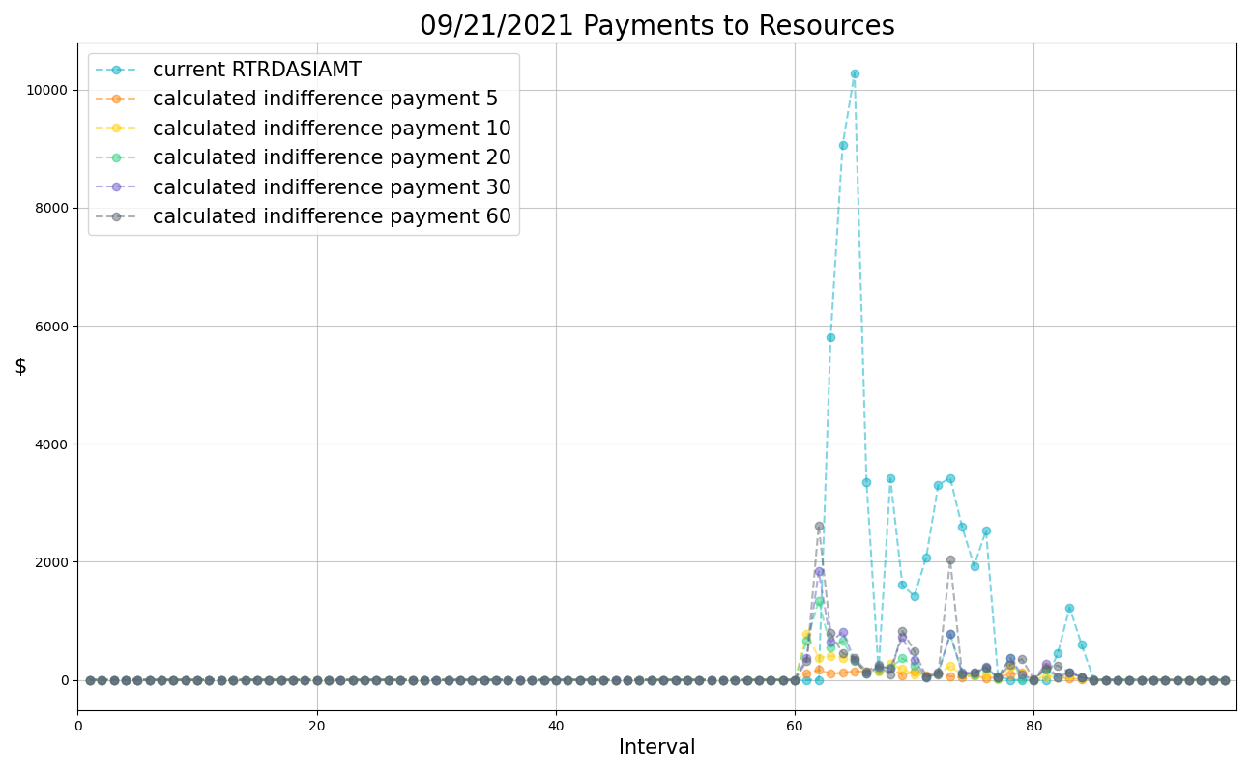
high wind, high curtailment through settlement interval 75
Notes:
Longer times are highest

Slide 15
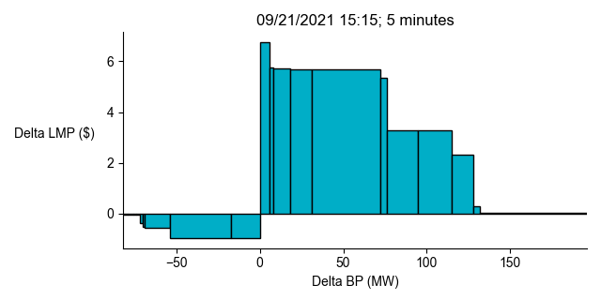
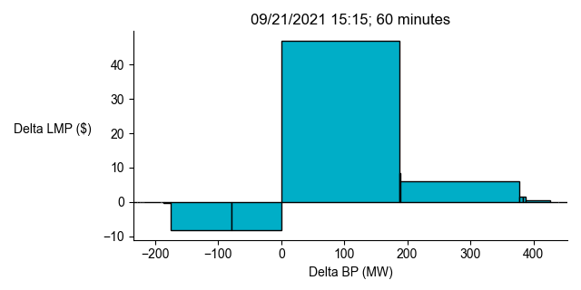
A shorter ramp caps changes in Base Points
Note: axes have different limits
Notes:
Area of each box is the indifference payment for one resource
Width is the delta_BP; height is the delta_LMP between the pricing run and the dispatch run
Position on x-axis is only showing the sorted delta_LMPs

Slide 16
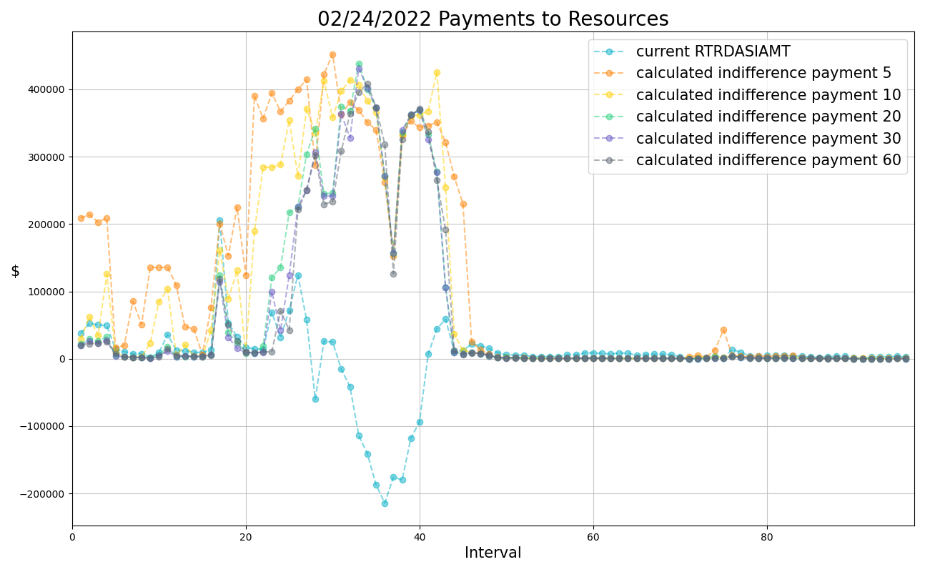
stressed grid conditions; low wind, very low curtailment, high RDPA
Notes:
Shorter times are typically highest

Slide 17
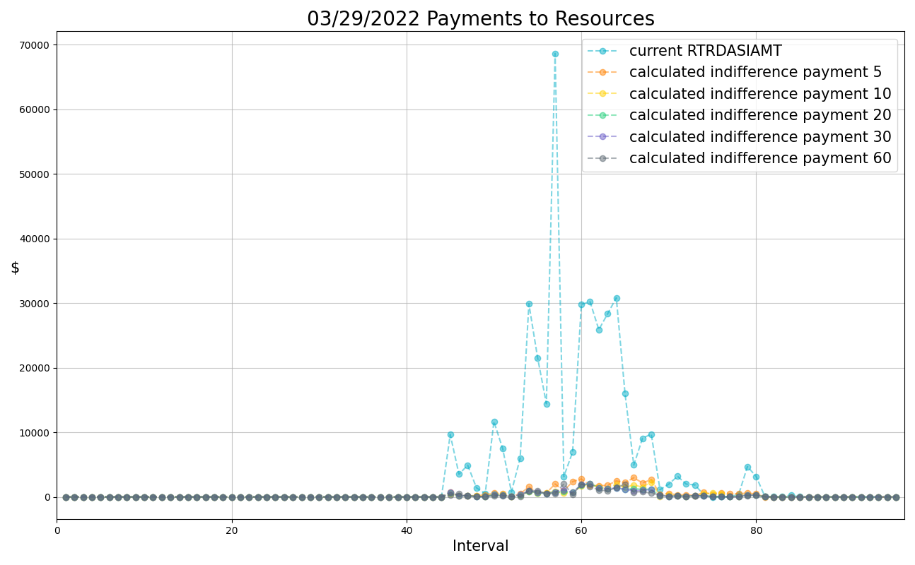
high wind, high curtailment
Notes:
Shorter times are highest

Slide 18
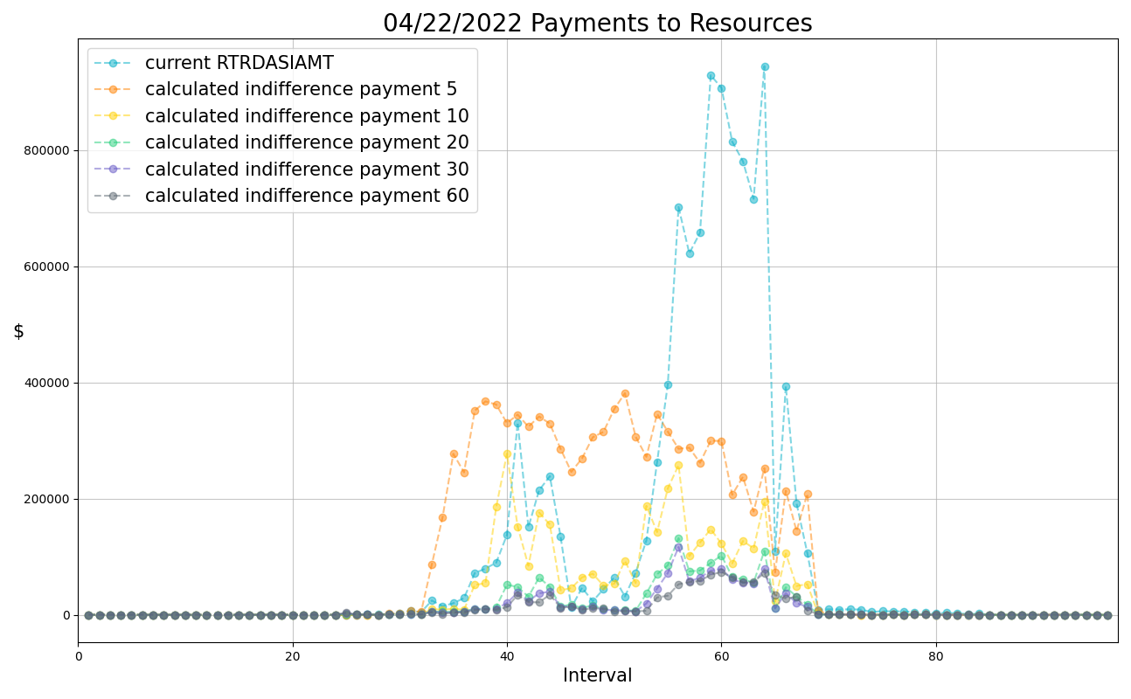
high wind, high curtailment
Notes:
Shorter times are highest; decreasing the prrr pushes indifference payment above imbalance payment for much of the day

Slide 19
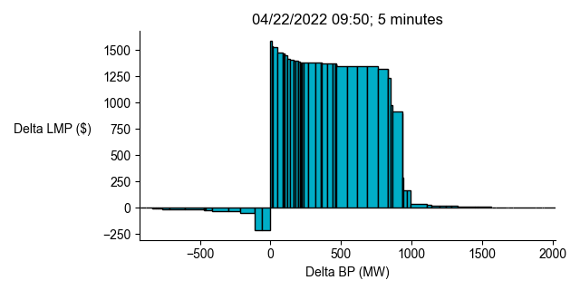
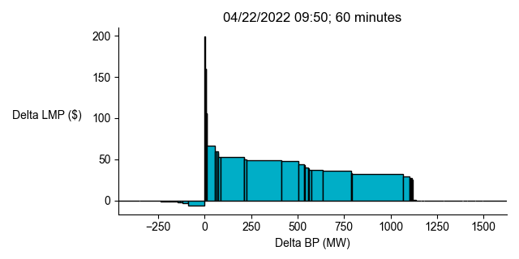
A shorter ramp may drive prices higher
Note: axes have different limits
Notes:
Ramp limited – prrr was raised to 60 minutes to mitigate this

Slide 20
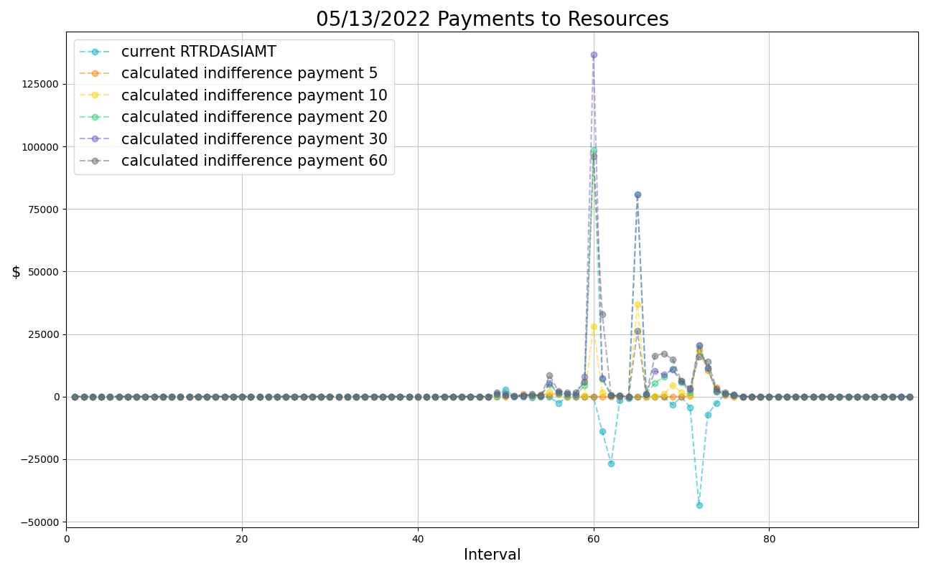
low wind, low curtailment
Notes:
Longer times are typically highest

Slide 21
Observations
The calculated indifference payment can either increase or decrease when the Pricing Run Ramp Rate Relaxation Parameter is changed. There is no clear trend.
When reducing the relaxation to 5 minutes decreases the indifference payment, there are typically large changes in Base Point that take more than 5 minutes to reach.
When reducing the relaxation to 5 minutes increases the indifference payment, there are typically large changes in Locational Marginal Price that become less dramatic with a 60-minute ramp.

