Slide 1
ERCOT Frequency Control Report
August 2022
ERCOT
Operations Planning
PDCWG | Sep 14th, 2022

Slide 2
Summary of August 2022
CPS1: 170.85%
Current CPS1 12-Month Rolling Average: 172.21%
1 BAAL Exceedance(s)
0 hourly CPS1 score below 100%
BAAL-003 Events have updated through 2020
2020 BAAL-003 FRM Performance: -789.34
2022 RMS1 Statistics
  Mean: 15.66 mHz
  Min: 12.43 mHz
  Max: 19.70 mHz
Energy Statistics
  Total Energy: 43,067,150 MWh
  Wind Energy: 6,279,388 MWh
  Percent Energy from Wind: 14.58 %
  Solar Energy: 2,374,549 MWh
  Percent Energy from Solar: 5.51%
Minimum System Inertia
  Mean: 295,241 MW*s
  Max: 333,523 MW*s on Aug 11th
  Min: 246,162 MW*s on Aug 28th
Notes:
Mean: 295,241 MW*s
Max: 333,523 MW*s on Aug 10th
Min: 246,162 MW*s on Aug 28th

Slide 3
Frequency Control
CPS1, BAAL, & RMS1

Slide 4
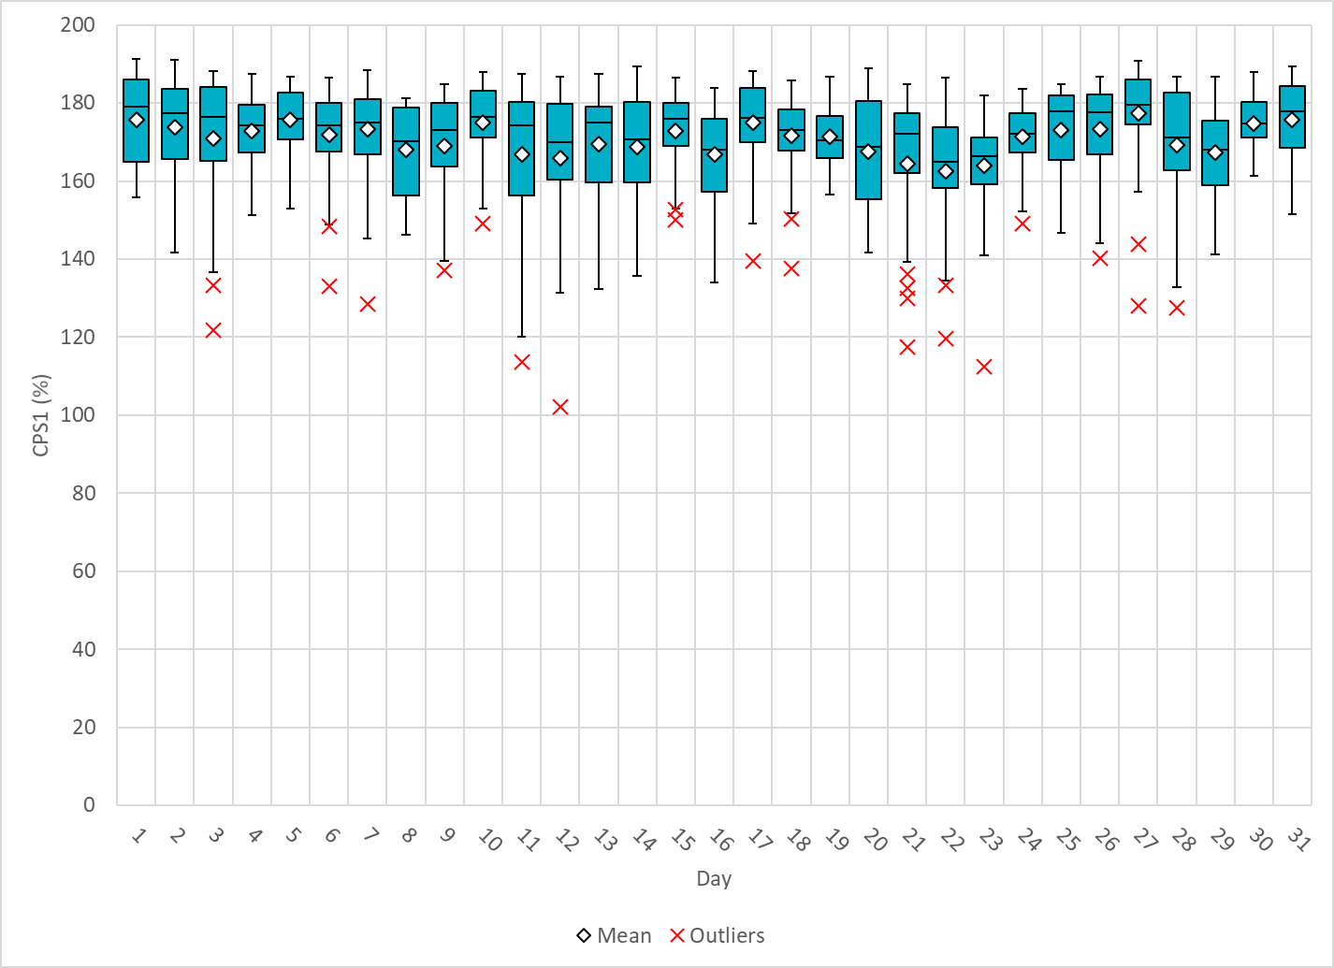
Hourly CPS1 by Day
Aug-22 CPS1 (%): 170.85

Slide 5
BAAL Exceedances & Violations
There is 1 BAAL exceedance(s) in August.
Notes:
Occurred on 8/21/2022 due to a gen loss event (8/21/2022 19:27:02)

Slide 6
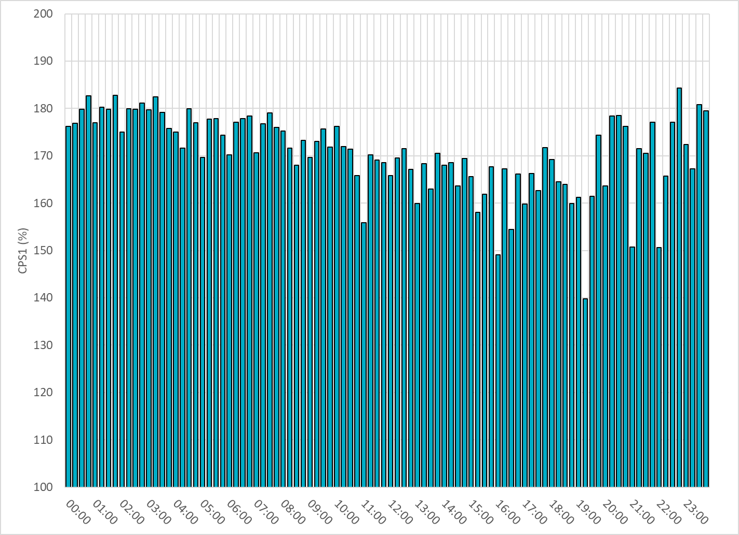
15-Minute Average CPS1%
Aug-22 CPS1 (%): 170.85

Slide 7
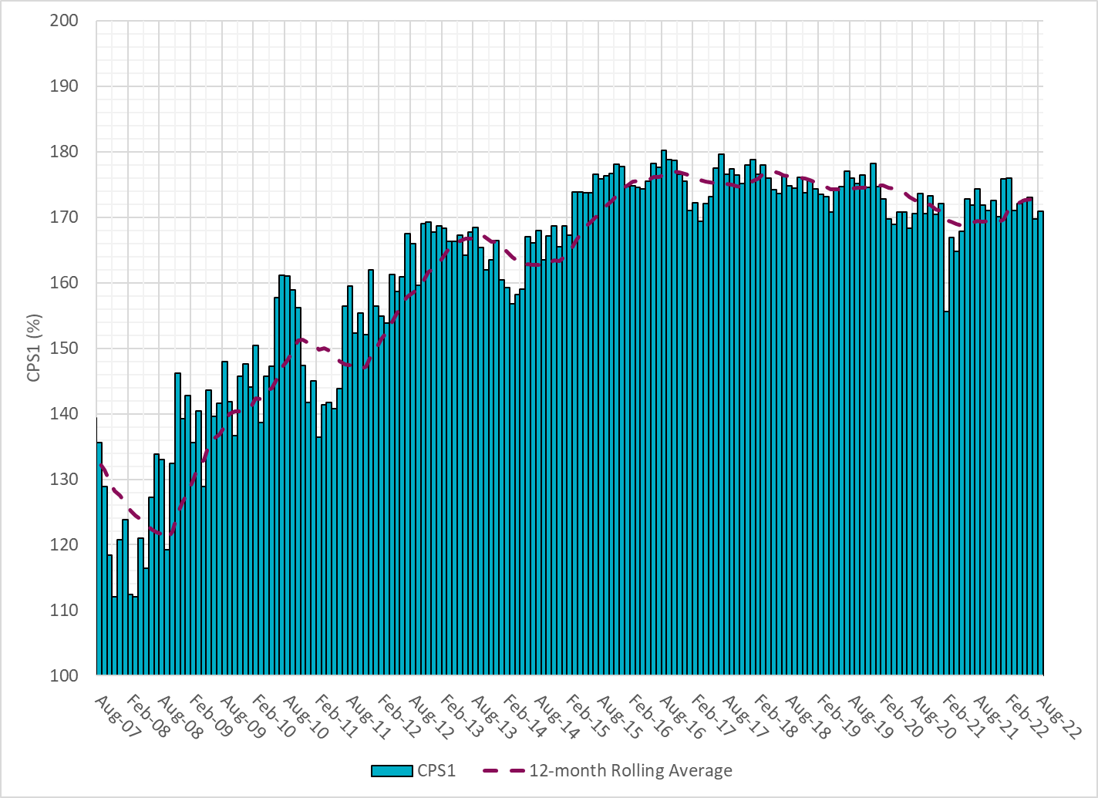
12-Month Rolling Average CPS1
Current 12-Month Rolling Average: 172.21%
Notes:
12 month rolling average CPS1 score is 172.21, which is good and CPS1 score for Aug is slightly higher than the last month.

Slide 8
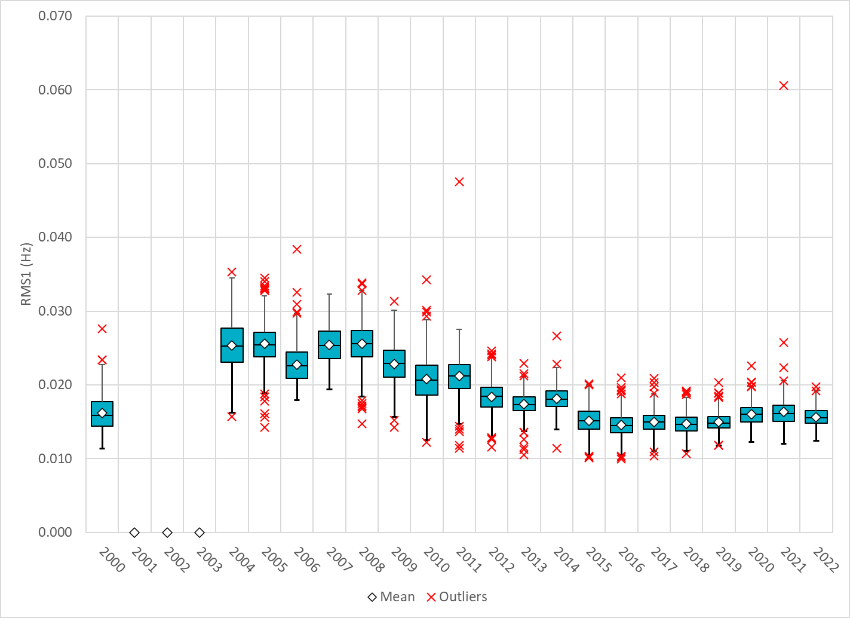
Daily RMS1 of ERCOT Frequency by Year
Notes:
Daily RMS1 frequency by year is so far slightly smaller overall compared with the 2021.
Mean: 15.66 mHz
Min: 12.43 mHz
Max: 19.7 mHz

Slide 9
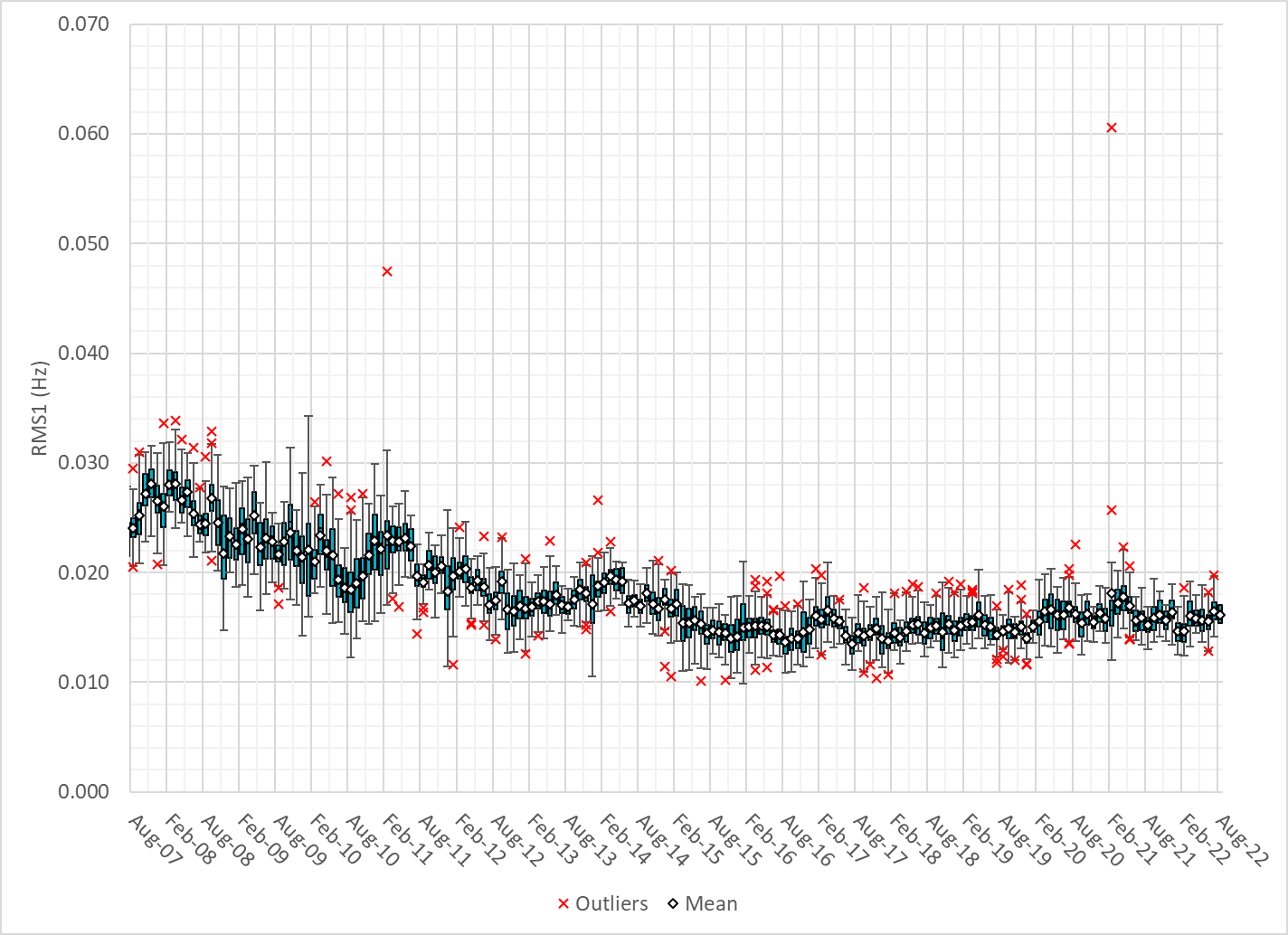
Daily RMS1 of ERCOT Frequency by Month
Notes:
A More granular look at last 15 years of RMS1 by month
16.17Mhz on avg for August 2022

Slide 10
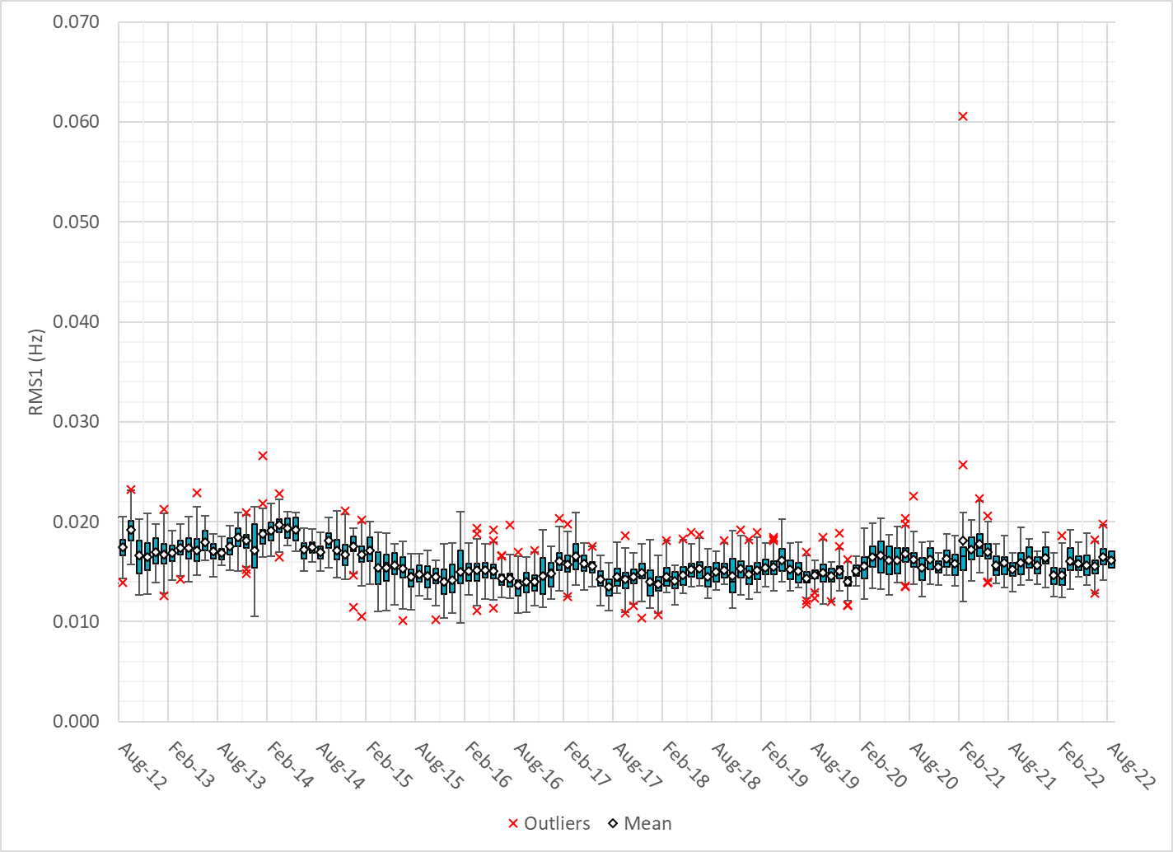
Daily RMS1 of ERCOT Frequency by Month

Slide 11
Frequency Profile Comparison

Slide 12
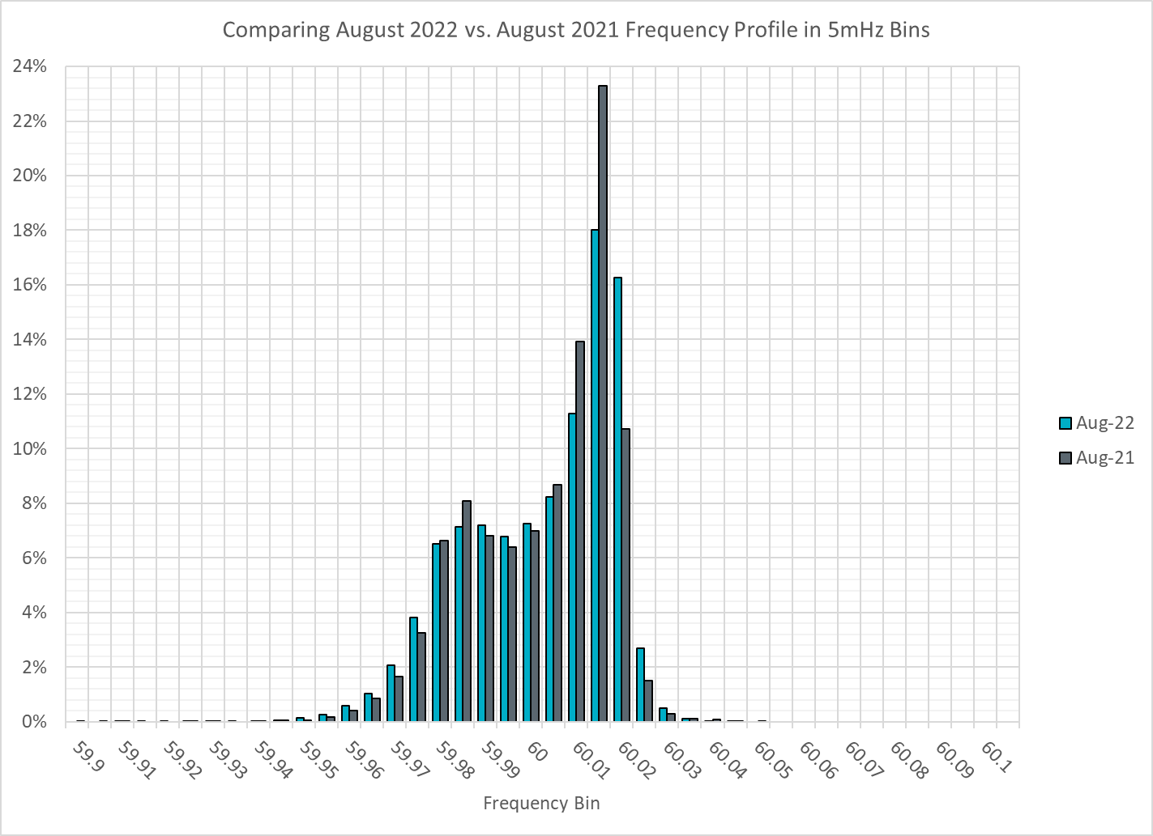
Frequency Profile Comparison

Slide 13
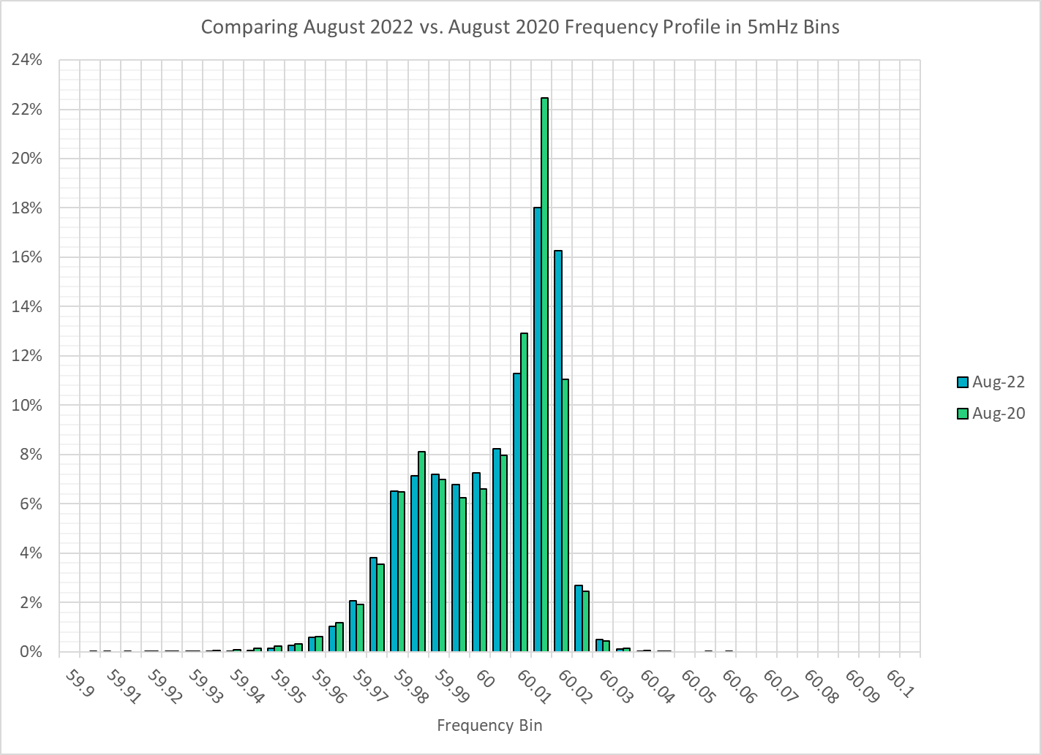
Frequency Profile Comparison

Slide 14
Time Error Correction

Slide 15
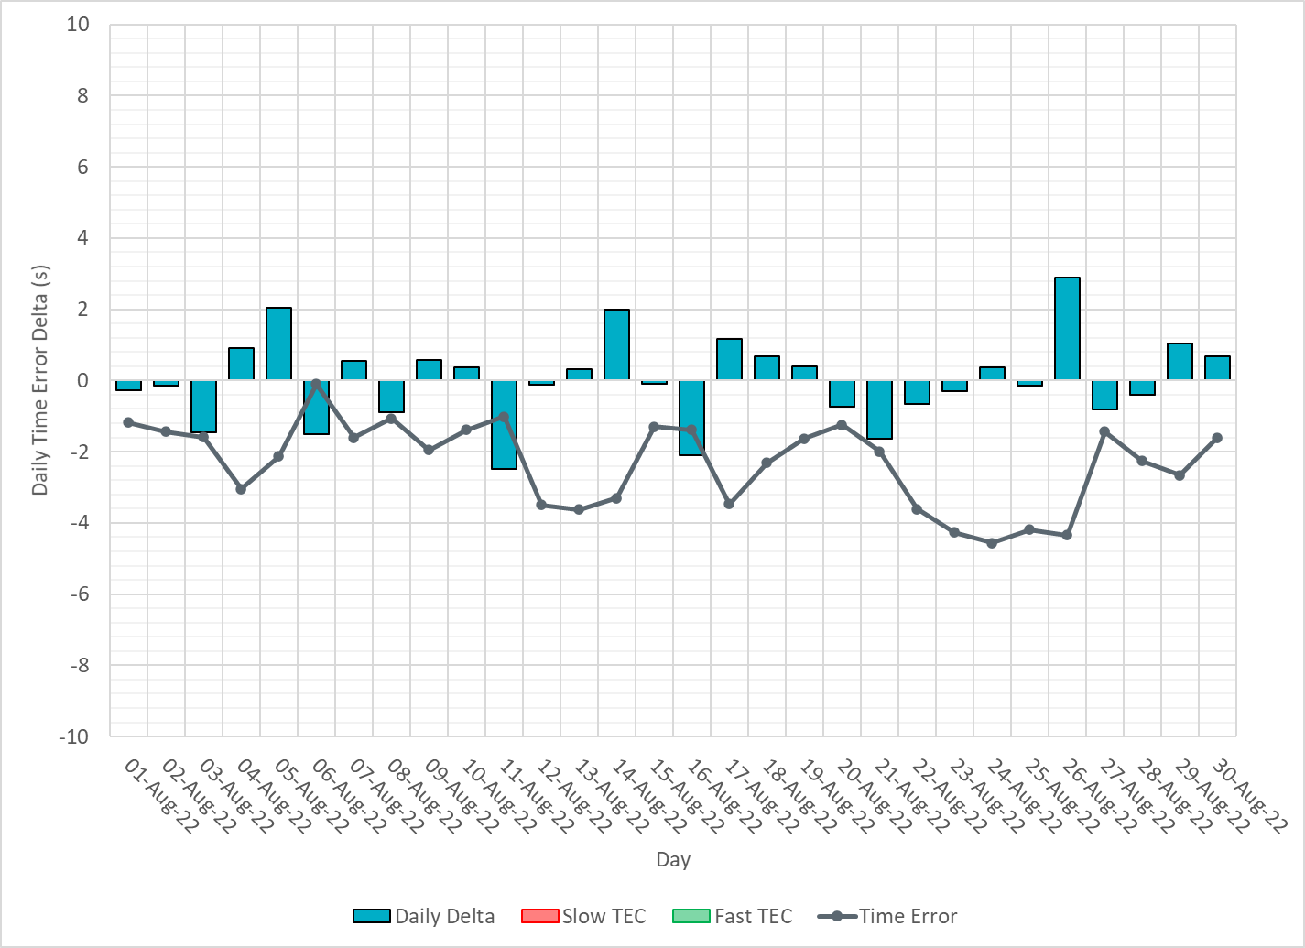
ERCOT Daily Time Error

Slide 16
Time Error Corrections Log Summary
There have been no time error corrections since December 2016

Slide 17
BAL-003 Performance

Slide 18
Op. Year 2020 BAL-003 Selected Events – Update
Notes:
BAL-003

Slide 19
Op. Year 2020 BAL-003 FRM Performance - Update
Notes:
OP2018: FRO = -381.0, FRM_median = -843.17, FRM_average = -959.7
OP2019: FRO = -381.0, FRM_median = -811.14, FRM_average = -892.5
OP2020: FRO = -425.0, FRM median = -789.34, FRM average = -879.0
OP2021: FRO =

Slide 20
ERCOT Energy Statistics

Slide 21
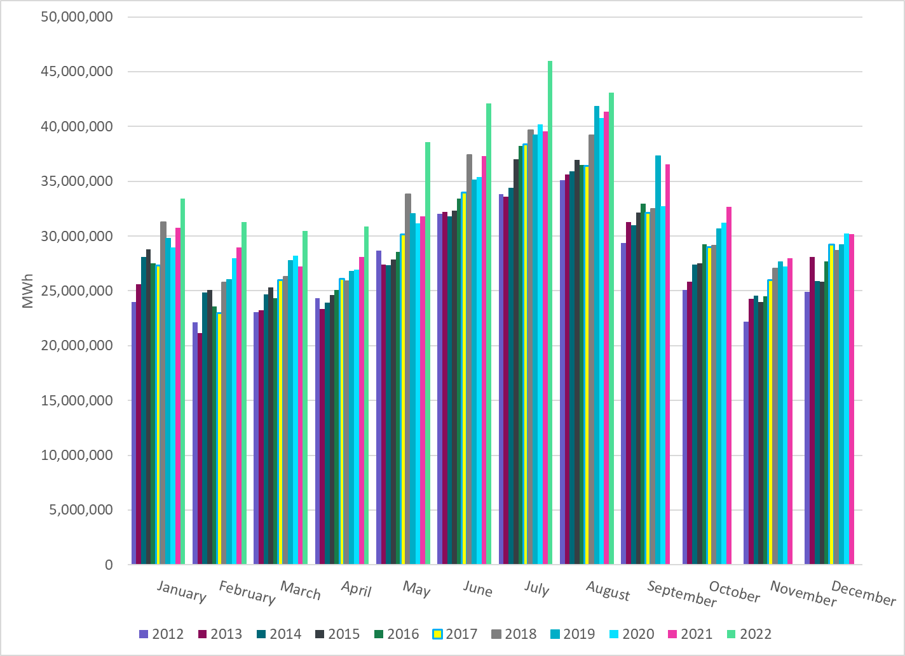
Total Energy
Notes:
43,067,150 MWh

Slide 22
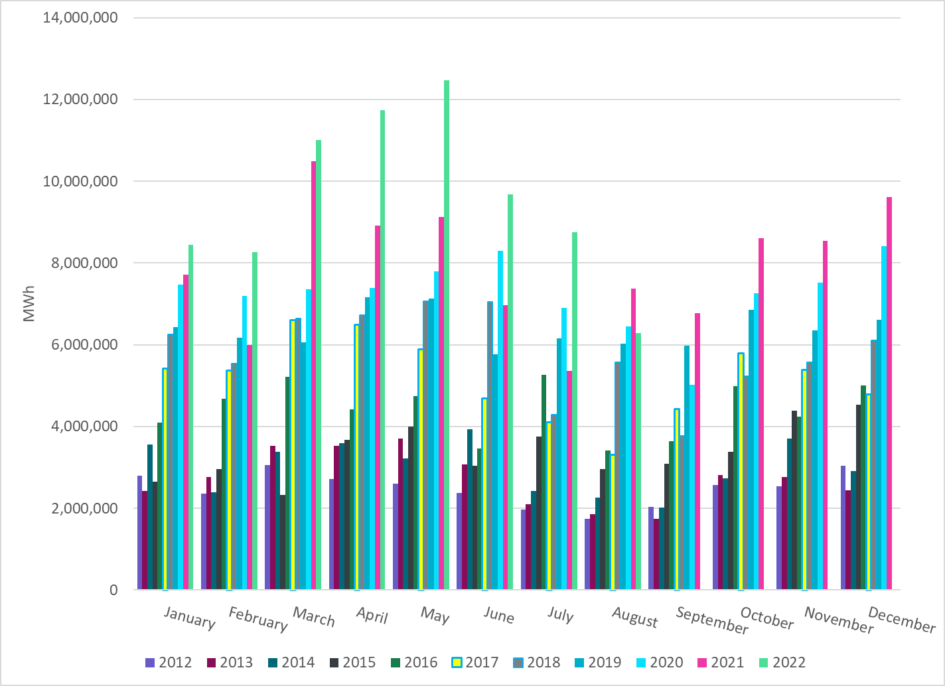
Total Energy from Wind Generation
Notes:
6,279,388 MWh

Slide 23
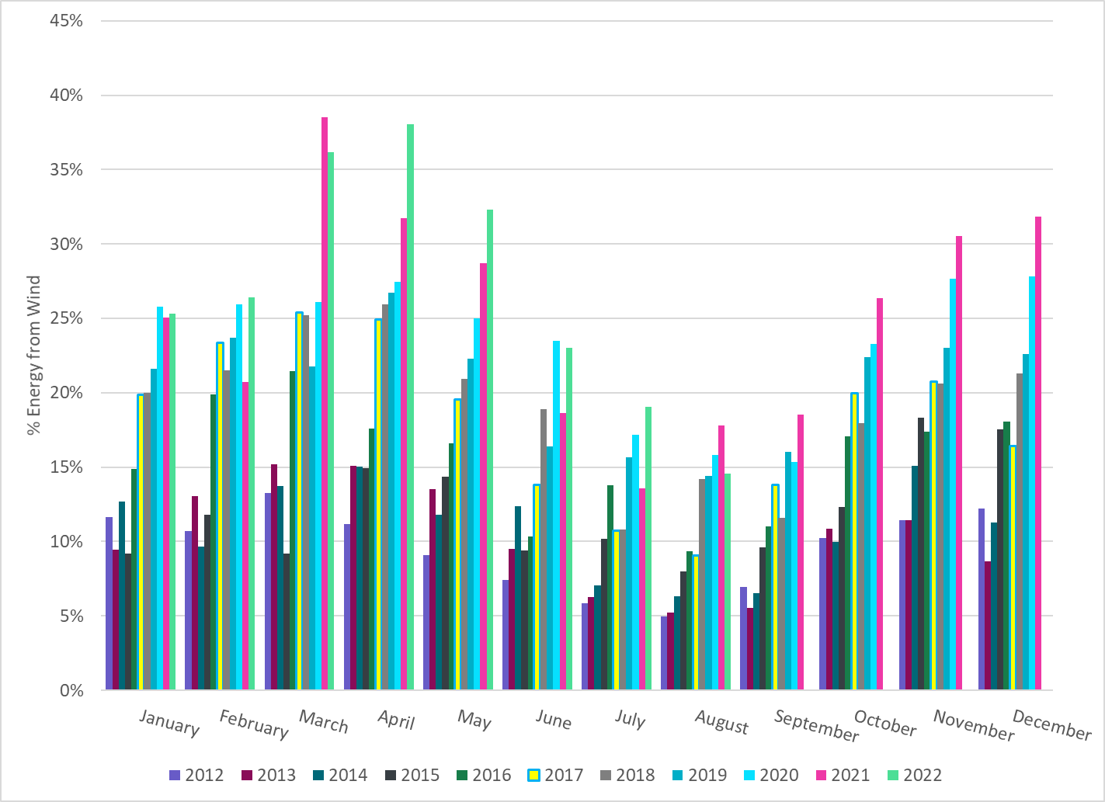
% Energy from Wind Generation
Notes:
14.58%
of total energy was provided by wind generation

Slide 24
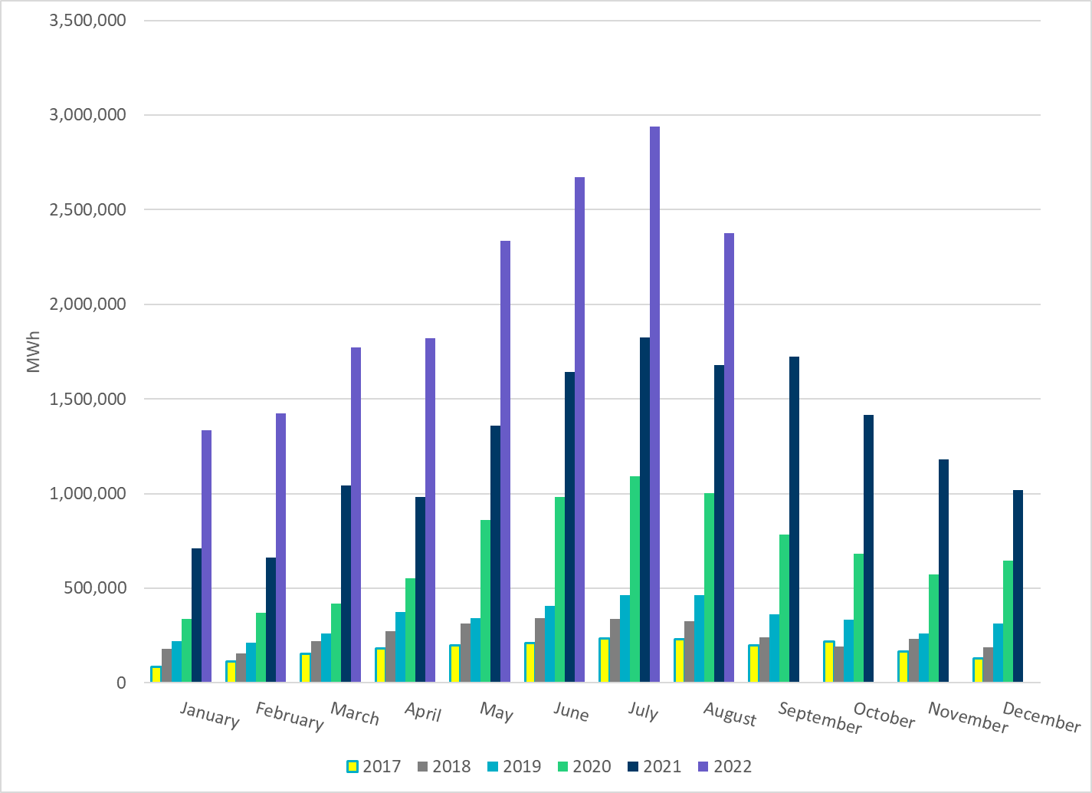
Total Energy From Solar Generation
Notes:
2,374,549 MWh

Slide 25
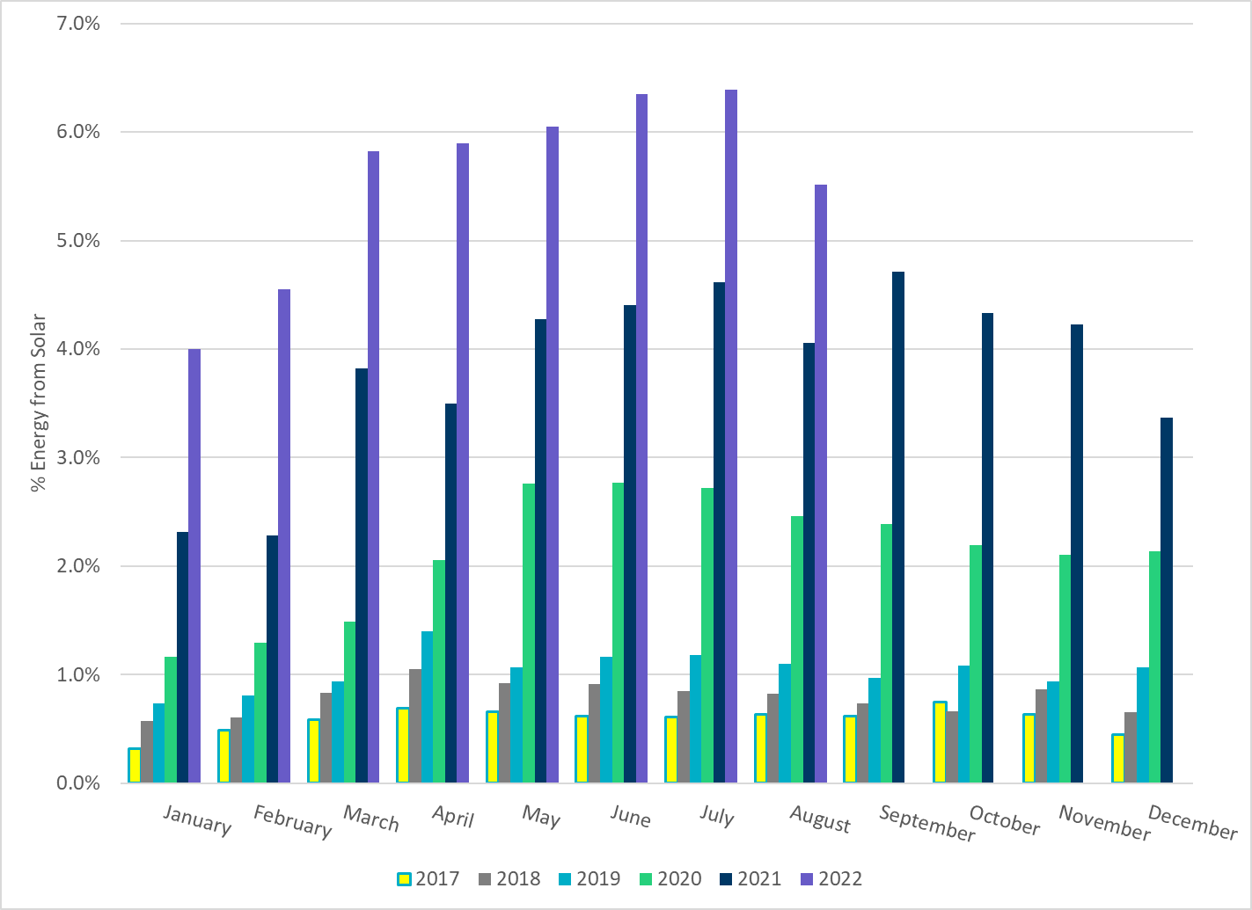
% Energy from Solar Generation
Notes:
5.51% of total energy was provided by solar generation

Slide 26
ERCOT System Inertia

Slide 27
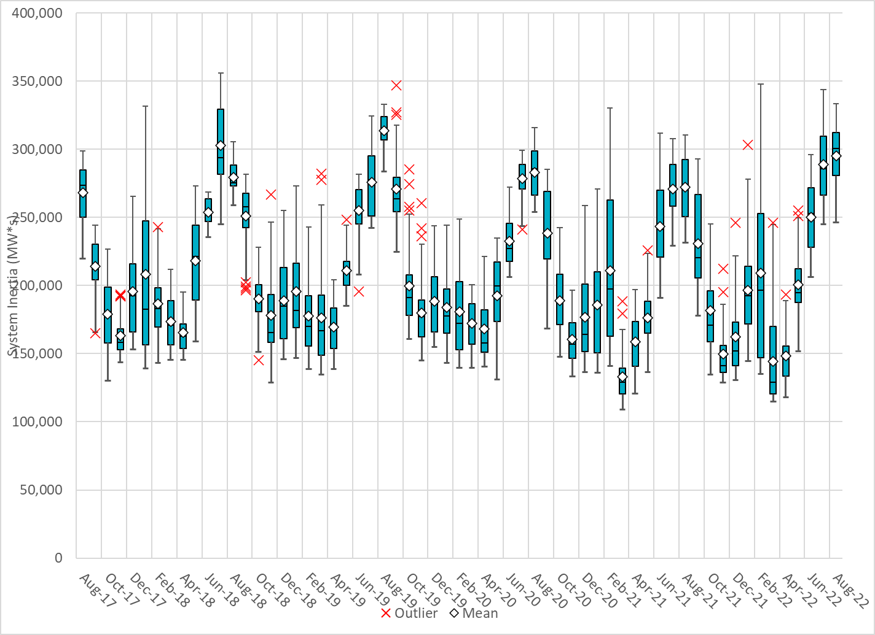
Daily Minimum System Inertia
Notes:
Minimum Inertia =246,162 MW*s on 08/28/2022
Previous Minimum was 109,029 MW*s on 3/22/2021
Data:
Mean: 295,241 MW*s
Max: 333,523 MW*s on Aug 10th
Min: 246,162 MW*s on Aug 28th

Slide 28
Questions?
Thank you!

