Slide 1
ERCOT Frequency Events
August 2022
ERCOT
Operations Planning
PDCWG | September 14th, 2022

Slide 2
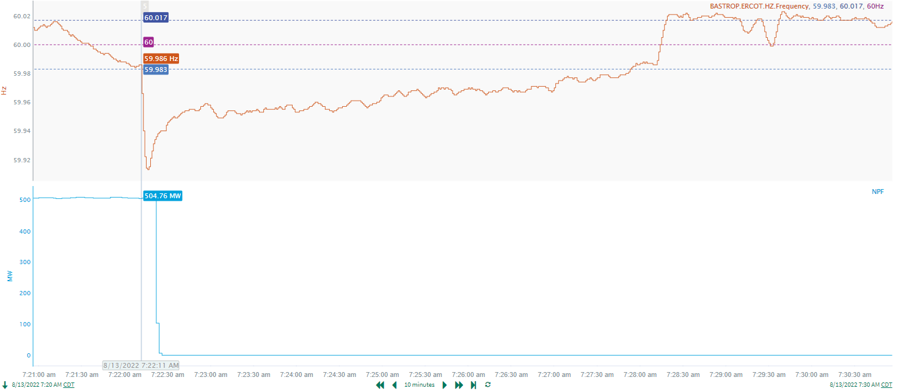
8/13/22 7:22:11(Non-FME)
Notes:
The combined cycle tripped offline while carrying approximately 505 MW
Starting Frequency: 59.986 Hz
Minimum Frequency: 59.914 Hz
A-C Time : 4 seconds
Recovery Time(back to deadband): 5 minutes 42 seconds
RRS Released: 0 MW
Trip Reason: Unknown at this time
Contextual Information: A total of 242 MW of regulation up was deployed during the event.
No Selection Reason : The delta frequency is too small (33 mHz) and MW loss is also smaller than what we typically look for

Slide 3
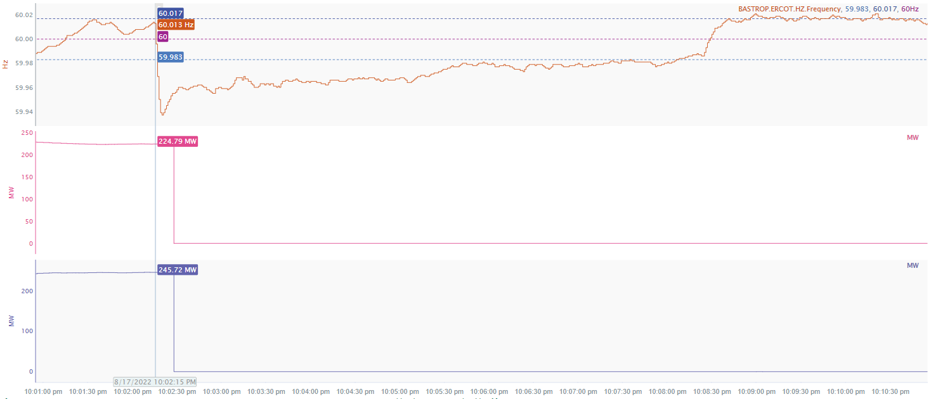
8/17/22 22:02:15(Non-FME)
Notes:
The units tripped offline while carrying approximately 471 MW
Starting Frequency: 60.013 Hz
Minimum Frequency: 59.937 Hz
A-C Time : 5 seconds
Recovery Time(back to deadband): 5 minutes 20 seconds
RRS Released: 0 MW
Trip Reason: Auxiliary breaker trip
Contextual Information: A total of 57 MW of regulation Up was deployed during the event.
No Selection Reason: The MW loss is smaller than what we typically look for (small event)

Slide 4
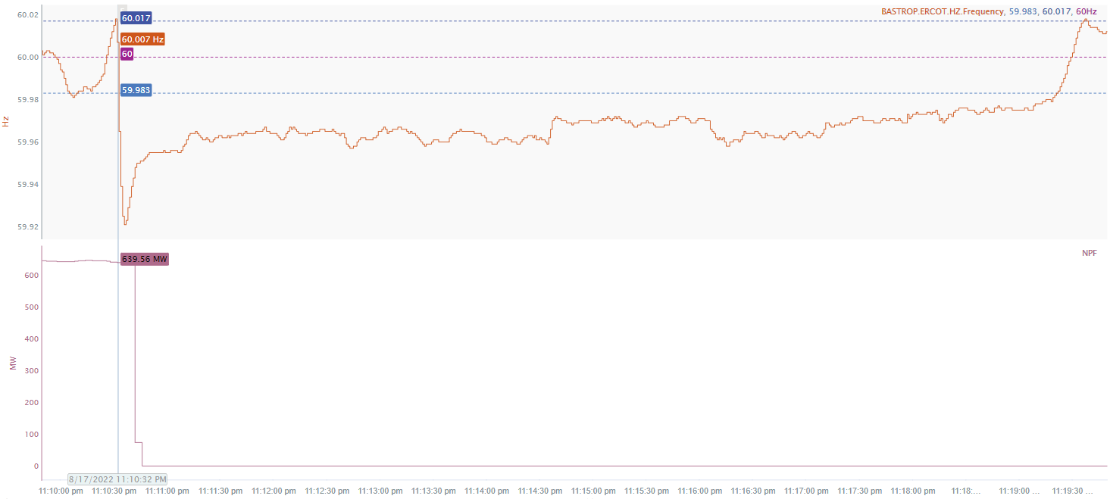
8/17/22 23:10:32(Non-FME)
Notes:
The unit tripped offline while carrying approximately 640 MW
Starting Frequency: 60.013 Hz
Minimum Frequency: 59.921 Hz
A-C Time : 4 seconds
Recovery Time(back to deadband): 8 minutes 49 seconds
RRS Released: 0 MW
Trip Reason: lightning strike
Contextual Information: A total of 48 MW of regulation Up was deployed and manual offset of 150 MW was applied during the event
No Selection Reason: The delta frequency is too small (33 mHz)

Slide 5
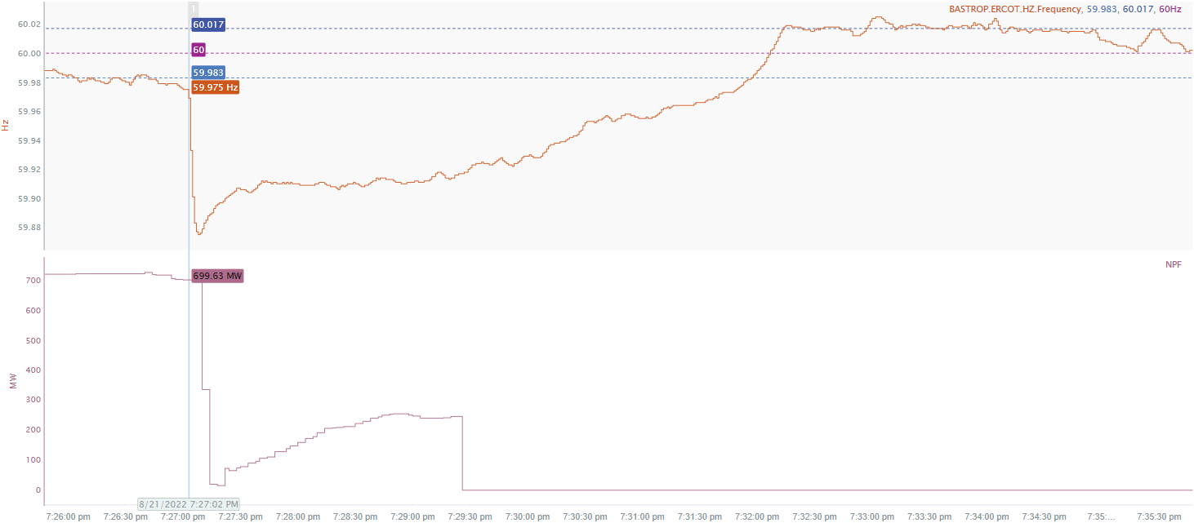
8/21/22 19:27:02(Non-FME)
Notes:
The unit tripped offline while carrying approximately 700 MW
Starting Frequency: 59.975 Hz
Minimum Frequency: 59.875 Hz
A-C Time : 6 seconds
Recovery Time(back to deadband): 4 minutes 49 seconds
RRS Released: 763 MW
Trip Reason: lightning strike
Contextual Information: A total of 225 MW of regulation Up was deployed and manual offset of 400 MW was applied during the event
No Selection Reason: The starting frequency is outside the low deadband.

Slide 6
Questions?
Thank you!

