Slide 1
IBRTF - NPRR 1138 – Reactive Oscillations
ERCOT
Stephen Solis – Principal, System Operations Improvement
September 13, 2022

Slide 2
Why NPRR 1138
ERCOT has observed the following:
Most IRRs remain synchronized to the ERCOT system when they are not generating real power ( 0 MW output). Most still affect voltage by their MVAR injection/absorption.
Most IRRs telemeter a Real time Telemetered Status of ON and an AVR status of ON when they are not generating real power.
Most IRRs are not leaving their AVR in voltage control mode and controlling voltage when they are not generating real power.
Most IRRs show to have significant reactive capability present at 0 MW output.
Some IRRs have an inability to have stable reactive control at very low MW outputs (e.g. 0-1 MW) resulting in large MVar and voltage swings on the system while having a 0 MW LSL.
IRRs with equipment limitations with voltage control at very low MW output can work with OEM to make adjustments to set its LSL to true equipment limitation.
Some IRRs will leave shunts in last state or utilize shunts to aid in voltage support during 0 MW output.

Slide 3
Why NPRR 1138
NPRR 1138 will provide accuracy and consistency in the following:
Representing accurate reactive capability of units that stay synchronized to the ERCOT system when they are not generating real power ( 0 MW output).
Improves accuracy of studies ability to identify post contingency voltage issues
Improves Operator situational awareness by having consistent application of status and reactive capability curves
Minimizes reactive power and voltage oscillations on the system caused by current equipment limitations

Slide 4
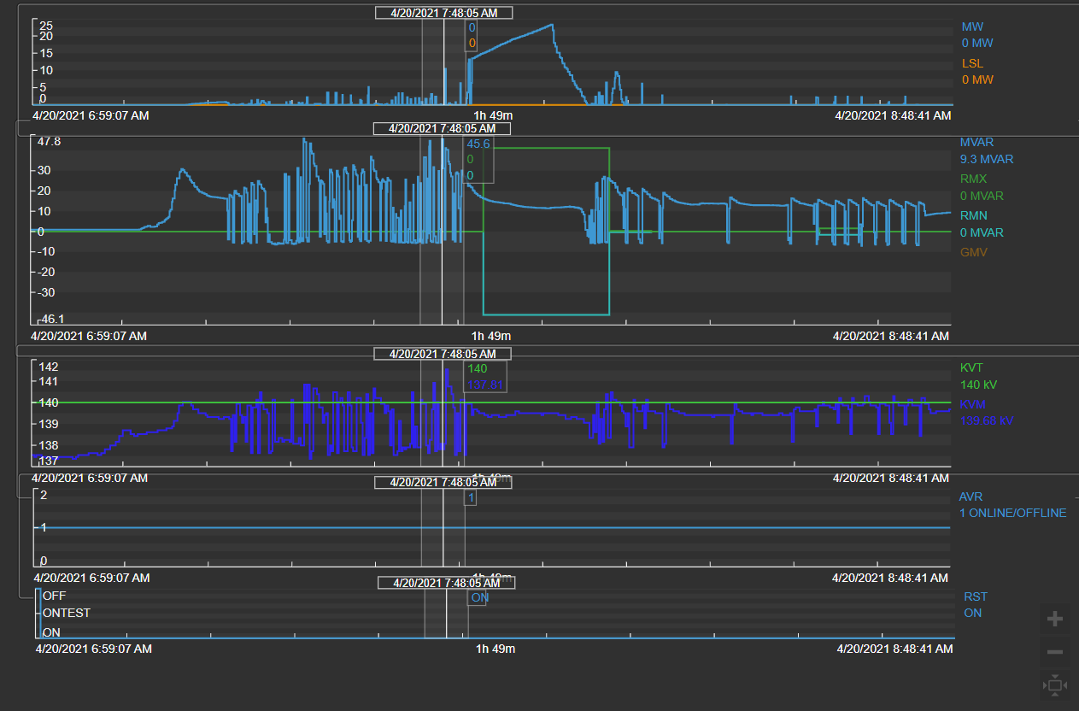
Example #2 – Unit with MVAR oscillations at low MW output
Solar unit
AVR = ON
Status = ON
MVAR = oscillating
Lag 0
Lead 0
Oscillations up to 50 MVAR when unit at very low MWs
3-4 kV voltage swings

Slide 5
Example #2 – Unit with MVAR oscillations at low MW output
ERCOT is currently assuming LSL reflects equipment limitations operating below that point.
Unit needs to work with OEM to achieve an LSL of 0 or as close to 0 as possible.
Units should provide stable reactive control at all times.
Current State
Not Capable
Capable
Solar at Night
AVR = ON
Status = ON
MVAR = oscillating
Lag 0
Lead 0
No V Ctrl
BKR Closed
MW1 = 0,0
MW2 = 41.18,41.18
LSL = 0
Solar unit at night
AVR = ON
Status = ON
MVAR = stable
Lag 0
Lead 0
No V Ctrl
BKR Closed
MW1 = 0,0
MW2 = Adjust to LSL
LSL = (set just above equipment limit for stable operations)
Solar unit at night
AVR = ON
Status = ON
MVAR = Variable
Lag 67.99
Lead -68.57
V Ctrl
BKR Closed
MW1 = 41.18,41.18
MW2 = 41.18, 41.18
LSL = 0

Slide 6
MVAR Oscillations Lessons Learned and Questions
Some oscillations have been able to be fully addressed through tuning and equipment adjustments.
ERCOT, with NPRR 1138, is in the short term focused on reducing the number of reactive oscillations that occur on the system due to equipment limitations.
ERCOT in the long term believes these limitations should not exist and that the IBR should have stable voltage control at all MW outputs.
Units needs to work with OEM to achieve an LSL of 0 or as close to 0 as possible if they have such a limitation.
This may require controller and inverter tuning and tighter operational margins.
These limitations are currently not being reported to ERCOT, but rather discovered in real time operations.
Approximately 3% of solar units are reflecting a non-zero LSL in real time snapshot on 9/12.
All wind units are reflecting a zero LSL in real-time snapshot on 9/12.
Why does this limitation exist for a some but not all units?
What prevents the inverter from having a feed to prevent the standby mode and or AVR to continue to function properly?

Slide 7
Questions?
Notes:
Ryan

