Slide 1
Fleet-level Overview of ERS Event Performance from 7/13/2022
DSWG Meeting
September 14, 2022

Slide 2
ERS deployment events 7/13/2022
*Only five additional ERS Resources were deployed in ERS TP4 because all other obligated ERS Resources for the time period were already deployed in TP3.
In total, 429 ERS Resources were deployed across time periods 3 & 4 on 7/13/2022. 103 ERS Resources were not deployed because they did not have any obligation within the deployed time periods.
In terms of cumulative deployment obligation time, ERS Resources were deployed for approximately 0hr:32min to 3hr:36min depending on service type (ERS10-NWS, ERS30-NWS, ERS30-WS) and Time Period obligations (TP3 & TP4).
The vast majority of the ERS fleet was deployed for at least 3hr:15min

Slide 3
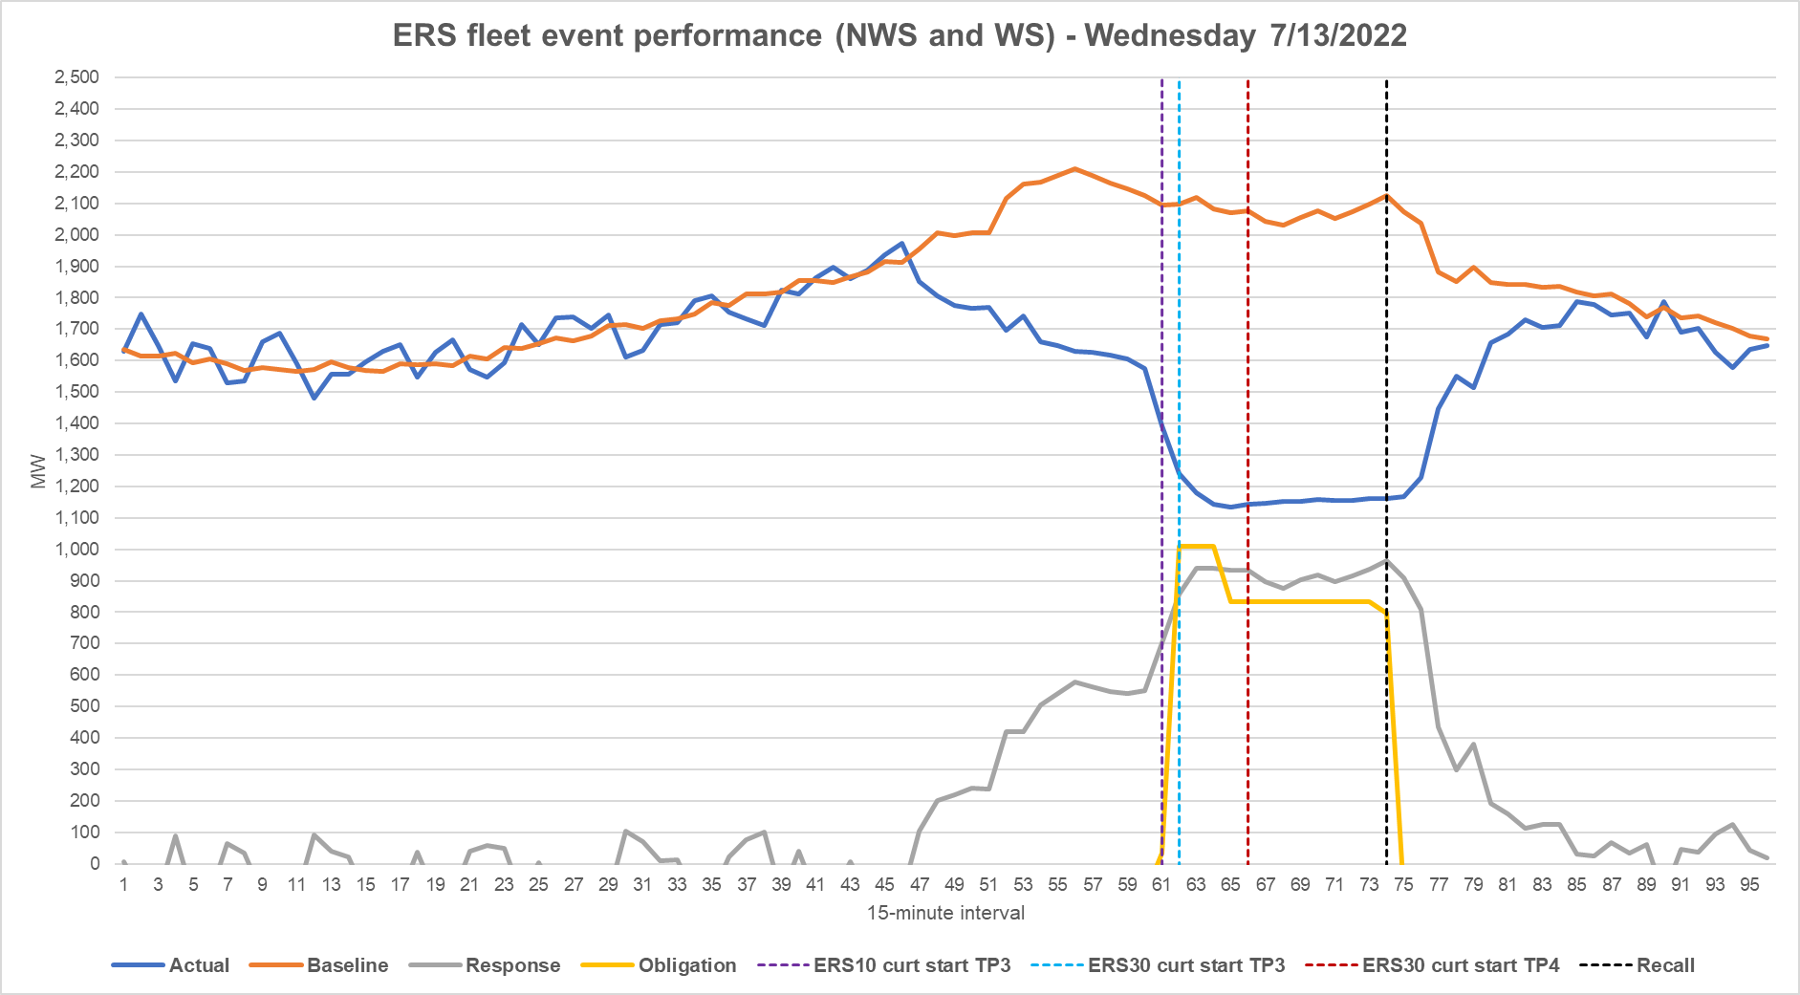
ERS deployment events 7/13/2022
Note: the ERS fleet performance depicted above is a representation of the aggregate megawatts for ERS resources and does not reflect how they will be assessed for performance during each individual ERS deployment event.
Notes:
Generally the fleet performed successfully across the event, but the fleet under performed during first few intervals

Slide 4
ERS deployment events 7/13/2022
The fleet generally underperformed during the first hour of the event and overperformed during the subsequent 2.5 hours.
  ERCOT is seeking feedback from ERS QSEs to better understand what issues contributed to underperformance during the event.
  During the obligated intervals of the event, the ERS fleet provided an average response of ~914 MW compared to an average obligation of ~834 MW
  MW response peaked at ~963 MW during the 15-minute interval ending at 6:30pm (last full interval of the event)

Slide 5
ERS deployment events 7/13/2022
Approximately half of the QSE portfolios deployed during the event failed to perform successfully across the entirety of the event. A smaller amount also failed to perform during the first full interval of the event.
  To perform successfully, ERS QSEs must achieve performance factors of 95% or greater (MW response >= 95% of MW obligation) during both the first full interval of the event and across all event intervals in aggregate.
  Of the QSE portfolios that failed, the average event performance factor was greater than 80% (weighted by MW obligation).
  Approximately one third of the QSE portfolios deployed achieved an event performance factor of 99% or greater.

