Slide 1
Supply Analysis Working Group Update
Caitlin Smith, Chair
Pete Warnken, Co-Vice Chair
Ian Haley, Co-Vice Chair
September 7, 2022

Slide 2
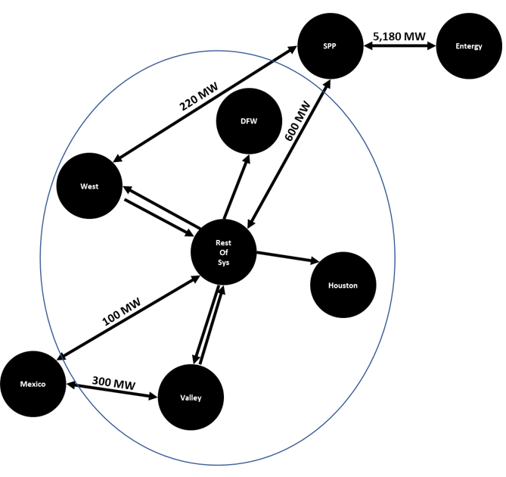
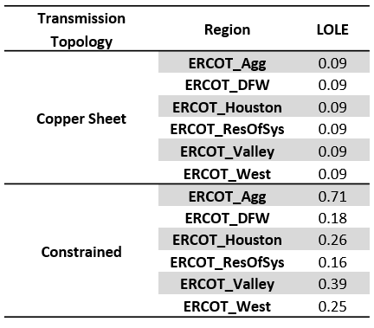
Modeling Project Status Update
Zonal Reliability Study
  Purpose of study is to test the concept of a multi-zone ERCOT representation for resource adequacy and the associated impact of transmission constraints
  Developed an ERCOT topology with five internal zones as well as DC tie connections to neighboring grids
  Reliability comparison of transmission-unconstrained and constrained systems to be made after setting both to a base reliability level (0.1 Loss-of-Load Events/year for 2023

Slide 3
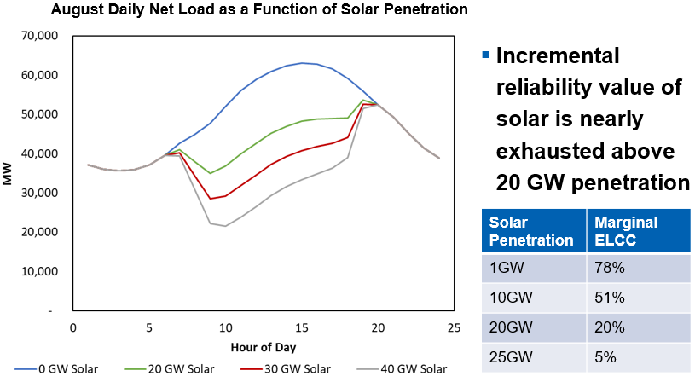
Modeling Project Update
Effective Load Carrying Capability (ELCC) Study
  Obtain ELCC values for range of scenarios:
    Alternative penetration levels of solar, wind and storage
    Location of wind and solar sites
    Solar technology type (single/dual axis tracking, DG)
    Storage utilization (Ancillary Service only vs. energy market)
  Obtain ELCC values for individual high-risk hours
  Currently wrapping up solar scenarios

Slide 4
NERC Probabilistic Assessment
NERC Probabilistic Assessment
  Biennial NERC requirement to determine a set of probabilistic reliability measures for the resource portfolios expected for two future years (2024, 2026); metrics include
    Loss of Load Hours
    Expected Unserved Energy
  Study now incorporates linear probabilistic impact of declining winter temperatures on unplanned outages (1.07% outage increase for each degree drop from 20⁰F to 0⁰F)
  Results show an increase in summer reliability due to solar additions, but winter reliability decreases due to modeling of additional temperature-driven unplanned outage risk

Slide 5
CDR Dispatchable/Flexible Adequacy Measures
Presented examples of new CDR screening measures, for a given forecast year and season, that gauge whether there is sufficient non-IRR resource capacity to address extreme net load risks:
  An exceptionally high net load scenario to be met by expected dispatchable resources
  An exceptionally large two-hour net load “up-ramp” to be met by expected flexible resources (CTs, ICEs, energy storage, hydro)
Measures would be reported for blocks of the highest-risk hours for the season; for example, summer “wind risk hours” of 2 through 5 pm, and “solar risk hours” of 6 through 8 pm

Slide 6
CDR Dispatchable/Flexible Adequacy Measures
Summer CDR Reporting Mock-up

Slide 7
Wind and Solar Profile Development
UL Services completed development of hourly wind and solar profiles covering weather years 1980 through 2021
Profiles and methodology report will be posted on ercot.com (Resource Adequacy webpage)
Significantly expanded the number of new sites for which profiles were created: wind – additional 58, solar – additional 103
For the next profile project, will investigate
  Feasibility of more granular profile data to further improve solar profiles during low-light hours
  Statistical/modeling analysis of the impact of winter weather events on turbine availability, e.g., precipitation events that cause significant icing issues

Slide 8
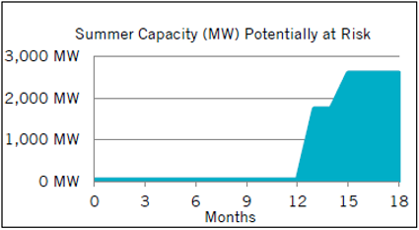
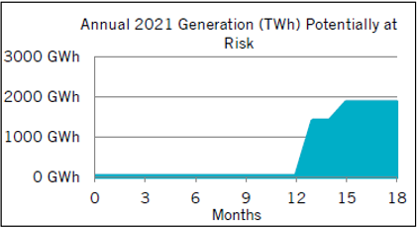
Drought Risk Assessment Tool, August 2022 Update
ERCOT estimates the amount of capacity and generation potentially at risk of losing sufficient water supplies within the next 18 months; latest assessment results:
Proposed model improvement: account for multiple groundwater wells as opposed to single representative well via generation owner surveys

Slide 9
Miscellaneous
Discussed the timing of a detailed Cost of New Energy (CONE) study
  Participants agreed to defer the study by at least one year
Next SAWG meeting will focus mainly on sharing the results of the zonal reliability and ELCC studies
  Will schedule the meeting to follow completion of the studies in September

