Slide 1
Market Credit Working Group update to the Wholesale Market Subcommittee
Brenden Sager, Austin Energy, Chair
Seth Cochran, DC Energy, Vice Chair
7 Sept 2022

Slide 2
General Update
  17 Aug 2022 Joint MCWG/CWG WEBEX Meeting
  Five NPRRs reviewed for their credit impacts
  NPRR 1146 from Shams Siddiqi on updated credit calculations
  Regular update on collateral and exposure

Slide 3
NPRR’s Reviewed
1084 NPRR Improvements to Reporting of Resource Outages and Derates
1118 NPRR Clarifications to the OSA Process
1128 NPRR Allow FFR Procurement up to FFR Limit Without Proration
1139 NPRR Adjustments to Capacity Shortfall Ratio Share for IRRs
1140 NPRR Recovering Fuel Costs for Generation Above LSL During RUC-Committed Hours
All considered operational without credit impacts

Slide 4
NPRR 1146
Example: DC tie transaction importing into ERCOT. URTA Unbilled Real-Time Amount drives credit requirements and when they’re importing power and ERCOT owes them money
EALt = Max [RFAF * Max {RTLE during the previous lrt days}, RTLF] + DFAF * DALE + Max [RTLCNS, Max {URTA during the previous lrt days}] + OUTt
Proposed EALt = Max [RFAF * Max {RTLE during the previous lrt days}, RTLF] + DFAF * DALE + RTLCS + OUTt
Proposal removes Unbilled Real-Time Amount max function
Due to Max functions, RTLF and RTLCNS, which capture recent positive RTM activity, is not taken into account at all. Rather RTLE and URTA, which lag behind by 7 days and have large M1=10 and M2=9 weights, set RTM exposure
Address issue of building collateral obligations when exposure flips from AP to AR in increasing price environment (as occurred during Uri)

Slide 5
NPRR 1146 ct’d
Proposal: To receive Trading Activity Only treatment, TAO-eligible entity would agree to suspend RTM activities immediately following receiving notice from ERCOT (simultaneously as when DAM activity is suspended) and not resume RTM activity until notified by ERCOT to do so (similar in concept to agreeing to special provisions to receive preferential “e” treatment in DAM)
DC Tie Load, even though allocated costs like other Load, is still a trading activity – i.e., there is no mass transition required for DC Tie Load. Currently, QSE engaging in trading activity only having no Load or generation but exporting over DC Ties (DC Tie Load) is not considered a TAO QSE. Change: Export (DC Tie Load) should be treated as trading activity in designation of TAO QSE.
From ERCOT: Not going to be manual monitoring by ERCOT; manual processes are difficult especially for RT activity
Presented and discussed at CWG/MCWG but no action taken

Slide 6
Monthly Highlights Jun 2022 – July 2022
Market-wide average TPE increased from $1,878.6 million in June to $1.967 million in July.
  TPE increased mainly due to higher Real-Time and Day-Ahead Settlement Point prices
    Discretionary Collateral is defined as Secured Collateral in excess of TPE,CRR Locked ACL and DAM Exposure
  Average Discretionary Collateral increased from $2,501.0 million in June to $3.160.6 million in July
  The increase in Discretionary Collateral is largely due to increase in Secured Collateral
No unusual collateral call activity

Slide 7
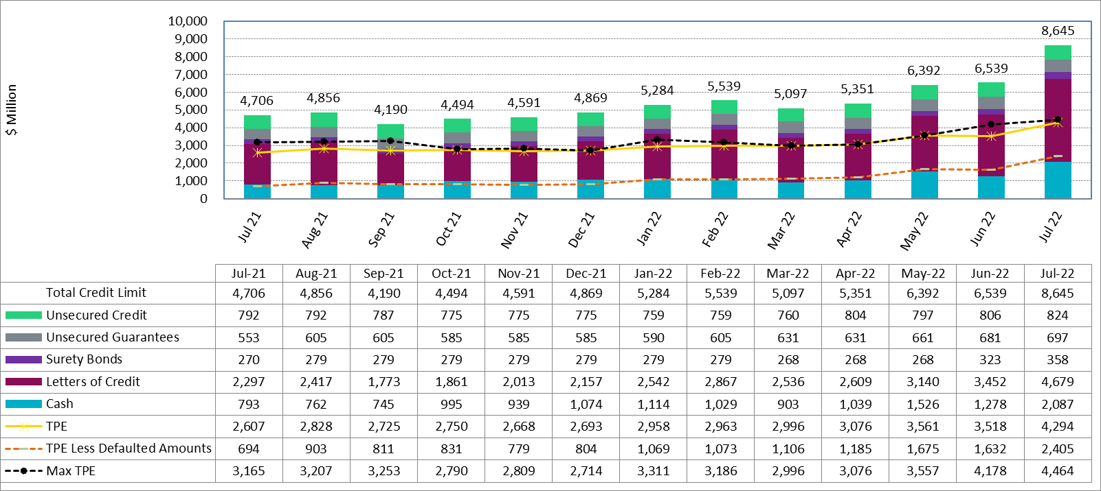
Available Credit by Type Compared to Total Potential Exposure (TPE) Jul 2021- Aug 2022

Slide 8
Discretionary Collateral May 2022 - June 2022

