Slide 1
PDCWG Report to ROS
Chair: Jimmy Jackson, CPS
Vice Chair: Vacant
ROS
Sep 1st, 2022

Slide 2
Report Overview & Notes
Report Overview
Meeting Minutes
BAL-001-TRE-2 FMEs and IMFR
1 FME in the month of July
Frequency Control Report

Slide 3
Meeting Minutes
PDCWG Meeting 8/17/2022
ECRS Deployment and Requirement Methodology
RRS Limit Study Update
ERCOT Reports
TRE Report

Slide 4
Frequency Measurable Events Performance

Slide 5
Frequency Measurable Events
There was 1 FME in July
7/27/2022 1:17:48
Loss of 517 MW of generation
Interconnection Frequency Response: 1,326 MW/0.1 Hz
80 Resources were evaluated. These includes,
34 Generation Resources
2 Controllable Load Resources
44 Energy Storage Resources
7 of 80 Evaluated Resources had less than 75% of their expected Initial Primary Frequency Response.
13 of 80 Evaluated Resources had less than 75% of their expected Sustained Primary Frequency Response.

Slide 6
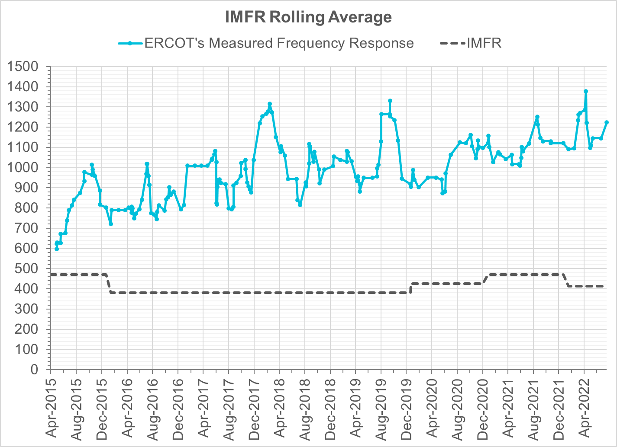
Interconnection Minimum Frequency Response (IMFR) Performance
IMFR Performance currently
1223.77 MW/0.1HZ
Frequency Response Obligation (FRO): 412 MW/0.1 Hz

Slide 7
Questions?

Slide 8
Frequency Control Report
July 2022

Slide 9
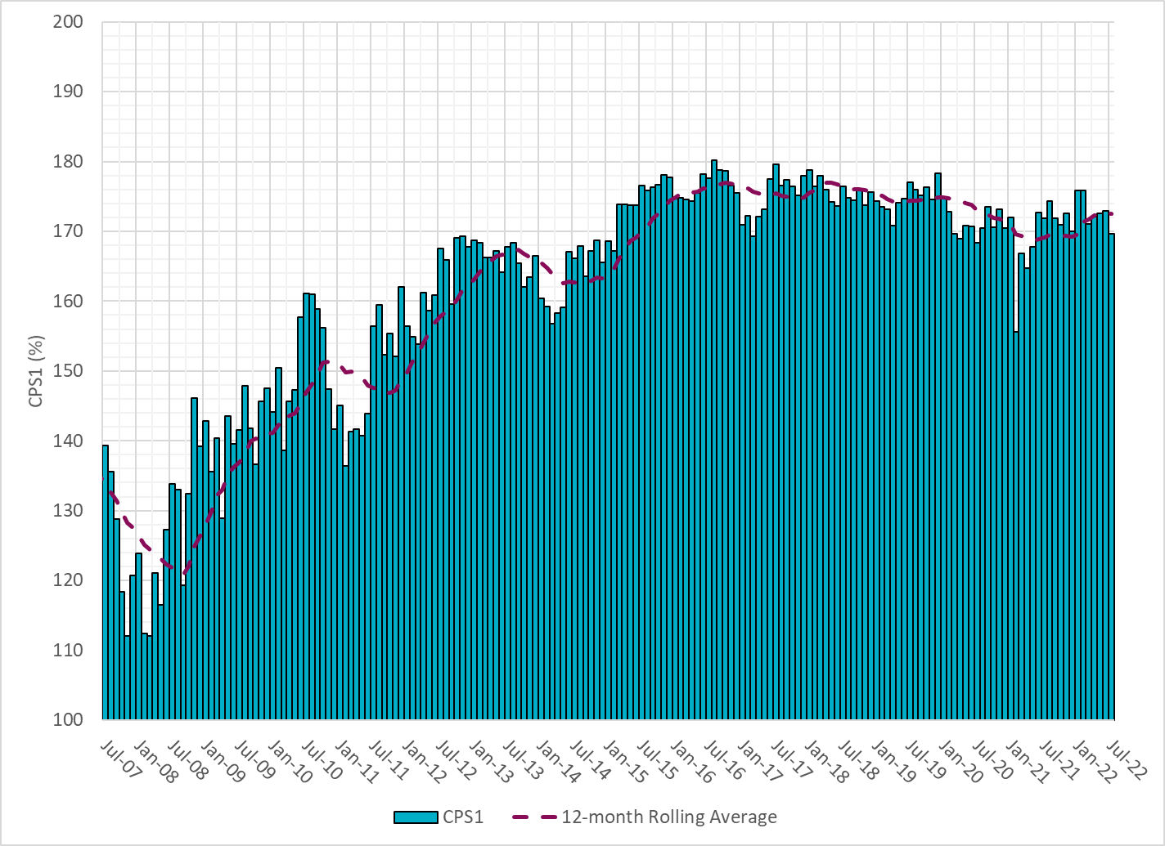
CPS1 Performance

Slide 10
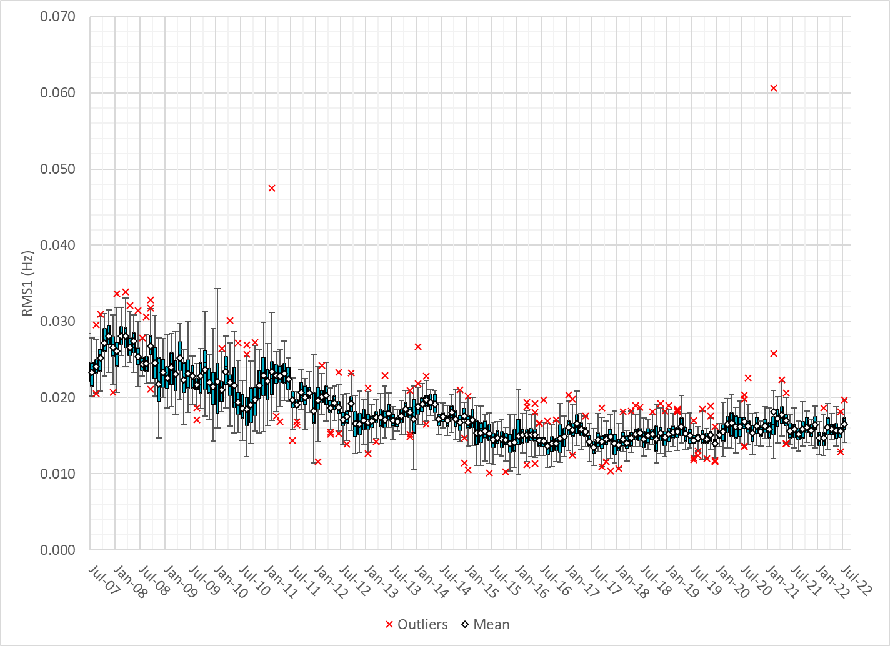
RMS1 Performance of ERCOT Frequency
Notes:
16.48Mhz on avg for July 2022

Slide 11
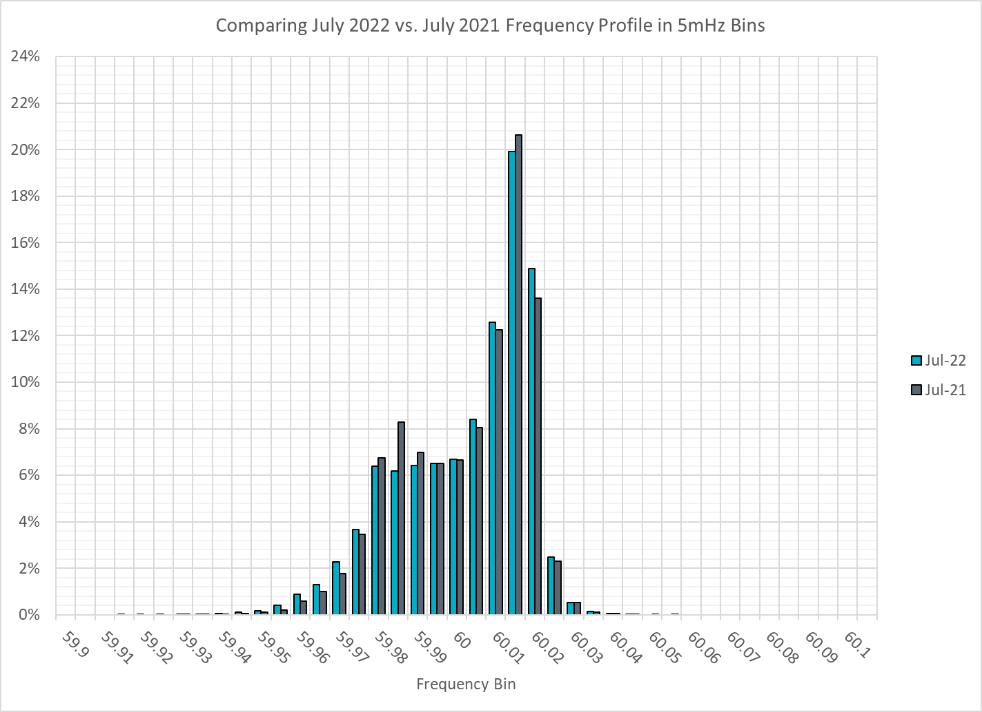
Frequency Profile Analysis

Slide 12
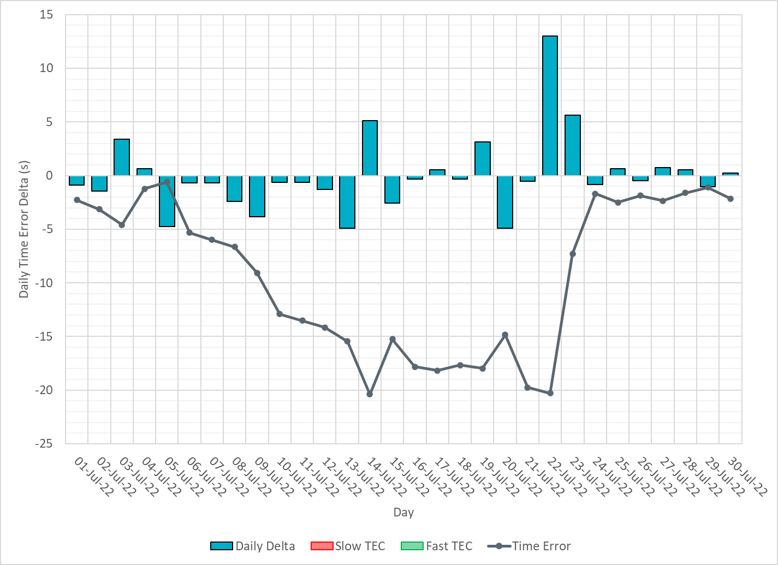
Time Error Corrections
Notes:
Time error started to go down around the 7th due to significant IRR ramps and heatwave. Several GTBD changes were made later in the month to recover time error.

Slide 13
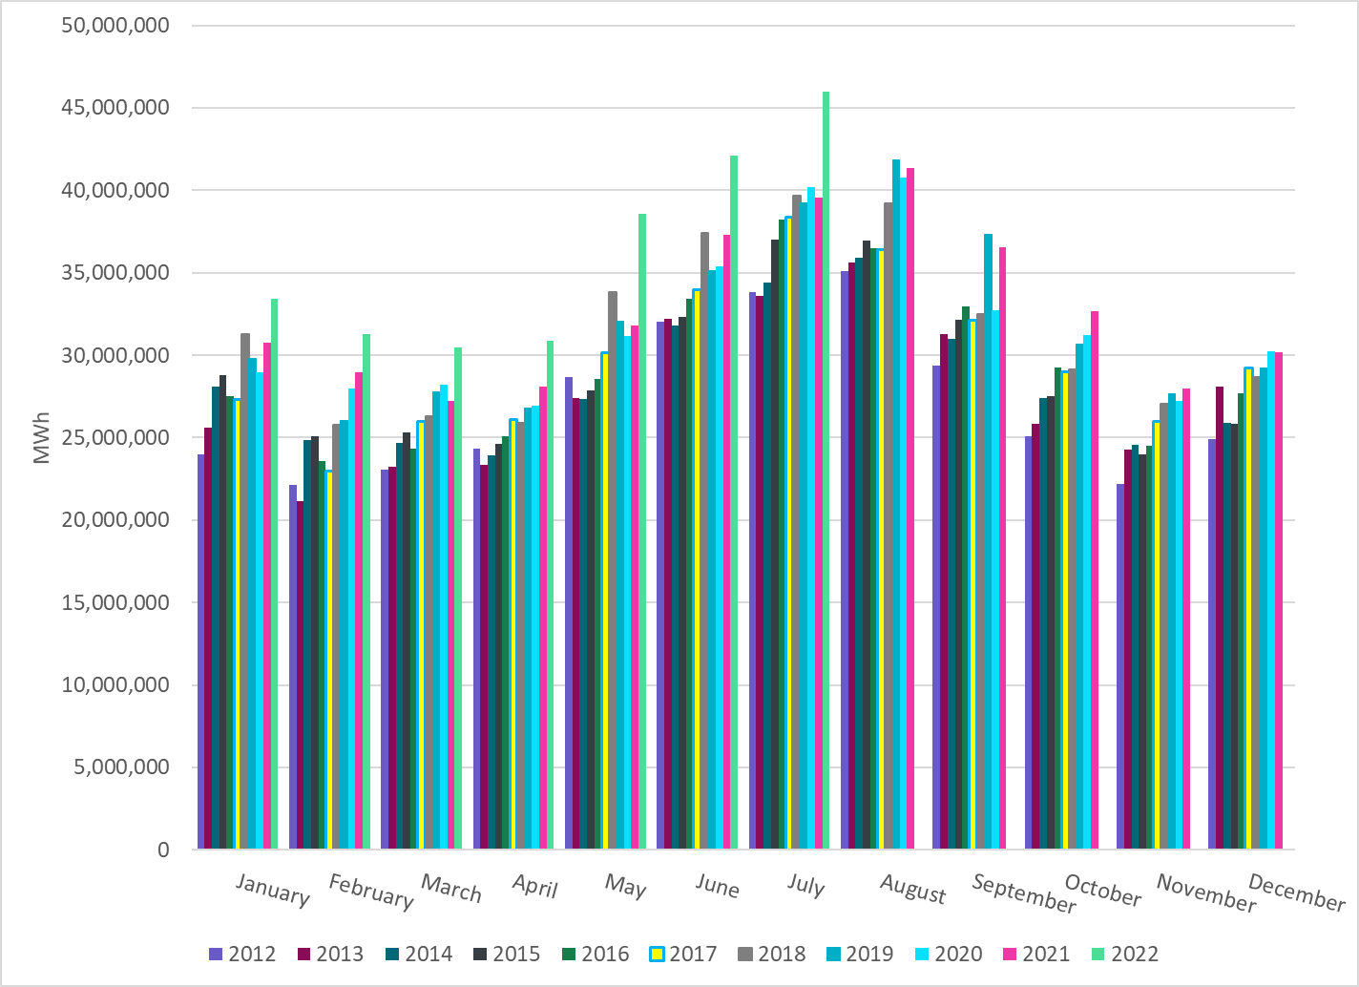
ERCOT Total Energy
Notes:
45,993,543 MWh

Slide 14
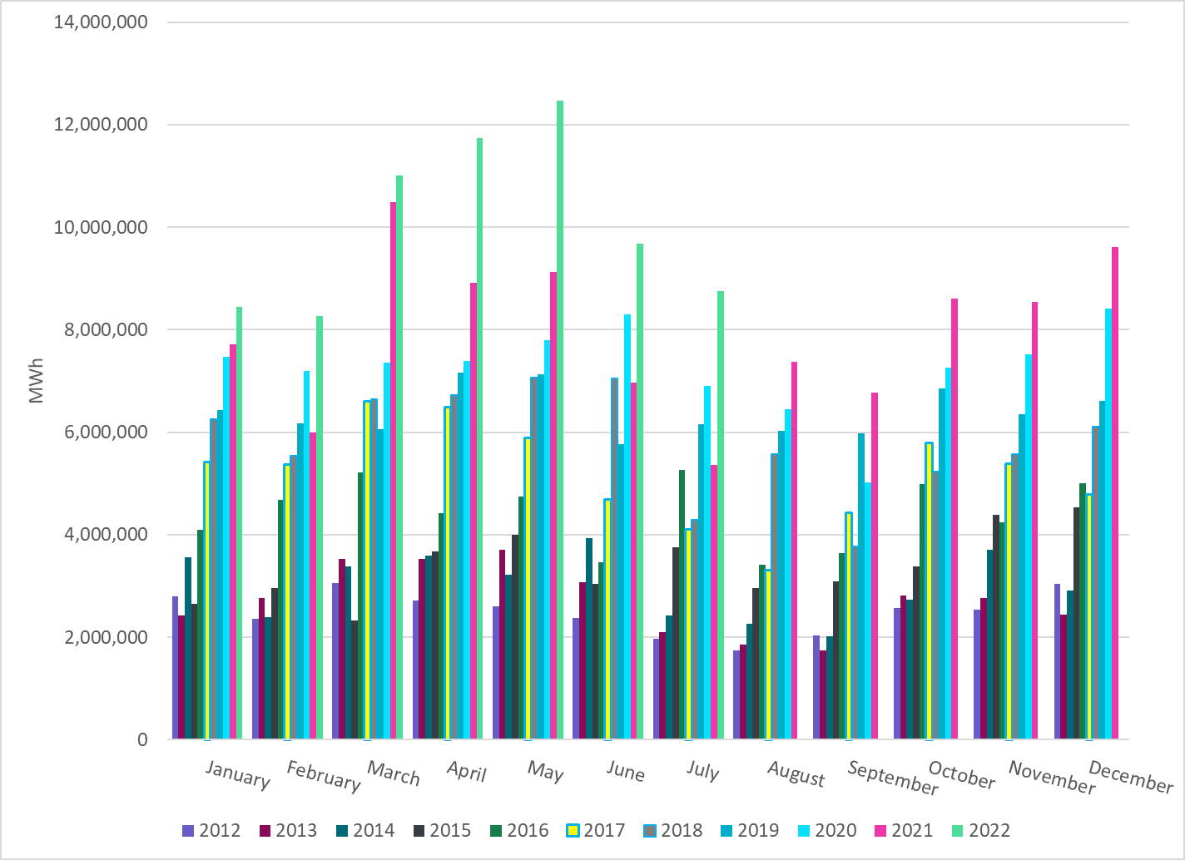
ERCOT Total Energy from Wind Generation
Notes:
8,753,431 MWh

Slide 15
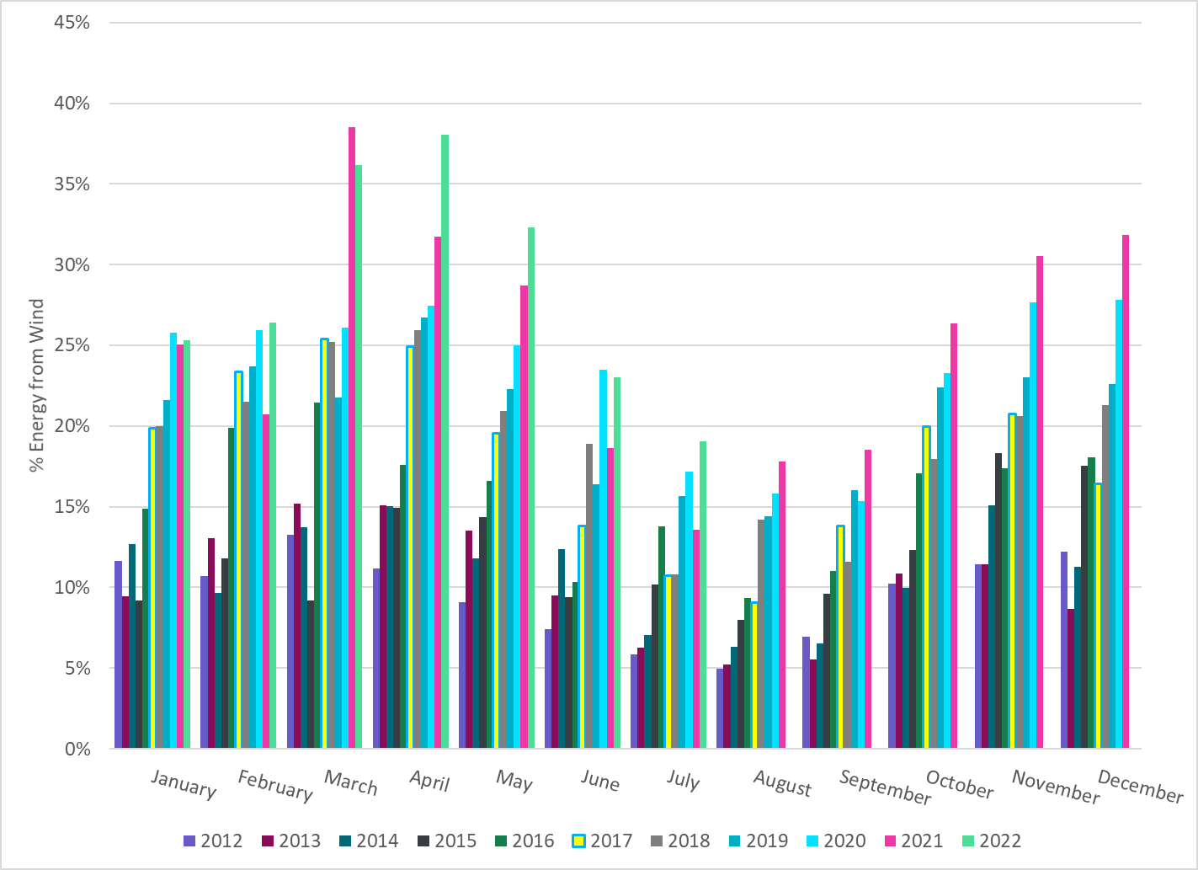
ERCOT % Energy from Wind Generation
Notes:
19.03%

Slide 16
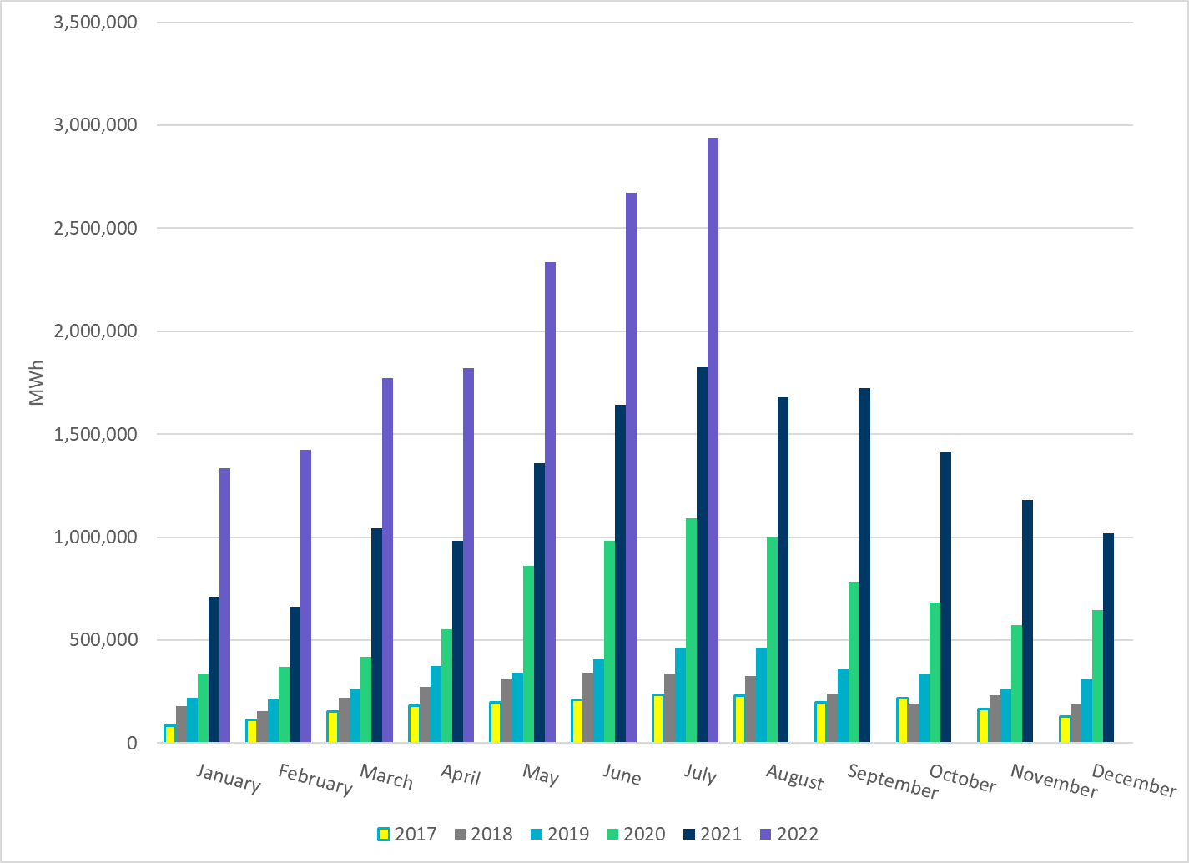
ERCOT Total Energy from Solar Generation
Notes:
2,937,875 MWh

Slide 17
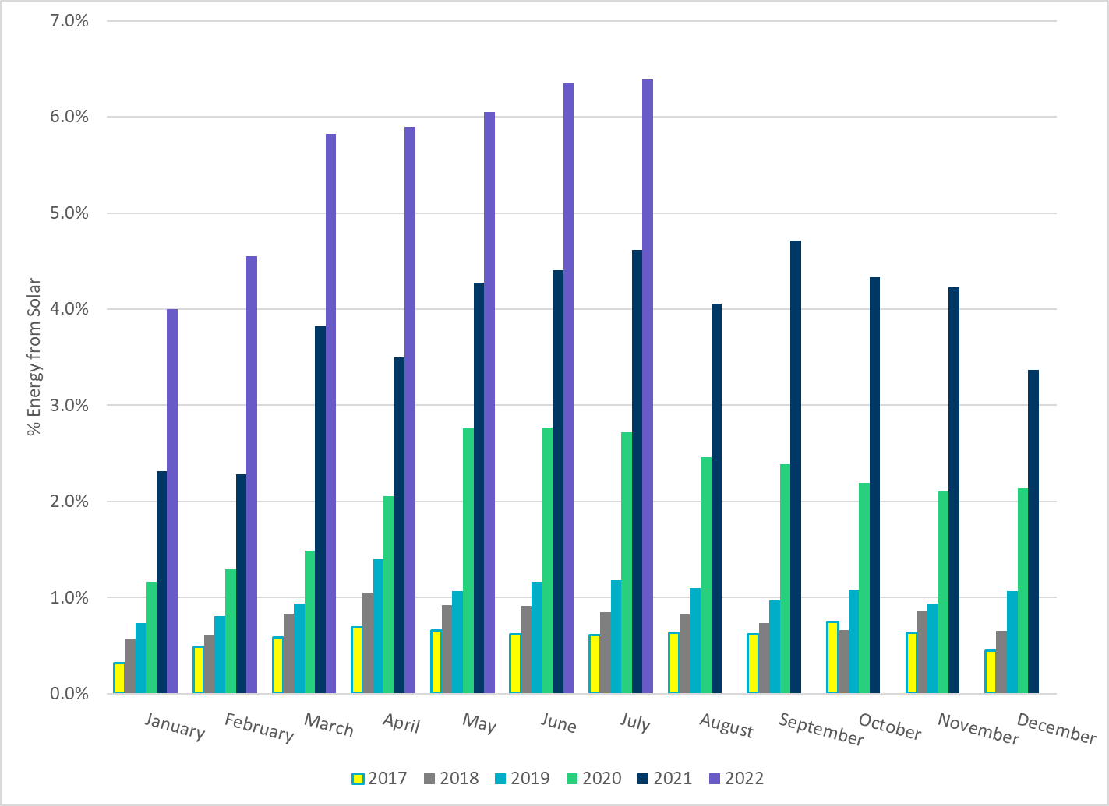
ERCOT % Energy from Solar Generation
Notes:
6.39%

