Slide 1
2022 Studies Update SAWG Presentation 08/29/2022
Prepared for Electric Reliability Council of Texas
Notes:
1

Slide 2
Zonal Reliability Study
Notes:
2

Slide 3
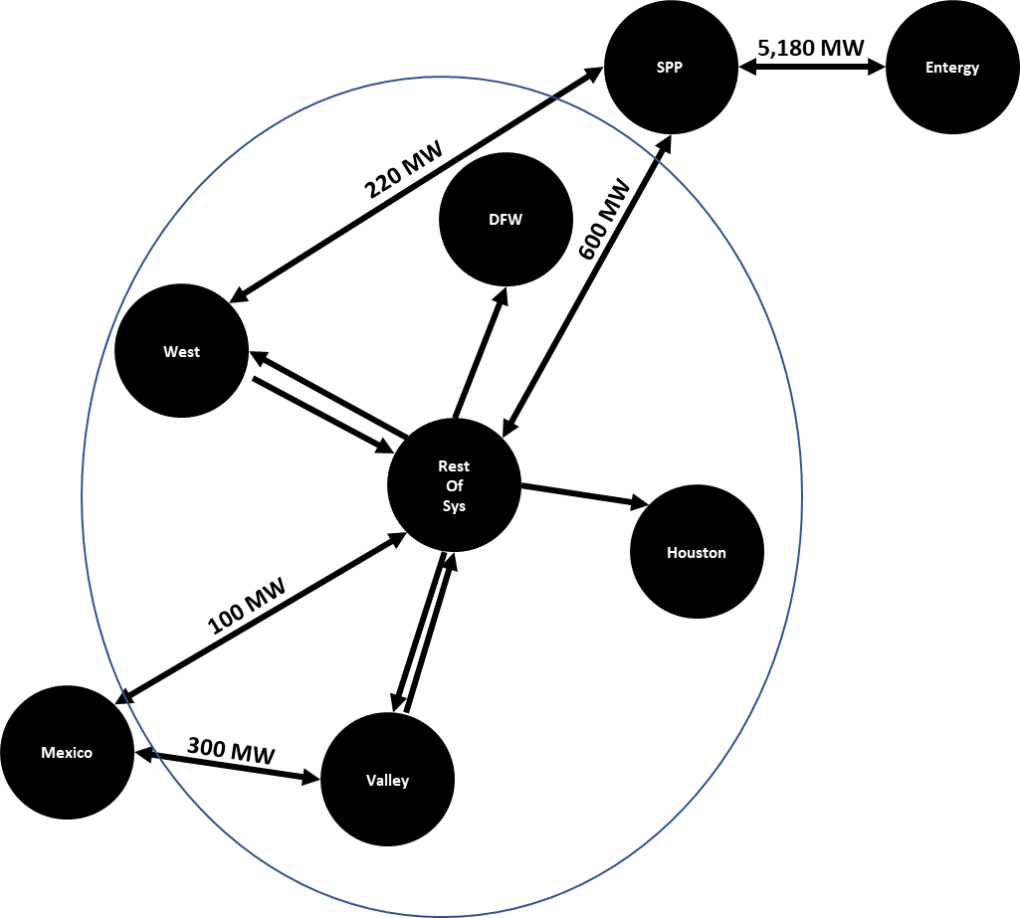
Background and Topology
Prior reliability analysis has assumed full deliverability during net peak load conditions across ERCOT
Zonal reliability study is the first step in understanding the impact that transmission constraints have on generation adequacy
This analysis includes simplified network constraints using a pipe and bubble representation

Slide 4
Draft Results
A transmission group was created that treated ERCOT as a copper sheet
The base reliability was determined, and then coal capacity was retired until the system reached ~0.1 LOLE
The copper sheet transmission group was then switched out for a more constrained group
Transmission Topology | Region | LOLE
Copper Sheet | ERCOT_Agg | 0.09
 | ERCOT_DFW | 0.09
 | ERCOT_Houston | 0.09
 | ERCOT_ResOfSys | 0.09
 | ERCOT_Valley | 0.09
 | ERCOT_West | 0.09
Constrained | ERCOT_Agg | 0.71
 | ERCOT_DFW | 0.18
 | ERCOT_Houston | 0.26
 | ERCOT_ResOfSys | 0.16
 | ERCOT_Valley | 0.39
 | ERCOT_West | 0.25

Slide 5
Next Steps
Perfect Capacity
Starting with the constrained group results, perfect capacity will be added to each zone uniformly until one zone reaches 0.1 LOLE
Capacity blocks will be added to the zones that are still short until all zones reach 0.1 LOLE
Transmission Capability
Starting with the constrained group results, transmission limits will be relaxed for each internal ERCOT transmission tie uniformly until one zone reaches 0.1 LOLE
All remaining ties not connected to the 0.1 LOLE region will continue to be increased uniformly until all zones reach 0.1 LOLE

Slide 6
ELCC Study
Notes:
6

Slide 7
ELCC Study SERVM Runs
Perform hourly analysis to obtain ELCC values for the following scenarios:
Solar 0 – 40 GW
Wind 0 – 50 GW
Storage 0 – 12 GW
Location Effects of Wind
Wind-C
Wind-O
Wind-P
Location Effects of Solar
West
Non-West
Technology Effects of Solar
DG
Tracking
Storage:
Serve A/S
Unable to Serve A/S
Perform analysis to obtain ELCC values for high-risk hours of solar, wind, and storage at 1 selected penetration level

Slide 8
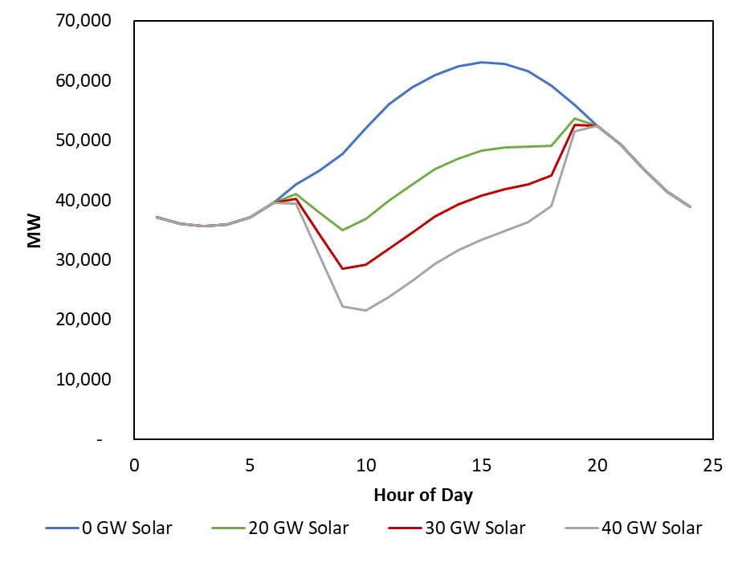
Solar Reliability Value
August Daily Net Load as a Function of Solar Penetration
Reliability value of solar is nearly exhausted above 20GW penetration.
Solar Penetration | Marginal ELCC
1GW | 78%
10GW | 51%
20GW | 20%
25GW | 5%

Slide 9
Schedule
Notes:
9

Slide 10
Schedule
Date | Milestone
9/9/22 | Draft Results for Zonal Reliability Study and ELCC Study
9/30/22 | Final Results for Zonal Reliability Study and ELCC Study
10

