Slide 1
Drought Risk Assessment Tool
August 2022 update
Dan Mantena
Resource Adequacy
8/29/22

Slide 2
Topics
Drought conditions (Summer 2011 vs. Summer 2022)
August 2022 update
Modeling of reservoirs under drought conditions overview
Results of the recent generator water RFI survey
Discuss improvements for tool
  Groundwater aquifers modeling

Slide 3
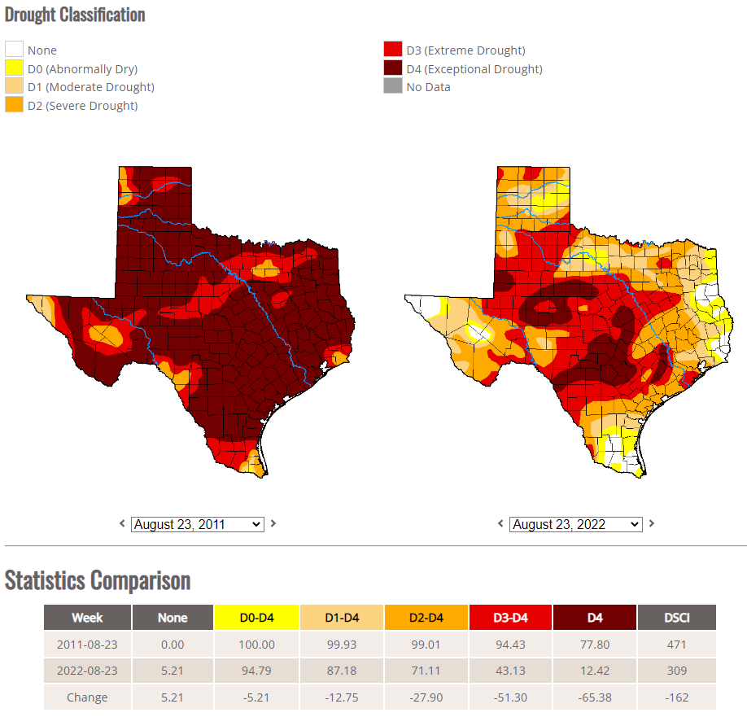
Drought Conditions (Summer 2011 vs. Summer 2022)
https://droughtmonitor.unl.edu/Maps/CompareTwoWeeks.aspx

Slide 4
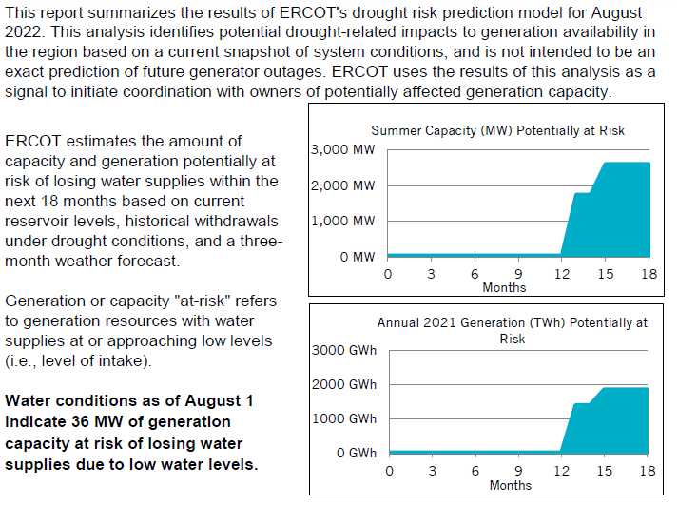
August 2022 Update of the Drought Risk Model
https://www.ercot.com/gridinfo/resource

Slide 5
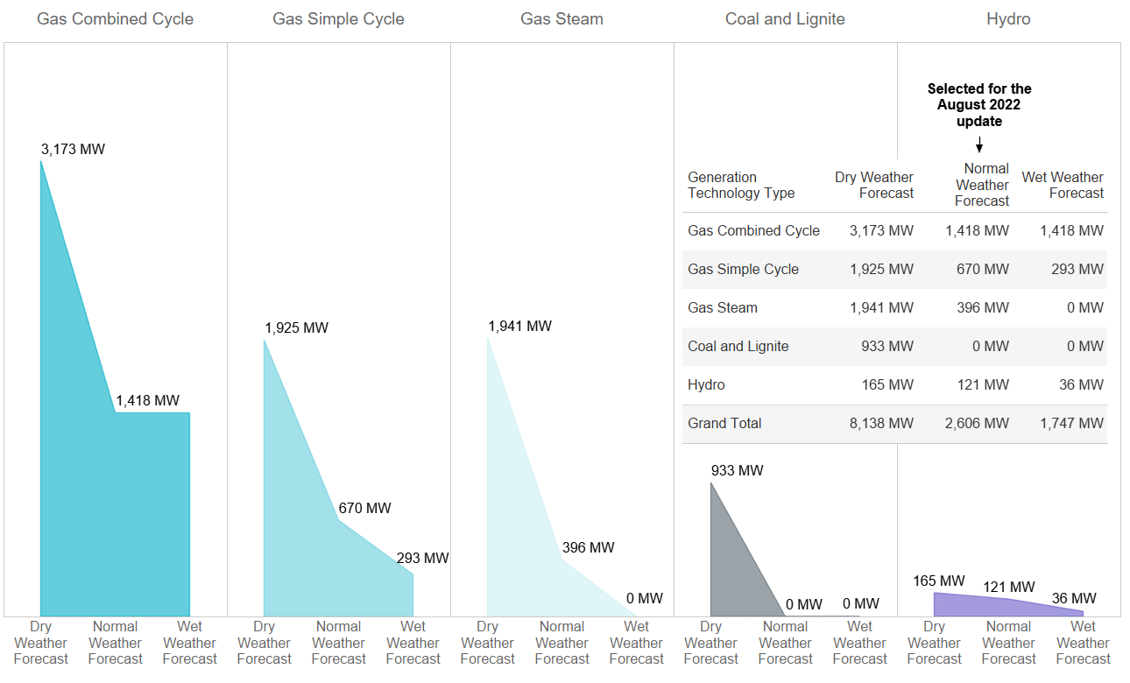
August 2022 At-risk Capacity for 18-MonthTime Horizon under Different Weather Forecasts

Slide 6
Modeling of Reservoirs under Drought Conditions
The model use a “Drought Fit” prediction by simulating monthly storage level changes in times of drought. For most reservoirs, the level of the 30th percentile is used to forecast monthly usage.
Short-term Weather forecast introduced into model at the end of 2019
  consists of a single qualitative descriptor for the upcoming 3 months based on temperature and precipitation outlooks for the state provided by ERCOT’s meteorologist.
  A wet weather forecast reflects the 75% percentile of monthly changes in storage for the upcoming 3 months.
  A normal weather forecast reflects the 50% percentile of monthly changes in storage for the upcoming 3 months.
  A dry weather forecast reflects the 25% percentile of monthly changes in storage for the upcoming 3 months.
A Normal forecast was used for Fall 2022 in the August update.

Slide 7
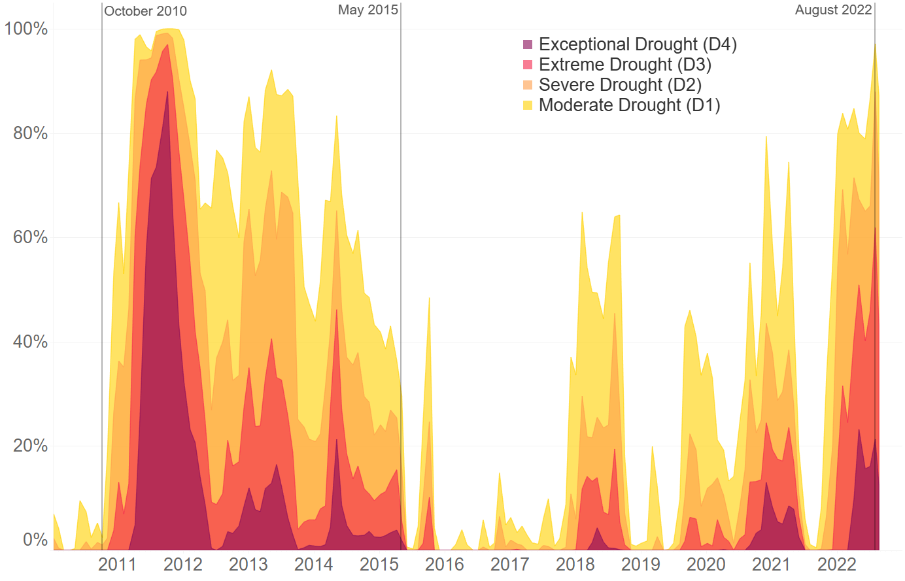
Percentage of State under Drought Conditions from U.S. Drought Monitor
https://droughtmonitor.unl.edu/About/AbouttheData/DSCI.aspx

Slide 8
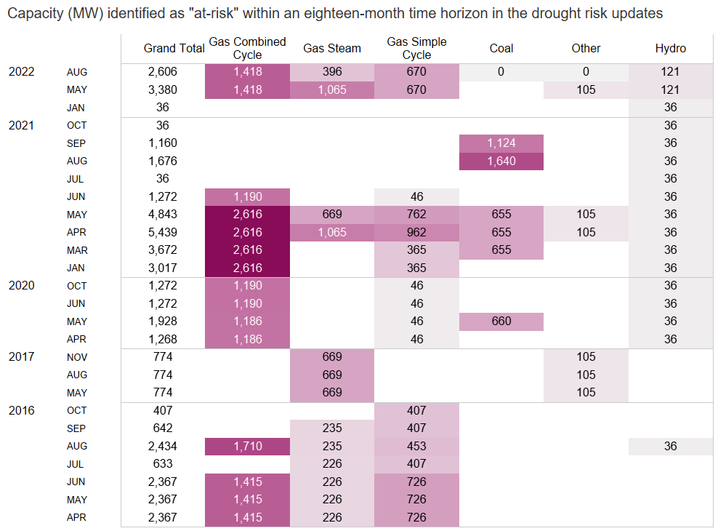
Drought Risk Monitoring Report Trends

Slide 9
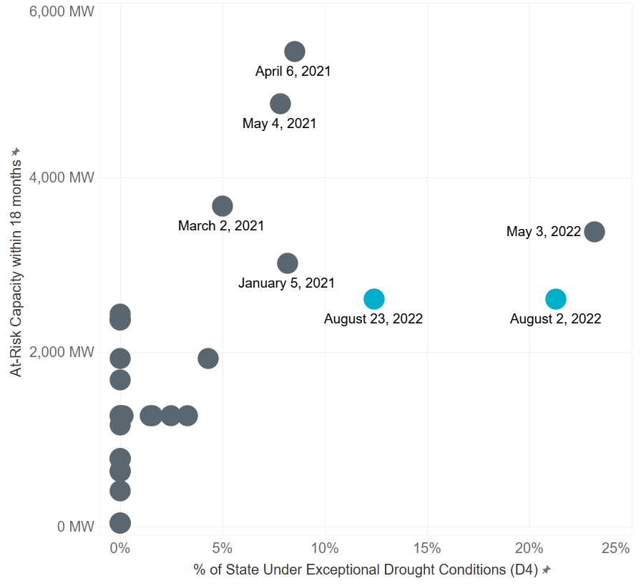
Drought Risk Model Updates Compared to U.S. Drought Monitor Exceptional Drought Metric

Slide 10
Results of Recent Generator RFI survey
Most units with inaccurate water source modeling were for units that relied on groundwater wells.

Slide 11
Next Steps: Revisit Modeling of Groundwater Aquifers
Current modeling relies on a single well to represent each of aquifer using data from here: https://www.waterdatafortexas.org/groundwater
A more targeted RFI survey to owners that use groundwater wells for plant operations could provide more accurate modeling (state well numbers).

Slide 12
Appendix
Additional related documents and public drought risk reports can be found under the Drought Risk section of the ERCOT Resource Adequacy page https://www.ercot.com/gridinfo/resource
Dmantena@ercot.com

