Slide 1
NERC 2022 Probabilistic Assessment
Julie Jin
Resource Adequacy Dept.
August 29, 2022
Notes:
Welcome to

Slide 2
Summary of Assessment Approach
Use Astrapé’s SERVM 8760 Hourly Chronological Commitment and Dispatch Model
Capture Uncertainty in the Following Variables by simulating many scenarios with multiple iterations
  Weather (42 years of weather history), 42 years of load shapes, wind profiles and solar profiles
  Economic Load Forecast Error (distribution of 5 points)
  Unit Outage Modeling (25 iterations): Multi-state Monte Carlo, and Frequency and Duration
  External Assistance/DC Ties
Optimize planned maintenance for case specific load shape

Slide 3
Modeled Interconnection Topology
SPP
810 MW
5,180 MW
ERCOT
Entergy
(MISO)
400 MW
Mexico
(Coahuila, Nuevo Leon, & Tamaulipas)

Slide 4
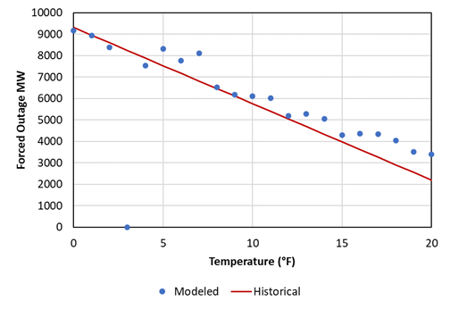
Low Temperature and Forced Outage Correlation
Unlike last study, additional probabilities were modeled for forced outages at temperatures below 20°F.
A linear probability was assigned with an incremental hourly forced outage probability of 1.07% at 0°F down to 0% at 20°F leading to an average of ~9,000 total MW being forced offline at 0°F. The impacts of the new weatherization requirements are not being considered in the temperature outage correlation modeling.

Slide 5
Base Case Study Results Comparison - Annual
2022 ProbA
2020 ProbA
Compared to the results from the 2020 Probabilistic Assessment, LOLH increased from 0.01 to 0.21 for the first study year.
The high level of reliability modeled in the summer is contingent on the projected construction of over 20GW solar resources.
Higher reserve margin in the 2022 Study, but lower reliability is driven by the surfacing of winter reliability events from increased forced outage rates and low solar reliability contribution in winter.

Slide 6
Base Case Study Results – Monthly (1)
2024
2026
Month | LOLH Hours/Year | EUE MWh
1 | 0.00 | 0.28
2 | 0.12 | 420.96
3 | - | -
4 | - | -
5 | - | -
6 | - | -
7 | - | -
8 | 0.00 | 0.04
9 | - | -
10 | - | -
11 | - | -
12 | 0.09 | 332.88
Total | 0.21 | 754.15
Month | LOLH Hours/Year | EUE MWh
1 | 0.00 | 1.08
2 | 0.16 | 657.30
3 | - | -
4 | - | -
5 | - | -
6 | - | -
7 | - | -
8 | 0.00 | 1.03
9 | 0.00 | 0.41
10 | - | -
11 | - | -
12 | 0.18 | 817.69
Total | 0.34 | 1,477.51

Slide 7
Base Case Study Results – Monthly (2)
Reliability events occur during the winter months in the weather years with extremely low temperatures.
The results are driven by the incorporation of additional forced outage risk in the winter. While the projected reserve margin for 2024 is much higher than what was projected in the 2020 ProbA Study, the additional reserves are from solar which does not provide significant winter reliability value.

Slide 8
Questions
Julie Jin
Julie.Jin@ercot.com
Pete Warnken
Pete.Warnken@ercot.com
?

