Slide 1
Solar Forecast Improvements
ERCOT Staff
August 30, 2022
WMWG

Slide 2
Summary
At the WMS meeting in September 2021, ERCOT received questions regarding the over-forecast bias in ERCOT’s hourly Solar forecast - STPPF. In response, ERCOT presented an initial analysis and proposed next steps at the WMWG meeting in September 2021.
Since then, the following actions were taken to reduce the bias and improve solar forecast accuracy
  Implementation of the Bias Correction Method
  Improved reporting of solar resource derates/outages
  Updated the forecasting model’s solar resource power curves
  Integration of Second Solar Forecast Vendor
In addition, the following improvements were made to increase ERCOT’s awareness and control of its solar forecasts
  Implementation of six new solar regions
  Release of the Forecast Presentation Platform

Slide 3
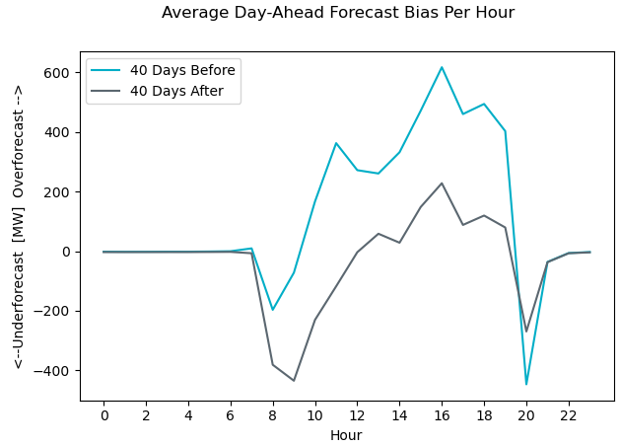
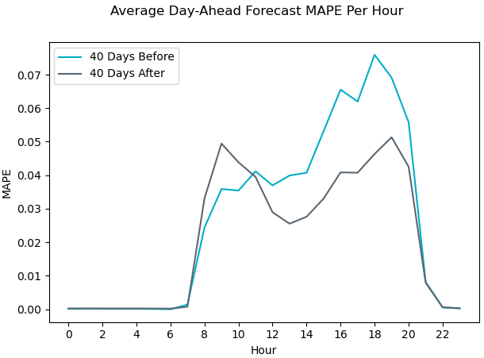
Bias Correction Method
The Bias Correction Method analyzes the bias of the past 30 days to calculate a forecast correction.
Results in reduced overforecast bias and improvements in error (MAPE)
Implemented on 06/22/2022
Before: 05/13/2022 to 06/22/2022
After: 06/22/2022 to 08/01/2022
Solar forecasted capacity went from 11,281 MW to 12,287 MW from 05/13 to 08/01

Slide 4
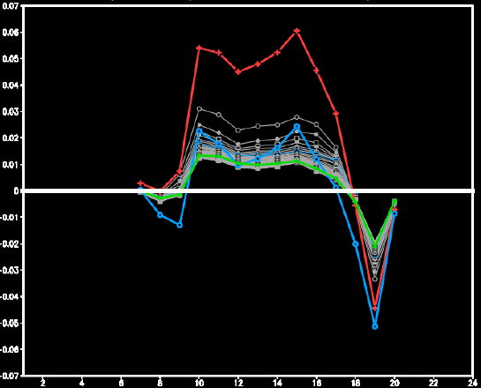
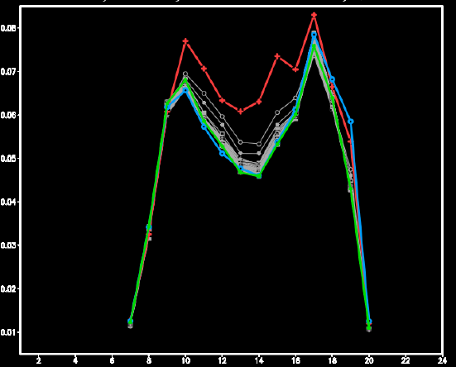
Bias Correction Method - Retroactive Analysis
Prior to implementation, the Bias Correction Method was retroactively applied using 12 months of data, with very good results.
  Red: Original Forecast
  Green: Bias Correction Method Applied, using rolling 30-days historical performance
  Grey: Bias Correction Method Applied, using varying number of days of historical performance
  Blue: Reducing the original forecast by 5%
  For hour ending 10 to 16, average bias was reduced from approximately 5% to 1% and MAPE was reduced by more than 1%
Bias
Average MAPE
<- Underforecast Overforecast ->
MAPE
Hour
Hour

Slide 5
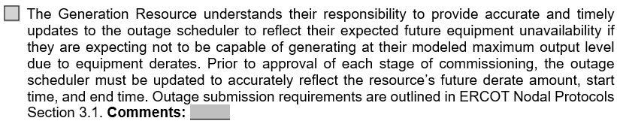
Addressing Improperly Reported Derates
On Dec. 10th, 2021, a presentation was given to the Resource Integration Workshop about the changes to the checklist and importance of updating the outage scheduler to renewable forecasting.
On Dec. 13th, 2021, the Resource Integration Commissioning Checklist has been modified to check whether a resource properly reported derates prior to each stage of commissioning.
Internal tools have been developed to help identify resources whose reported derates are inconsistent with their real-time behavior.
  In Q4 2021 and Q1 2022, 12 units have been identified with issues regarding reported derates. These units made corrections to their outage scheduler after being contacted by ERCOT.
Notes:
ERCOT Nodal Protocols Section 3.1.2 “Each Resource Entity shall use reasonable efforts, consistent with Good Utility Practice, to continually update its Outage Schedule.”

Slide 6
Updating Solar Resource Power Curves
Power curves describe the relationship between a resource’s irradiance and the expected power output.
  Developed per site, using site-specific equipment parameters and historical telemetry.
  Power curves for solar resources were updated on 01/03/2022.
After the update on 01/03/2022, ERCOT observed slight improvements in forecast performance and reductions in overforecast bias. Observed improvements should not be entirely attributed to the power curve updates.
 | Count
Units with Improved MAPE | 43
Units with Reduced Overforecast Bias | 57
Solar Units Evaluated | 79
 | Pre-Update | Post-Update
Average Unit-Level Bias | 2.20% Overforecast | 0.27% Underforecast
Average Unit-Level MAPE | 11.32% | 11.21%
Moving forward, solar forecast vendors will update power curves each quarter.
* Metrics calculated on this slide exclude intervals where system-wide solar HSL < 5 MW
Notes:
ERCOT Nodal Protocols Section 3.1.2 “Each Resource Entity shall use reasonable efforts, consistent with Good Utility Practice, to continually update its Outage Schedule.”

Slide 7
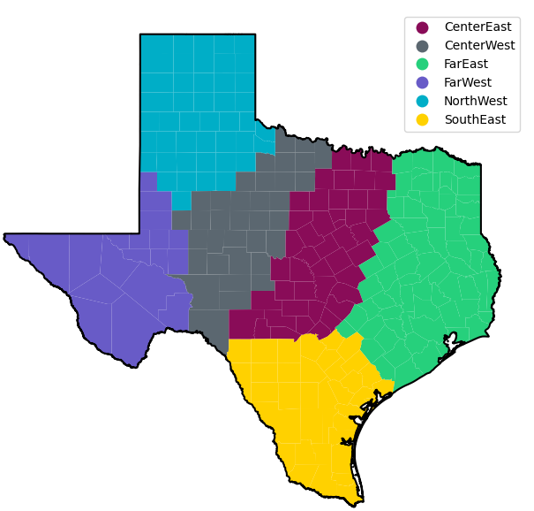
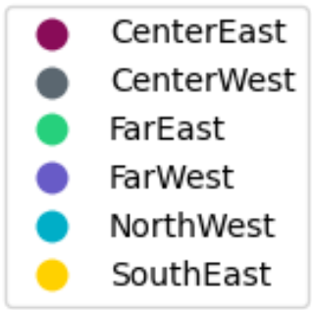
Forecast Presentation Platform
The following changes were made on 06/30/2022
  The Forecast Presentation Platform was released, allowing operators to view and select all available solar and wind forecast models.
  A second solar forecast vendor was integrated into ERCOT systems and was made available for operator selection.
    The first solar forecast vendor is still ERCOT’s default active forecast selection.
    The forecast performance of the second vendor is close to the first, but the new forecasts’ performance will continue to be monitored to ensure consistent high performance.
  Six new solar regions were created to track regional forecast performance.
  New CDR reports have been posted to the MIS which include forecast information from both vendors, at a regional-level.
    Solar Power Production - Actual 5-Minute Averaged Values by Geographical Region
    Solar Power Production - Hourly Averaged Actual and Forecasted Values by Geographical Region
    Hourly System-Wide and Regional Solar Forecasts by Model
    Intra-Hour Solar Power Forecast by Geographical Region
Map of 6 new solar regions
Notes:
ERCOT Nodal Protocols Section 3.1.2 “Each Resource Entity shall use reasonable efforts, consistent with Good Utility Practice, to continually update its Outage Schedule.”

Slide 8
Summary
The following actions were taken to reduce the bias and improve solar forecast accuracy
  Bias correction method
    Implemented on June 22, 2022
    This method makes a correction to the forecast based on the bias seen in the past 30-days.
    Significantly reduced the average Overforecast bias and MAPE.
  Improve reporting of solar resource derates/outages
    Modified resource commissioning checklist requiring new resources to properly submit derates before being approved for each stage of commissioning.
      Changes were presented to the resource integration workshop in December 2021.
    Developed internal tools to identify resources whose reported availability is not aligned with real-time behavior.
  Updating the forecasting model’s solar resource power curves
    Power curves were updated on 01/03/2022, resulting in small improvement to overforecast bias and MAPE
    The newest contract with ERCOT’s solar forecast vendor requires a quarterly update.
  Integration of Second Solar Forecast Vendor
    Forecasts from new vendor have been available for operator selection since June 30, 2022
    Forecast performance for both vendors are close. ERCOT is closely monitoring performance of the second vendor to ensure they perform consistently at a high level.
The Resource Forecasting and Analysis team is continuously evaluating renewable forecast performance and will continue to monitor the impact of these changes.

Slide 9
Discussion

Slide 10
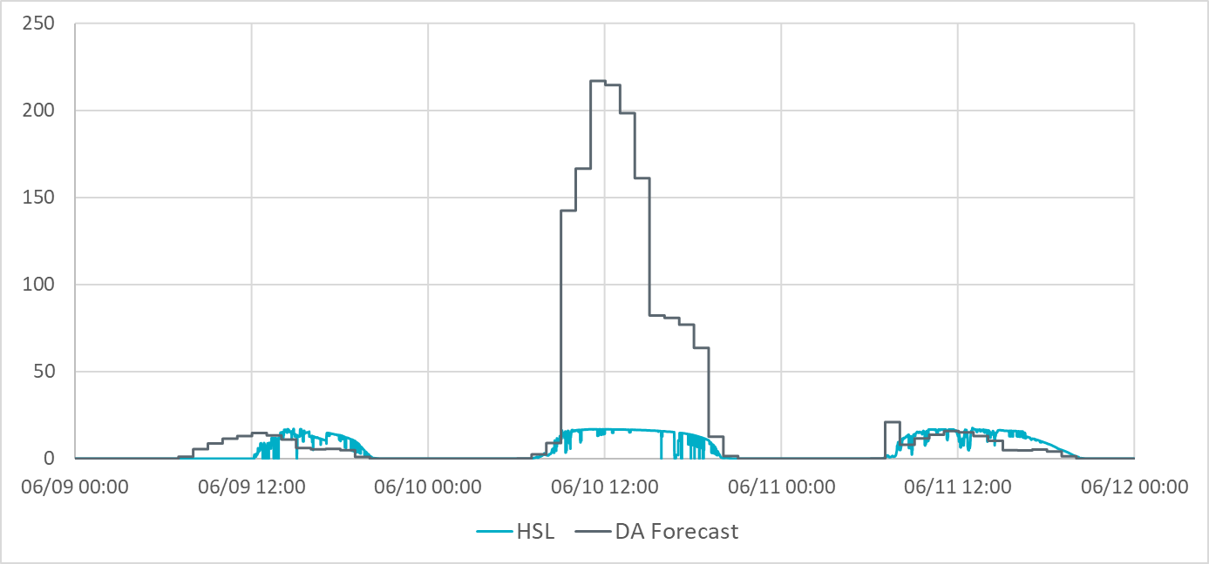
Example: Impact of Late Outage Submission on Forecast
ERCOT’s solar forecast vendor uses a snapshot of the most recent outage data submitted in ERCOT’s Outage Scheduler to determine future solar resource availability in its forecasting process.
  ERCOT expects solar resources to accurately report the resource’s availability and/or capability changes in ERCOT Outage Scheduler.
Many of the units that had issues with outage submissions are new units that are still in the commissioning process.
  ERCOT expects new resources to report availability and/or capability changes in ERCOT Outage Scheduler while in the commissioning phase.
Below is an example of the impact outages have on the Day Ahead solar forecast for a resource.
On 6/9 at 14:00
Day Ahead Snapshot for 6/10
On 6/9 at 16:00 a new Derate to 20 MVA Submitted
Day Ahead forecast for 6/10 built using the 6/9@14:00 snapshot assumes full availability. Results in up to ~200MW over-forecast error
On 6/10 at 14:00
Day Ahead Snapshot for 6/11
Day Ahead forecast for 6/11 captures the Outage amount in the forecast.
Notes:
ERCOT Nodal Protocols Section 3.1.2 “Each Resource Entity shall use reasonable efforts, consistent with Good Utility Practice, to continually update its Outage Schedule.”

Slide 11
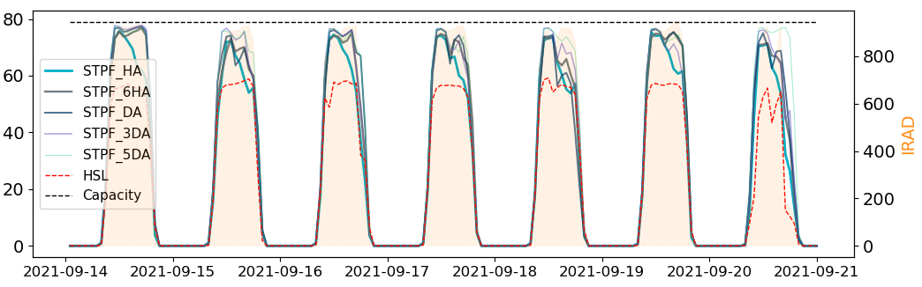
Example: Systematic Reduction in Capability
Some resources are demonstrating a systematic reduction in their overall capability.
  ERCOT will be reaching out to these individual resources to better understand the underlying driver for this behavior.
  ERCOT is also working with its solar vendor ensure that going forward improvements are put in place such that the solar forecast models automatically adapt to the recent resource behavior. This should help in improving the overall solar forecast performance.
Below is an example that compares the forecasts generated for a solar resource with its actual HSL on a sunny day.
MW

Slide 12
How Forecasting Impacts Operations
Current Operating Plans (COP) for Wind & Solar resources are limited to be up to their most recent STWPF/STPPF.
  Used in ERCOT’s Look Ahead studies (e.g. Day Ahead Market (DAM), Day Ahead Reliability Unit Commitment (DRUC), Hourly Reliability Unit Commitment (HRUC), etc.).
The intra-hour IRR forecasts help determine the Generation to be Dispatched, provided to SCED every 5 minutes.
When renewables are over-forecast, there is a potential for insufficient resources being committed or dispatched.
When renewables are under-forecast, there is a potential of over commitment or dispatch of conventional resources, which can lead to curtailments and other market inefficiencies.
Notes:
1.ERCOT will automatically populate cop hsl from latest forecast.
2. QSE have opportunity to override.

