Slide 1
ESR Telemetry Review
SOC, MXSOC, MNSOC, MXCP, MXDP
Operations Planning & Ancillary Services
8/22/22

Slide 2
Expectations for SOC, MXOS, MNOS Telemetry
Maximum Operating State of Charge (MXOS) – telemetry represents the maximum amount of stored energy capability in MWh that can be delivered at the POI and cannot be exceeded.
  For example, if the ESR currently has the capability of storing a maximum of 10 MWh and the discharge efficiency is 0.94, then this telemetered value (SOC_Max) = 0.94*10=9.4 MWh
State of Charge (SOC) – telemetry represents the amount of energy in MWh that can be delivered to the POI.
  For example, if the ESR is currently storing 6 MWh and the discharge efficiency is 0.94, then this telemetered value (SOC) = 0.94*6=5.64 MWh
Minimum Operating State of Charge (MNOS) – telemetry represents the required minimum amount of stored energy in MWh that can be delivered at the POI and cannot be go below.
  For example, if the ESR is required to store a minimum of 2 MWh and the discharge efficiency is 0.94, then this telemetered value (SOC_Min) = 0.94*2=1.88 MWh

Slide 3
Expectations for SOC, MXOS, MNOS Telemetry
With minimum, maximum, and current state of charge telemetry points, Operators can visualize the ESRs current charge with respect to the charging range.
Notes:
General check:
Values should be in MWh
MXOS > 0.00 MWh
MNOS<=SOC<=MXOS
MNOS >= 0.00 MWh
Telemetry is utilized for situational awareness tools for the ERCOT Operators.

Slide 4
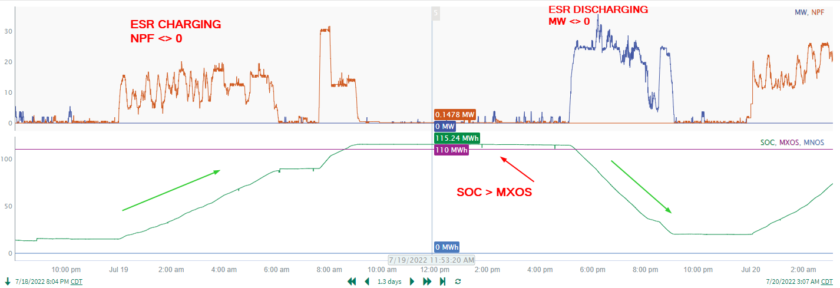
Example of Real Time Telemetry
Notes:
SOC should increase when the ESR-CLR is charging (NPF <> 0)
SOC should decrease when the ESR-GR is discharging (MW <> 0)
This will be flagged for having SOC > MXOS
General check:
Values should be in MWh
MXOS > 0.00 MWh
MNOS<=SOC<=MXOS
MNOS >= 0.00 MWh

Slide 5
Expectations for MXCP and MXDP Telemetry
Maximum Operating Discharge Power Limit (MXDP) – telemetry represents the true inverter discharge capability in MW. This point should account for derates for operational issues. Ideally this would be close to ESR-GR HSL.
  For Example, if a +-10 MW ESR is telemetering a HSL of 3 MW for the ESR-GR, the MXDP should be +10 MW unless there is a derate for operational reason. One can look at the values of HSL and MXDP and if there are differences, one can deduce that the ESR is running out of SOC and is trying to show less MW to SCED for discharge purpose.
Maximum Operating Charge Power Limit (MXCP) – telemetry represents the true inverter charging capability in MW. This point should account for derates for operational issues, but ideally this would be close to ESR-CLR MPC.
  For example, a +-10 MW ESR is telemetering a MPC of 3 MW for the ESR-CLR, the MXCP should be +10 MW unless there is a derate for operational reason. One can look at the values of MPC and MXCP and if there are differences, one can deduce that the ESR is almost full SOC and is trying to show less MW to SCED for charge purpose.

Slide 6
Charge/Discharge Duration
MXDP – Maximum Operating Discharge Power Limit
MXCP – Maximum Operating Charge Power Limit
Min. Discharge Time
Min. Charge Time
With the current state of charge and the maximum discharge/charge rates, ERCOT can calculate the minimum times to reach MXOS and MNOS.

Slide 7
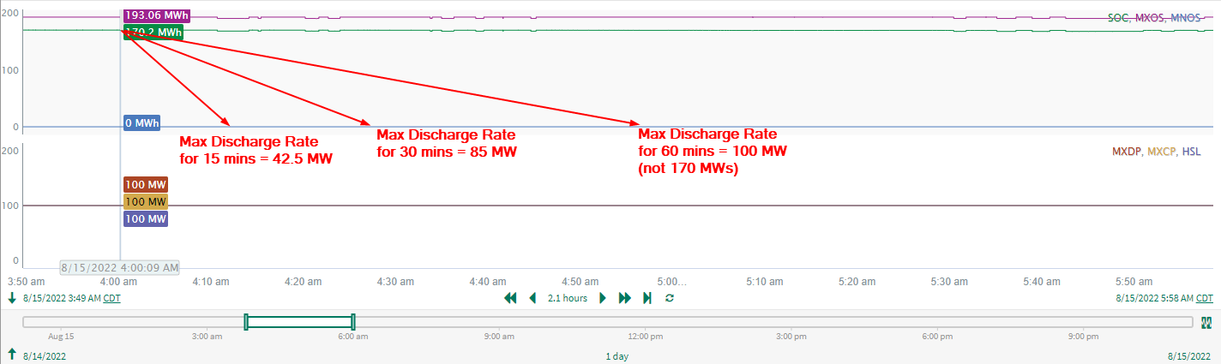
Example of Real Time Telemetry
Notes:
MXOS = 193.06 MWh
SOC = 170.2 MWh
MNOS = 0 MWh
Calculations are as follows:
MW_Discharge = Min(MaxOperDischargeMW, (SOC-SOC_Min)/TimeRange
MW_Charging = Min(MaxOperChargeMW, (SOC_Max-SOC)TimeRange
For the 60 min calculation we hit the max operating discharge limit.

Slide 8
Additional Resources
ICCP Handbook
  https://www.ercot.com/files/docs/2022/02/10/ERCOT_Nodal_ICCP_Communications_Handbook.docx
QMWG Document from Oct 15, 2018 Meeting
  https://www.ercot.com/files/docs/2018/11/08/New_Telemetry_for_Storage_Resourcev2.docx

Slide 9
Questions?

