Slide 1
Review PGRR085 Model Parameter Verification Requirements
John Schmall
ERCOT Transmission Planning
Resource Integration Working Group Meeting
August 23, 2022

Slide 2
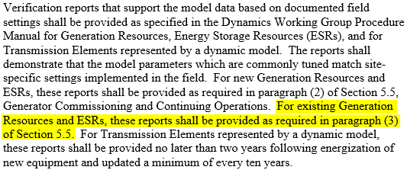
Planning Guide Section 6.2(5)(b)
Document that site specific tunable field settings are accurately reflected in submitted model parameters

Slide 3
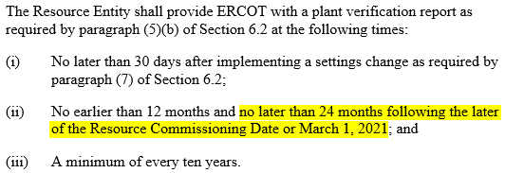
Planning Guide Section 5.5(3)(b)
Specifies timing for providing parameter verification report – required by March 1, 2023, for Resources commissioned prior to March 1, 2021

Slide 4
NERC Recommendation
Panhandle Wind Disturbance: Joint NERC and Texas RE Staff Report
This recommendation is addressed by the model parameter verification component of PGRR085 which was approved and became effective as of March 1, 2021
A Market Notice to remind Resource Entities of this requirement was sent out on August 18, 2022

Slide 5
Summary of Dynamic Model Requirements
Requirement | Applicable Equipment | Required Tests⁽¹⁾ | When to Update | Responsible Entity | Language
Model Quality Test for PSS/e Model | All Resources and Dynamic Transmission Elements (system strength test is only required for inverter-based devices) | Flat start, small and large voltage disturbance, small frequency disturbance, and system strength tests | A new or updated model | Equipment owner (RE, IE or TSP) | PG 6.2(5)(c)
Model Quality Test for PSCAD Model | Inverter-based Resources (IBRs) and Inverter-based Dynamic Transmission Elements | All above tests plus phase angle jump test | A new or updated model | Equipment owner (RE, IE or TSP) | PG 6.2(5)(c)
Unit Model Validation for PSCAD Model | Inverter-based Resources (IBRs) | Step change in voltage, large voltage disturbance, system strength, phase angle jump, and subsynchronous tests | A new PSCAD model provided after 3/1/21. (Validation tests should not need updating for model parameter updates on an existing model.) | Resource owner (RE or IE) | PG 6.2(5)(d)
Model Parameter Verification (“Verification Report”)¹ | All Resources and Dynamic Transmission Elements | Provide evidence that tunable model parameters match what is implemented in the field. Evidence can take the form of screenshots, nameplate photographs, signed manufacturer commissioning reports, etc. | Within 30 days of COD (i.e., Part 3 approval), 12 to 24 months after COD or 12-24 months after March 1, 2021 for existing resources, A minimum of every 10 years. Within 30 days of a change at the plant | Equipment owner (RE, IE or TSP) | PG 5.5, PG 6.2(5)(b)
Helpful instruction can be found in the recently updated Model Quality Guide package posted at: https://www.ercot.com/services/rq/re. After downloading package, please review the “About Verification Reports” document.

Slide 6
Questions
?

