Slide 1
Monthly Review of Reliability Unit Commitment Market Impacts - July 2022
Wholesale Market Working Group
ERCOT Staff
August 30, 2022

Slide 2
RUC Resource-Hours
July 2022 | Total | Opt-Out | Non-Opt-Out
Instructed Resource-Hours
Total Count | 928.4 | 236.0 | 692.4
Effective Resource-Hours*
Total Count | 907.9 | 235.8 | 672.1
Average LSL | 48.7 | 54.0 | 46.8
Average LDL | 88.8 | 169.7 | 60.4
Average BP | 100.4 | 198.7 | 65.8
Average HSL | 272.5 | 289.5 | 266.5
* The difference between “Instructed” and “Effective” values is a result of Resources starting up, shutting down, receiving partial hour instructions, or otherwise not being dispatchable by SCED.

Slide 3
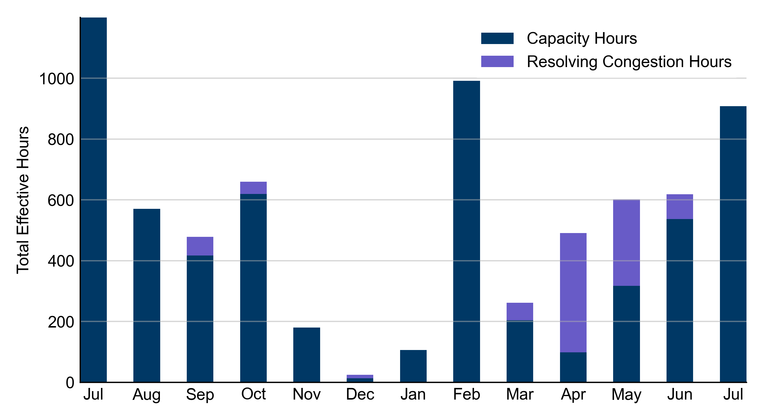
RUC Instruction Reasons: Last 13 Months RUCs in July 2022 were driven exclusively by system-wide capacity concerns.

Slide 4
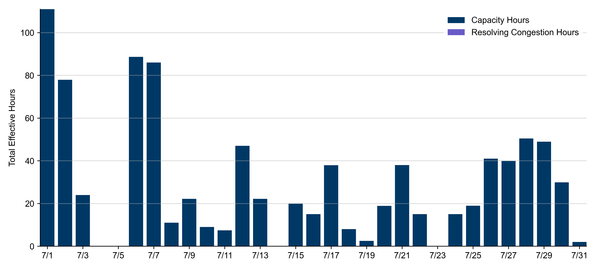
RUC Instruction Reasons
July 2022
907.9 effective RUC Resource-hours.
100.0% for capacity concerns.

Slide 5
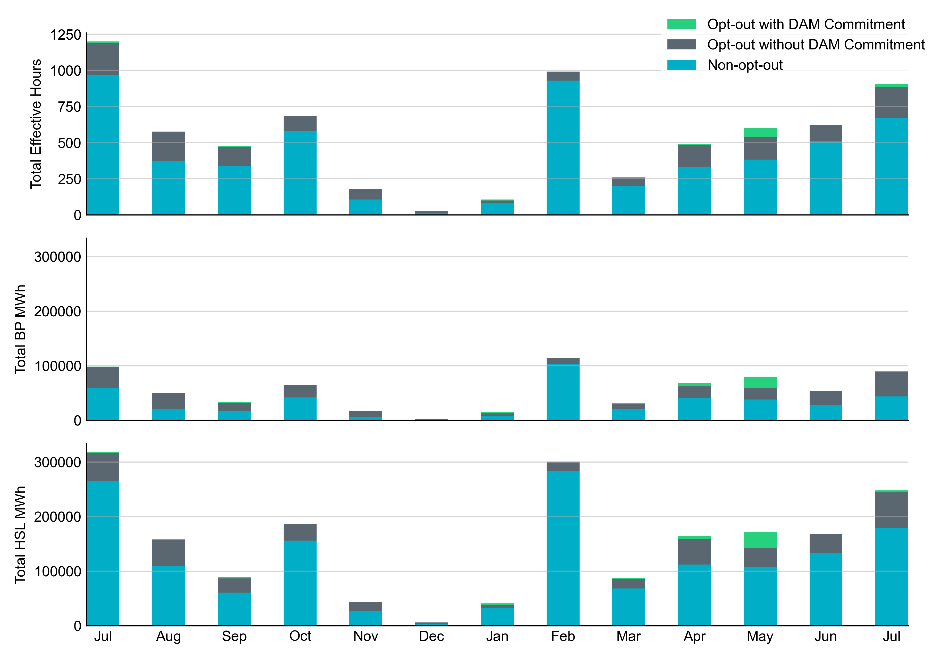
Non-opt-out and Opt-out Totals: Last 13 Months July 2022 had a total of 672.1 non-opt-out effective Resource-hours (74.0%) and 235.8 opt-out effective Resource-hours (26.0%).

Slide 6
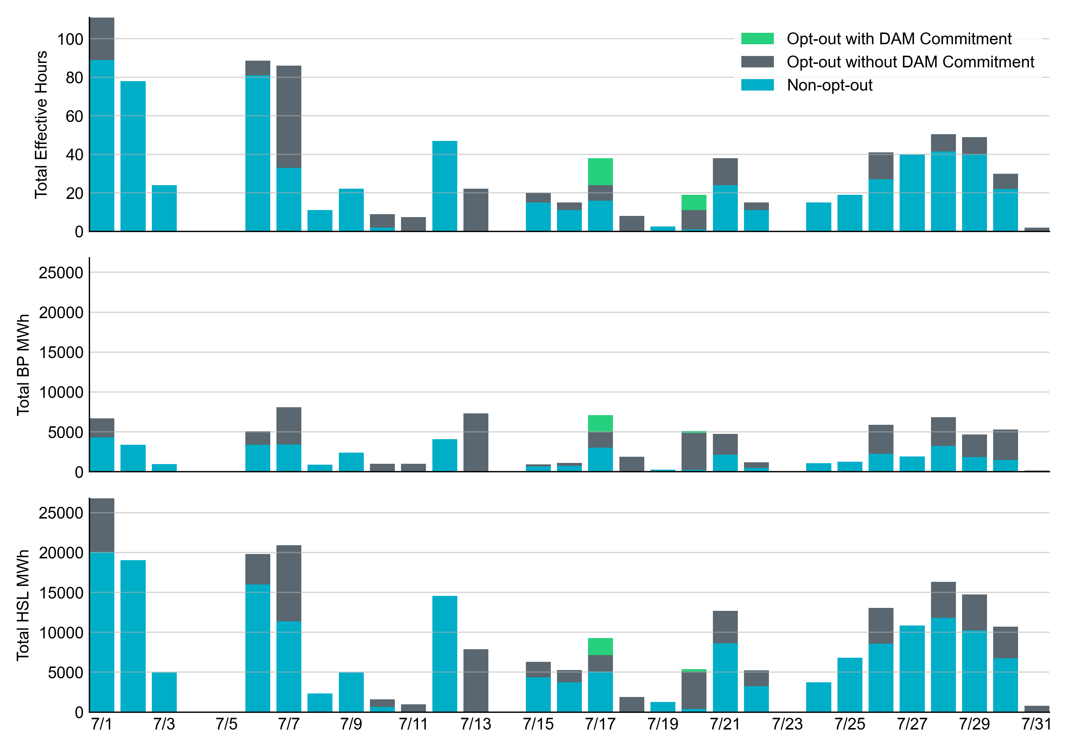
Non-opt-out and Opt-out Totals: July 2022

Slide 7
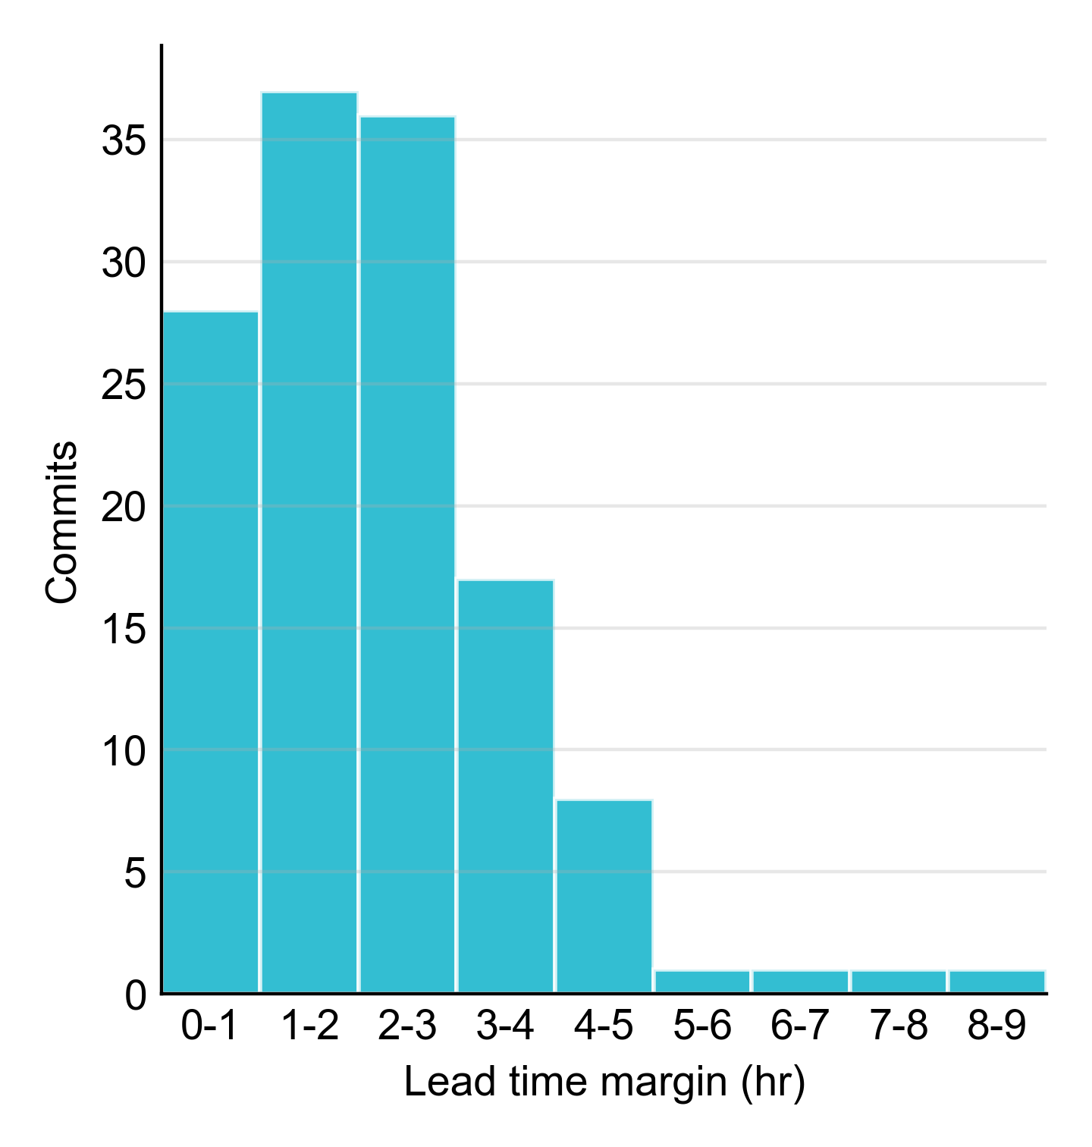
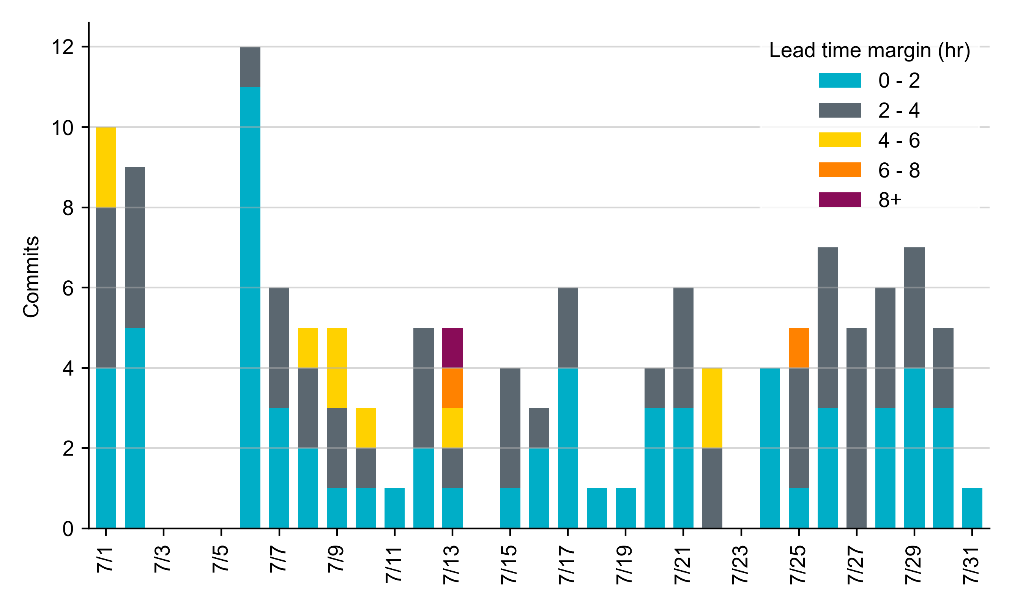
RUC Lead Time Margin: July 2022
Most RUC commit windows had lead time margin at or below 2 hours.
Lead time refers to the length of time between a RUC instruction and the start of the commitment window.
Lead time margin is the difference between lead time and the Resource’s startup time.
In cases where a Resource is committed for multiple back-to-back time blocks, lead time margin is calculated from the first instruction.
Notes:
The first bin is both-inclusive (i.e. [0, 2] ), while subsequent bins are right-inclusive (i.e. (2, 4], (4, 6], etc.).

Slide 8
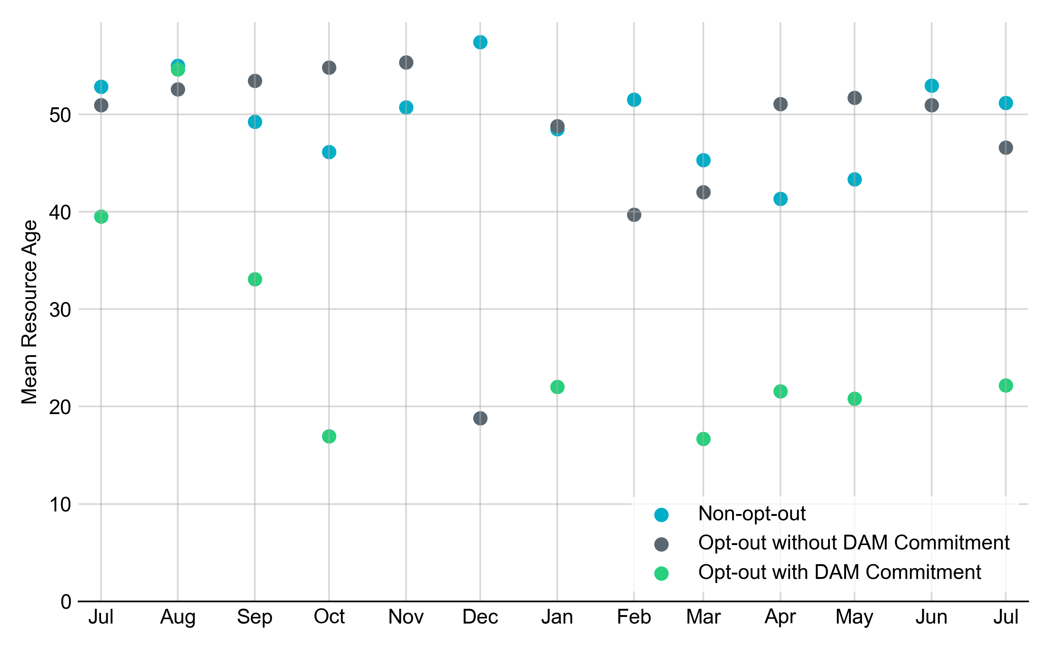
Average Resource Age In July 2022, the mean age of RUC-committed Resources was 51.2 years for Non-Opt-Out Resource-hours, 46.6 years for Opt-Out Resource-hours without DAM Commitments, and 22.2 years for Opt-Out Resource Hours with DAM Commitments.
Note: For Resource configurations with multiple physical generators, the age of the oldest generator is used.

Slide 9
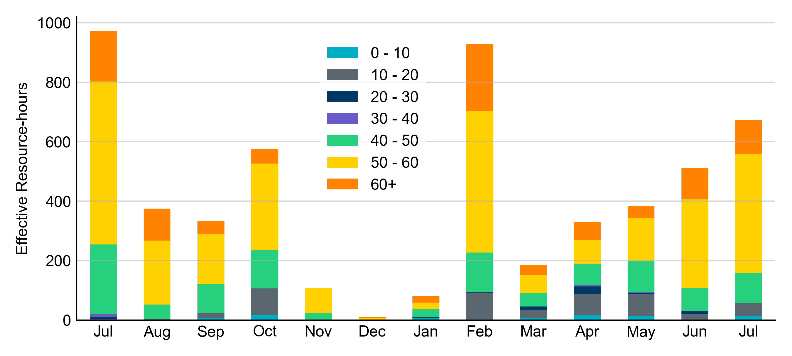
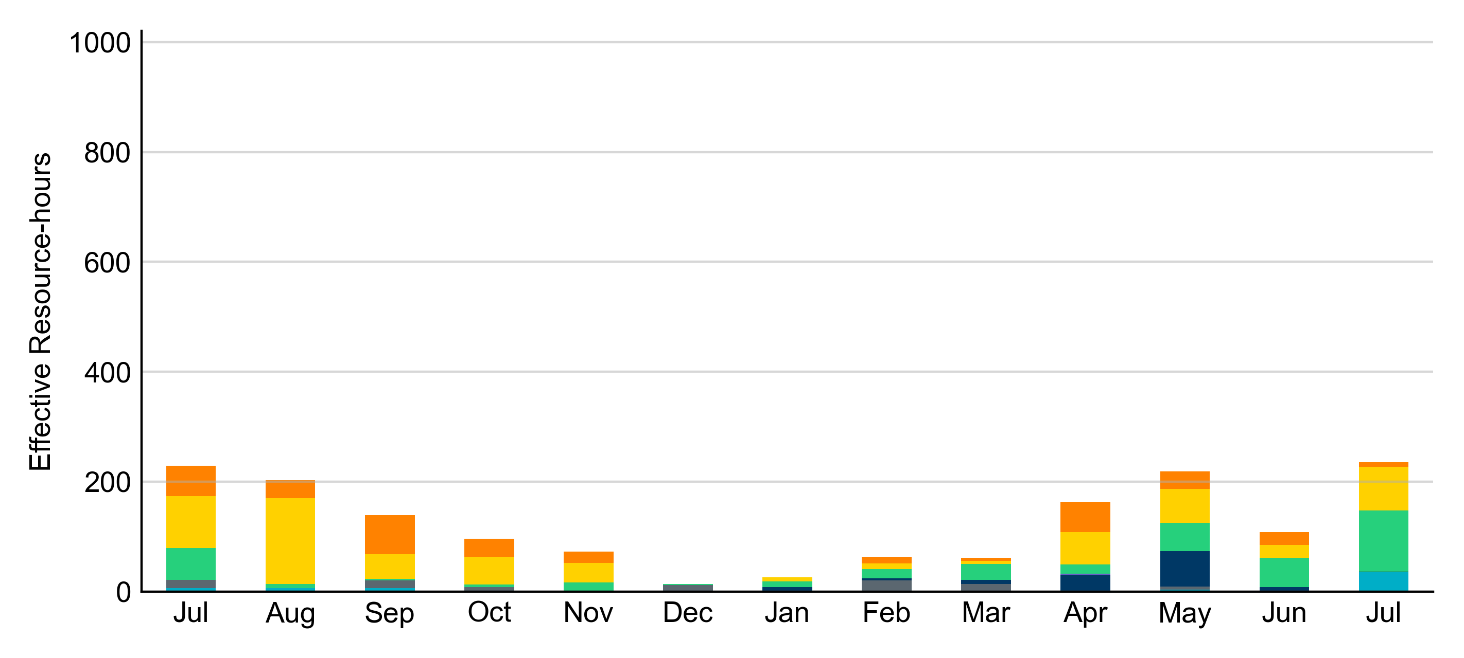
Age Category Most RUC-Committed Resources in July 2022 were older than 40 years.
Non-opt-out
Opt-out

Slide 10
RUC-Instructed Resource Dispatch above LDL
July 2022
When Resources did not successfully opt out, there were 88.4 effective Resource-hours for which the Resource was dispatched above its LDL.
For 19.7 of these Resource-hours, the LMP for the RUC-instructed Resource was above the RUC offer floor.
For 68.7 of these Resource-hours, the LMP for the RUC-instructed Resource was below the RUC offer floor.
For all these Resource-hours, the RUC-instructed Resource was mitigated.
There were no Exceptional Fuel Cost submissions for RUC-Committed Resources in July 2022.

Slide 11
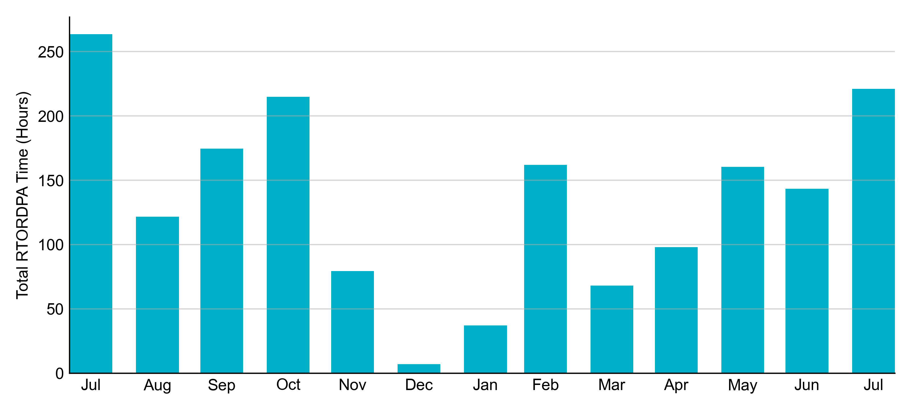
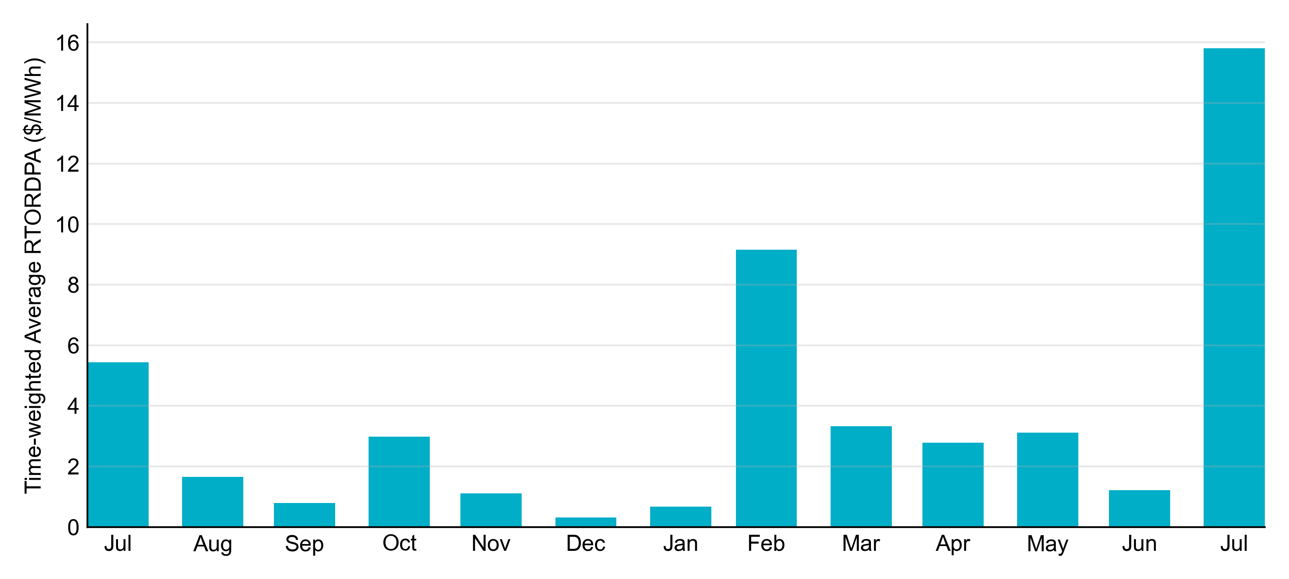
Reliability Deployment Price Adder: Last 13 Months July 2022 had a total of 221.2 RTORDPA hours with an average value of $15.81/MWh.

Slide 12
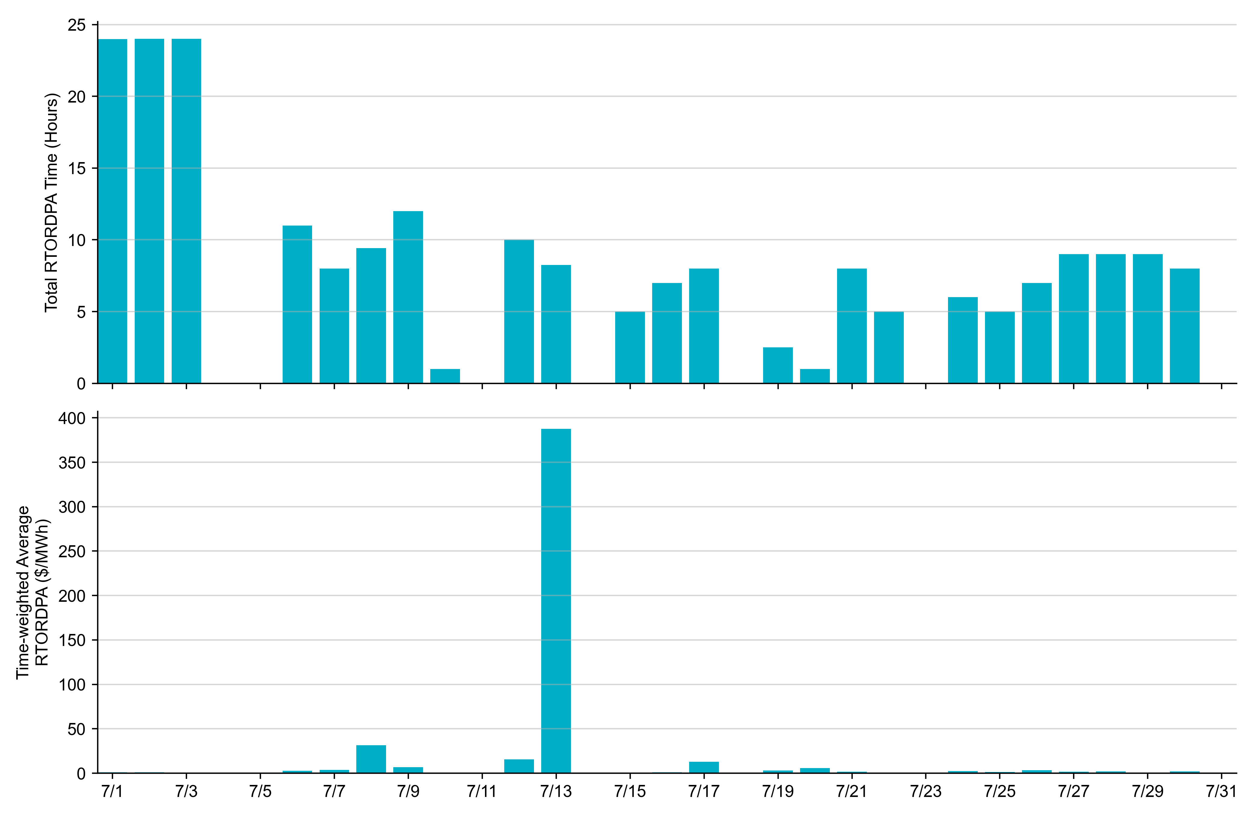
Reliability Deployment Price Adder: July 2022 OD 7/13 had the highest daily time-weighted average RTORDPA: $387.66/MWh.

Slide 13
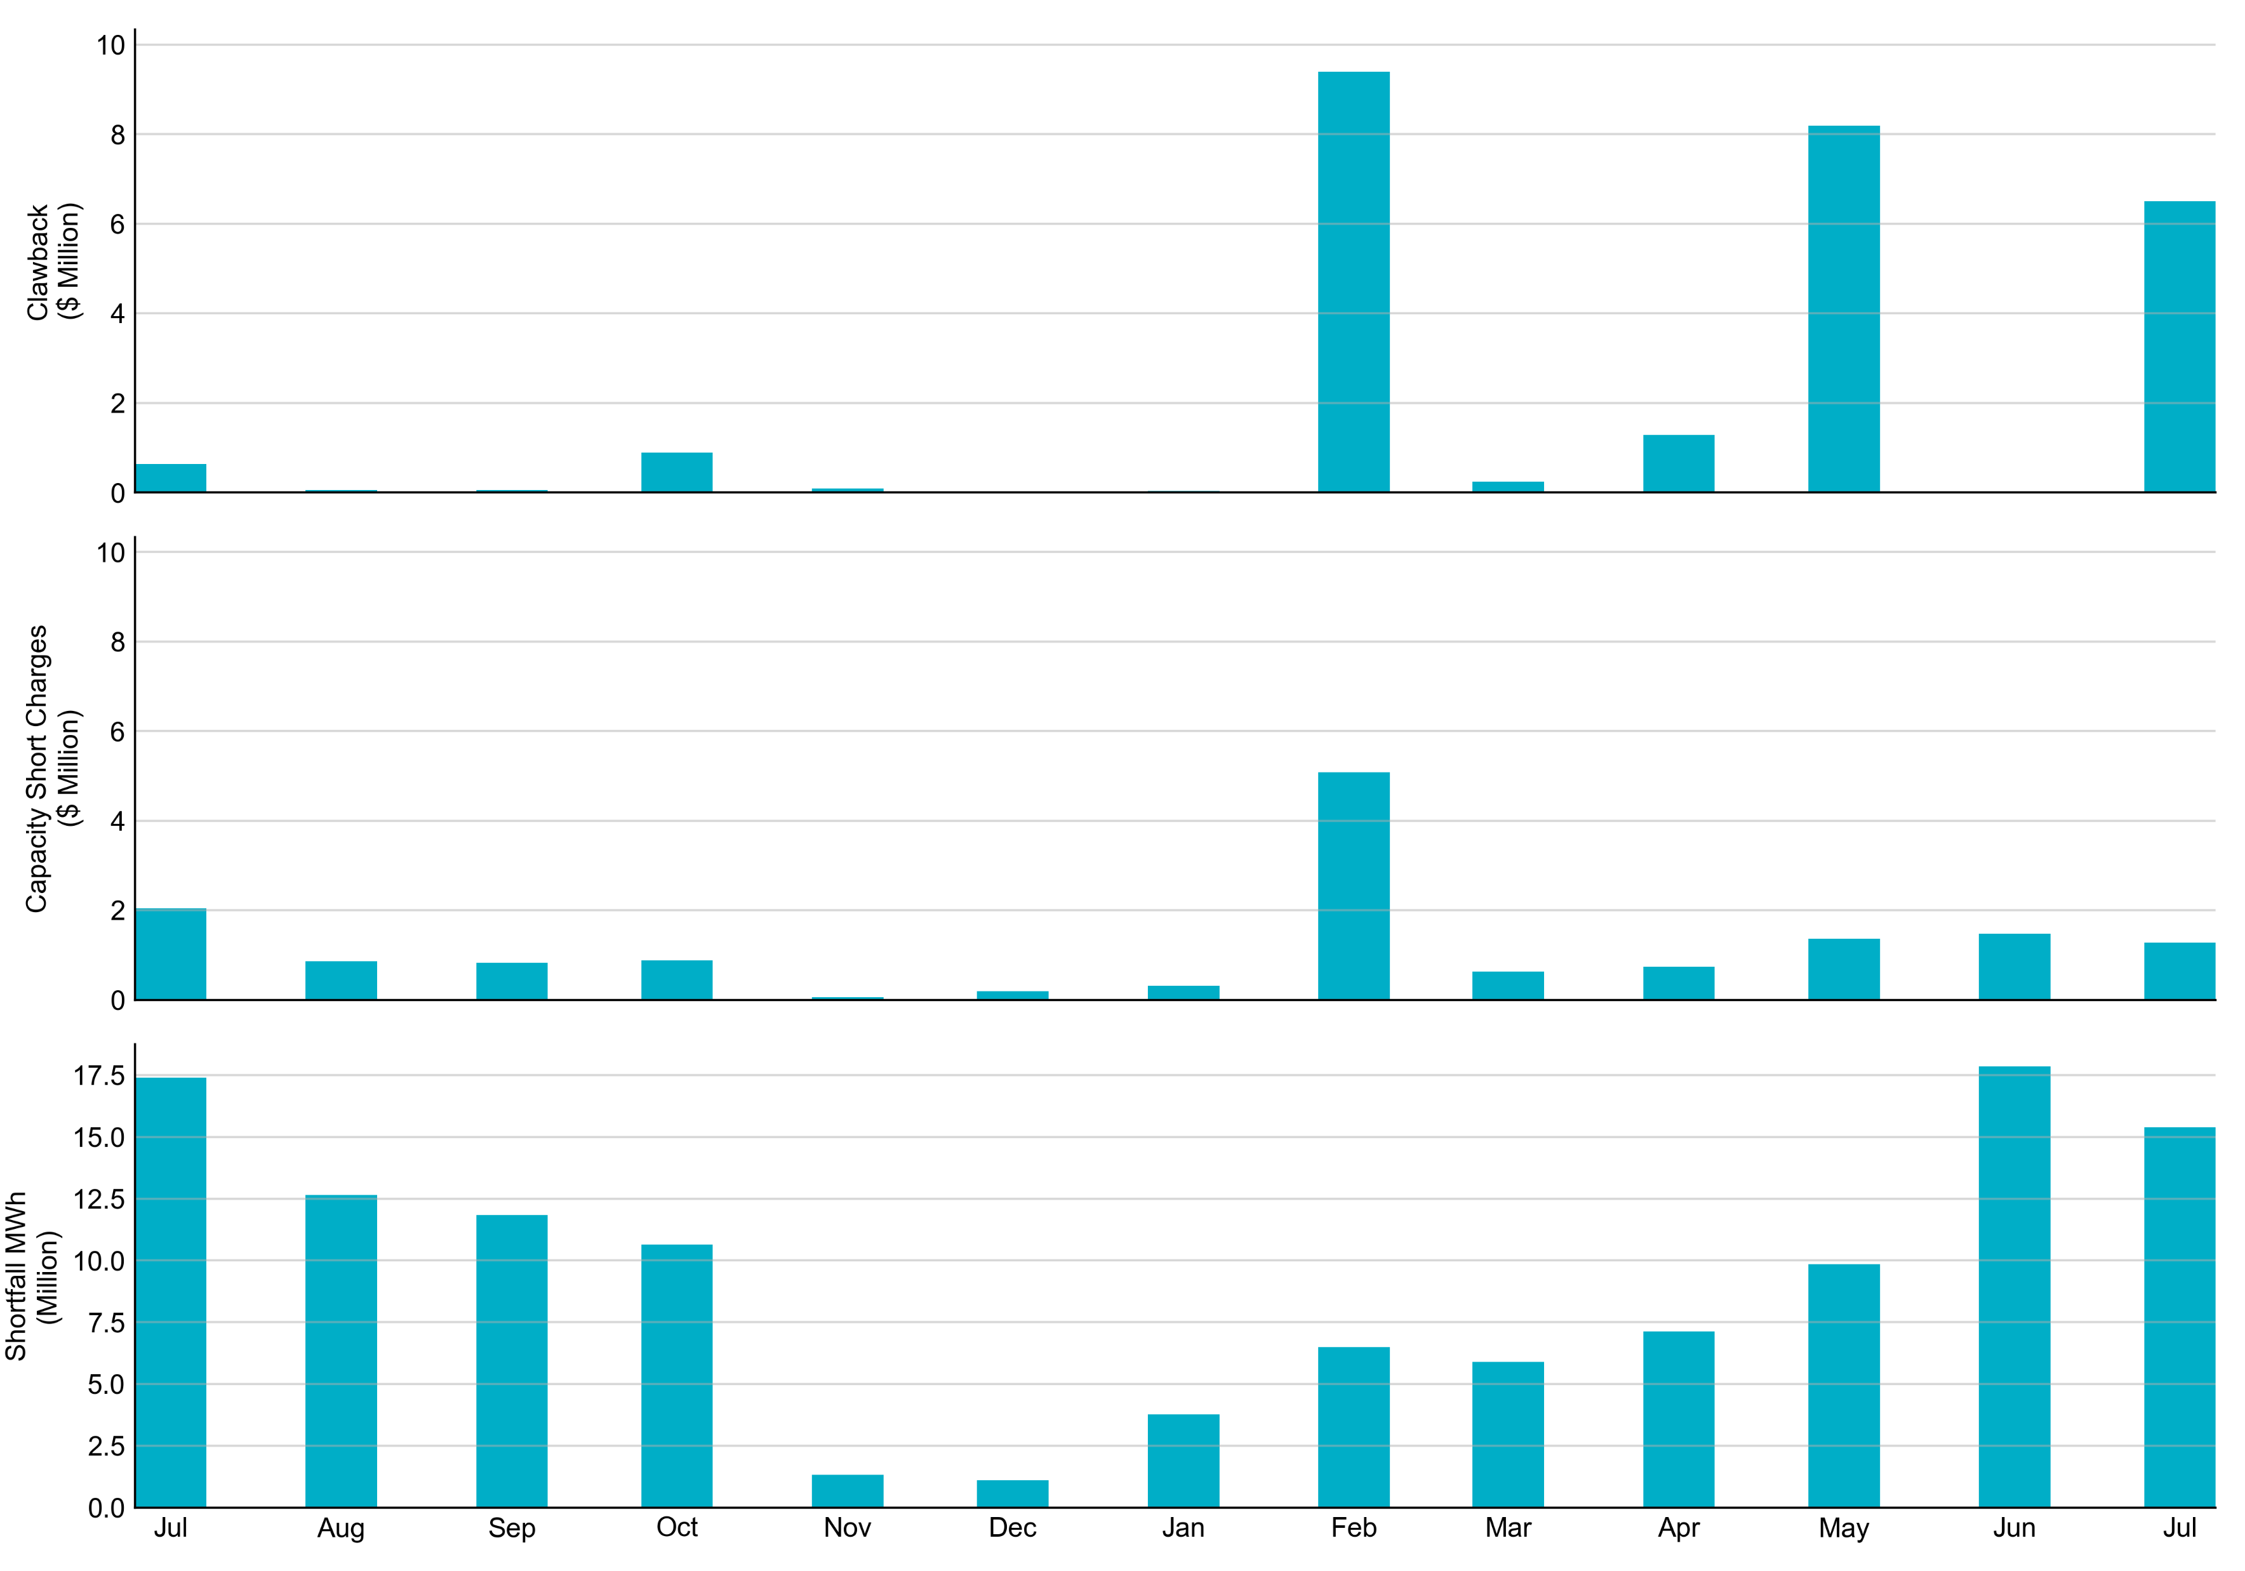
RUC Clawback, Capacity Short Charges, and Shortfall For July 2022, the total Clawback charge was $6.501M. The total Make-Whole payment was $1.283M, which was almost entirely covered through capacity-short charges.
In July 2022, $1.283M in Make-Whole was paid out. Only $6.88 was uplifted to load due to rounding.

