Slide 1
ERCOT Frequency Control Report
July 2022
ERCOT
Operations Planning
PDCWG | Aug 17th, 2022

Slide 2
Summary of July 2022
CPS1: 169.69%
Current CPS1 12-Month Rolling Average: 172.50%
0 BAAL Exceedance(s)
7 hourly CPS1 score below 100%
BAAL-003 Events have updated through 2020
2020 BAAL-003 FRM Performance: -789.34
2022 RMS1 Statistics
  Mean: 15.58 mHz
  Min: 12.43 mHz
  Max: 19.70 mHz
Energy Statistics
  Total Energy: 45,993,543 MWh
  Wind Energy: 8,753,431 MWh
  Percent Energy from Wind: 19.03 %
  Solar Energy: 2,937,875 MWh
  Percent Energy from Solar: 6.39%
Minimum System Inertia
  Mean: 288,716 MW*s
  Max: 344,003 MW*s on July 11th
  Min: 245,198 MW*s on July 2nd
Notes:
Mean: 288,716 MW*s
Max: 344,003 MW*s on July 11th
Min: 245,198 MW*s on July 2nd

Slide 3
Frequency Control
CPS1, BAAL, & RMS1

Slide 4
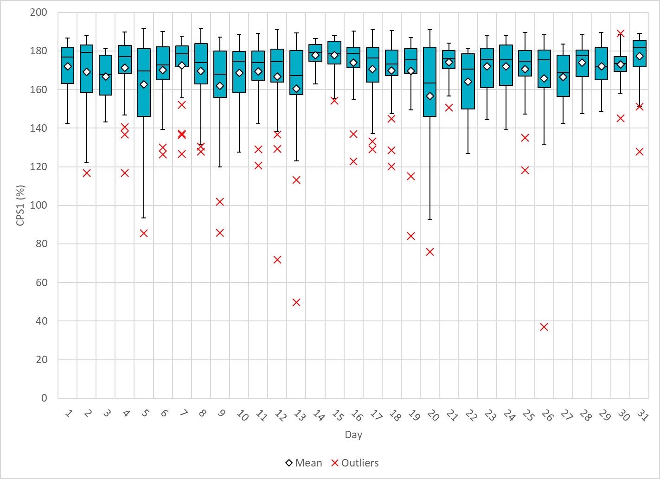
Hourly CPS1 by Day
July-22 CPS1 (%): 169.69
Notes:
1. 85.59%@ 7/5/2022 HE 18:00
Expected Generation Deviation
Between 17:00-18:00 the Expected gen dev remained negative. The largest expected gen dev was -2459MW @ 5:23 PM with signification contribution from solar and wind generation.
IRR Ramps
Between 17:00-18:00 wind ramped down by ~2600 MW
Regulation: Regulation up was exhausted for most part of this hour. A manual SCED offset of 350 MW was applied.
2. 85.77% @ 7/9/2022 HE 16:00
Expected Generation Deviation
Expected generation deviation remained negative during most part of the hour. The largest expected gen dev was -541MW @ 4:40 PM with significant contribution from solar and thermal generation.
IRR Ramps
Between 4:05pm to 4:40 pm solar ramped down by ~700 MW.
One thermal unit was derated due to equipment issues.
Regulation: Regulation up was exhausted during the low expected gen dev periods.
3. 71.83%@ 7/12/2022 HE 21:00
Expected Generation Deviation
Between 20:00-21:00 the Expected gen dev remained negative. The largest expected gen dev was -1522MW @ 8:05 PM with signification contribution from solar and wind generation.
IRR Ramps
Between 20:00-21:00 wind ramped down by ~1100 MW
Between 20:00-21:00 solar ramped down by ~1700 MW
Regulation: Regulation up was exhausted for over half of this hour. Two manual SCED offsets of 300 and 200 MW were applied.
4. 49.81%@ 7/13/2022 HE 16:00
Expected Generation Deviation
Between 15:00-16:00 the Expected gen dev remained negative for most part of the hour. The largest expected gen dev was -2119MW @ 3:23 PM with signification contribution from solar generation.
IRR Ramps
Between 15:00-15:23 solar ramped down by ~800 MW
Between 15:50-16:00 solar ramped down by ~700 MW
Regulation: Regulation up was exhausted during the IRR ramping periods.
5. 84.20%@ 7/19/2022 HE 19:00
Expected Generation Deviation
Between 18:00-19:00 the Expected gen dev remained negative for most part of the hour. The largest expected gen dev was -2052MW @ 6:20 PM with signification contribution from solar and wind generation.
IRR Ramps
Between 18:05-18:20 wind ramped down by ~300 MW
Between 18:00-19:00 solar ramped down by ~2800 MW
Regulation: Regulation up was exhausted during the IRR ramping periods. Two manual SCED offsets of 300 and 500 MW were applied.
6. 75.90%@ 7/20/2022 HE 20:00
Expected Generation Deviation
Between 18:00-19:00 the Expected gen dev remained negative for the entire hour. The largest expected gen dev was -1971MW @ 7:30 PM with signification contribution from solar generation.
IRR Ramps
Between 19:00-20:00 solar ramped down by ~4000 MW
Regulation: Regulation up was exhausted for most part of this hour. A manual SCED offset of 300 MW was applied.
7. 36.92%@ 7/26/2022 HE 20:00
Expected Generation Deviation
Between 18:00-19:00 the Expected gen dev remained negative for the entire hour. The largest expected gen dev was -2968MW @ 7:32 PM with signification contribution from solar and wind generation.
IRR Ramps
Between 19:00-20:00 solar ramped down by ~4700MW
Regulation: Regulation up was exhausted for most part of this hour. Multiple SCED offsets were applied with the max offset of 400 MW.

Slide 5
BAAL Exceedances & Violations
There are 0 BAAL exceedance(s) in July.

Slide 6
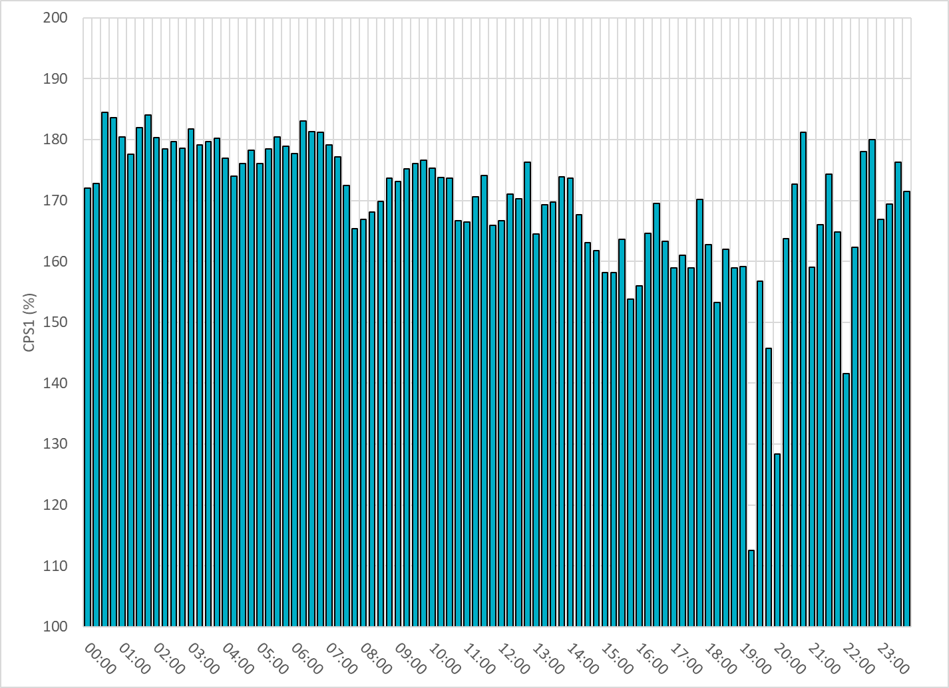
15-Minute Average CPS1%
July-22 CPS1 (%): 169.69
Notes:
Overall the 15 min CPS1 score is above 160, Between 19:00 and 20:00 ,the CPS1 is between 110 to 150 due to solar down ramps.

Slide 7
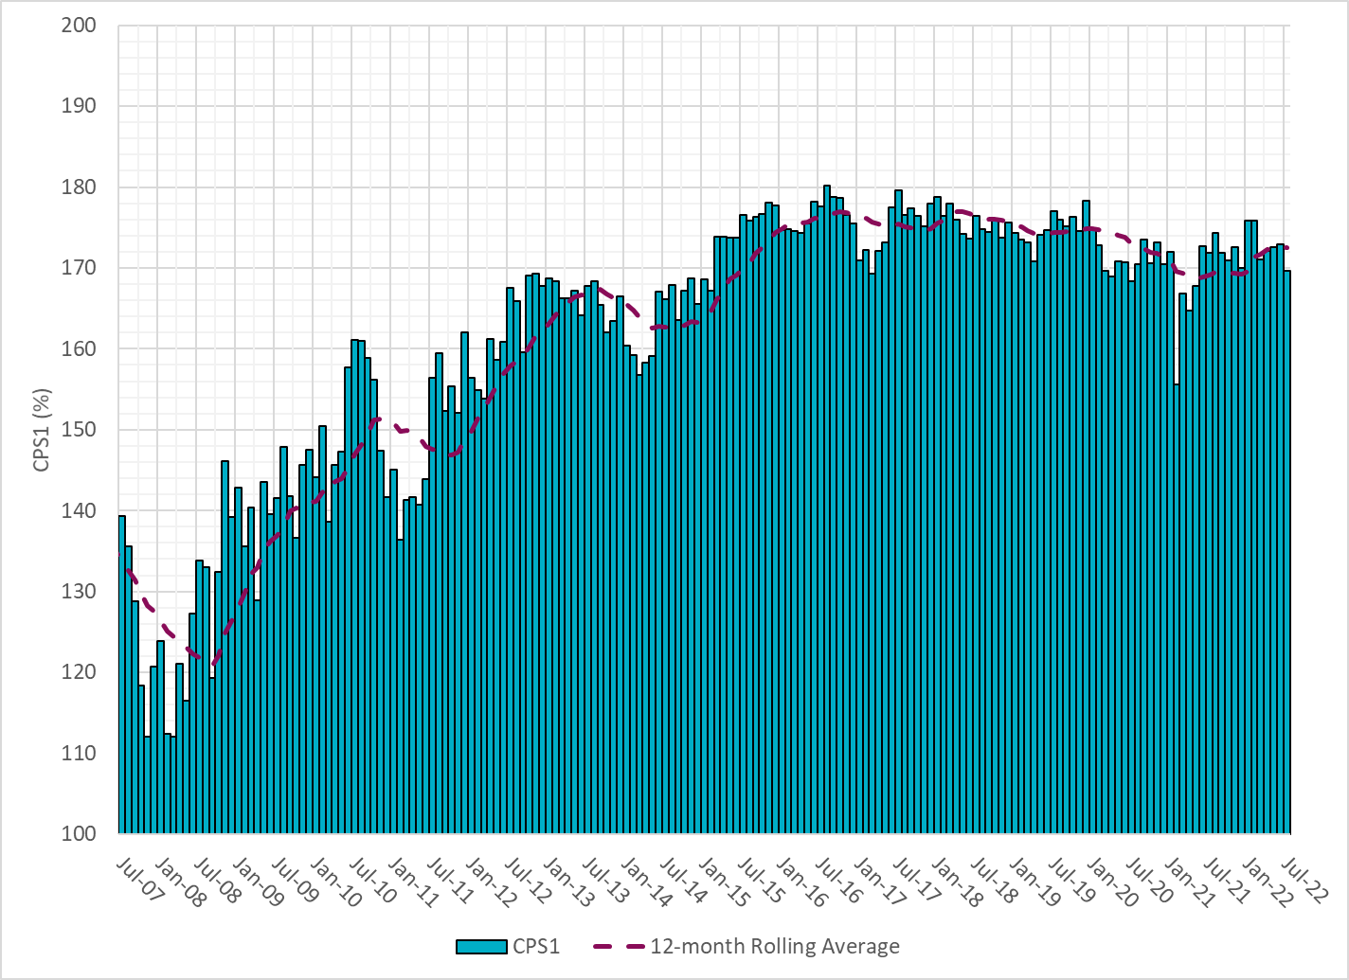
12-Month Rolling Average CPS1
Current 12-Month Rolling Average: 172.50%
Notes:
12 month rolling average CPS1 score is 172.50, which is good and CPS1 score for July is slightly lower than the last month.

Slide 8
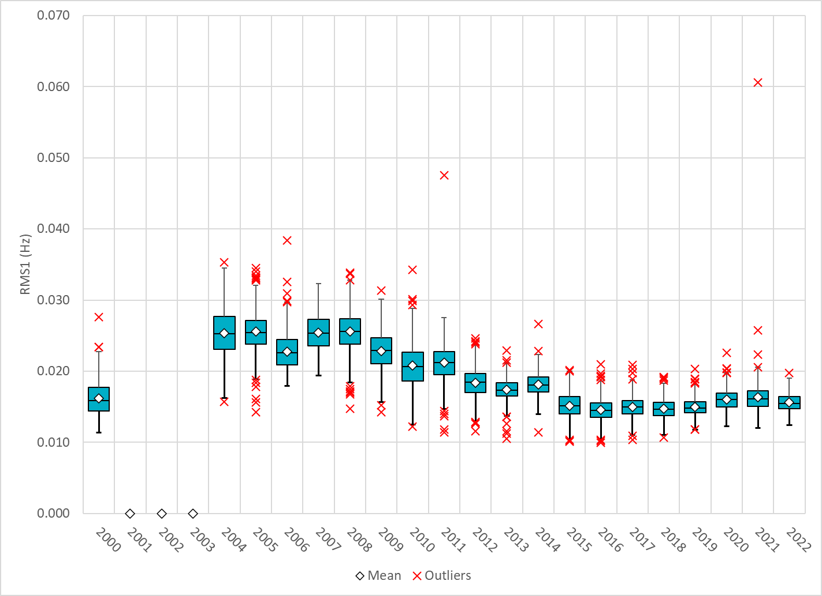
Daily RMS1 of ERCOT Frequency by Year
Notes:
Daily RMS1 frequency by year is so far slightly smaller overall compared with the 2021.
Mean: 15.58 mHz
Min: 12.43 mHz
Max: 19.7 mHz

Slide 9
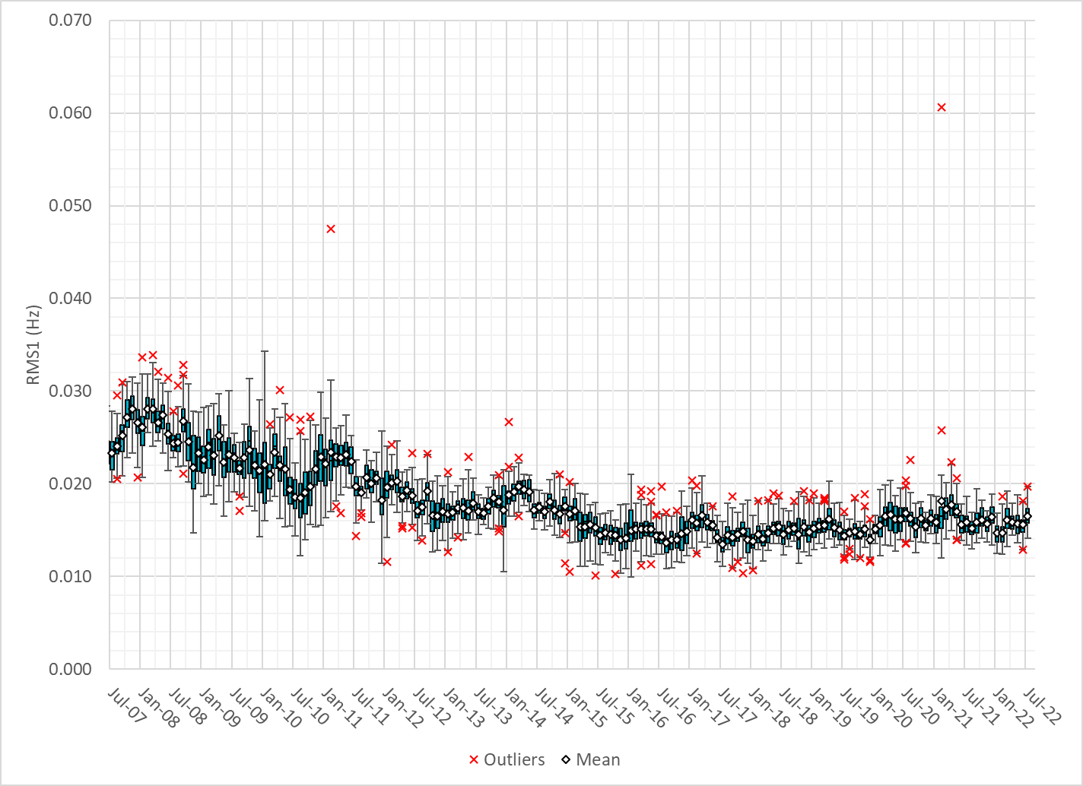
Daily RMS1 of ERCOT Frequency by Month
Notes:
A More granular look at last 15 years of RMS1 by month
16.48Mhz on avg for July 2022

Slide 10
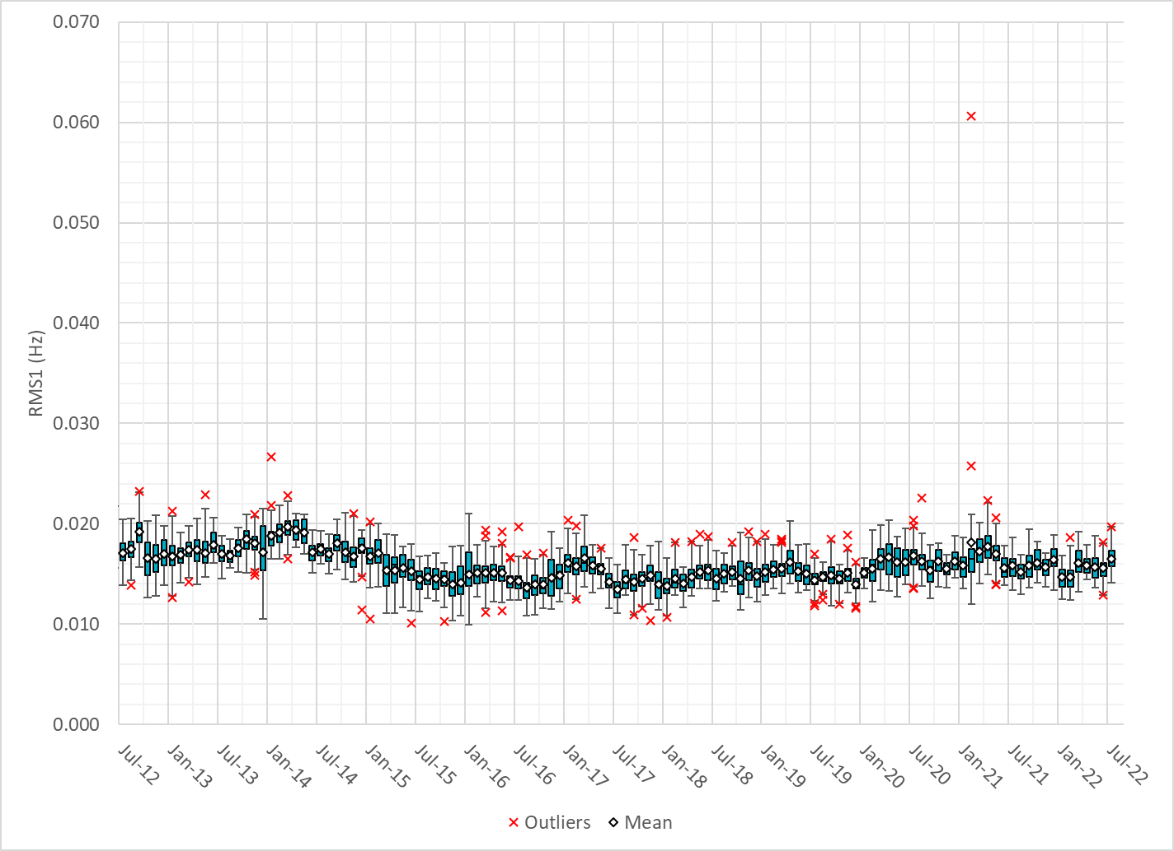
Daily RMS1 of ERCOT Frequency by Month
Notes:
Same data but only showing for the last 10 years

Slide 11
Frequency Profile Comparison

Slide 12
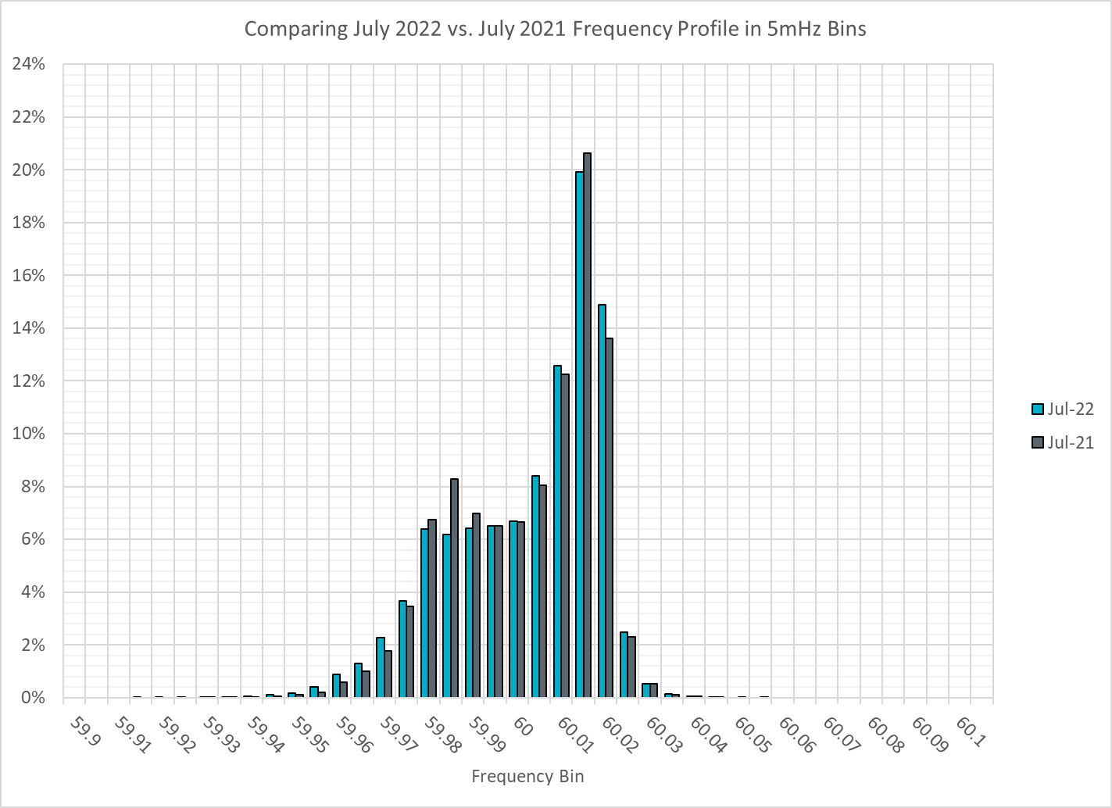
Frequency Profile Comparison
Notes:
Comparison of frequency profile for July 2021 and July 2022, we see slightly more instances of frequency hovering at or below the lower deadband in July 2022.

Slide 13
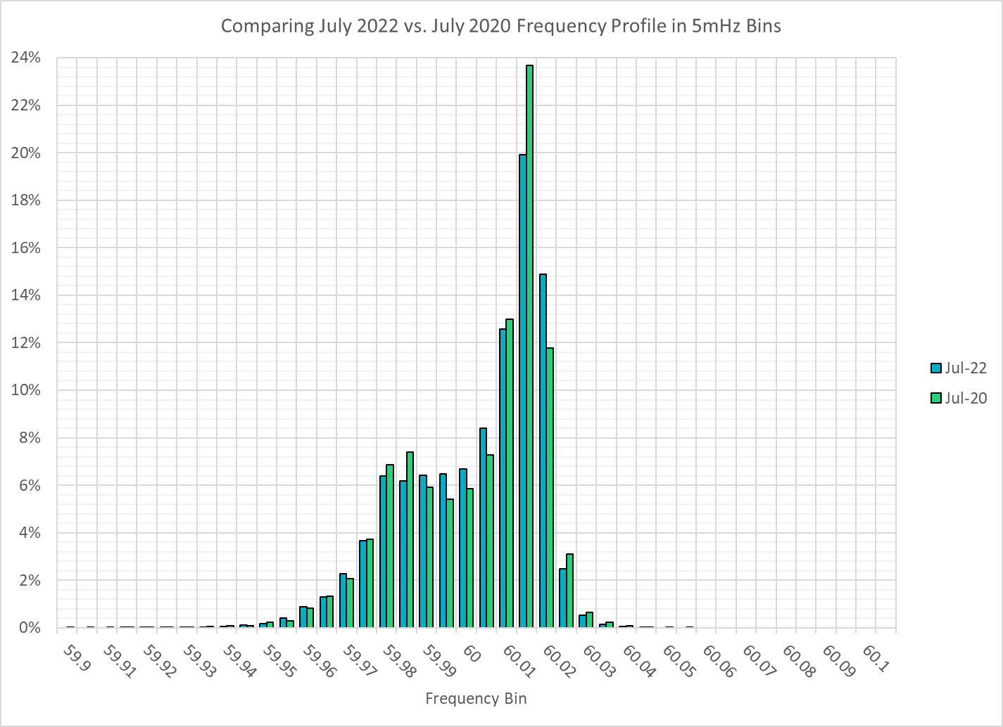
Frequency Profile Comparison
Notes:
Comparison of frequency profile for July 2020 and July 2022, same observation here, we see slightly more instances of frequency hovering at or below the lower deadband in July 2022.

Slide 14
Time Error Correction

Slide 15
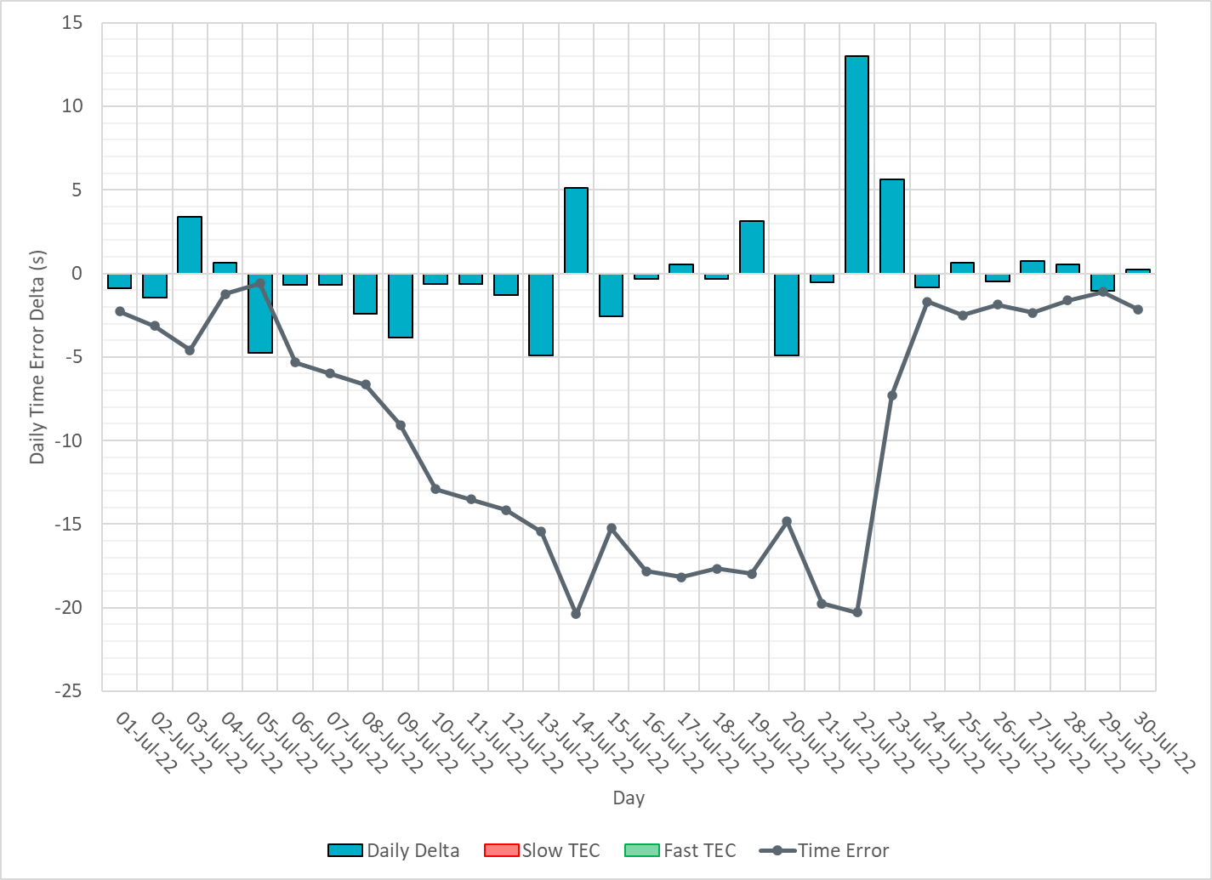
ERCOT Daily Time Error
Notes:
We did not make time error corrections. The drop in time error was due to significant IRR ramps. By making GTBD changes, we were able to successfully recover time error.

Slide 16
Time Error Corrections Log Summary
There have been no time error corrections since December 2016

Slide 17
BAL-003 Performance

Slide 18
Op. Year 2020 BAL-003 Selected Events – Update
Notes:
BAL-003

Slide 19
Op. Year 2020 BAL-003 FRM Performance - Update
Notes:
OP2018: FRO = -381.0, FRM_median = -843.17, FRM_average = -959.7
OP2019: FRO = -381.0, FRM_median = -811.14, FRM_average = -892.5
OP2020: FRO = -425.0, FRM median = -789.34, FRM average = -879.0
OP2021: FRO =

Slide 20
ERCOT Energy Statistics

Slide 21
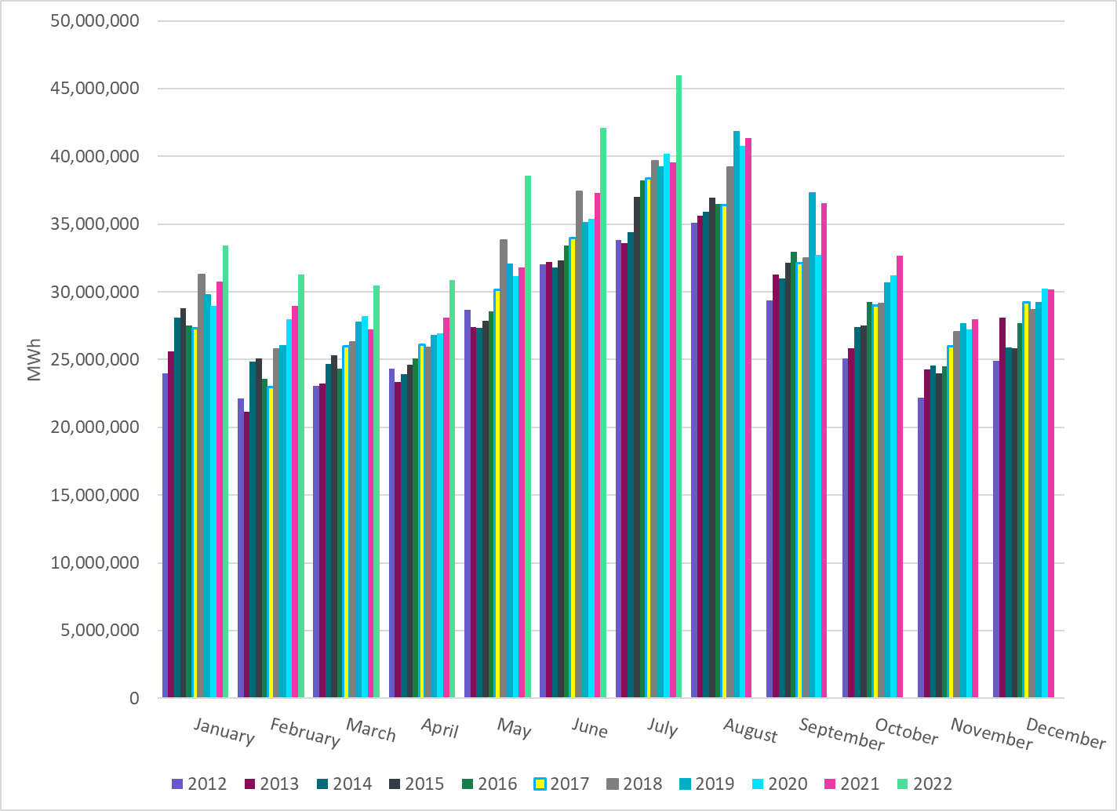
Total Energy
Notes:
45,993,543 MWh
There is an increase in total energy compared to last year and last month

Slide 22
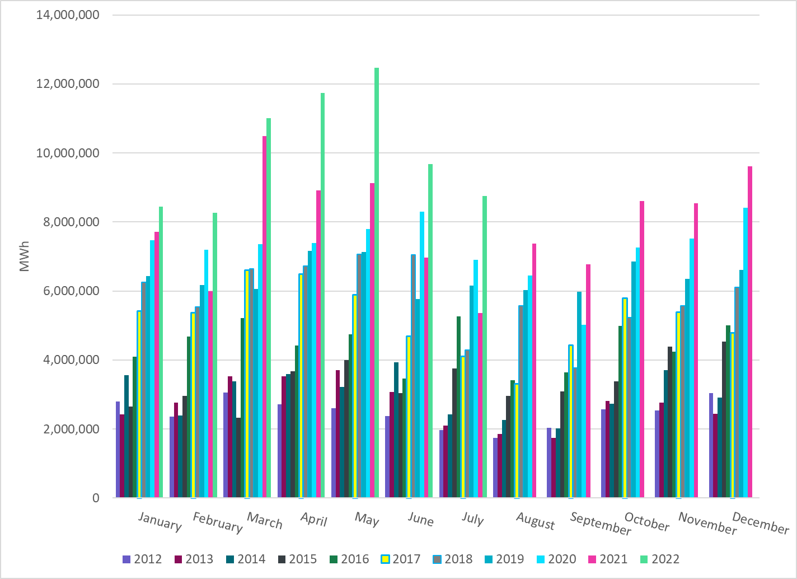
Total Energy from Wind Generation
Notes:
8,753,431 MWh
We see notable decrease in the wind energy production in July.

Slide 23
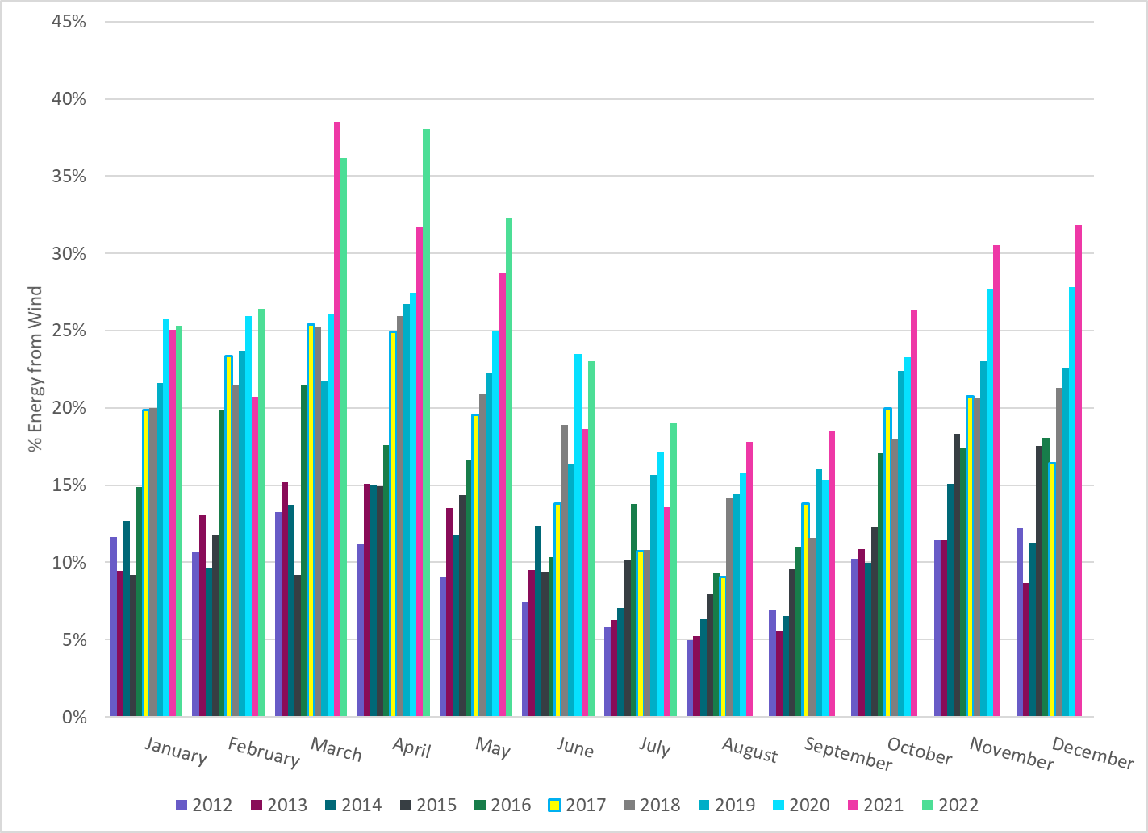
% Energy from Wind Generation
Notes:
19.03%
of total energy was provided by wind generation

Slide 24
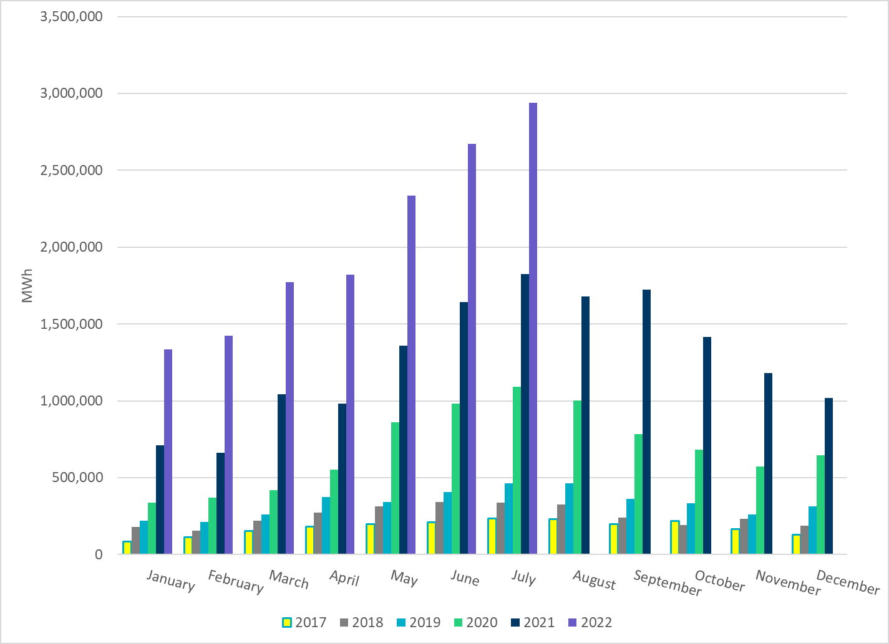
Total Energy From Solar Generation
Notes:
2,937,875 MWh
There is also a notable increase in solar energy production in July.

Slide 25
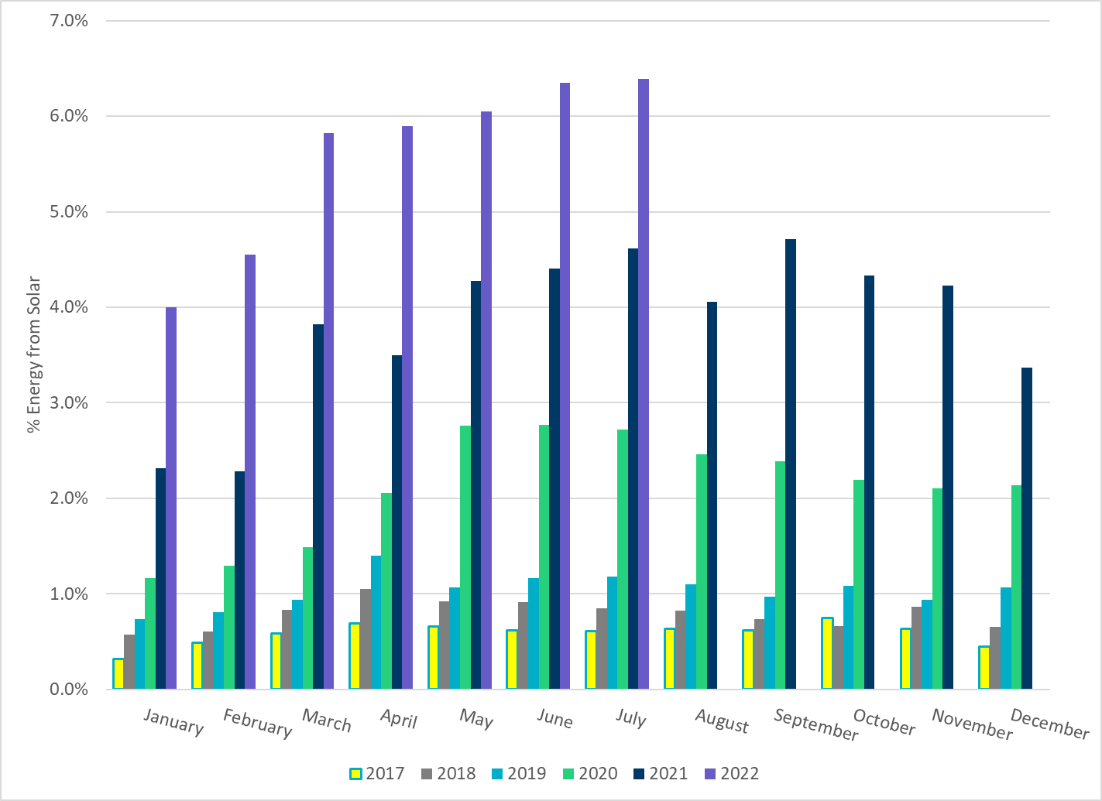
% Energy from Solar Generation
Notes:
6.39% of total energy was provided by solar generation

Slide 26
ERCOT System Inertia

Slide 27
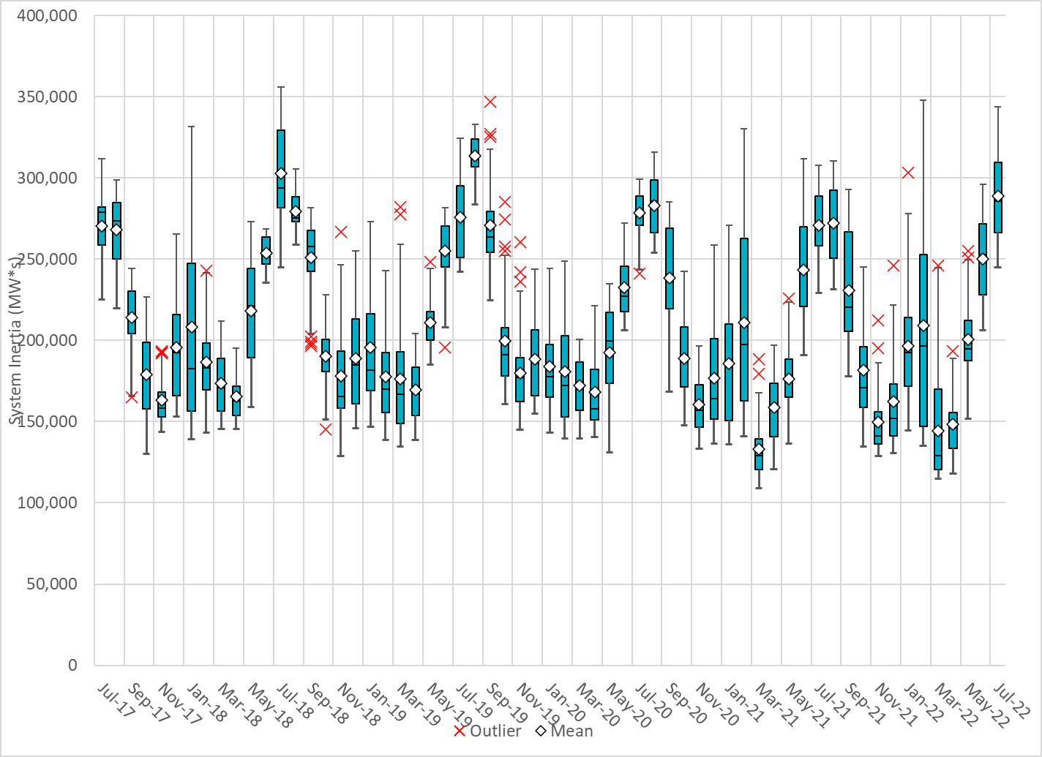
Daily Minimum System Inertia
Notes:
Minimum Inertia =245,198 MW*s on 07/02/2022
Previous Minimum was 109,029 MW*s on 3/22/2021
Data:
Mean: 288,716 MW*s
Max: 344,003 MW*s on July 11th
Min: 245,198 MW*s on July 2nd

Slide 28
Questions?
Thank you!

