Slide 1
ERCOT Frequency Events
July 2022
ERCOT
Operations Planning
PDCWG | August 17, 2022

Slide 2
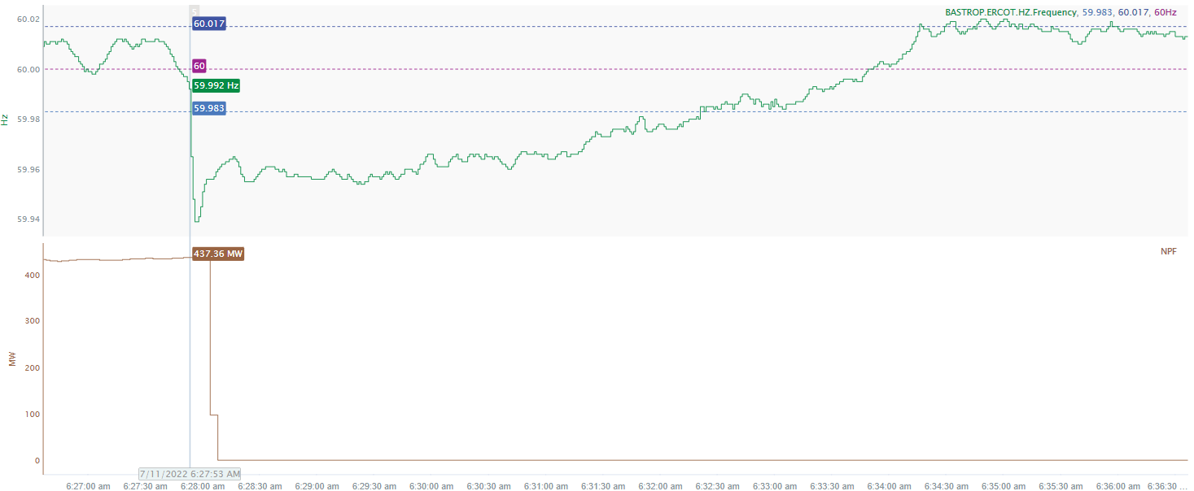
7/11/22 6:27:53(Non-FME)
Notes:
The combined cycle tripped offline while carrying approximately 437 MW
Starting Frequency: 59.992 Hz
Minimum Frequency: 59.939 Hz
A-C Time : 4 seconds
Recovery Time(back to deadband): 4 minutes 28 seconds
RRS Released: 0 MW
Trip Reason: Unknown at this time
Contextual Information: A total of 344 MW of regulation up was deployed during the event.
No Selection Reason : The MW lost is only 437 MW (small event)

Slide 3
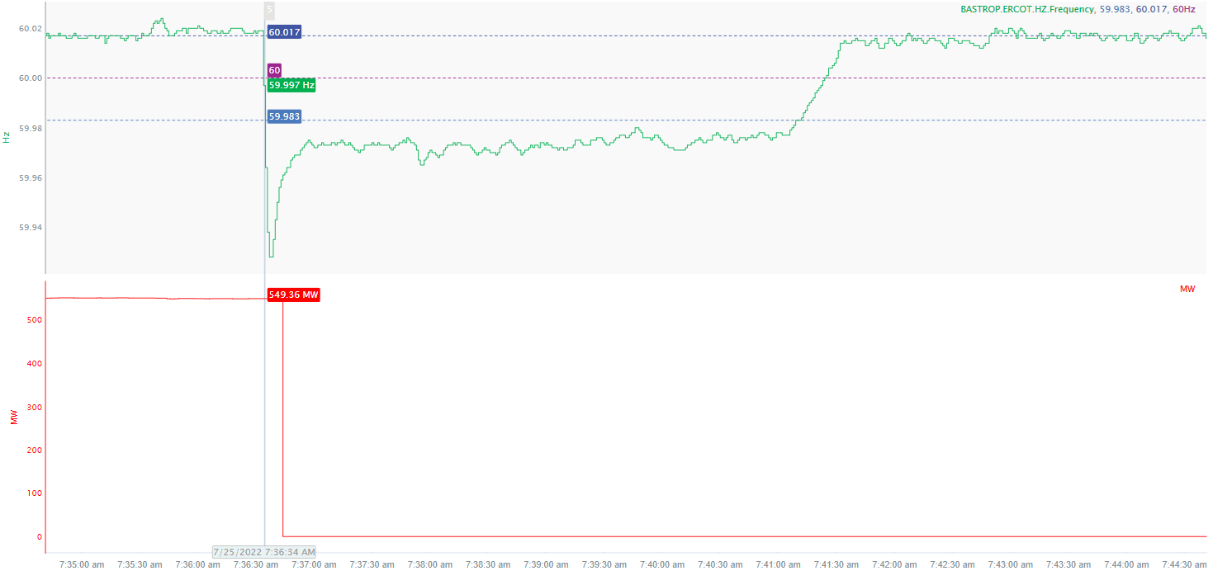
7/25/22 7:36:33(Non-FME)
Notes:
The unit tripped offline while carrying approximately 549 MW
Starting Frequency: 59.997 Hz
Minimum Frequency: 59.928 Hz
A-C Time : 5 seconds
Recovery Time(back to deadband): 4 minutes 36 seconds
RRS Released: 0 MW
Trip Reason: Blown insulator on the GSU
Contextual Information: A total of 282 MW of regulation Up was deployed during the event.
No Selection Reason: The starting frequency was outside the high deadband

Slide 4
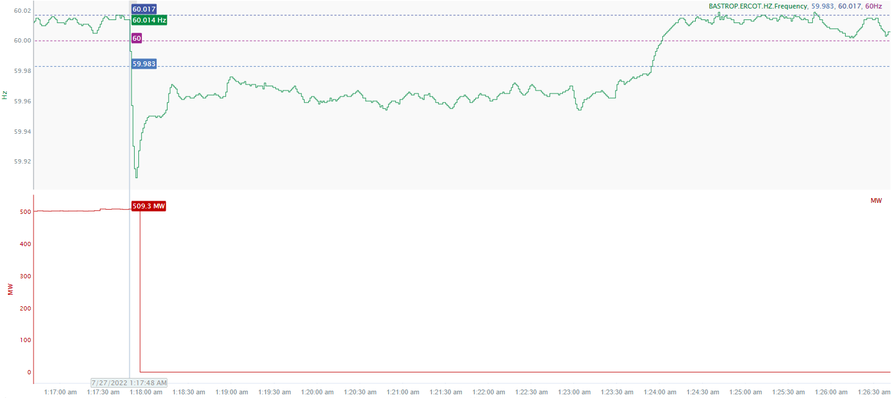
7/27/22 1:17:48(FME)
Notes:
The units tripped offline while carrying approximately 517 MW.
Starting Frequency: 60.014Hz
Minimum Frequency: 59.909 Hz
A-C Time: 5 seconds
Recovery Time (back to deadband): 6 minutes 6 seconds
RRS Released : 0 MW
Trip Reason: Removal of ID fan from service for maintenance
Contextual Information: A total of 88.5 MW of Regulation Up was deployed during the event.

Slide 5
Questions?
Thank you!

