Slide 1
OWG - NPRR 1138
ERCOT
Stephen Solis – Principal, System Operations Improvement
August 18, 2022

Slide 2
Why NPRR 1138
ERCOT has observed the following:
Most IRRs remain synchronized to the ERCOT system when they are not generating real power ( 0 MW output). Most still affect voltage by their MVAR injection/absorption.
Most IRRs telemeter a Real time Telemetered Status of ON and an AVR status of ON when they are not generating real power.
Most IRRs are not leaving their AVR in voltage control mode and controlling voltage when they are not generating real power.
Most IRRs show to have significant reactive capability present at 0 MW output.
Some IRRs have an inability to have stable reactive control at very low MW outputs (e.g. 0-1 MW) resulting in large MVar and voltage swings on the system while having a 0 MW LSL.
IRRs with equipment limitations with voltage control at very low MW output can work with OEM to make adjustments to set its LSL to true equipment limitation.
Some IRRs will leave shunts in last state or utilize shunts to aid in voltage support during 0 MW output.

Slide 3
Why NPRR 1138
NPRR 1138 will provide accuracy and consistency in the following:
Representing accurate reactive capability of units that stay synchronized to the ERCOT system when they are not generating real power ( 0 MW output).
Improves accuracy of studies ability to identify post contingency voltage issues
Improves Operator situational awareness by having consistent application of status and reactive capability curves
Minimizes reactive power and voltage oscillations on the system caused by current equipment limitations

Slide 4
Units with reactive capability at 0 MW output
NPRR 1138, as currently drafted, assumes units with reactive capability at 0 MW will enable and begin controlling voltage at its POIB when at 0 MW
Any unit, if not committed/instructed to remain online, can choose to open its breaker and desynchronize from the system.
Units with reactive capability at 0 MW that remain synchronized to the ERCOT system must reflect that capability and control voltage.
Section 3.15.3 Generation Resource Requirements Related to Voltage Support
(4) Each Generation Resource providing VSS shall operate with the unit’s Automatic Voltage Regulator (AVR) in the automatic voltage control mode unless specifically directed to operate in manual mode by ERCOT, or when the unit is telemetering its Resource Status as STARTUP, SHUTDOWN, or ONTEST, or the QSE determines a need to operate in manual mode due to an undue threat to safety, undue risk of bodily harm, or undue damage to equipment at the generating plant.
(5) Each Generation Resource providing VSS shall maintain the Voltage Set Point established by ERCOT, the interconnecting TSP, or the TSP’s agent, subject to the Generation Resource’s operating characteristic limits, voltage limits, and within tolerances identified in paragraph (4) of Nodal Operating Guide Section 2.7.3.5, Resource Entity Responsibilities and Generation Resource Requirements.
(7) Each QSE shall send to ERCOT, via telemetry, the AVR and Power System Stabilizer (PSS) status for each of its Generation Resources providing VSS. For AVRs, an “On” status will indicate the AVR is on and set to regulate the Resource’s terminal voltage in the voltage control mode, and an “Off” status will indicate the AVR is off or in a manual mode. For PSS, an “On” status will indicate the service is enabled and ready for service, and an “Off” status will indicate it is off or out of service. Each QSE shall monitor the status of its Generation Resources’ regulators and stabilizers, and shall report status changes to ERCOT.

Slide 5
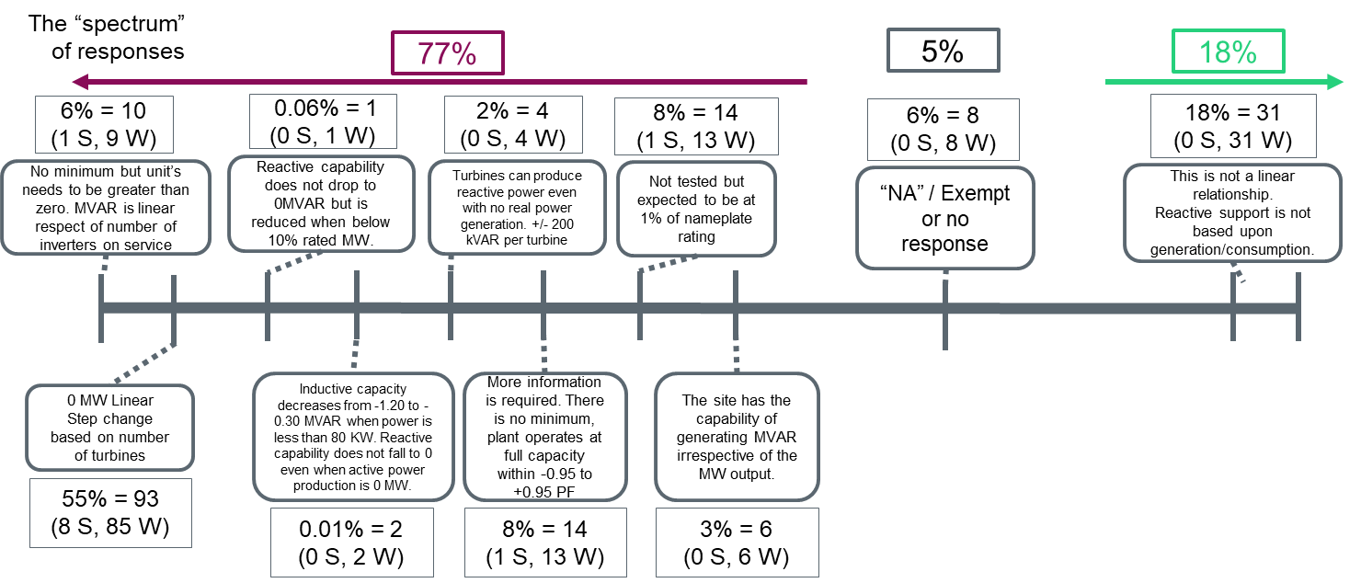
Survey Responses Example #1
Changes are needed to consistently and more accurately reflect system reactive capability and voltage control on the ERCOT system. Survey results from late 2019.

Slide 6
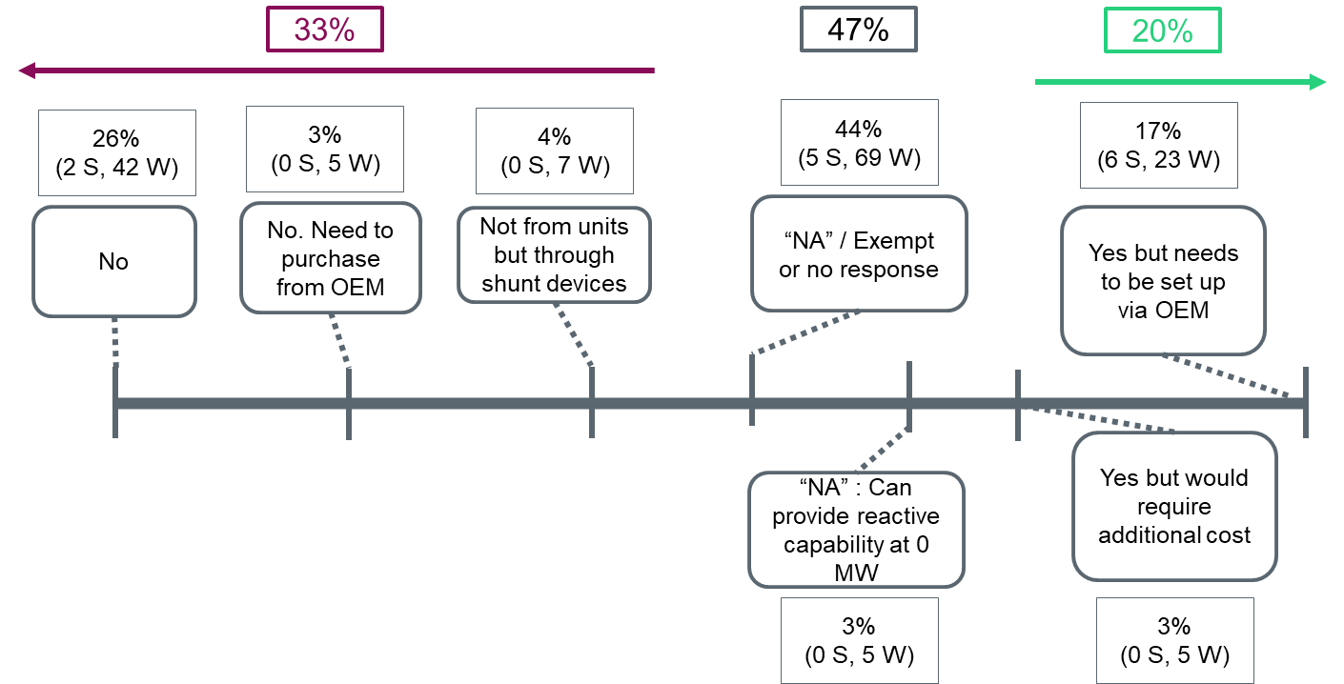
Survey Responses Example #2
Survey indicated that 20% were “capable” of providing reactive capability while at 0 MW.
# | Question
19 | Can the site provide reactive capability while producing 0 MW? If so, does the site provide that capability today?

Slide 7
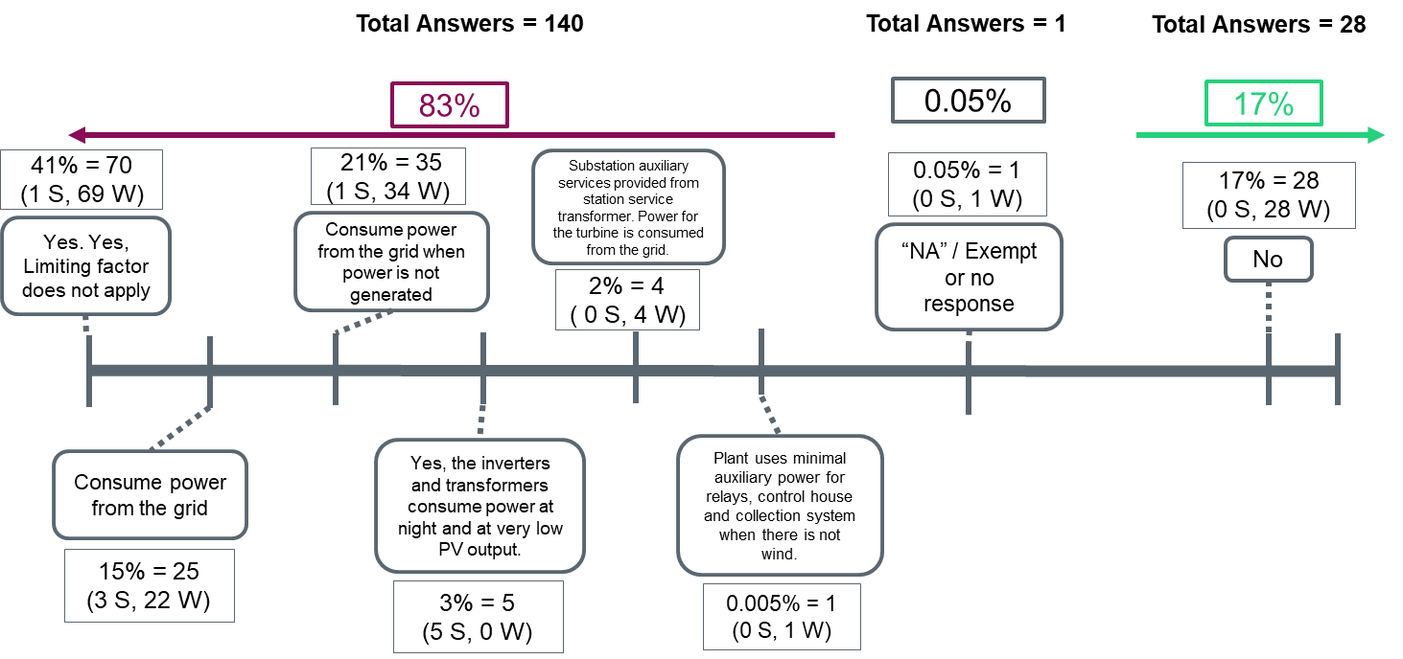
Survey Responses Example #3
Survey indicated that a decent portion of facilities are already consuming real power from the grid when at 0 MW output.
# | Question
20 | Is the site currently maintaining equipment online by using auxiliary power or by consuming power from the grid? If not, what is the limiting factor for the site from this configuration?

Slide 8
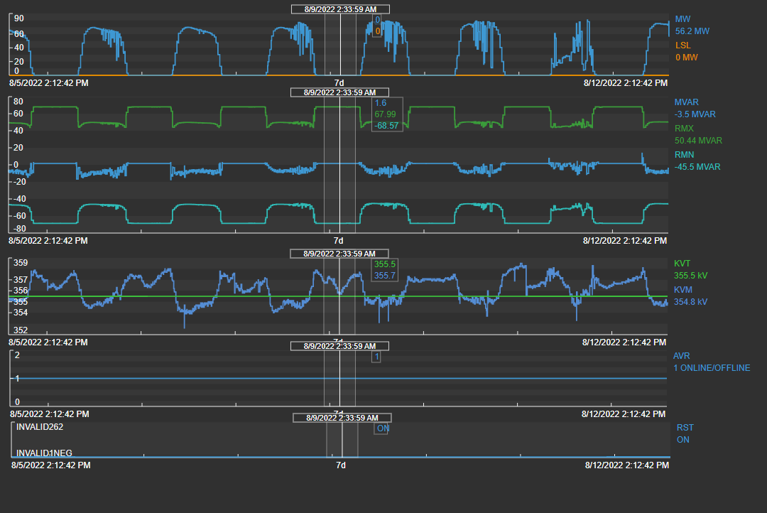
Example #1 – Unit showing inaccurate reactive capability at 0 MW
MW1 | LAG MVAR_MW1 | LEAD_MVAR_MW1 | MW2 | LAG_MVAR_MW2 | LEAD_MVAR_MW2 | MW3 | LAG_MVAR_MW3 | LEAD_MVAR_MW3 | MW4 | LAG_MVAR_MW4 | LEAD_MVAR_MW4 | MW5 | MAX_LAG_MVAR | MAX_LEAD_MVAR
0.1 | 67.99 | -68.57 | 12.63 | 43.69 | -53 | 88.41 | 51.79 | -44 | 124.6 | 36.62 | -24 | 136.2 | 67.99 | -68.57
Solar unit @ night
AVR = ON
Status = ON
MVAR = 1.6
Lag 67.99
Lead -68.57
No MVAR response to control voltage
Systems assume post contingency MVAR response

Slide 9
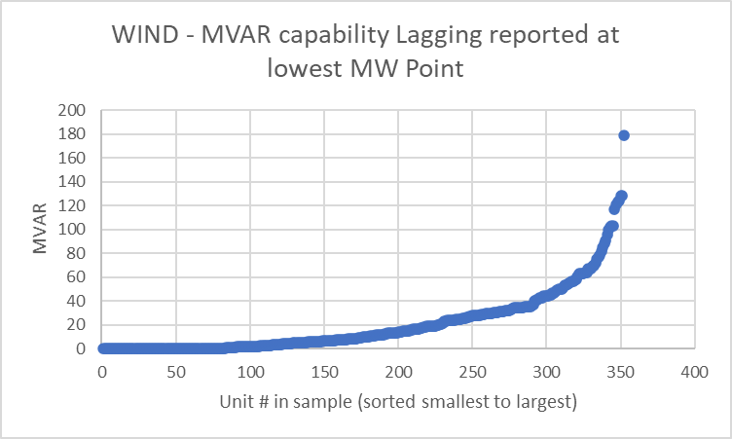
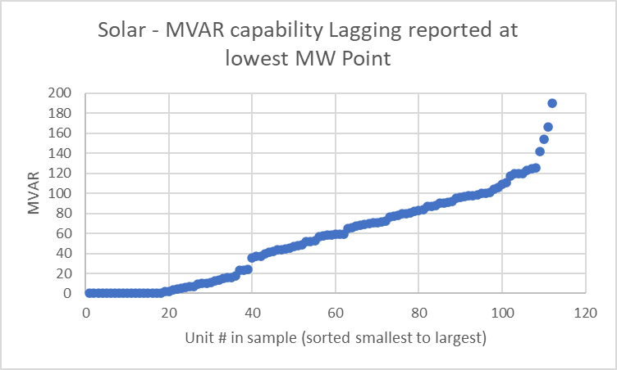
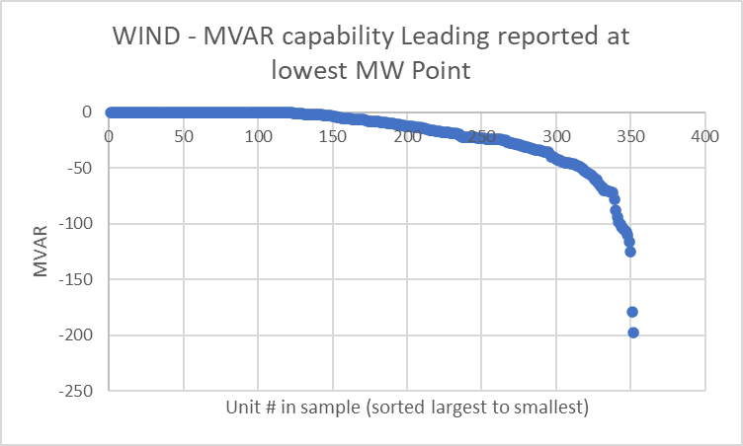
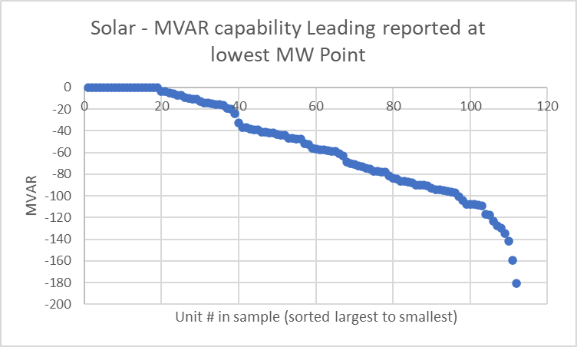
IRR Reactive Capability at lowest MW Point in RIOO

Slide 10
Example #1 – Unit showing inaccurate reactive capability at 0 MW
ERCOT is currently assuming reactive capability exists to respond to a disturbance which may be masking issues.
Unit needs to adjust its reactive capability curve in RARF/RIOO to reflect its lack of reactive power capability at 0 MW OR
Unit needs to control voltage with its available reactive capability
Current State
Not Capable
Capable
Solar at Night
AVR = ON
Status = ON
MVAR = 1.6
Lag 67.99
Lead -68.57
No V Ctrl
BKR Closed
MW1 = 67.99,-68.57
MW2 = 43.69,-53
MW3 = 51.79,-44
Solar unit at night
AVR = ON
Status = ON
MVAR = 1.6
Lag 0
Lead 0
No V Ctrl
BKR Closed
MW1 = 0,0
MW2 = Adjust to LSL
MW3 = Adjust
Solar unit at night
AVR = ON
Status = ON
MVAR = Variable
Lag 67.99
Lead -68.57
V Ctrl
BKR Closed
MW1 = 67.99,-68.57
MW2 = 43.69,-53
MW3 = 51.79,-44

Slide 11
Study 1 : 8/11/2022 05:57
Real-Time snapshot savecase
Actual status and flows for all solar and wind facilities (most if not all had breaker closed in unless if it was on outage). Night and low wind (~1300 MW)
233 wind and solar units with AVR on and a Resource Status set to ON at 0 MW output (collector systems and or controls injecting 641.4 MVar and absorbing 246.5 MVar)
7,460/6,975 MVar of lagging/leading capability
1 post contingency voltage violations and 0 unsolved contingencies.
Opened all 233 wind and solar units with AVR/Status ON
13 post contingency voltage violations and 0 unsolved contingencies

Slide 12
Study 2 : 8/12/2022 01:57
Real-Time snapshot savecase
Actual status and flows for all solar facilities (most if not all had breaker closed in unless if it was on outage). Night and higher wind (~7,600 MW)
121 solar units (collector systems injecting 138.2 MVAR)
6,181/5,901 MVar of lagging/leading capability
92 solar units had AVR = ON
4,826/3,369 MVar of lagging/leading capability
0 voltage violations or unsolved contingencies.
Opened all solar unit breakers
1 new post contingency 69kV voltage violation

Slide 13
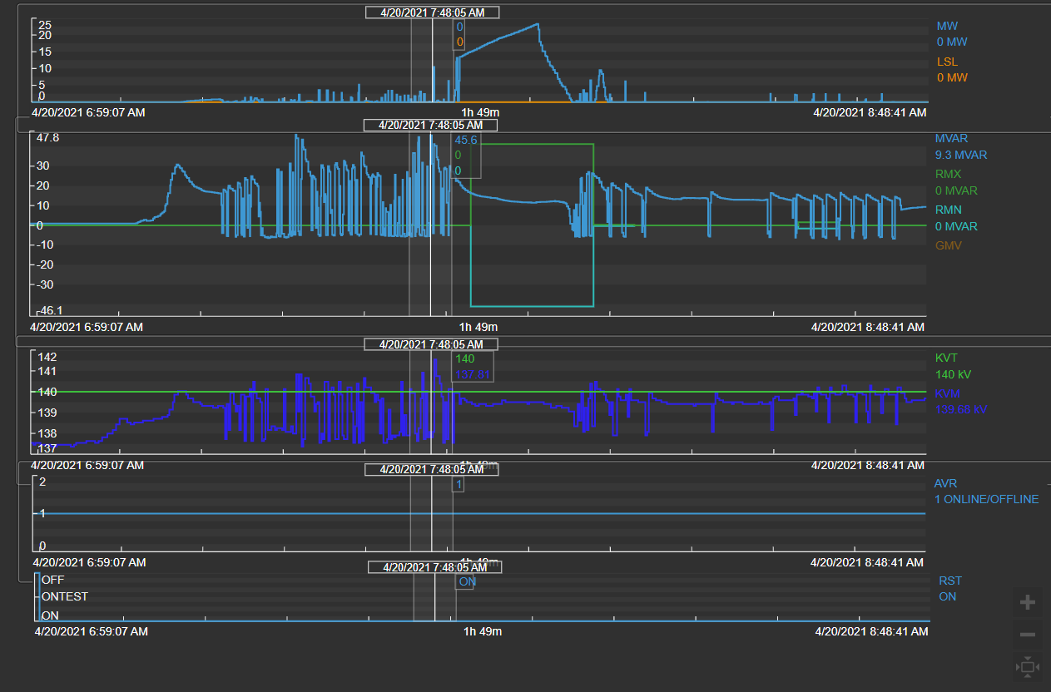
Example #2 – Unit with MVAR oscillations at low MW output
Solar unit
AVR = ON
Status = ON
MVAR = oscillating
Lag 0
Lead 0
Oscillations up to 50 MVAR when unit at very low MWs
3-4 kV voltage swings

Slide 14
Example #2 – Unit with MVAR oscillations at low MW output
ERCOT is currently assuming LSL reflects equipment limitations operating below that point.
Unit needs to work with OEM to achieve an LSL of 0 or as close to 0 as possible.
Units should provide stable reactive control at all times.
Current State
Not Capable
Capable
Solar at Night
AVR = ON
Status = ON
MVAR = oscillating
Lag 0
Lead 0
No V Ctrl
BKR Closed
MW1 = 0,0
MW2 = 41.18,41.18
LSL = 0
Solar unit at night
AVR = ON
Status = ON
MVAR = stable
Lag 0
Lead 0
No V Ctrl
BKR Closed
MW1 = 0,0
MW2 = Adjust to LSL
LSL = (set just above equipment limit for stable operations)
Solar unit at night
AVR = ON
Status = ON
MVAR = Variable
Lag 67.99
Lead -68.57
V Ctrl
BKR Closed
MW1 = 41.18,41.18
MW2 = 41.18, 41.18
LSL = 0

Slide 15
Questions?
Notes:
Ryan

