Slide 1
ERCOT Updates
August NDSWG
Joel Koepke
8/16/2022

Slide 2
Topics
NDSWG Contact List Update
Org Changes
DPC Implementation Window
NMMS Project Updates
  NMMS Tech Health
  CIM16 Upgrade

Slide 3
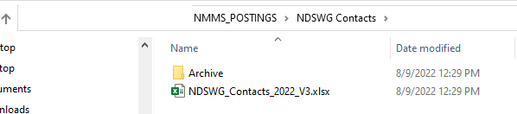
NDSWG Contact List
NDSWG contact list is available in the NMMS_Postings folder within Citrix

Slide 4
Grid Coordination Organizational Changes
Joel Koepke
Manager, Grid Coordination Support and Development
Rochie Guiyab
Manager, Network Modeling
Trish Miller
Supervisor, Network Model Coordination
Sujatha Kotamarty
Supervisor, Network Model Maintenance
Eric Meier
Supervisor, Network Model Administration
Agee Springer
Large Load Integration Manager
Bill Blevins
Director, Grid Coordination

Slide 5
DPC Implementation Window Proposal
Issue
  Completion times of DPC-initiating field work are estimated and can change due to changes or delays in the field.
  DPC submissions require explicit implementation times.
Proposal
  Implementation of DPCs can be delayed for up to 48 hours if communicated with ERCOT Control Room staff.
  DPCs cannot be delayed across database loads.
  DPCs submitted for Friday implementation cannot be delayed until Monday due the to 48 hour hold policy

Slide 6
NMMS Projects

Slide 7
NMMS Projects - Tech Health Project
Status:
  In “Execution”
Scope:
  Update backend hardware
  Upgrade database version
    No changes to “grid” data
  (due to the above) Upgrade SGEM
Schedule
  Cutover to New NMMS: October/November 2022
  Functionality Overview: September NDSWG

Slide 8
Tech Health Project – Notable Improvements
Ownership/Operatorship Correction
  TSPs will be able to add additional ownership/operatorship associations without the need of a CAMR.
    Timing of process change TBD.
  Removal of own ownership/operatorship must still be done with a CAMR
Diagram Improvements
  Changes to avoid validation errors after viewing
  Saving inconsistencies resolved
(Tentative) MOTE Environment
  Utilize Citrix MOTE environment for testing and training
  Beneficial during CIM16 transition

Slide 9
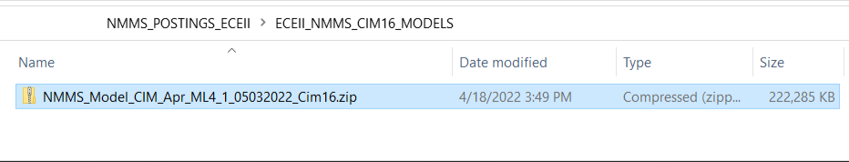
NMMS Projects – Schema Upgrade to CIM16
Status:
  Approved; not scheduled.
Scope:
  Convert underlying NMMS schema from CIM10 to CIM16
    Example – Transformers are modeled differently
  Posted CIM models will change to version 16
  Ensure non-native NMMS extracts are unaffected
  Ensure proper awareness to all MPs
Schedule
  TBD but starting no earlier than Q4 2022
  Duration expected to be 18/24 months.
CIM16 file is available today on ECEII NMMS Postings folder

Slide 10
CIM16 Project Details

Slide 11
Overview – Upgrading from CIM10 to CIM16
ERCOT produces Network Models following CIM standards and in an XML format
  Since 2010, the Network Model Management System (NMMS) produces models using the CIM10 schema (with customizations)
  In 2021, a process was developed a post-process to translate a CIM10 models into CIM16 allowing for downstream systems to upgrade their importers
ERCOT is formalizing a project to enhance NMMS to natively produce CIM16 model files
  Reduce the need for ERCOT-specific legacy code in vendor applications
  Currently collecting vendor estimates and determining resource loading
  Tentatively scheduled to start in first half of 2023
  Project duration is estimated at 18-24 months
ERCOT will no longer produce CIM10 models after project completion

Slide 12
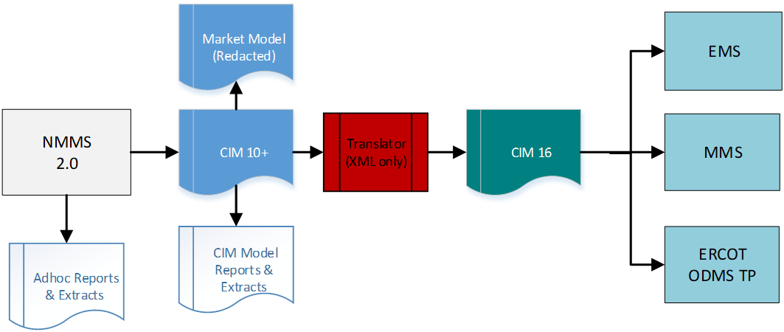
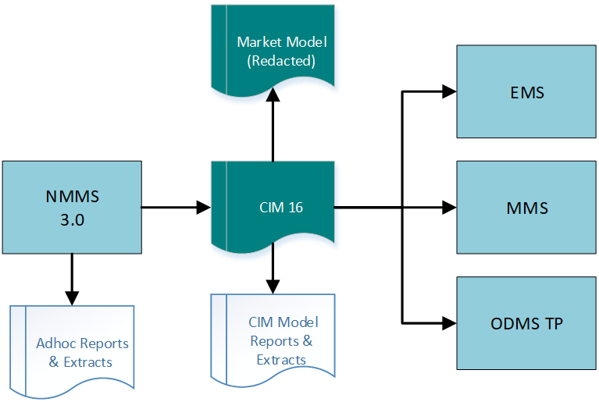
Goal - Removing the CIM10 to CIM16 Translator
After
Before

Slide 13
CIM-Related Inputs/Outputs of NMMS

Slide 14
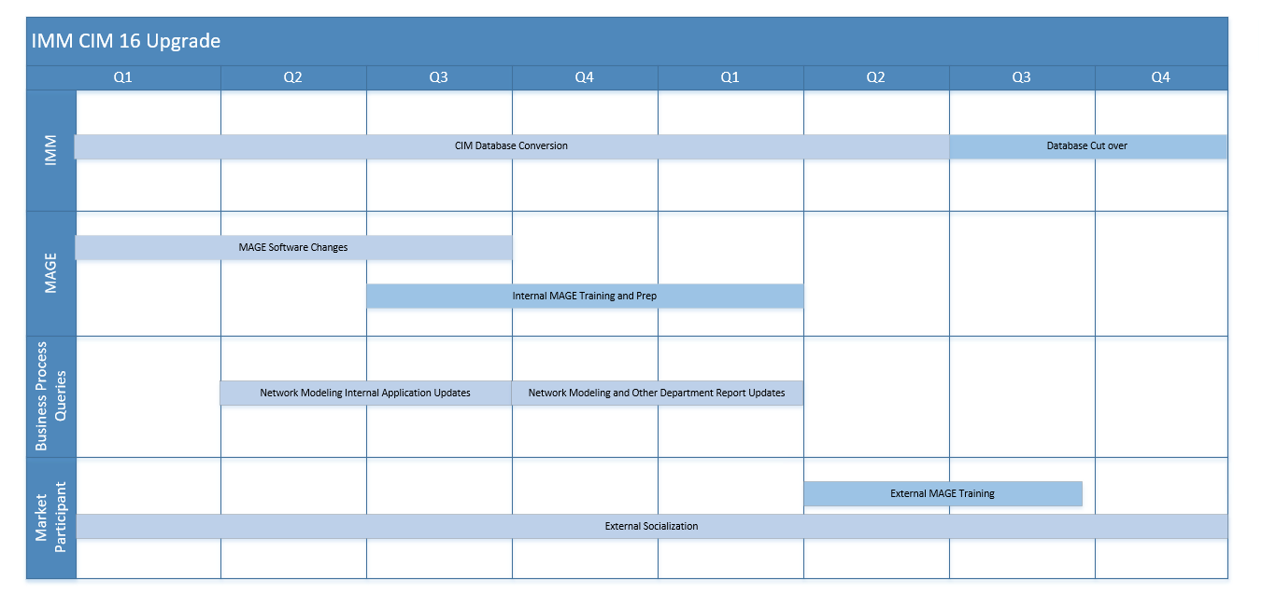
Rough Estimated Timeline
Sample full CIM16 file already posted to Citrix folder
Incremental files will not be available until later in the timeline

Slide 15
Who/What is Affected?
Any processes utilizing files directly created from NMMS will need to prepare for an updated schema.
Files include:
  MIS Secure:
    Redacted CIM Network Model - EMIL ID: NP3-450-SG
  MIS Certified:
    TSP Version of the CIM Network Model XMLs (via Citrix)
    Incremental CIM Change Requests XMLs (via Citrix/NMMS)

Slide 16
Example Schema Change
CIM10
Equipment
Power Transformer
Conducting Equipment
Terminal
Transformer Winding
In CIM16 attributes associated to a TransformerWinding are moved to a new class called TransformerEnd
CIM16
Power Transformer
Conducting Equipment
Terminal
Transformer End

Slide 17
ICCP Handbook

