Slide 1
Credit Exposure Update
Credit Work Group
ERCOT Public
August 17, 2022

Slide 2
Monthly Highlights Jun 2022 – Jul 2022
Market-wide average TPE increased from $1,878.6 million in June to $1.967 million in July.
  TPE increased mainly due to higher Real-Time and Day-Ahead Settlement Point prices
    Discretionary Collateral is defined as Secured Collateral in excess of TPE,CRR Locked ACL and DAM Exposure
  Average Discretionary Collateral increased from $2,501.0 million in June to $3.160.6 million in July
  The increase in Discretionary Collateral is largely due to increase in Secured Collateral
No unusual collateral call activity

Slide 3
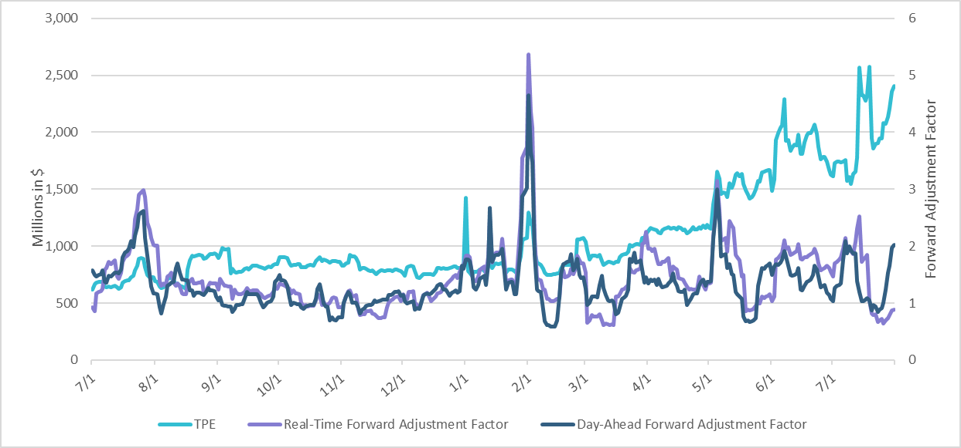
TPE and Forward Adjustment Factors Jul 2021- Jul 2022
*TPE adjusted to exclude short pay entities eliminating data skew

Slide 4
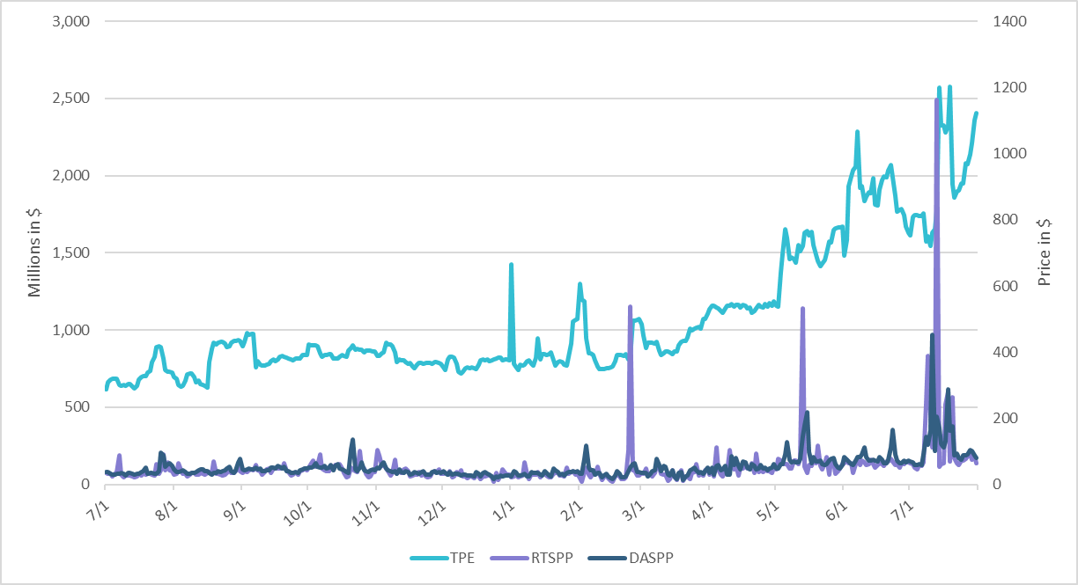
TPE/Real-Time & Day-Ahead Daily Average Settlement Point Prices for HB_NORTH July 2021- July 2022
* TPE adjusted to exclude short pay entities eliminating data skew

Slide 5
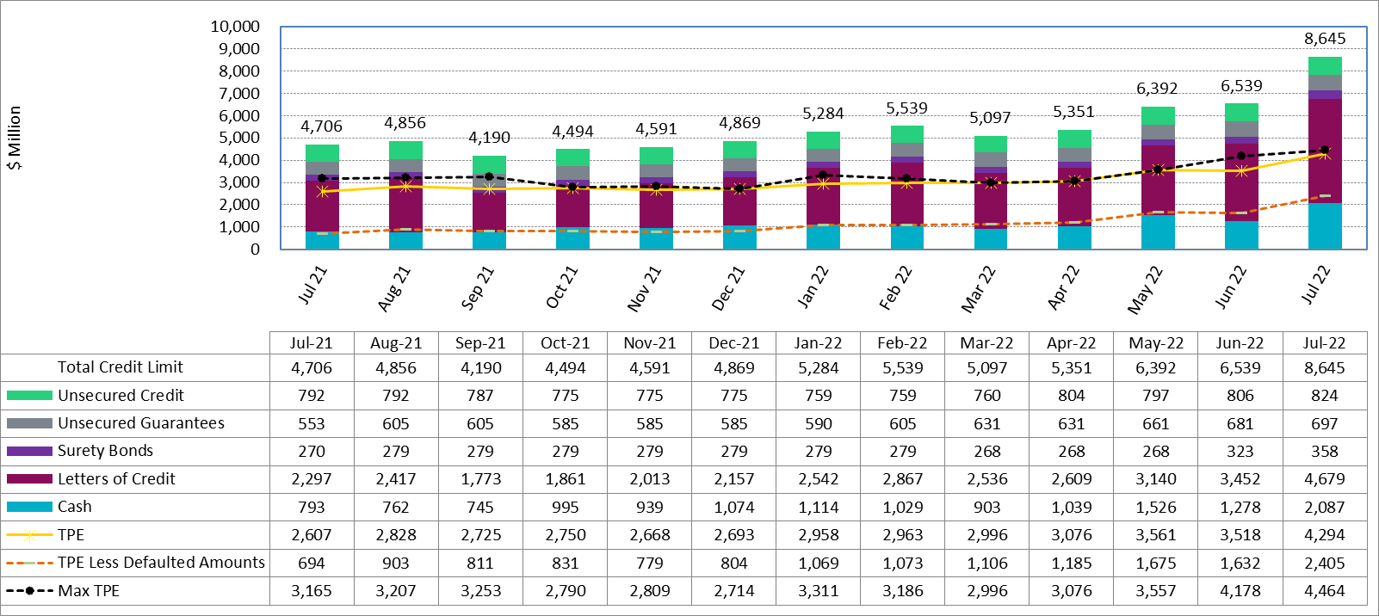
Available Credit by Type Compared to Total Potential Exposure (TPE) Jun 2021- Jun 2022
Numbers are as of month-end except for Max TPE
Max TPE is the highest TPE for the corresponding month
TPE less Defaulted Amounts: TPE – Short-Paid Invoices

Slide 6
Discretionary Collateral June 2022 - July 2022
* Discretionary collateral doesn’t include Unsecured Credit Limit or parent guarantees
* TPE adjusted to exclude short pay entities eliminating data skew

Slide 7
TPE and Discretionary Collateral by Market Segment- July 2022*
Load and Generation entities accounted for the largest portion of discretionary collateral
*Discretionary collateral doesn’t include Unsecured Credit Limit or parent guarantees
* TPE adjusted to exclude short pay amounts eliminating data skew

Slide 8
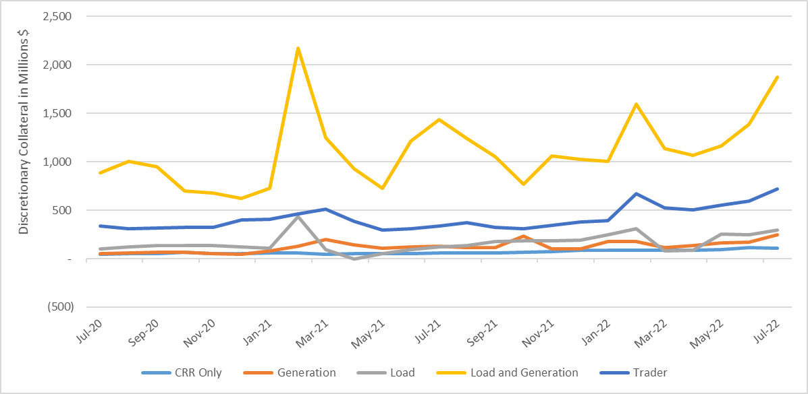
Discretionary Collateral by Market Segment July 2020- July 2022
* Discretionary Collateral adjusted to exclude short pay amounts eliminating data skew

Slide 9
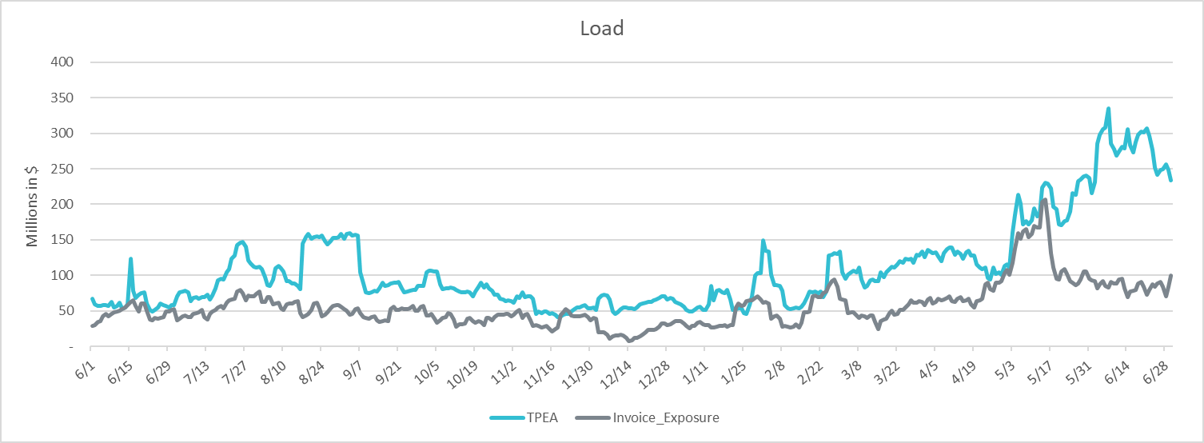
TPEA Coverage of Settlements June 2021– June 2022
*TPEA exceeds invoice exposure
*TPEA adjusted to exclude short pay entities eliminating data skew

Slide 10
TPEA Coverage of Settlements June 2021– June 2022
*TPEA generally exceeds invoice exposure

Slide 11
TPEA Coverage of Settlements June 2021– June 2022
Invoice exposure generally exceeds TPEA
TPEA adjusted to exclude short pay entities eliminating data skew

Slide 12
TPEA Coverage of Settlements June 2021– June 2022
* TPEA generally exceeds Invoice exposure

Slide 13
TPES Coverage of Settlements June 2021– June 2022
*TPES exceeds actual/invoice exposure

Slide 14
TPEA Coverage of Settlements June 2021– June 2022
*TPEA closely approximates actual/invoice exposure
*TPEA adjusted to exclude short pay entities eliminating data skew

Slide 15
Appendix

Slide 16
Summary of Distribution by Market Segment*
* Excess collateral doesn’t include Unsecured Credit Limit and is defined as Collateral in excess of TPE
* TPE adjusted to exclude short pay amounts eliminating data skew

Slide 17
Summary of Distribution by Rating Group*
* TPE adjusted to exclude short pay amounts eliminating data skew

Slide 18
Distribution of TPE by Rating and Category*
* TPE adjusted to exclude short pay amounts eliminating data skew

Slide 19
Distribution of Excess Collateral by Rating and Category*
*Excess collateral doesn’t include Unsecured Credit Limit
* TPE adjusted to exclude short pay amounts eliminating data skew

Slide 20
TPEA Coverage of Settlements
  TPEA covers Settlement/Invoice exposure and estimated Real-Time and Day- Ahead completed but not settled activity (RTLCNS and UDAA)
  The analysis was performed for the period, May 2021 - May 2022
  Only Settlement invoices due to ERCOT are considered in the calculation
  Example
  For business date 2/1/2020, if a Counter-Party has M1 value of 20, then all the charge invoices till 2/21/2020 including RTLCNS and UDAA as of 2/1/2020 is summed up to arrive at “Invoice Exposure”

Slide 21
Questions

