Slide 1
ERCOT IBRTF: NERC and Other Industry Updates
Julia Matevosyan
Chief Engineer
08/11/2022

Slide 2
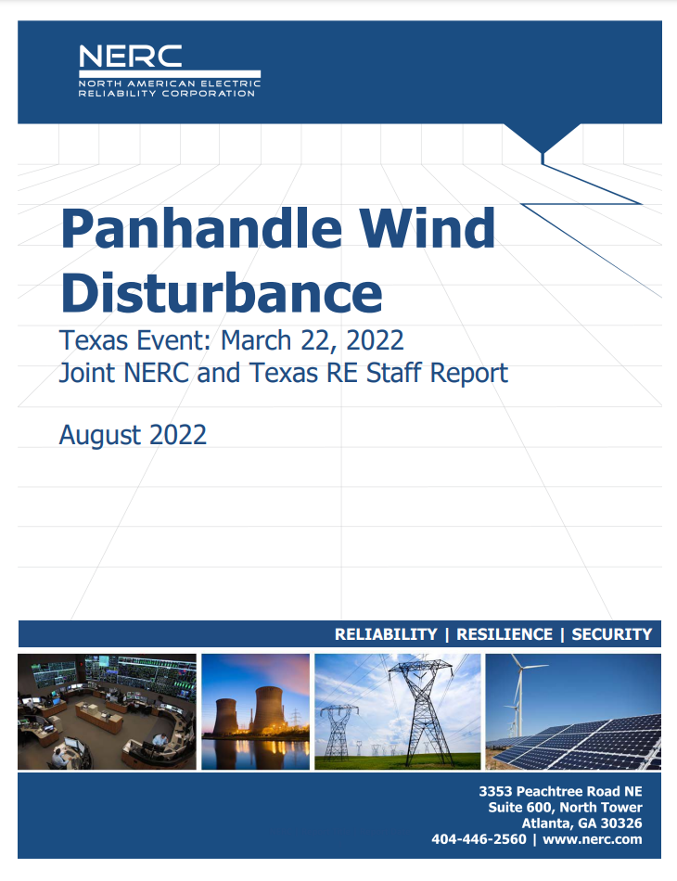
NERC & TRE Panhandle Wind Disturbance Report, March 22nd 2022
Event 1:
At 4:16:26 a.m., a phase-to-phase fault on a radial 345 kV tie line connecting a wind plant to the ERCOT system.
Cleared normally, consequentially tripping 273 MW of wind generation.
Multiple wind plants in the area unexpectedly reduced output by 492 MW.
Total active power reduction was 765 MW for this fault (10 facilities).
Frequency dropped to 59.90 Hz, and 524 MW of RRS deployed. Frequency recovered to nominal in just under three minutes.
Event 2:
At 4:47:55 a.m., another normally-cleared phase-to-phase fault on a 345‌ kV line nearby.
Multiple wind plants again unexpectedly reduced power output, totaling 457 MW (8 facilities).
Frequency dropped to 59.942 Hz and no RRS was deployed. Frequency recovered in 29 seconds.
https://www.nerc.com/pa/rrm/ea/Documents/Panhandle_Wind_Disturbance_Report.pdf

Slide 3
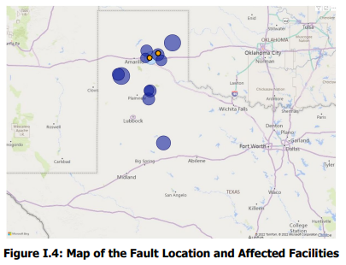
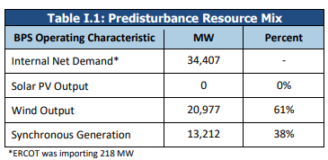
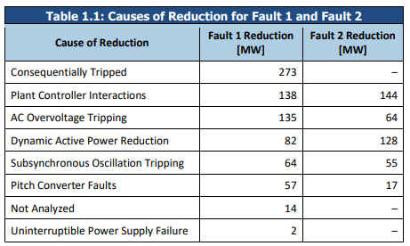
System Conditions, Location and Causes of Reductions
Orange – fault locations
Light blue – wind plants that tripped
Dark blue – other wind facilities that responded abnormally
Circle size illustrate magnitude of reduction
Wind plants identified as abnormally responding to the event were located up to about 170 miles away from the fault location.

Slide 4
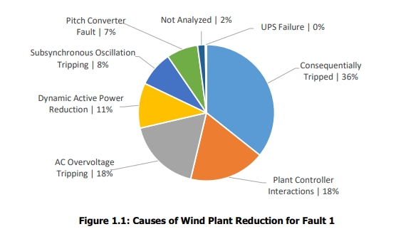
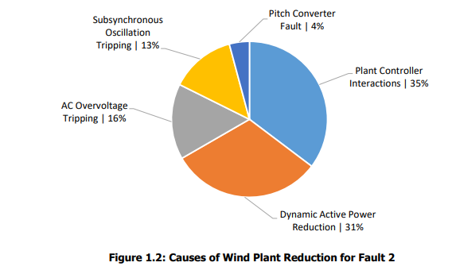
Causes of Reduction
Notes:
Plants in VRT mode but frequency also low due to MW loss. In LVRT conditions plant controller cedes control to individual turbines. Once voltage recovers post fault clearing the plant controller regains control and resumes dispatch of turbines, however in this event the handoff wasn’t properly coordinated. E.g. of one plant is shown where handoff happens before full active power recovery back to pre-disturbance value and PFR is provided in response to frequency deviation to a level that is below pre-disturbance level and held it at it preventing active power output recover until frequency recovered. These issues are not identified in the dynamic models (positive sequence or EMT) the GO provided to ERCOT, so they will not be identified and corrected during interconnection studies or during long-term planning or operations studies.

Slide 5
Ability to Capture Causes of Reduction in Models
The majority of abnormal performance from the event cannot be accurately simulated in positive sequence studies nor in EMT studies most commonly performed by TPs and PCs.
This aligns with the findings observed in past events involving solar PV resources.
This is because these models are not generally used to study these causes of tripping and interactions and limitations of positive sequence tools (1/4 cycle timestep), modeling simplifications around inverter, and plant protection systems and controls.
EMT simulations will also be challenged to study or recreate these tripping causes since many of these protections and interactions are not modeled in those models either.
SSCI can be studied in EMT; however, accurate models reflective of as-built facilities are needed.
Performance validation is necessary to mitigate abnormal performance issues in a timely manner.
IBR owners should analyze abnormal performance events and develop mitigating measures to eliminate these risks in the future if possible.
The issues and their mitigations should be reported to the BA and RC for wide-area tracking of fleet performance and reported to NERC as a new classification of “IBR mis-operations.”
Notes:
causes of tripping and interactions (e.g., plant controller interactions, pitch converter faults)
In multiple cases in both the ac overvoltage protection and the SSR protection situations, the model does not accurately reflect the as-built equipment.

Slide 6
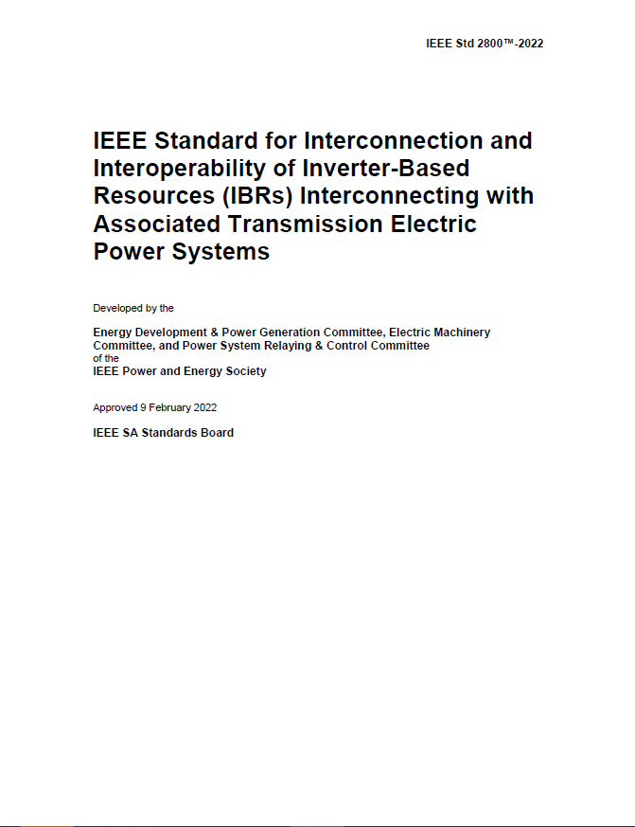
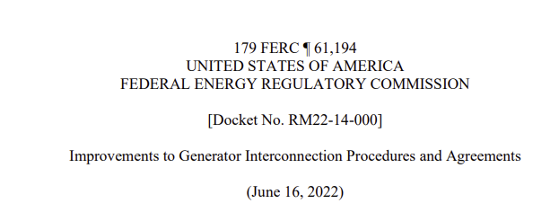
Joint Generator Interconnection Workshop
Slides on: https://www.esig.energy/event/joint-generator-interconnection-workshop/ Recording on: ESIG YouTube

Slide 7
Day 2: Modeling
All models have their limitations generic models are not necessarily bad, EMT models are not necessarily more accurate
Use appropriate type of models for appropriate studies (e.g. detailed UDM models are necessary for control tuning, while correctly parametrized, validated generic model may be used for planning studies; sub-cycle phenomena and unbalanced conditions are not captured in the positive sequence and EMT models/studies are needed)
Control-loops and protective functions relevant for a studied phenomena should be included in the model
Model validation and diligent parametrization is crucial for both positive sequence (UDM and generic) and EMT models
Limited validation against field tests is possible at commissioning. Unit type-testing combined with careful plant design evaluation can be used to gain fidelity in the models. Then, post-commissioning disturbance monitoring should be used to validate the models for large signal disturbances.

Slide 8
Day 2: Modeling
Present models (both positive sequence and EMT) have been unable to capture some of the causes of inverter tripping in the disturbance events analyzed by NERC.
Limitation of a model should not be confused with limitation of the simulation domain itself. Improved future models, both in positive sequence and EMT, can help capture the behavior observed in the field.
It is recommended to start collecting, quality testing and validating EMT models ahead of EMT studies being needed. For example, ISO-NE and ERCOT have been doing this for a number of years and over time improved their EMT skills, model quality/model validation requirements.

Slide 9
Day 3: Interconnection Requirements & IEEE2800
Balanced and harmonized interconnection requirements play a critical role in the deployment of advanced technology capabilities to meet grid needs; provide certainty to OEMs and improve grid reliability
For example, harmonized requirements have been approved in Europe in 2016 (ENTSO-E RfG)
IEEE2800 has been developed with wide industry participation and has been approved in April 2022 with high approval rate
IEEE2800 defines minimum capability requirements for IBRs connected to sub-transmission and transmission (includes modeling requirements)
IEEE2800.2 Recommended Practice for Test and Verification Procedures for Inverter-based Resources (IBRs) is under development

Slide 10
Day 3: Interconnection Requirements & IEEE2800
OEMs and developers welcome harmonization efforts and implementation of IEEE2800. If adopted in the regions it provides certainty and improves grid reliability.
Majority of the capabilities required by IEEE2800 are already available in existing equipment.
Several, more complex/demanding requirements will need to be implemented in new equipment. Transitional arrangements need to be developed in collaboration with grid operators.
Plants that may get built in a near future may not be fully compliant with 2800. OEMs, developers, grid operators should work together to realize which IEEE 2800 requirements can be met for plants going in-service in a near future.
Smaller developers, especially of solar and battery storage plants need additional education about interconnection requirements and performance expectations for IBRs.
Notes:
OEMs brough up multiple ride through requirements as potential challenging for solar and Vars at 0 MW requirement may impact cooling systems. They are still investigating that.

Slide 11
Day 3: Interconnection Requirements & IEEE2800
Grid operators need to be proactive to keep developers well informed on interconnection requirements, modeling requirements and performance expectations. ERCOT IBRTF was bought up as a good example of such efforts.
Some grid operators already started a gap analysis of their existing requirements in comparison with 2800 with the goal of piecemeal implementation. Some of the IEEE2800 requirements, if implemented, will mitigate some of the IBR tripping causes observed in recent disturbance events.
Voltage ride-through requirement proposed in the FERC NOPR likely needs revision to encourage IBR behavior that’s more helpful for the grid recovery. Harmonization with PRC-024 or IEEE2800 language is beneficial.

Slide 12
Proposed Interconnection Requirements
FERC NOPR RM22-14-000
Clause 9.7.3: Ride Through Capability and Performance (p. 389)
… During abnormal frequency conditions and voltage conditions within the “no trip zone” defined by Reliability Standard PRC-024-2 or its successor standards, non-synchronous Generating Facilities must maintain real power production at pre-disturbance levels unless providing primary frequency response or fast frequency response and must provide dynamic reactive power to maintain system voltage in accordance with the Generating Facility’s voltage schedule.

Slide 13
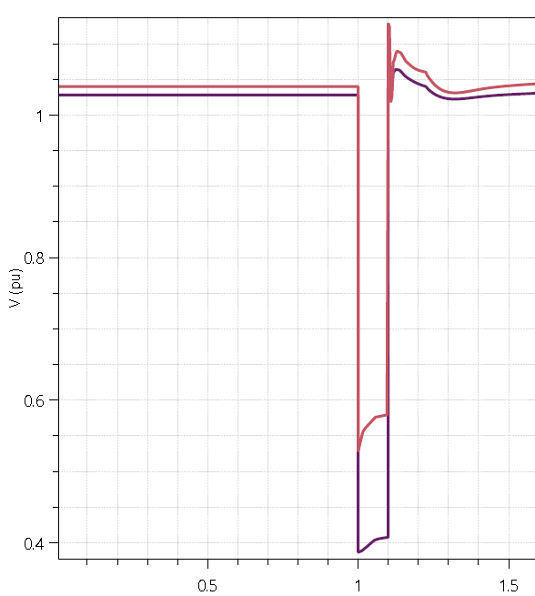
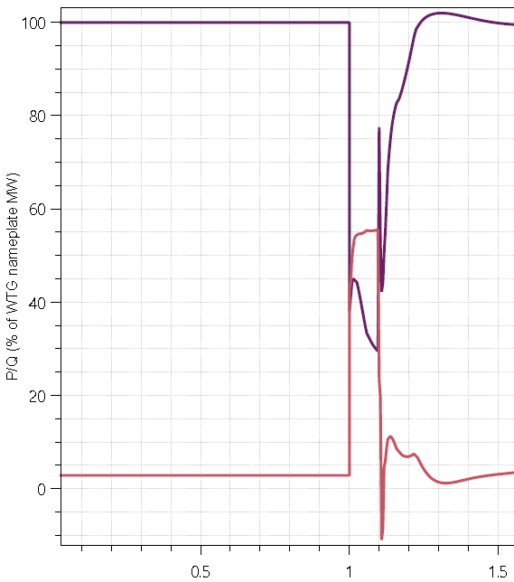
IBR Behavior during a grid fault
IBR terminal quantities during a normally cleared 3ph fault
What happens during a grid fault?
Grid and IBR terminal voltage drop
Reactive power increases to support grid and terminal voltage (reactive power is given priority)
Active power reduces depending on severity of voltage drop to prevent further voltage collapse
Fault is cleared and plant rides through disturbance
Voltage recovers; recovery highly dependent on grid strength and network topology
Active power recovers after voltage recovers to prevent voltage collapse.
V_{T}
Voltage drops during fault
V_{POI}
Active Power
Active power reduces during fault and recovers after grid voltage stabilizes
Reactive power increases to support voltage
Reactive Power
Courtesy: GE Energy Consulting
Notes:
From the Panhandle Wind Disturbance Report: NERC is not recommending a specific type of dynamic performance during faults for any technology; however, many BPS-connected inverter-based resources (and distributed energy resources) will significantly reduce active power for depressed voltages. The breadth and depth of the voltage depression is dependent on system strength and other factors. Regardless, this type of active power response to voltage will change grid dynamics and could have BPS reliability impacts over time. It is important, particularly in islanded systems, that the active power reduction is minimized to avoid degraded frequency response, any active power reduction is recovered quick and in a stable manner, and dynamic reactive power is provided throughout to hold BPS voltages stable throughout the event (including the appropriate injection of fault current).

Slide 14
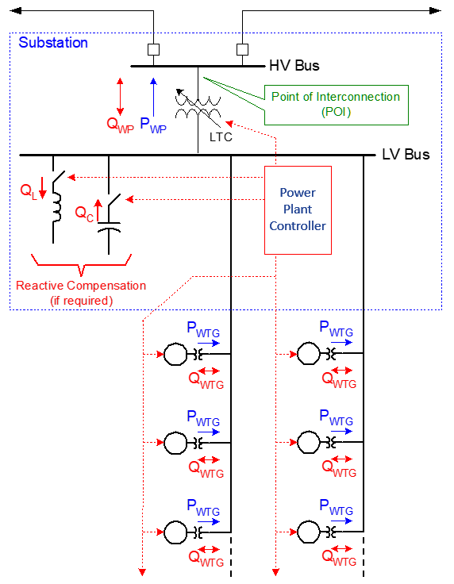
IBR Behavior during a grid fault
Power plant controller maintains plant voltage schedule in
quasi-steady-state (many seconds)
What happens during a grid fault?
Grid and IBR terminal voltage drop
IBR unit (inverter) responds quickly to support terminal voltage and reactive power and ride through (~100(s) msec)*
Plant controller adjusts plant reactive power from all units to rebalance system during and after recovery (seconds to 10s of seconds)
* Highly dependent on grid conditions
IBRs quickly maintain terminal voltage during disturbances (msecs); follows plant command during recovery (many seconds)
Behavior during disturbances is dominated by the IBR unit managing its terminal quantities to ride through
Courtesy: GE Energy Consulting

Slide 15
Considerations
Align with the intent of PRC-024-3 language:
R1: Each Generator Owner shall set its applicable frequency protection in accordance with PRC-024 Attachment 1 such that the applicable protection does not cause the generating resource to trip or cease injecting current within the “no trip zone” during a frequency excursion…
Align with the intent of IEEE 2800 language:
The active power recovery time shall be configurable within a range between 1.0 s and 10 s. The default active power recovery time is 1 s; however, in weak grids, in order to reduce oscillatory behavior of the IBR plant upon fault recovery and maintain system stability, it may be desirable to reduce the average rate of active power recovery in consultation with the TS owner.
The IBR unit shall have capability to select operation in either active current priority mode or reactive current priority mode during a high- or low-voltage ride-through events. By default, the IBR unit shall operate in reactive current priority mode during high- and low-voltage ride-through events. If requested by the TS owner, and mutually agreed with the IBR owner, the IBR unit may operate in active current priority mode for both the high and low-voltage ride-through events.

Slide 16
THANK YOU
Julia Matevosyan
julia@esig.energy

