Slide 1
PDCWG Report to ROS
Chair: Jimmy Jackson, CPS
Vice Chair: Vacant
ROS
Aug 10th, 2022

Slide 2
Report Overview & Notes
Report Overview
Meeting Minutes
BAL-001-TRE-2 FMEs and IMFR
0 FMEs in the month of June
Frequency Control Report

Slide 3
Meeting Minutes
PDCWG Meeting 7/20/2022
NOGRR226 Update
Large Net Load Ramp Event on 3/24/22 (ERCOT Presentation)
BAL-001-TRE-SAR Update
ERCOT Reports
TRE Report

Slide 4
Frequency Measurable Events Performance

Slide 5
Frequency Measurable Events
There was 0 FME’s in June

Slide 6
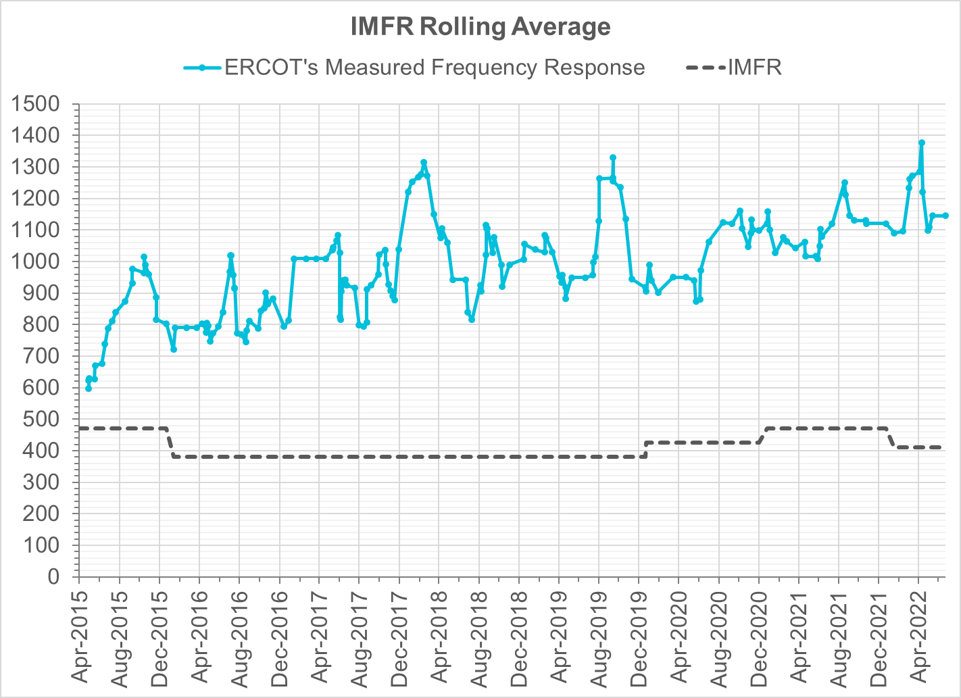
Interconnection Minimum Frequency Response (IMFR) Performance
IMFR Performance currently
1144.94 MW/0.1HZ
Frequency Response Obligation (FRO): 412 MW/0.1 Hz

Slide 7
Questions?

Slide 8
Frequency Control Report
May 2022

Slide 9
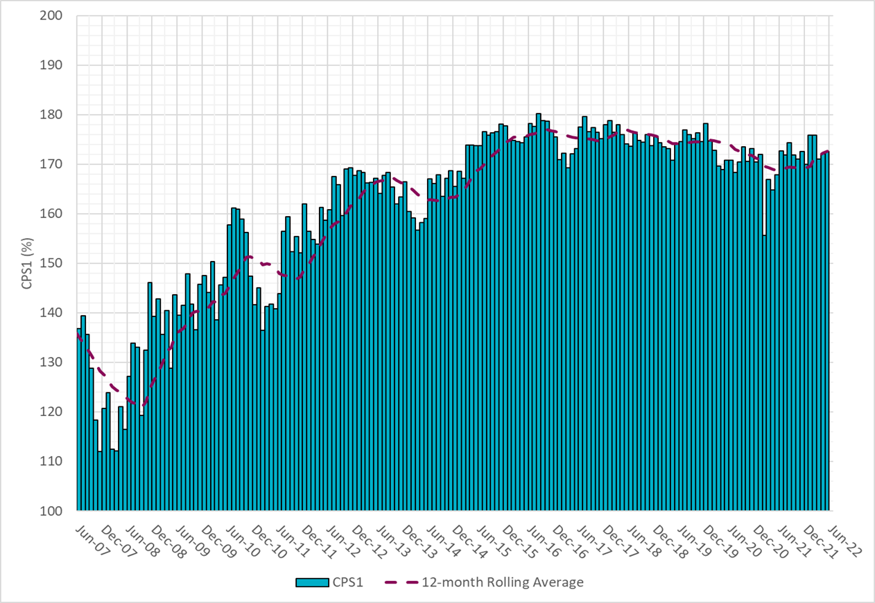
CPS1 Performance

Slide 10
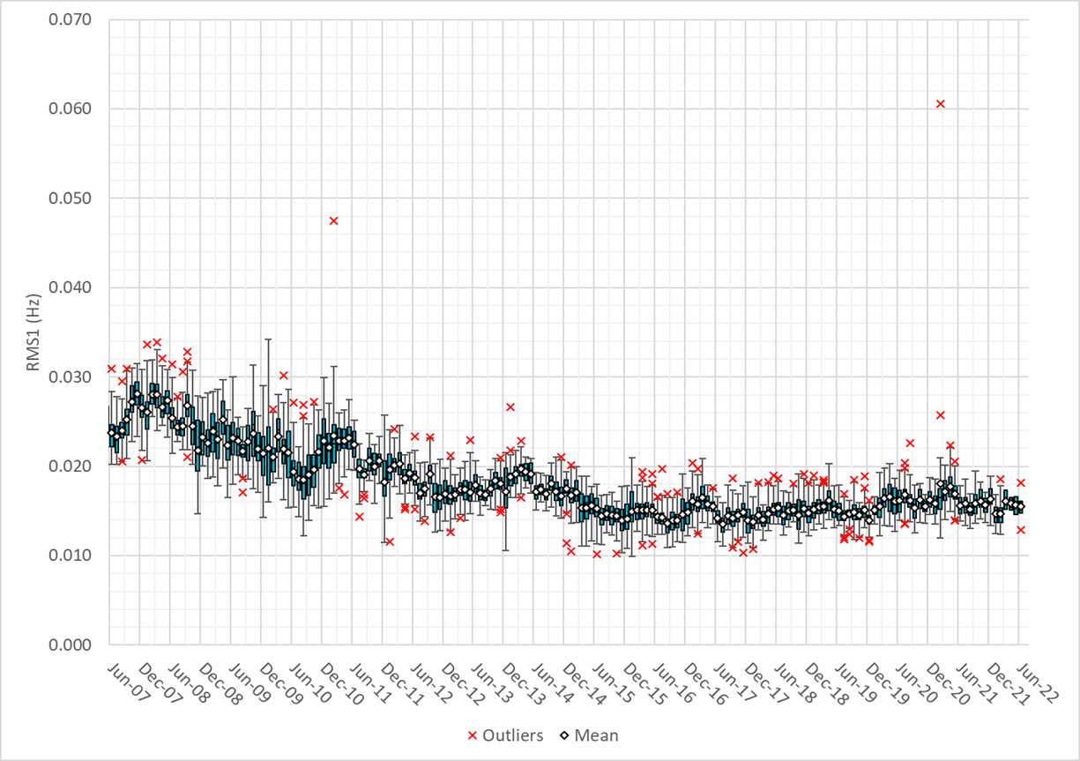
RMS1 Performance of ERCOT Frequency
Notes:
15.56Mhz on avg for June 2022

Slide 11
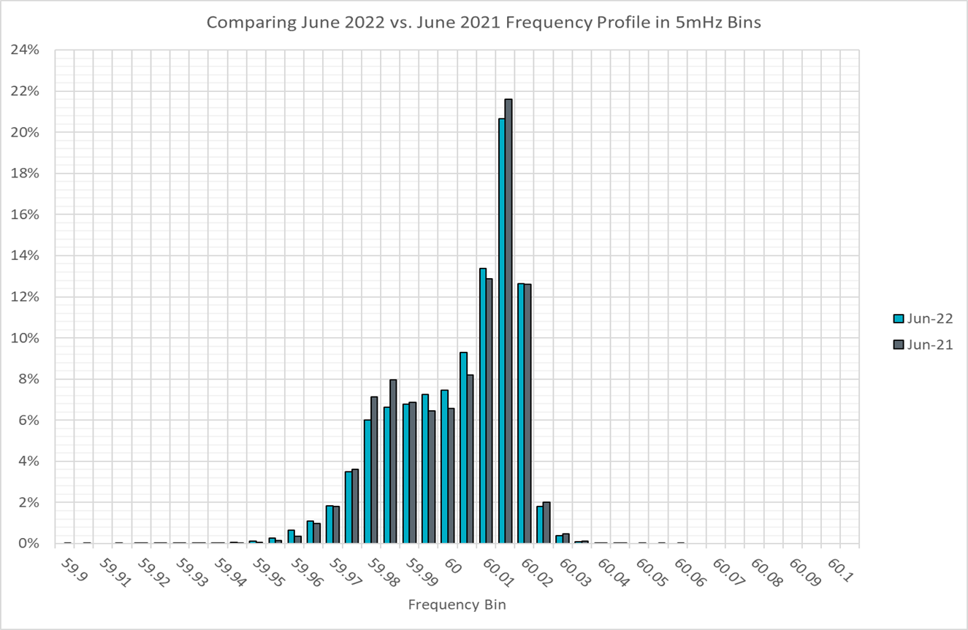
Frequency Profile Analysis

Slide 12
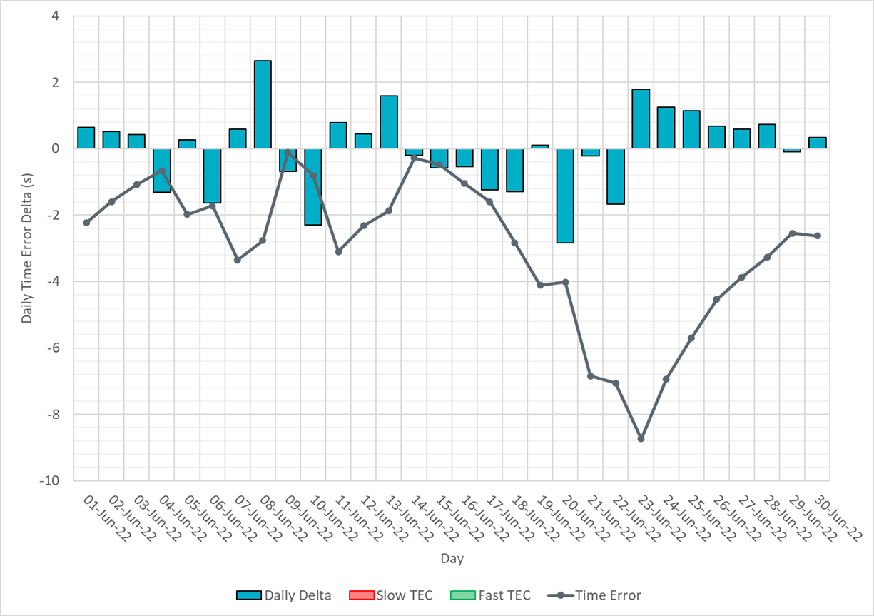
Time Error Corrections
Notes:
Time error started to go down around the 20th due to a significant solar and wind ramp coincided with each other. Also, temperature picks up in late June.

Slide 13
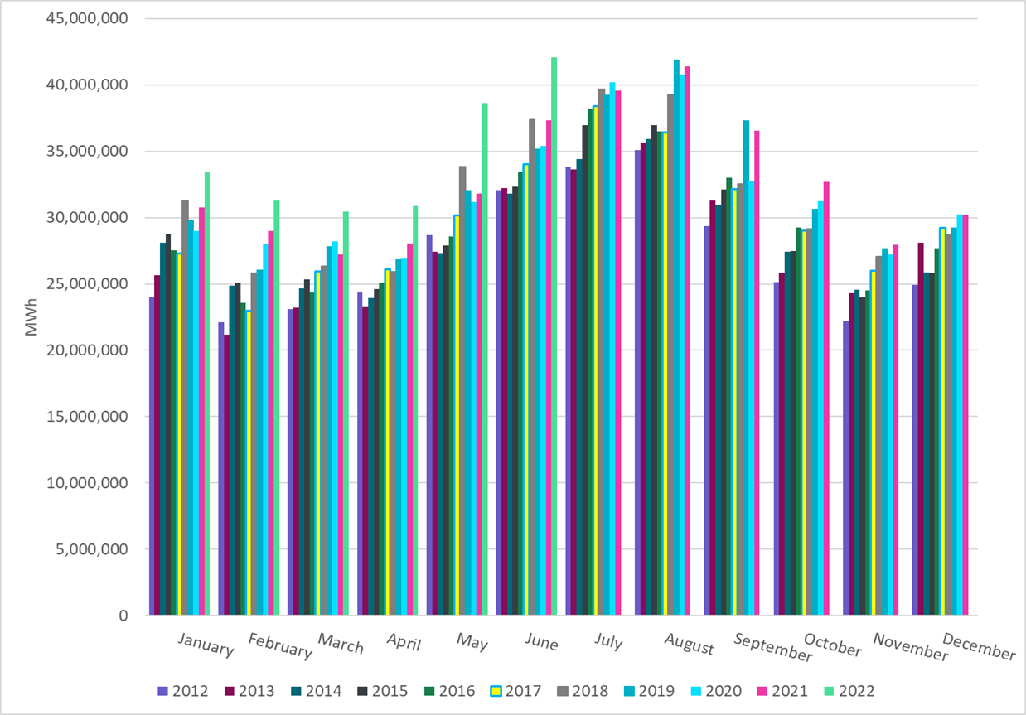
ERCOT Total Energy
Notes:
42,088,672 MWh

Slide 14
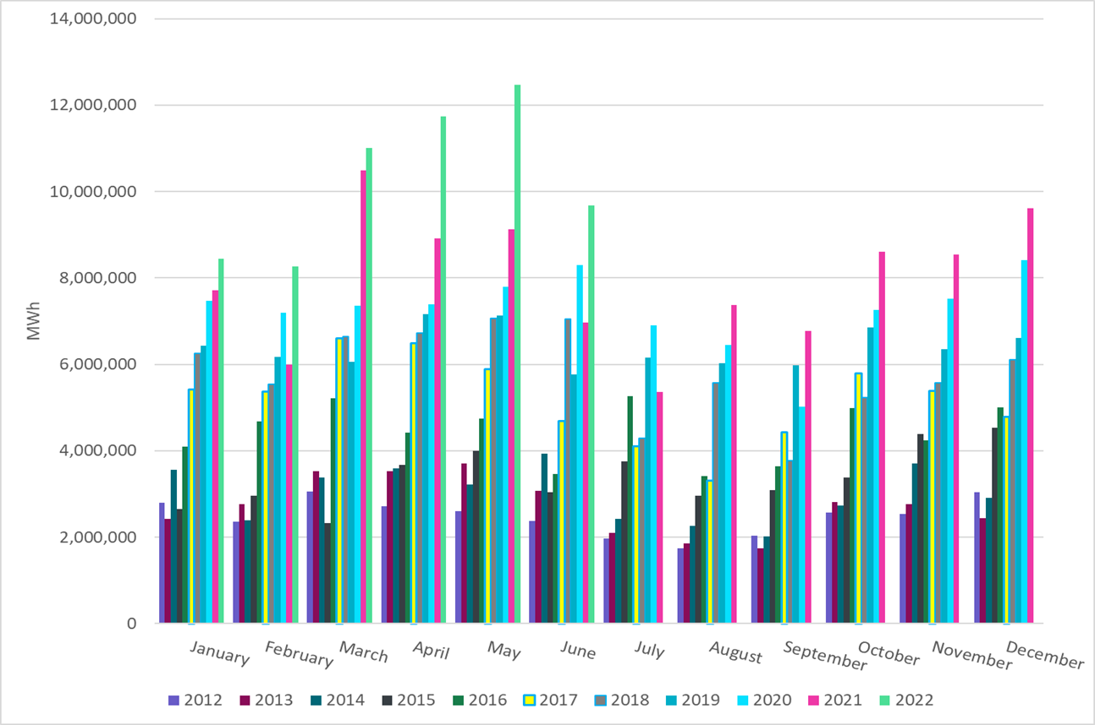
ERCOT Total Energy from Wind Generation
Notes:
9,677,677 MWh

Slide 15
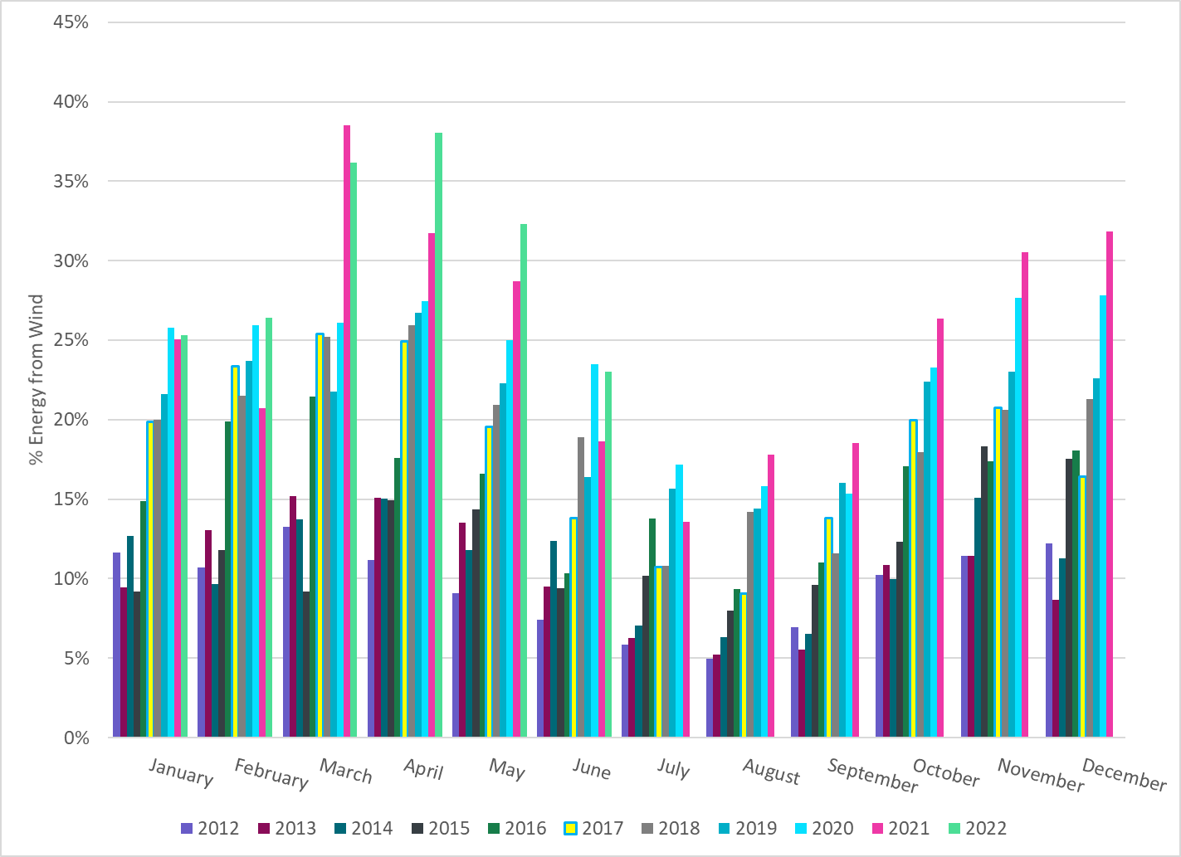
ERCOT % Energy from Wind Generation
Notes:
22.99%

Slide 16
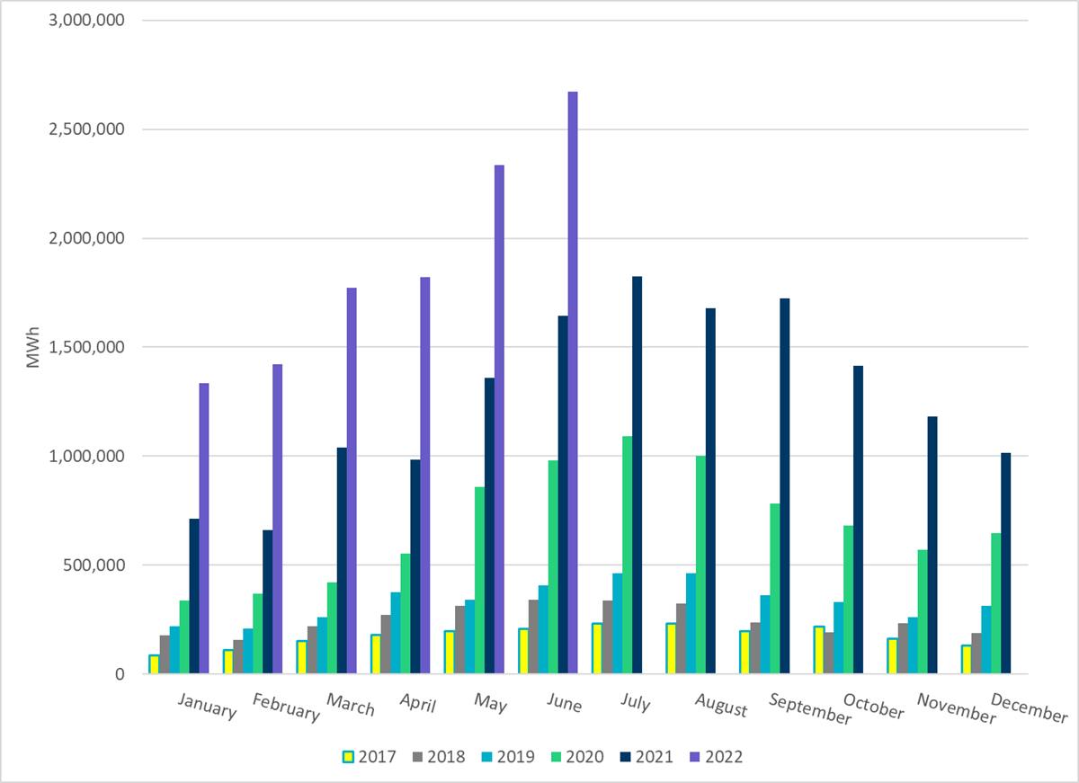
ERCOT Total Energy from Solar Generation
Notes:
2,672,960 MWh

Slide 17
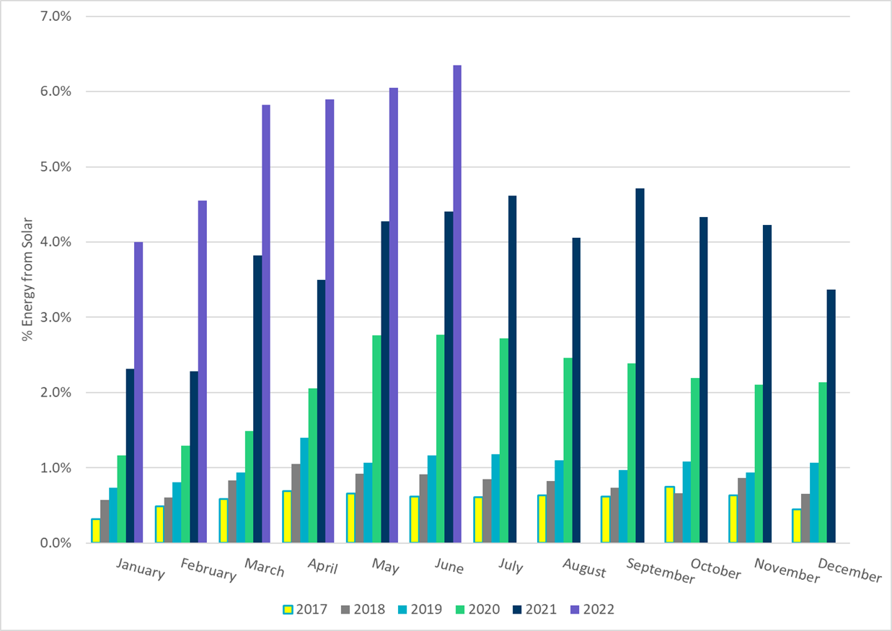
ERCOT % Energy from Solar Generation
Notes:
6.35%

