Slide 1
Project Update
August 11, 2022
Troy Anderson
ERCOT Portfolio Management

Slide 2
Project Update Agenda
Recent / Upcoming Project Highlights
2022 Release Targets
In-Flight Strategic Projects
Fast-Frequency Response (FFR) Advancement
NPRR1120 Create Firm Fuel Supply Service
Additional Project Status Information (new slide)
Priority/Rank Options for Revision Requests with Impacts
NPRR1058 – Resource Offer Modernization
Technology Working Group
8/4/2022 discussion points
Appendix
BES Combo Model Implementation
Location of Revision Request Project Information: http://www.ercot.com/services/projects

Slide 3
Recent / Upcoming Project Highlights
2022 July Release – Off-Cycle – 7/15/2022 Complete
NPRR1129 – Posting ESI IDs of Transmission-Voltage Customer Opt-Outs
2022 July Release – R4 – 7/26/2022-7/28/2022 Complete
NPRR1108 – ERCOT Shall Approve or Deny All Resource Outage Requests
Report postings – see 7/19/2022 market notice
2022 August Release – Off-Cycle – 8/16/2022 In Flight
NPRR1108 – ERCOT Shall Approve or Deny All Resource Outage Requests
Remainder of NPRR – see 8/5/2022 market notice
2022 October Release – R5 – 10/4/2022-10/6/2022 In Flight
NPRR987 – BESTF-3 Energy Storage Resource Contribution to Physical Responsive Capability portion
NPRR1002 – BESTF-5 Charging Restrictions in Emergency Conditions portion
2022 October Release – Off-Cycle – 10/13/2022 In Flight
FFR Advancement (FFRA portion of NPRR863)
NPRR1120 – Create Firm Fuel Supply Service
OBDRR039 – ORDC Changes Related to NPRR1120
Note: Projected Go-Live dates are subject to change. Please watch for market notices as the effective dates approach.

Slide 4
2022 Release Targets – Board Approved NPRRs / SCRs / xGRRs
R1
R3
R5
February Various Dates | April 4/5 – 4/7 | May 5/24 – 5/26 | July 7/26 – 7/28 | October 10/4 – 10/6 | December 12/6 – 12/8
LPGRR068 NPRR1054(a) NPRR1005 NOGRR210 RRGRR025 NPRR917 NPRR1052 NPRR1065 NPRR1073 NPRR1016 PGRR082 NOGRR212 | None NPRR1092(a) | NPRR939 NPRR1093 NPRR1101 NPRR1113 NOGRR191 NOGRR198 NOGRR232 OBDRR032 OBDRR033 OBDRR035 SCR800 SCR809 SCR814 MarkeTrak User Interface Refresh | NPRR1108(a) NPRR935(b) NOGRR239 NPRR1129 NPRR1108(b) | NPRR987(a) NPRR1002(a) FFR Advancement (NPRR863 FFR) NPRR1120 OBDRR039 | NPRR1097 NPRR1040
R2
R4
R6
ü
ü
ü
ü
ü
ü
ü
ü
ü
ü
ü
ü
ü
ü
ü
ü
ü
ü
E
E
E
E
E
NS
ü
ü
ü
ü
7/1
ü
ü
Securitization Subchapter N March Go-Live
7/15
10/13
DGR/DESR
ü
ü
8/16
SCR789 Ph2
Late 2022
E
1/1
ü
ü
ü
ü
5/13
6/4 – 6/6
ü
NPRR1120 Firm Fuel Supply Serv
Issue RFP no later than 8/1/2022
Contracts start in November
ü
EMS Freeze
May 2023 – Jan. 2024
TBD | NPRRs: 484,825(b),826,829,841,857,879,885,904,918,930,936,941,945,962,963,965,975,987,995,1004,1006,1007,1019,1023,1026,1030,1032,1034,1057, 1063,1077,1090,1092(b),1105 SCRs: 799,805,807,810,812,813,816,818,819 PGRRs: 066,076,088,091,094,099 Other: OBDRR009,OBDRR017,RRGRR028
Go-live dates can differ from Protocol effective dates – Please refer to market notices for more details
APPENDIX
Red Text: New additions and target release changes
Strike-Through Text: Previous target release
(a), (b), etc.: Multiple phase release
Project Status Codes
NS = Not Started
I = Initiation
P = Planning
E = Execution
H = On Hold
NPRR1054(a) – Portion of gray box
NPRR935(b) – New solar forecasts and reports
NPRR987(a) – ESR Contribution to PRC
NPRR1002(a) – Charging Restrictions in Emergency Conditions
NPRR1092(a) – RUC offer floor change
Release targets are subject to change

Slide 5
In-Flight Strategic Projects
PR325-01 Fast-Frequency Response (FFR) Advancement (gated to Execution on 6/22/2021)
Planned for off-cycle go-live on 10/13/2022
NPRR863, NPRR1015, NPRR1079, NOGRR187
FFRA readiness meeting on July 25 (will be market notice next week with details)
Reminder of market submission impacts
All AS Offers affected by changes
Testing/MOTE dates Aug 15 – Oct 7 (publish metrics for submissions for QSEs with AS)
More discussion held at July 25 meeting and August TWG meeting
PR394-01 NPRR1120 Create Firm Fuel Supply Service (gating to Execution in mid-July 2022)
Planned for off-cycle go-live on 10/13/2022
Market submission impacts:
QSEs with FFSS will need to submit Availability Plans with new Availability Type (FFSS)
XSD specifications were posted 7/6/22
Changes will be in MOTE with FFRA (Aug 15 – Oct 7)

Slide 6
Additional Project Status Information
Revision Request | Description | Project Phase | Additional Detail
NPRR863 | ECRS portion of NPRR863 | Execution | Go-Live Target = 2023-R3
NPRR1020 | Allow Some Integrated Energy Storage Designs to Calculate Internal Loads | Execution | EPS Metering portion of NPRR Go-Live Target = Early 2023
SCR812 | Create Intermittent Renewable Generation Integration Report | Planning | Go-Live Target = Q4 2020
NPRR1095 | Texas SET V5.0 Changes | Initiation | Expected completion in 2024
SCR817 | MarkeTrak Validation Revisions Aligning with Texas SET V5.0 | Initiation | Expected completion in 2024
NPRR1040 | Compliance Metrics for Ancillary Service Supply Responsibility | Not Started | Initiates in August Go-Live Target = 2023-R1
NPRR1096 | Require Sustained Two-Hour Capability for ECRS and Four-Hour Capability for Non-Spin | Not Started | Non-Spin portion
SCR807 | Increase CRR Transaction Capability | Not Started | Initiates in August
SCR816 | CRR Auction Bid Credit Enhancement | Not Started | Initiates in August
Projects not on slide 4 but are in-flight or will be in-flight soon

Slide 7
Priority / Rank Options for Revision Requests with Impacts
Options for…
Revision Request | Description | Priority | Rank | Comments
NPRR1058 | Resource Offer Modernization | 2023 | 3730 | $100k-$150k, 6-8 months Impacted Systems: MMS, S&B, Data Management Potential to slot this in after ECRS in 2023
SCR820 | Operator Real-Time Messaging During Emergency | TBD | TBD | IA of alternate approach near completion IA expected to be available for review at September 2022 PRS Impacted Systems: Grid Ops Support Systems
PPL Rank Information
Next available 2022 Rank in Business Strategy = 3630
Next available 2023 Rank in Business Strategy = 3730
Next available Rank in Regulatory = 340

Slide 8
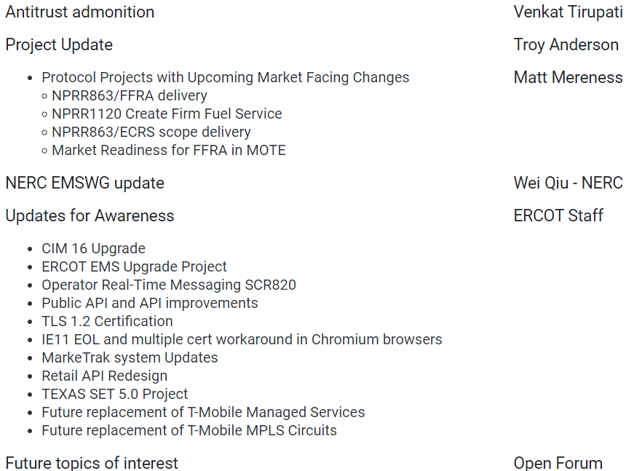
ERCOT Technology Working Group (TWG)
Meeting held on 8/4/2022
Discussion points:

Slide 9
Appendix

Slide 10
BES Combo Model Implementation
ESR: Energy Storage Resource
BES: Battery Energy Storage
PR353-01 BES Combo Model Implementation – decoupled into separate efforts below
NPRR987 – BESTF-3 ESR Contribution to Physical Responsive Capability and RT On-Line Reserve Capacity Calcs
TARGETING IMPLEMENTATION IN 2022-R5
NPRR1002 – BESTF-5 ESR Single Model Registration and Charging Restrictions in Emergency Conditions
TARGETING IMPLEMENTATION IN 2022-R5
NPRR989 – BESTF-1 ESR Technical Requirements
NPRR1038 – BESTF-8 Limited Exemption from Reactive Power Requirements for Certain ESRs
POTENTIAL IMPLEMENTATION IN 2022
NPRR1002 – BESTF-5 ESR Single Model Registration and Charging Restrictions in Emergency Conditions
RUN IN PARALLEL WITH RARF REPLACEMENT – TARGET GO-LIVE 2023
NPRR963 – Base Point Deviation Settlement & Deployment Performance Metrics for ESRs (Combo Model)
NPRR987 – BESTF-3 ESR Contribution to Physical Responsive Capability and RT On-Line Reserve Capacity Calcs
NPRR1069 – Align Ancillary Service Responsibility for ESRs with NPRR987
EXPECTED IMPLEMENTATION AFTER ECRS IN 2023 (re-assessing delivery options in September)
NPRR1026 – BESTF-7 Self-Limiting Facilities and Self-Limiting Resources
IMPLEMENTATION TIMELINE TBD

