Slide 1
2022 Monitoring and Situational Awareness Technical Conference
Wei Qiu, NERC EA
ERCOT TWG Conference Call
August 04, 2022

Slide 2
Date/Time
Location: Webex Events
Date and Time:
Thursday, September 22, 2022 1:00 p.m. – 3:00 p.m. Eastern
Thursday, October 06, 2022 1:00 p.m. – 3:00 p.m. Eastern
Thursday, October 20, 2022 1:00 p.m. – 3:00 p.m. Eastern
Theme: Post Pandemic --- New Normal in EMS
Session1: Overview
Session2: System Operations
Session3: Vendor Panel

Slide 3
Proposed Plan
Session 1: Overview
Analysis of EMS Events (NERC EA)
NERC Alerts system (NERC BPSA)
An EMS Lesson Learned (NERC and an EMS Vendor)
Session 2: System Operations
Cloud Computing (NERC & AMAZON AWS)
Frequency Response Monitoring and Mitigation using real-time stability analysis for RC West (RC West)
ERCOT on EMS improvement regarding loss of ICCP data (ERCOT)*
Session 3: Vendor Panel
Vendor Panel Discussion (GE, OSI, Siemens, and Hitachi Energy) Dwayne Fewless, ReliabilityFirst – Moderator

Slide 4
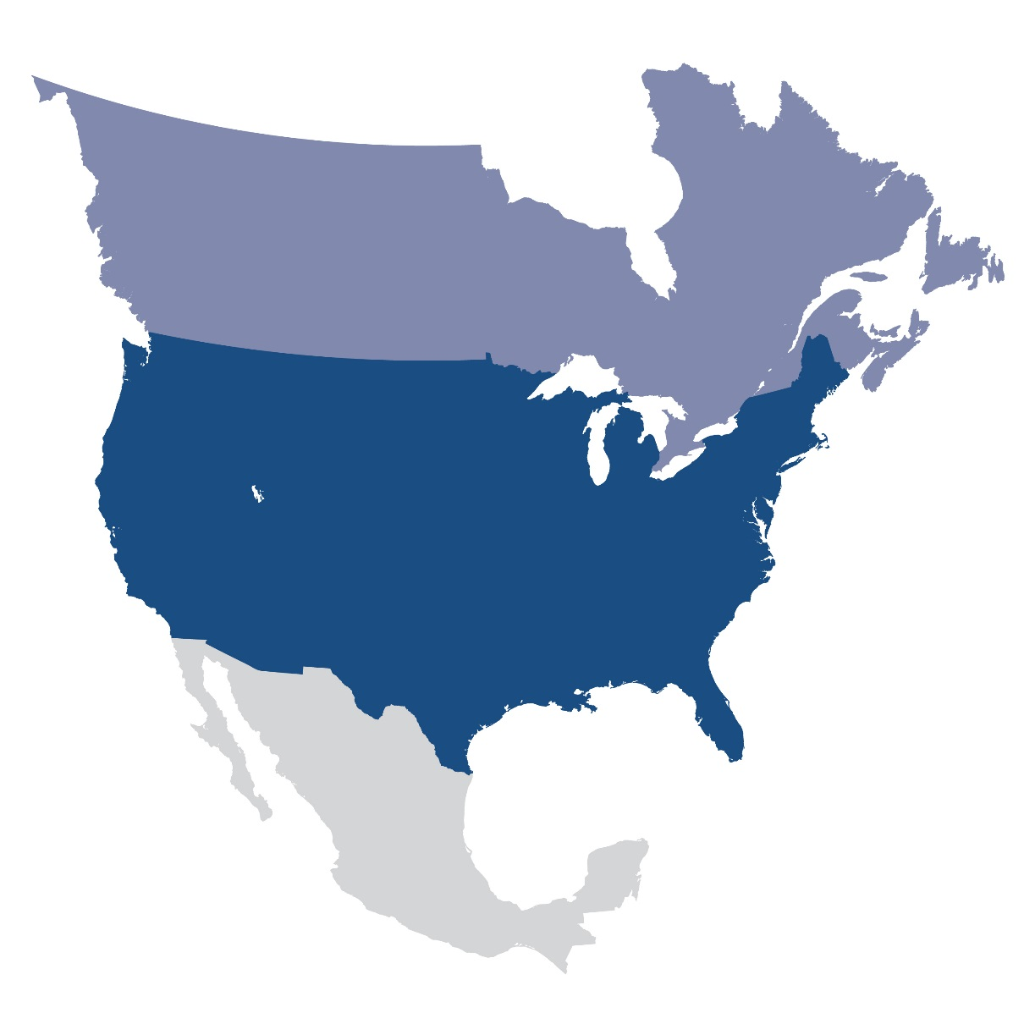
Questions and Answers
Contact Information:
wei.qiu@nerc.net

