Slide 1
System Protection Working Group (SPWG)
Update to ROS
August 10, 2022
Chair: Bret Burford, P.E.

Slide 2
SPWG Meeting Overview
2nd SPWG Meeting of 2022 was held on July 20, 2022
Topics Discussed:
Texas RE 2022 Q1 Misoperation Data (included)
NERC SPCWG Activities
PRC-019-2 – Compliance Implementation Guidance completed and sent to NERC for approval. Technical Reference document has been posted to SPCWG webpage.
PRC-023 SAR – to be posted for industry comment soon.
PRC-002 SARs – 1st effort involving Notification requirements was posted for comment/ballot and SDT will meet week of August 8th to review comments; 2nd effort involving DME for IBR locations has only been discussed in a brainstorming session.
PRC-005 SAR – Testing of AVR protective functions, etc.; SAR still in revision stage.
Reviewed latest ERCOT Study report for NOGRR226 – UFLS change for 59.4 Hz
ERCOT SPWG Future Year cases are posted in MIS

Slide 3
Protection System Misoperations
2022 Q1

Slide 4
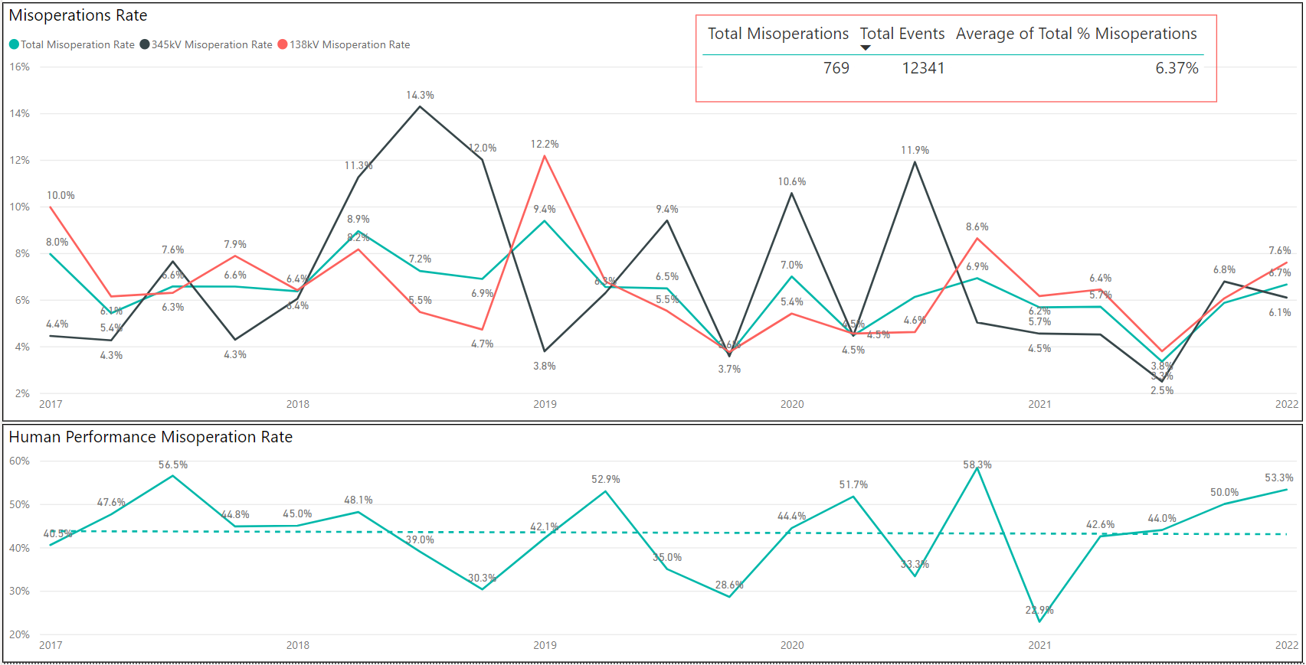
Protection System Misoperations: 2017-2022 Q1

Slide 5
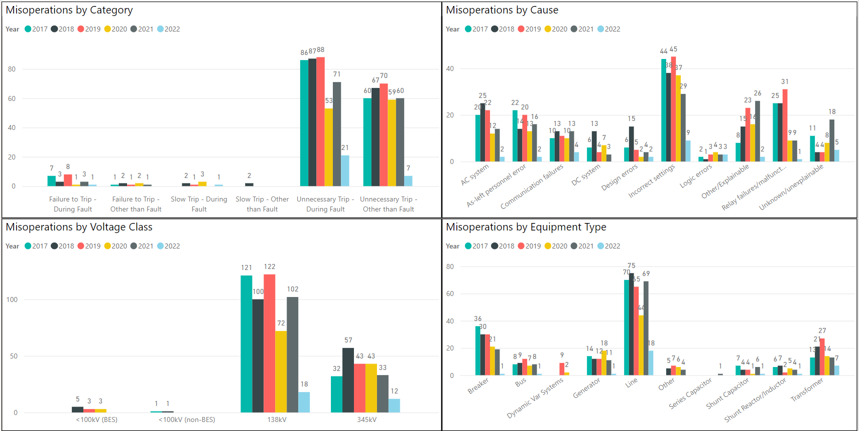
Protection System Misoperations: 2017-2022 Q1

Slide 6
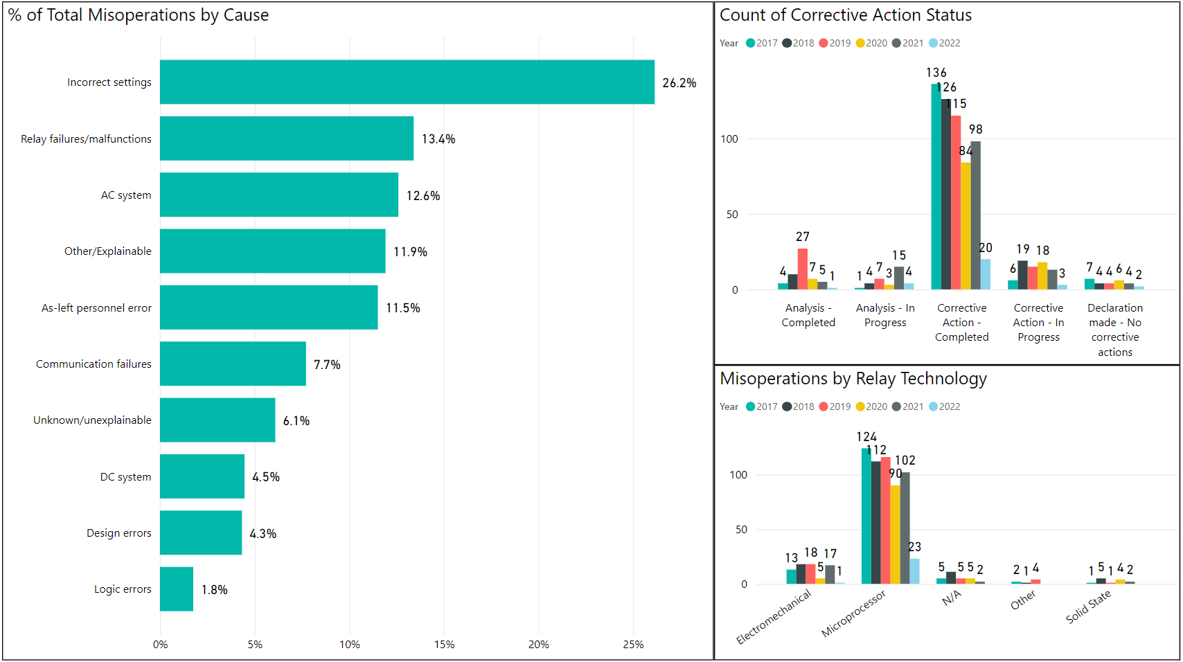
Protection System Misoperations: 2017-2022 Q1

Slide 7
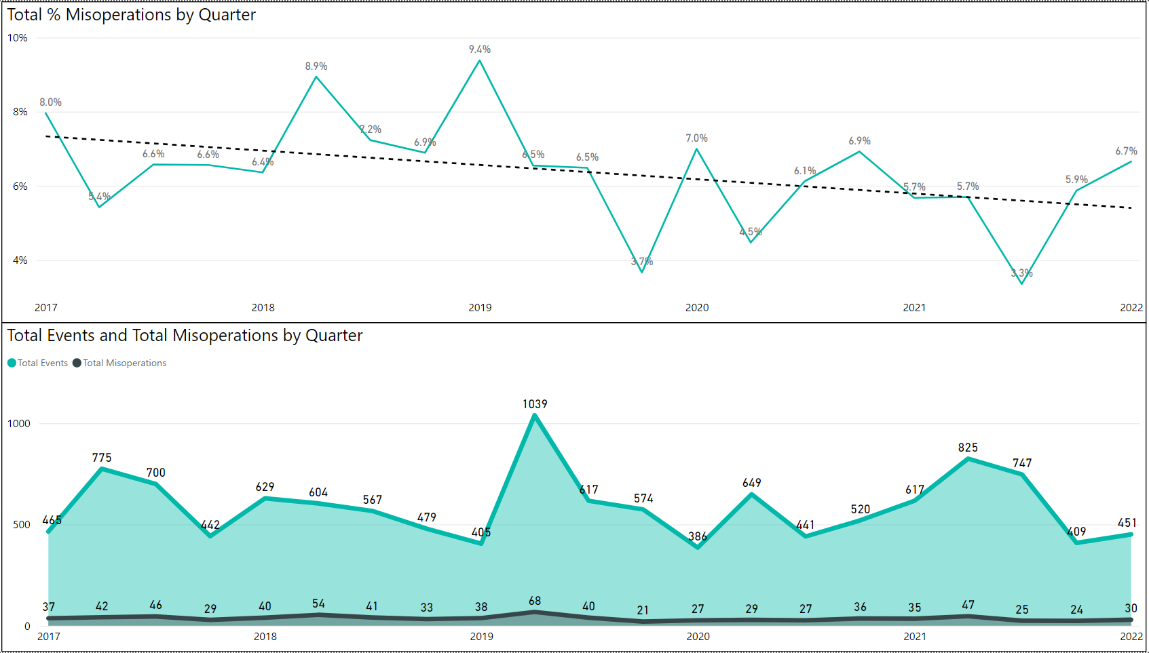
Protection System Misoperations: 2017-2022 Q1

Slide 8
Protection System Misoperations – 2022 Q1
 |  | Q1 | 2022 YTD
# of Misoperations | Total | 30 | 30
 | 345 kV | 12 | 12
 | 138 kV | 18 | 18
 | < 100 kV | 0 | 0
By Category | Failure to Trip | 1 | 1
 | Slow Trip | 1 | 1
 | Unnecessary Trip during Fault | 21 | 21
 | Unnecessary Trip – Non Fault | 7 | 7
 | RAS | 0 | 0
By Relay System Type | Electromechanical | 1 | 1
 | Solid State | 0 | 0
 | Microprocessor | 23 | 23
 | Other/ N/A | 6 | 6
By Equipment Protected | Line | 18 | 18
 | Transformer | 7 | 7
 | Generator | 1 | 1
 | Shunt/Series Capacitor | 1 | 1
 | Shunt/Series Reactor | 1 | 1
 | Dynamic VAR system | 0 | 0
 | Bus | 1 | 1
 | Breaker | 1 | 1
 | Other | 0 | 0

Slide 9
Protection System Misoperations 2022 Q1
Summary of Human Performance Issues noted for 2022 Q1:
345kV line breaker overtripped due to the power line carrier switch left in the OFF position.
A 138kV line breaker overtripped due to a wiring error between the output of the power line carrier and the relay.
A 138kV line terminal overtripped due to a logic error. The breaker failure initiate was programmed to immediately trip the terminal rather than start the breaker failure timer.
A wind plant GSU tripped due to a misprogrammed ground overcurrent element.
A 138kV line terminal overtripped due to a mismatch between the CT phase wiring and the phase rotation setting in the relay, causing the symmetrical component calculations within the relay to be incorrect.
A 138kV line terminal overtripped due to updated settings not being applied to the relay.
A 345kV bus tripped due to an incorrect CT ratio on the bus differential protection.
Failure to Trip/Slow Trip Misoperations in 2022 Q1:
A fault was on a radial 138kV line to a customer-owned substation was slow to clear. Slow clearing was due to inadequate modeling of the line and not allowing enough safety margin to ensure all faults on the radial line would be properly detected.
Generator 345kV lead line failed to trip during a fault. Line differential relay was disabled due to test switches in the incorrect position.

Slide 10
End of SPWG Presentation
Next Meeting Scheduled for November 9-10, 2022
Next ERCOT ROS Update will be Provided on December 1, 2022
Thank You
Any Questions?

Slide 11
Definitions
Protection System –
Protective relays which respond to electrical quantities,
Communications systems necessary for correct operation of protective functions
Voltage and current sensing devices providing inputs to protective relays,
Station dc supply associated with protective functions (including station batteries, battery chargers, and non-battery-based dc supply), and
Control circuitry associated with protective functions through the trip coil(s) of the circuit breakers or other interrupting devices

Slide 12
Definitions
Composite Protection System - The total complement of Protection System(s) that function collectively to protect an Element. Backup protection provided by a different Element’s Protection System(s) is excluded.
Misoperation – The failure a Composite Protection System to operate as intended for protection purposes. Any of the following is a Misoperation:
Failure to Trip – During Fault – A failure of a Composite Protection system to operate for a Fault condition for which it is designed.
Failure to Trip – Other than Fault - A failure of a Composite Protection system to operate for a non-Fault condition for which it is designed, such as a power swing, undervoltage, overexcitation, or loss of excitation.

Slide 13
Definitions
Misoperation – The failure a Composite Protection System to operate as intended for protection purposes. Any of the following is a Misoperation:
Slow Trip – During Fault – A Composite Protection system that is slower than required for a Fault condition if the duration of its operating time resulted in the operation of at least one other Element’s Composite Protection System.
Slow Trip – Other than Fault - A Composite Protection system that is slower than required for a non-Fault condition, such as a power swing, undervoltage, overexcitation, or loss of excitation, if the duration of its operating time resulted in the operation of at least one other Element’s Composite Protection System.

Slide 14
Definitions
Misoperation – The failure a Composite Protection System to operate as intended for protection purposes. Any of the following is a Misoperation:
Unnecessary Trip – During Fault – An unnecessary Composite Protection system operation for a Fault condition on another Element.
Unnecessary Trip – Other than Fault - An unnecessary Composite Protection system operation for a non-Fault condition. A Composite Protection System operation that is caused by personnel during on-site maintenance, testing, inspection, construction, or commissioning activities is not a Misoperation.

