Slide 1
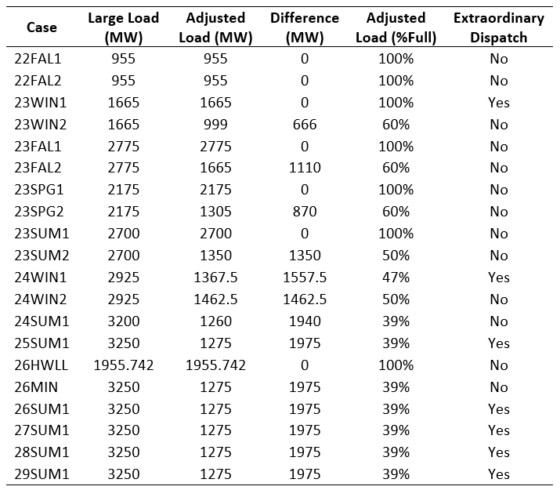
22SSWG Cases
Ross Cloninger (Chair)
Joshua Wichers (Vice-Chair)

