Slide 1
Supply Analysis Working Group Update
Caitlin Smith, Chair
Ian Haley, Vice Chair
Pete Warnken, Vice Chair
August 3, 2022

Slide 2
Mid-Term Load Forecast Presentation Follow-up
Summarized model updates for summer
For Day-Ahead, E2 forecast no longer necessarily using the most extreme weather forecast – now targeting E2 to be 1-2% higher than base 50/50 forecast
E3 forecast will use one of the most extreme weather forecasts for ERCOT system for 4+ days in the future, but necessarily the most extreme; control room discretion for extreme forecast selection

Slide 3
CDR/SARA Issues Associated with Large Flexible Loads and PUNs
LFL_49 Action Item: Consider how co-located or Stand-alone LFLs and Resources should be considered in resource adequacy reports, including if they should be classified as Private Use Networks in ERCOT reports
Action Item Owners:
ERCOT (Evan Neel)
Lancium (Eric Goff)
AEP (Blake Gross)
Oncor (Martha Henson)
Jupiter Power (Caitlin Smith)

Slide 4
CDR/SARA Issues Associated with Large Flexible Loads and PUNs, continued
Reporting issues summarized:
Co-located LFLs as possible separate PUN category with disclosure of project MW capacity only
Capacity contribution method needed for proper representation in planning reserve margins; understanding operational behavior of LFLs during peak load hours is needed
LFLs in deterministic scenarios and probabilistic modeling
Standalone LFLs included in Long Term Load Forecast

Slide 5
NERC Energy Reliability Assessment Task Force
NERC’s Reliability and Security Technical Committee (RSTC) formed the Energy Reliability Assessment Task Force (ERATF) in 2021 to assess risks associated with energy constrained resources
ERATF developed two Standard Authorization Requests (SARs) to address fuel assurance for the planning horizon, and operations and operations planning horizons, respectively
Objective is to create new or revise existing standards to require energy reliability assessments

Slide 6
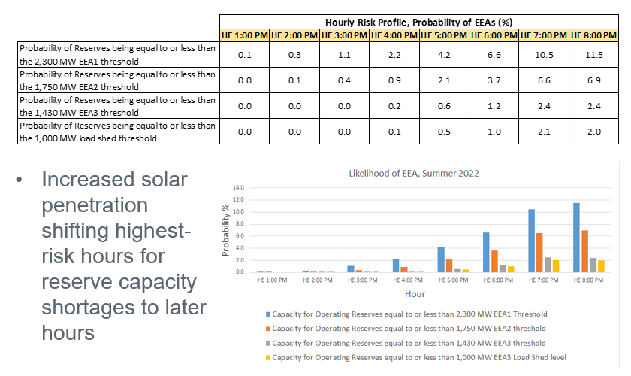
Summer 2022 SARA Probabilistic Model

Slide 7
CDR/SARA Improvement Project
Two PUCT CDR/SARA workshops and June 6 Open Public Meeting
“Framework of principles” to be in market rules by December 2022 that tie the CDR/SARA to Phase 2 market design
Release CDR on a quarterly basis with seasonal outlooks
Include probabilistic metric(s)
Gather stakeholder feedback on Reliability Standard and metrics in parallel with Consultant Phase 2 analysis
Standards should support resiliency goals
Put target publication dates in the Rules, but allow some flexibility

Slide 8
CDR/SARA Improvement Project, continued
Rulemaking for voluntary registration of Large Flexible Loads and critical loads
Tie to LFLTF progress
Other CDR reforms like load forecasting improvement, resource accreditation, and scenario analysis can be managed by ERCOT rather than codified in the Rules
Continue to collaborate with the Commission
Maintain data and methodology transparency for stakeholders

Slide 9
CDR/SARA Improvement Project, continued
SARA reports
ERCOT proposal to release monthly resource adequacy reports that includes probabilistic risk assessment results
PUCT goal: Identify “downside” seasonal scenarios that the fleet needs to prepare for to provide sufficient reliability

Slide 10
Upcoming ERCOT Studies
Reserve Margin Study – initiate in 2022.Q4
Cost of New Entry (CONE) Study
Plan to initiate in 2022.Q4, starting with an RFP for a consultant to conduct the study, but would like WMS to weigh-in on study timing

