Slide 1
Market Credit Working Group update to the Wholesale Market Subcommittee
Brenden Sager, Austin Energy, Chair
Seth Cochran, Direct Energy, Vice Chair
3 August 2022

Slide 2
General Update
  20 July 2022 Joint MCWG/CWG WEBEX Meeting
  No NPRRs reviewed for their credit impacts
  NPRR 1126 proposal (Seth Cochran covering separately)
  Draft NPRR from Shams Siddiqi on updated credit calculations

Slide 3
Another credit calculation adjustment proposal
Example: DC tie transaction importing into ERCOT. URTA Unbilled Real-Time Amount drives credit requirements and when they’re importing power and ERCOT owes them money
EALt = Max [RFAF * Max {RTLE during the previous lrt days}, RTLF] + DFAF * DALE + Max [RTLCNS, Max {URTA during the previous lrt days}] + OUTt
Proposed EALt = Max [RFAF * Max {RTLE during the previous lrt days}, RTLF] + DFAF * DALE + RTLCS + OUTt
Proposal removes Unbilled Real-Time Amount max function
Due to Max functions, RTLF and RTLCNS, which capture recent positive RTM activity, is not taken into account at all. Rather RTLE and URTA, which lag behind by 7 days and have large M1=10 and M2=9 weights, set RTM exposure

Slide 4
Another credit calculation adjustment proposal
Proposal: To receive Trading Activity Only treatment, TAO-eligible entity would agree to suspend RTM activities immediately following receiving notice from ERCOT (simultaneously as when DAM activity is suspended) and not resume RTM activity until notified by ERCOT to do so (similar in concept to agreeing to special provisions to receive preferential “e” treatment in DAM)
DC Tie Load, even though allocated costs like other Load, is still a trading activity – i.e., there is no mass transition required for DC Tie Load. Currently, QSE engaging in trading activity only having no Load or generation but exporting over DC Ties (DC Tie Load) is not considered a TAO QSE. Change: Export (DC Tie Load) should be treated as trading activity in designation of TAO QSE.
From ERCOT: Not going to be manual monitoring by ERCOT; manual processes are difficult especially for RT activity

Slide 5
Monthly Highlights May 2022 – Jun 2022
Market-wide average TPE increased from $1,515.9 million in May to $1,878.6 million in June.
  TPE increased mainly due to
    higher Forward Adjustment Factors and
    higher Real-Time and Day-Ahead Settlement Point prices
    Discretionary Collateral is defined as Secured Collateral in excess of TPE,CRR Locked ACL and DAM Exposure
  Average Discretionary Collateral increased from $2,225.2 million in May to $2,501.0 million in June
  The increase in Discretionary Collateral is largely due to increase in Secured Collateral
No unusual collateral call activity

Slide 6
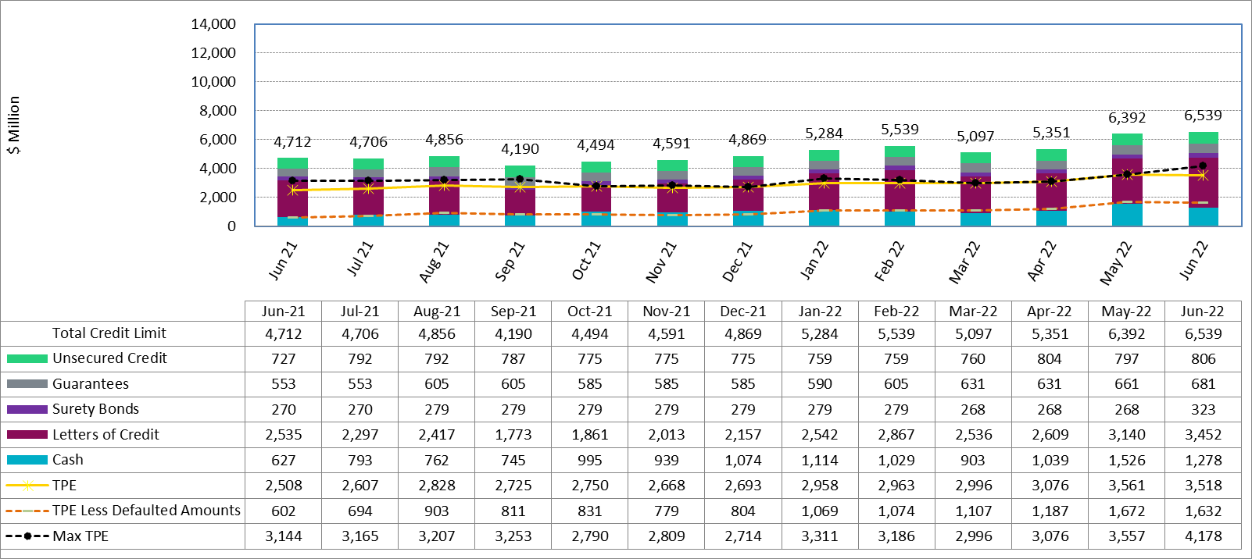
Available Credit by Type Compared to Total Potential Exposure (TPE) Jun 2021- Jun 2022

Slide 7
Discretionary Collateral May 2022 - June 2022

