Slide 1
Lubbock Power & Light
ERCOT & Retail Market Subcommittee
Entry into Retail Market Presentation
August 2, 2022

Slide 2
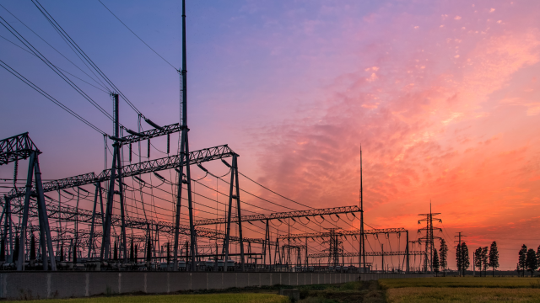
About LP&L
Established in 1916
257,013 population
Division I university
Texas Tech UNIVERSITY

Slide 3
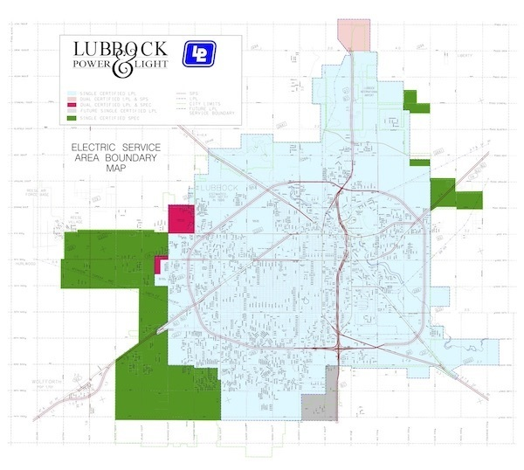
Service Area for 107,000 Customers

Slide 4
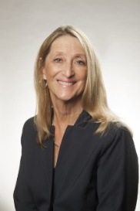
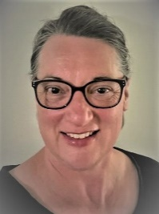
Meet Our Starting Lineup
Consultant
Support
Carolyn Shellman
Pam Shaw

Slide 5
Governance
Electric Utility Board
City Council
Recommends approval of an annual budget and retail rate schedules to Council
Appointment of Director and General Counsel
Establish policies and determine viability of support services
Oversees other customer programs
Managing the general reserve fund
Approves annual budget and retail rates
Eminent Domain
Debt Issuance
Approves EUB members

Slide 6
Thank You
LP&L staff has been working closely with both the ERCOT and the PUCT staff throughout this process.
Thank you to ERCOT’s many staff members and to Ted Hailu, Jerry Huerta, Brett Hunsucker for driving these meetings and to Sarah Heselmeyer for her efforts coordinating our meetings. To Shawnee Claiborn-Pinto and Floyd Walker of the PUCT and many others of the PUCT staff that have participated in our meetings, thank you.

Slide 7
Timeline For Market Entry
LP&L will move our remaining 30% of customers to ERCOT in the Spring of 2023, pending state regulatory approval.
2023 - LP&L projecting to go-live in October/November 2023.
Period for Customer Choice will occur July/August through Mid-September.
Mid-September through October 1 – Blackout period to allow for those customers who have not selected a REP to be assigned a Default REP.

Slide 8
Timeline For Market Entry
12 month minimum notice is being sent this month, a date certain City Council resolution will occur in mid 2023
POLR selection is planned for late 2022
Process to establish Default REP’s spring 2023

Slide 9
Current LP&L Customers
Customer count entering competition
Total Meters – ~107,000
Residential Customers - ~93,000
Commercial <50kW - ~5,000
Commercial 50-1000kW- ~2,000
Commercial >1,000kW - ~100
Critical Care/Critical Load Customers - ~150 Critical Care customers

Slide 10
Rate Structure
LP&L will simplify its current rate structure similar to the structure below:
Residential
Small Non-Residential (<50kW)
Medium Non-Residential (50kW-1000kW)
Large Non-Residential (>1000kW)
Non-metered Miscellaneous

Slide 11
AMI Meters
99.6% of LP&L meters deployed are Advanced Meters.
96.4% of LP&L Residential Meters are Remote Connect/Disconnect.
LP&L is considering methods which we may provide Interval Data information.

Slide 12
ESI IDs
LP&L ESI ID will be configured as a 15 digit number.
10-11292-xxxxxxxx
10 = placeholder for future use.
11292 = five digit Department of Energy identification code for the assigning TDSP.
xxxxxxxx = number assigned by the TDSP. This will be a random number for LP&L.

Slide 13
Service Addresses
LP&L has accurate GIS service addresses. Non-metered loads such as streetlights and security lights do not have addresses associated with them.

Slide 14
REP Self-help and
LP&L Market Operations Group
LP&L will not be supplying a self-help portal at the time of market entry. All communication will flow through ERCOT. A Market Operations Group will be in place to interface with REPs as needed. This Market Operations Group will be the point of contact for the Retail Electric Providers.

Slide 15
Registration of REPs
LP&L is reviewing and evaluating processes and procedures for registering REPs in its certificated area and will update the market on these processes and procedures at the appropriate time.

Slide 16
Next Steps
LP&L is seeking to modernize the Pro Forma Tariff from its original creation in 2001-2002
LP&L’s proposal is to offer an expedited filing to the PUCT based on a pre-arranged agreement between interested stakeholders
LP&L has posted the PFT to our website for access by interested stakeholders. If interested in reviewing and/or commenting, please visit:
https://lpandl.com/retail-competition/retail-providers
LP&L requests assistance from the RMS Task Force to ensure all parties are included

Slide 17
Questions?

