Slide 1
Settlement Stability
2022 Q2 Update to WMS
Settlements Group
ERCOT
08/03/2022

Slide 2
8.2(2)(c)(i) Track number of price changes
Reporting Period: 2022 Q2
Operating Day | # of Corrected Prices |  |  |  |  | # of Intervals Affected |  |  |  |  | Market Notice
 | DASPP | MCPC | RTSPP | RTRMPR | ORDC Adders | DASPP | MCPC | RTSPP | RTRMPR | ORDC Adders
- | - | - | - | - | - | - | - | - | - | - | -
Notes:
There were no price changes in Q2 2022.
The price changes reported on this slide display the price corrections that have been done after the Settlement Statement has posted for the Operating Day.

Slide 3
8.2(2)(c)(iv) Track number of resettlements due to non-price errors
Reporting Period: 2022 Q2
Operating Day(s) Resettled | Reason for Resettlement | Affected Charge Types | Market Notice Number
- | - | - | -
Notes:
There were no resettlements due to non-price errors in Q2 2022.

Slide 4
8.2(2)(c)(ii) Track number and types of disputes submitted 8.2(2)(c)(iii) Compliance with timeliness of response to disputes
YEAR | 2022 |  | 100% of dispute resolutions were timely.
CALENDAR QUARTER REPORTED | Q2
Disputed Charge Sub-Type | Submitted | Resolved | Denied | Granted | Granted with Exceptions
Ancillary Services-RTM | 4 | 4 | 3 | 1 | 0
DA/RT Invoice | 1 | 1 | 1 | 0 | 0
Emergency Operations | 0 | 1 | 1 | 0 | 0
Energy-DAM | 3 | 2 | 2 | 0 | 0
Energy-RTM | 15 | 11 | 8 | 3 | 0
Gene. Res. Base Pt. Deviation | 3 | 3 | 3 | 0 | 0
Reliability Unit Commitment | 29 | 10 | 0 | 10 | 0
TOTAL | 55 | 32 | 18 | 14 | 0
Submitted but not resolved disputes may be:
Not started
Open
Rejected
Withdrawn

Slide 5
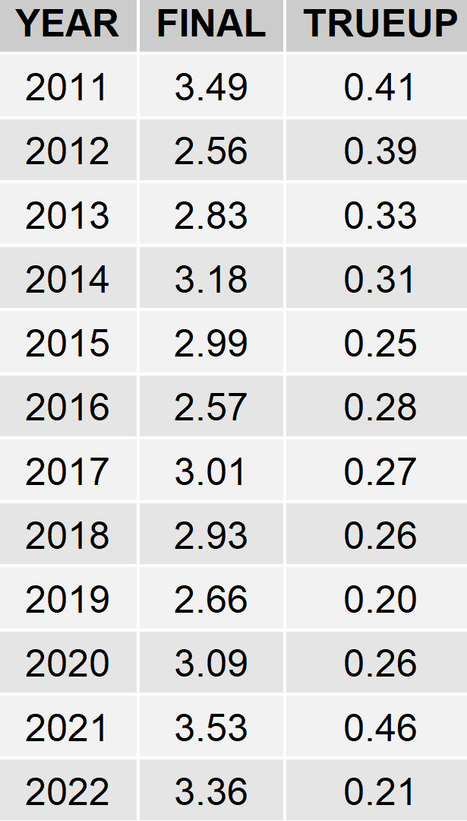
8.2(2)(c)(iv) Other Settlement metrics
NOTE: ERS Final settlement OD data is not represented in graph.
Average percent change

Slide 6
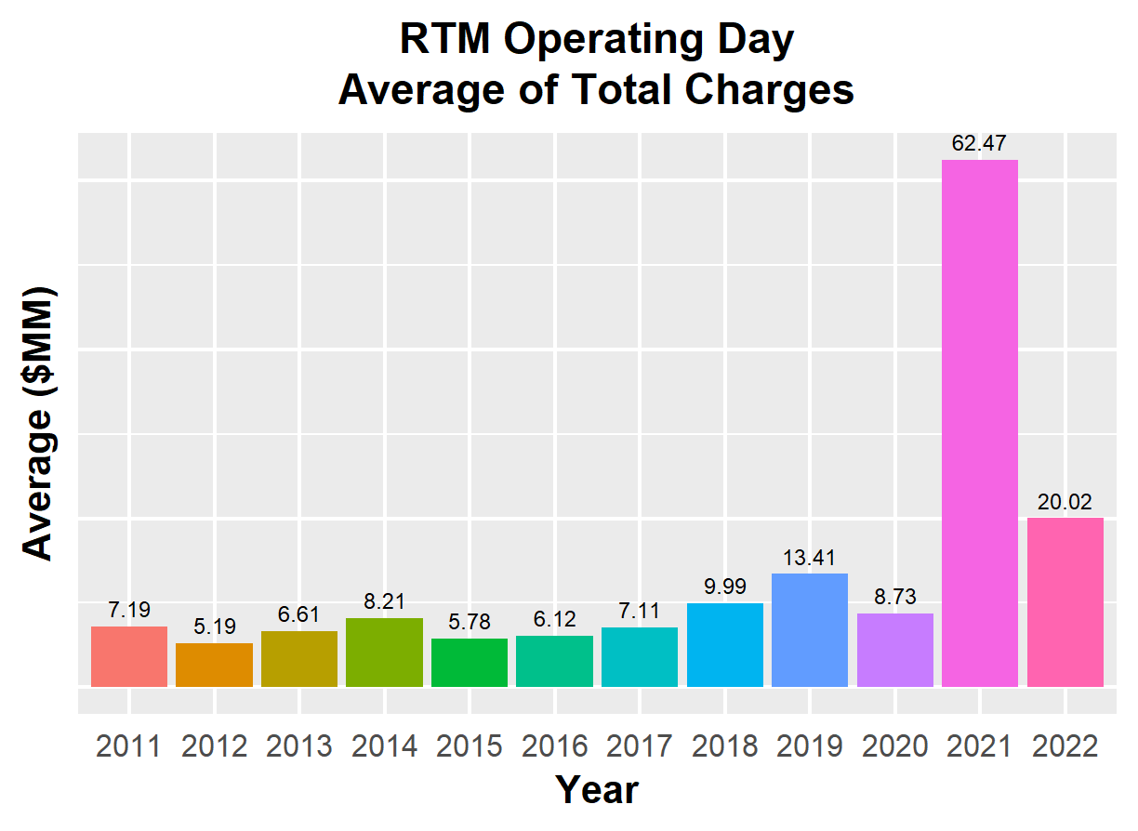
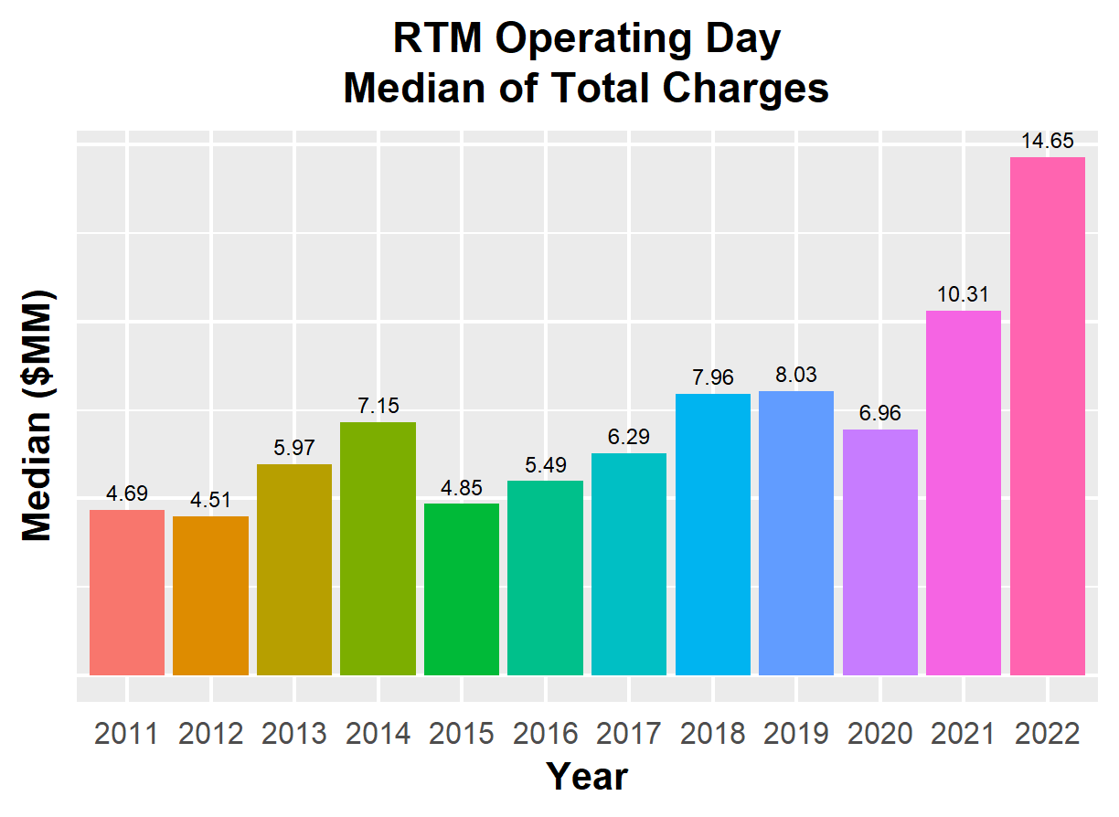
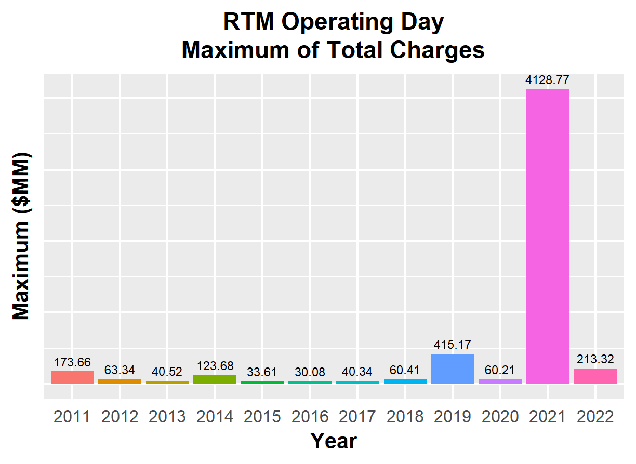
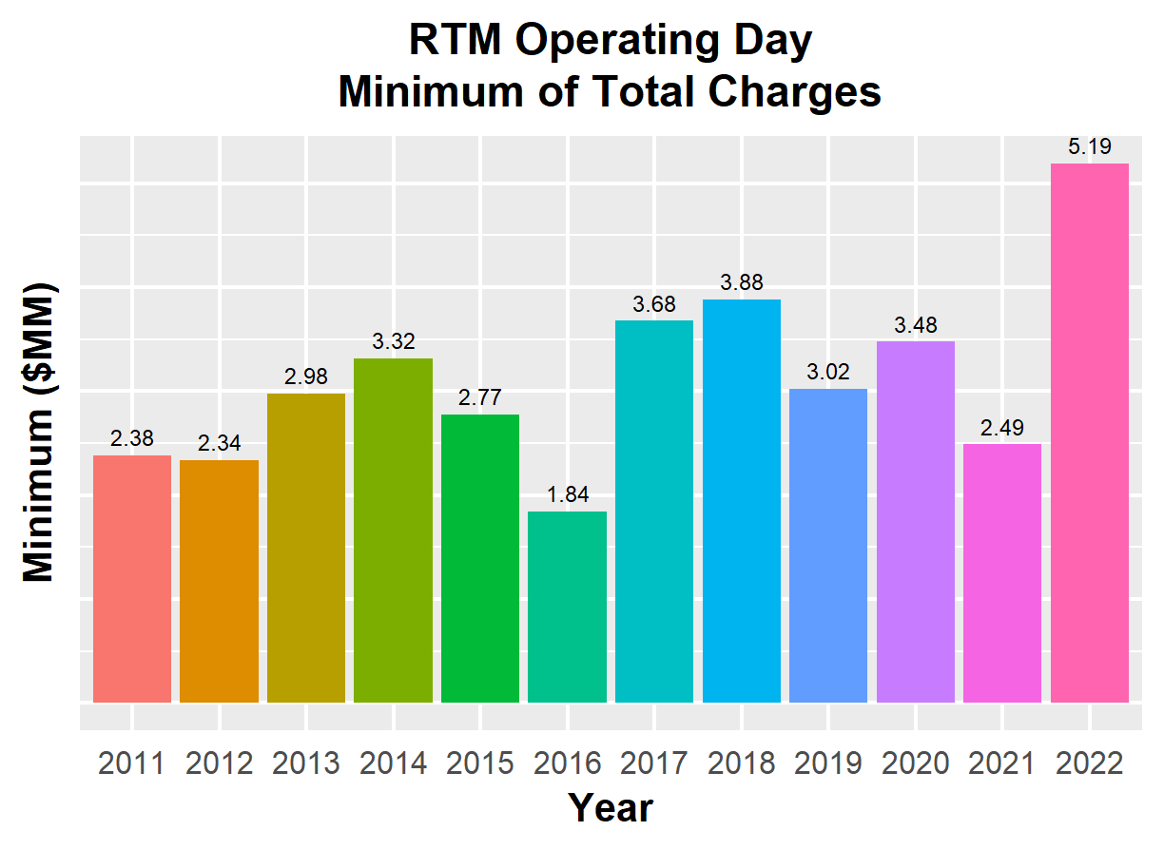
8.2(2)(c)(iv) Other Settlement metrics

Slide 7
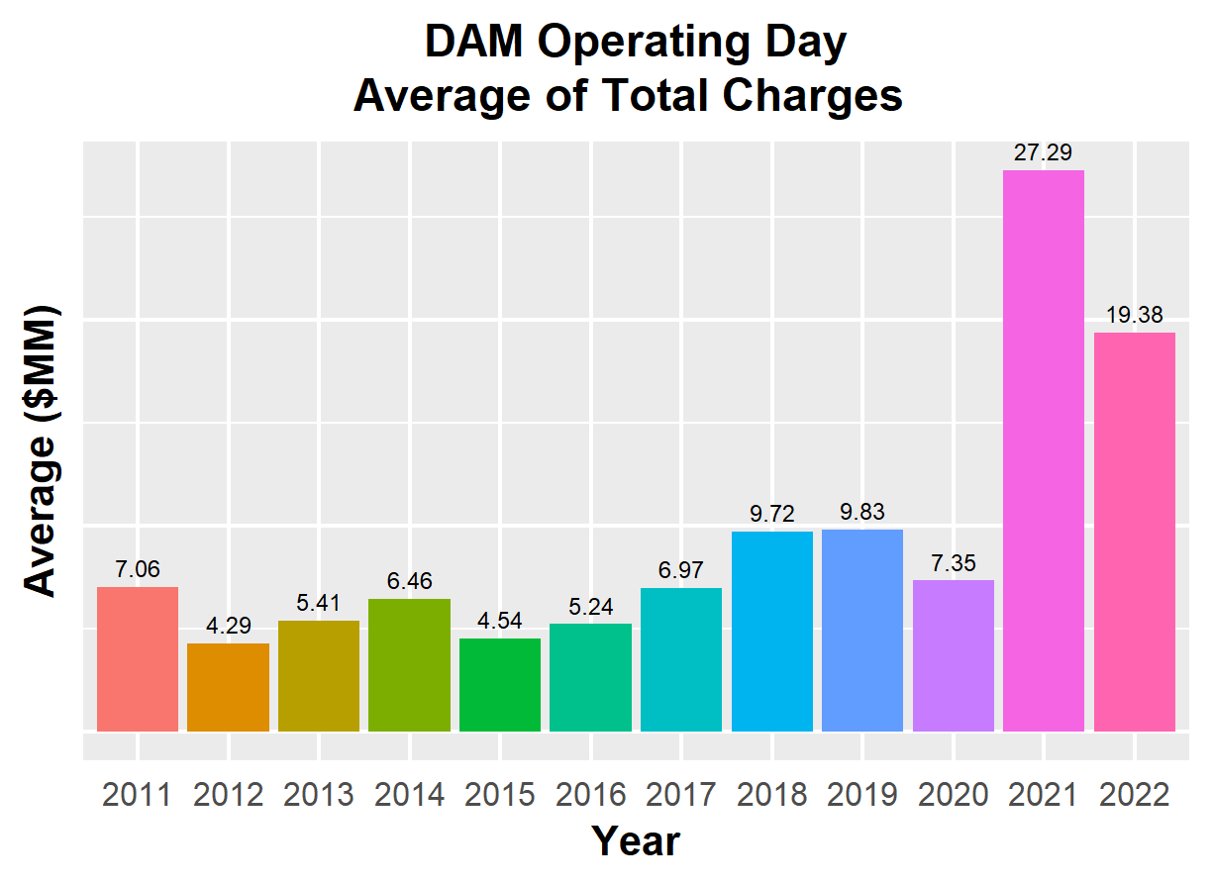
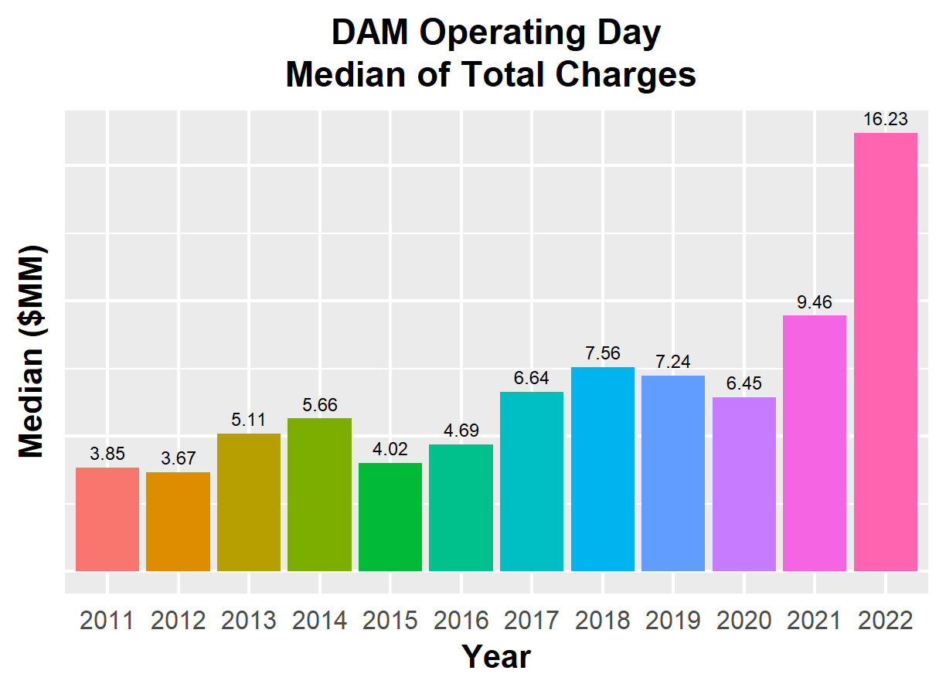
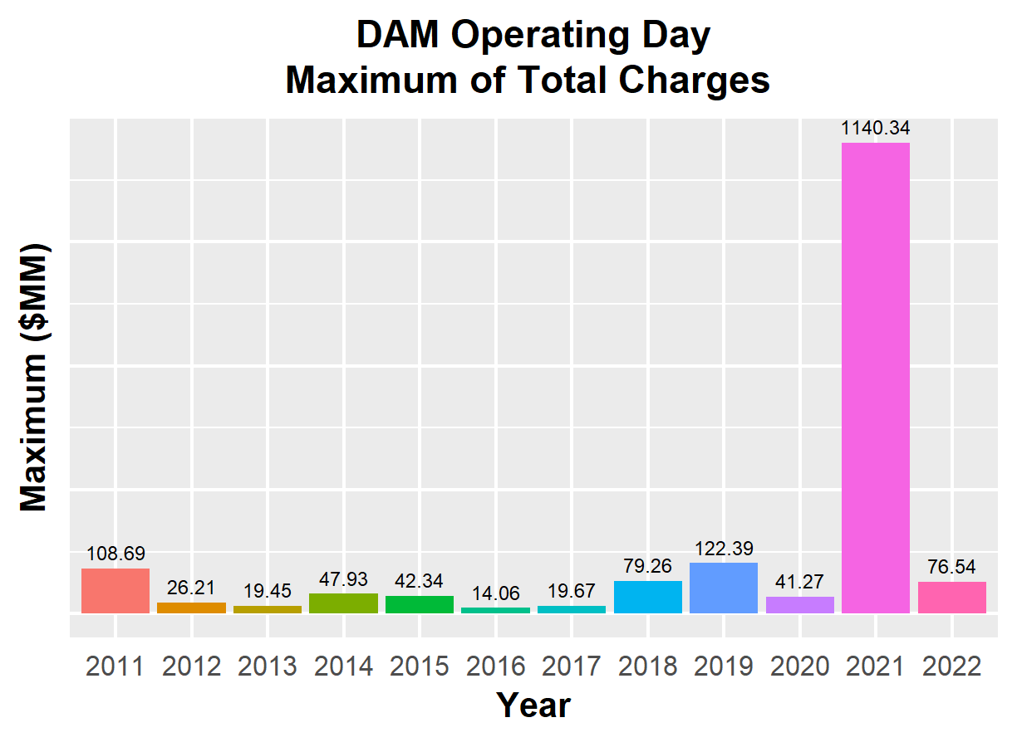
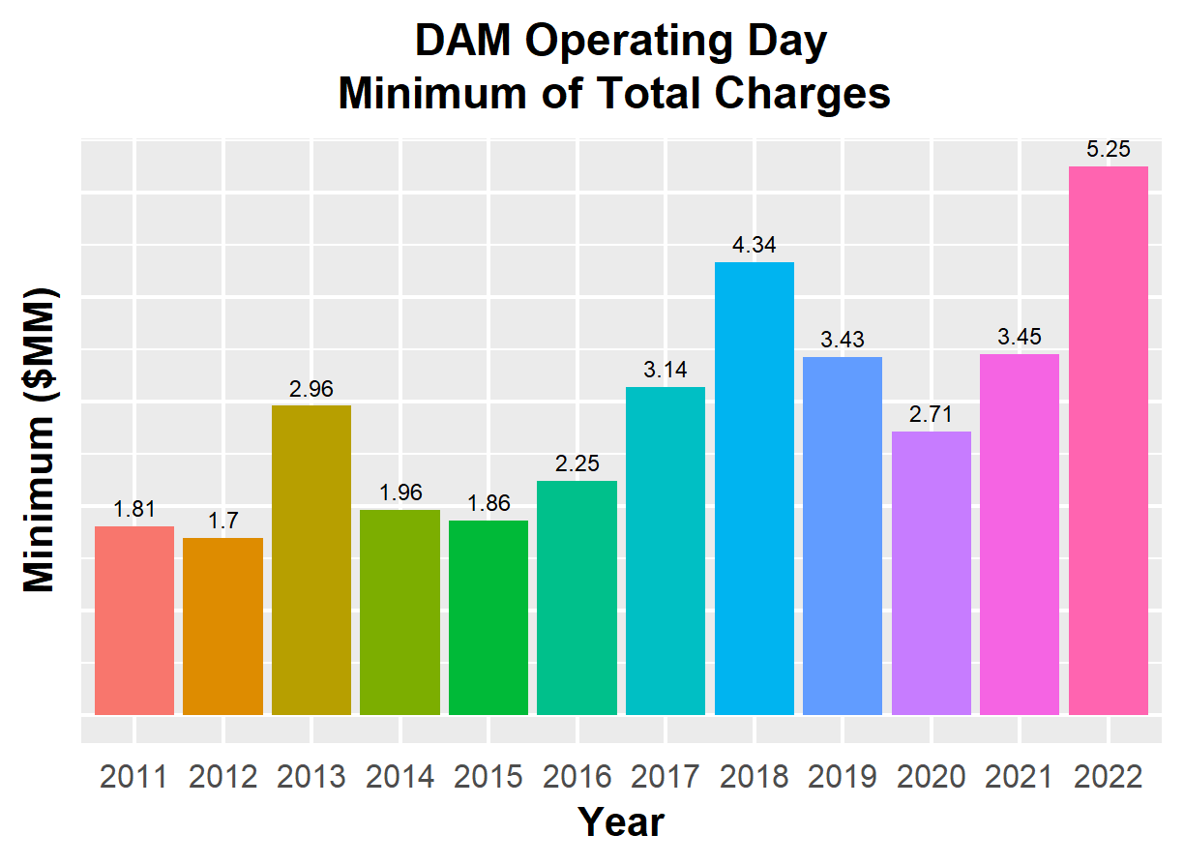
8.2(2)(c)(iv) Other Settlement metrics

Slide 8
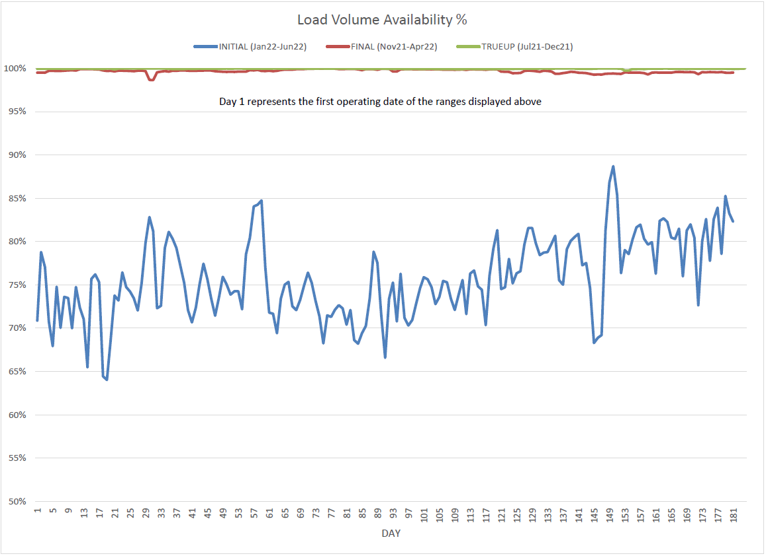
8.2(2)(c)(v) Availability of ESIID consumption data

Slide 9
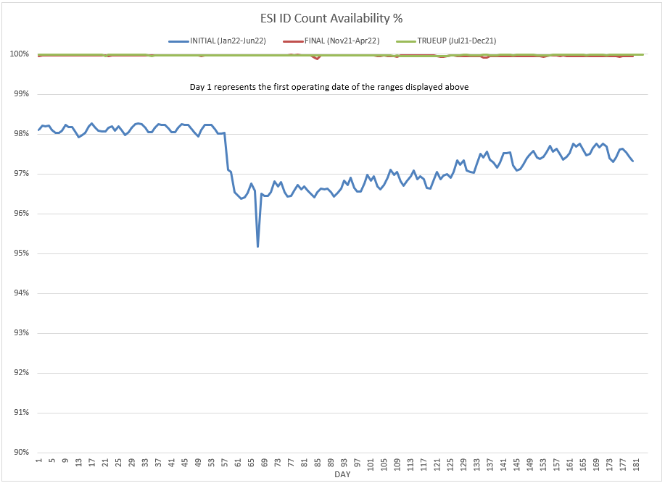
8.2(2)(c)(v) Availability of ESIID consumption data

Slide 10
8.2(2)(g) Net Allocation to Load - Totals and $/MWh
NET ALLOCATION TO LOAD ($M)
 | Jun 2021 | Jul 2021 | Aug 2021 | Sep 2021 | Oct 2021 | Nov 2021 | Dec 2021 | Jan 2022 | Feb 2022 | Mar 2022 | Apr 2022 | May 2022 | Jun 2022
Ancillary Service Settlement | 61.2 | 69.2 | 74.2 | 81.5 | 132.4 | 83.4 | 49.1 | 31.8 | 67.5 | 76.9 | 91.5 | 230.2 | 106.0
Balancing Account Payout to Load | -11.7 | -9.2 | -17.5 | -16.2 | -22.4 | -5.2 | -0.5 | -7.0 | -10.3 | -13.9 | -26.7 | -72.2 | -43.1
Base Point Deviation Payments | -0.4 | -0.3 | -0.3 | -0.4 | -0.4 | -0.4 | -0.3 | -0.3 | -0.5 | -0.4 | -0.5 | -1.2 | -0.7
Black Start Service Settlement | 0.5 | 0.6 | 0.6 | 0.6 | 0.6 | 0.6 | 0.6 | 0.6 | 0.5 | 0.6 | 0.6 | 0.6 | 0.6
Block Load Transfer Settlement | 0.0 | 0.0 | 0.0 | 0.0 | 0.0 | 0.0 | 0.0 | 0.0 | 0.0 | 0.0 | 0.0 | 0.0 | 0.0
Emergency Energy Charges | 0.1 | 0.0 | 0.1 | 0.1 | 0.2 | 0.4 | 0.3 | 0.3 | 0.1 | 0.3 | 0.4 | 0.6 | 0.2
ERCOT Admin Fee Settlement | 20.7 | 22.0 | 23.0 | 20.3 | 18.2 | 15.6 | 16.8 | 18.6 | 17.4 | 17.0 | 17.1 | 21.5 | 23.4
ERO Pass-Through Fee⁵ | 1.6 | 1.6 | 1.6 | 1.6 | 1.6 | 1.6 | 1.6 | 1.8 | 1.8 | 1.8 | 1.8 | 1.8 | 1.8
ERS Settlement¹ | 3.5 | 3.5 | 3.5 | 3.5 | 4.7 | 4.7 | 6.2 | 6.2 | 6.2 | 6.2 | 0.0 | 0.0 | 0.0
High Dispatch Limit Override | 0.0 | 0.0 | 0.0 | 0.0 | 0.0 | 0.0 | 0.0 | 0.0 | 0.0 | 0.0 | 0.0 | 0.0 | 0.0
Non-Zonal Auction Distribution | -21.0 | -15.0 | -14.1 | -15.6 | -26.0 | -28.4 | -21.7 | -22.5 | -22.7 | -34.4 | -34.5 | -43.3 | -47.3
ORDC Settlement | 1.6 | 3.4 | 0.4 | 0.6 | -0.7 | 0.3 | 0.0 | 0.8 | 5.1 | 2.4 | 12.5 | -10.2 | 1.3
Revenue Neutrality Total | -2.3 | 1.7 | 2.1 | 3.1 | 3.0 | 8.8 | 9.8 | 2.9 | 4.4 | 12.8 | -3.2 | 0.6 | -5.4
RMR Settlement | 0.0 | 0.0 | 0.0 | 0.0 | 0.0 | 0.0 | 0.0 | 0.0 | 0.0 | 0.0 | 0.0 | 0.0 | 0.0
RUC Settlement | -0.1 | -0.6 | -0.1 | -0.1 | -0.9 | -0.1 | 0.0 | 0.0 | -9.4 | -0.2 | -1.3 | -8.2 | 0.0
Voltage Services Settlement | 0.0 | 0.0 | 0.0 | 0.0 | 0.0 | 0.0 | 0.0 | 0.0 | 0.0 | 0.0 | 0.0 | 0.0 | 0.0
Zonal Auction Distribution² | -58.6 | -63.0 | -59.0 | -48.4 | -45.4 | -37.9 | -49.8 | -47.5 | -42.7 | -43.8 | -42.8 | -48.3 | -66.4
Total Allocation to Load | -4.9 | 13.9 | 14.5 | 30.6 | 64.9 | 43.4 | 12.1 | -14.3 | 17.4 | 25.3 | 14.9 | 71.9 | -29.6
Adjusted Metered Load (TWh) | 37.4 | 39.6 | 41.4 | 36.6 | 32.7 | 28.1 | 30.3 | 33.5 | 31.4 | 30.5 | 30.9 | 38.7 | 42.1
$/MWh³ | -0.1 | 0.4 | 0.4 | 0.8 | 2.0 | 1.5 | 0.4 | -0.4 | 0.6 | 0.8 | 0.5 | 1.9 | -0.7
Note: The Net Allocation to Load amounts provided in this presentation are for informational purposes only and cannot be relied upon for accurate measurements or forecasts of individual QSE charges and payments.
¹The total ERS charges have been evenly allocated across the contract period.
²Zonal Auction Distribution by 2003 Congestion Management Zone, shown below.
³The $/MWh value as calculated per PR 8.2 (2) g
⁴The $/MWh value by 2003 Congestion Management Zone, as calculated per PR 8.2(2) g
⁵Allocated to load from two years prior per the Electric Reliability Organization Fee Assessment and Collection Guide

Slide 11
8.2(2)(g) Net Allocation to Load - Totals and $/MWh
ZONAL AUCTION DISTRIBUTION PER CONGESTION MANAGEMENT ZONE ($M)
 | Jun 2021 | Jul 2021 | Aug 2021 | Sep 2021 | Oct 2021 | Nov 2021 | Dec 2021 | Jan 2022 | Feb 2022 | Mar 2022 | Apr 2022 | May 2022 | Jun 2022
HOUSTON | -7.7 | -6.8 | -6.7 | -5.0 | -4.8 | -3.6 | -4.0 | -4.2 | -3.0 | -3.2 | -3.8 | -3.1 | -4.1
NORTH | -13.9 | -14.7 | -14.8 | -10.4 | -6.2 | -5.6 | -7.0 | -9.9 | -11.2 | -5.2 | -5.0 | -7.4 | -14.6
SOUTH | -20.9 | -24.8 | -21.9 | -17.1 | -17.1 | -17.5 | -18.0 | -18.8 | -17.0 | -22.0 | -21.7 | -23.6 | -27.4
WEST | -16.2 | -16.7 | -15.6 | -15.8 | -17.3 | -11.3 | -20.8 | -14.5 | -11.5 | -13.4 | -12.4 | -14.3 | -20.2
TOTAL | -58.6 | -63.0 | -59.0 | -48.4 | -45.4 | -37.9 | -49.8 | -47.5 | -42.7 | -43.8 | -42.8 | -48.3 | -66.4
REAL-TIME ADJUSTED METERED LOAD BY CONGESTION MANAGEMENT ZONE (TWh)
 | Jun 2021 | Jul 2021 | Aug 2021 | Sep 2021 | Oct 2021 | Nov 2021 | Dec 2021 | Jan 2022 | Feb 2022 | Mar 2022 | Apr 2022 | May 2022 | Jun 2022
HOUSTON | 10.5 | 10.9 | 11.4 | 9.8 | 9.1 | 7.6 | 8.4 | 8.4 | 7.7 | 8.1 | 8.4 | 10.8 | 11.4
NORTH | 12.8 | 14.0 | 14.5 | 12.5 | 10.6 | 9.2 | 9.8 | 11.9 | 11.2 | 10.1 | 9.6 | 12.4 | 14.5
SOUTH | 9.8 | 10.2 | 10.9 | 9.9 | 8.8 | 7.2 | 7.9 | 8.7 | 8.4 | 7.9 | 8.4 | 10.6 | 11.3
WEST | 4.3 | 4.5 | 4.6 | 4.4 | 4.3 | 4.1 | 4.3 | 4.5 | 4.1 | 4.4 | 4.4 | 4.9 | 4.8
TOTAL | 37.4 | 39.6 | 41.4 | 36.6 | 32.7 | 28.1 | 30.3 | 33.5 | 31.4 | 30.5 | 30.9 | 38.7 | 42.1
ZONAL AUCTION REVENUE PER CONGESTION MANAGEMENT ZONE ($/MWh)
 | Jun 2021 | Jul 2021 | Aug 2021 | Sep 2021 | Oct 2021 | Nov 2021 | Dec 2021 | Jan 2022 | Feb 2022 | Mar 2022 | Apr 2022 | May 2022 | Jun 2022
HOUSTON | -0.7 | -0.6 | -0.6 | -0.5 | -0.5 | -0.5 | -0.5 | -0.5 | -0.4 | -0.4 | -0.5 | -0.3 | -0.4
NORTH | -1.1 | -1.0 | -1.0 | -0.8 | -0.6 | -0.6 | -0.7 | -0.8 | -1.0 | -0.5 | -0.5 | -0.6 | -1.0
SOUTH | -2.1 | -2.4 | -2.0 | -1.7 | -1.9 | -2.4 | -2.3 | -2.2 | -2.0 | -2.8 | -2.6 | -2.2 | -2.4
WEST | -3.8 | -3.7 | -3.4 | -3.6 | -4.0 | -2.8 | -4.8 | -3.2 | -2.8 | -3.0 | -2.8 | -2.9 | -4.2
TOTAL | -1.6 | -1.6 | -1.4 | -1.3 | -1.4 | -1.3 | -1.6 | -1.4 | -1.4 | -1.4 | -1.4 | -1.2 | -1.6
NET ALLOCATION TO LOAD PER CONGESTION MANAGEMENT ZONE ($/MWh)⁴
 | Jun 2021 | Jul 2021 | Aug 2021 | Sep 2021 | Oct 2021 | Nov 2021 | Dec 2021 | Jan 2022 | Feb 2022 | Mar 2022 | Apr 2022 | May 2022 | Jun 2022
HOUSTON | 0.7 | 1.3 | 1.2 | 1.7 | 2.9 | 2.4 | 1.5 | 0.5 | 1.5 | 1.9 | 1.4 | 2.8 | 0.5
NORTH | 0.3 | 0.9 | 0.8 | 1.4 | 2.8 | 2.3 | 1.3 | 0.2 | 0.9 | 1.8 | 1.4 | 2.5 | -0.1
SOUTH | -0.7 | -0.5 | -0.2 | 0.5 | 1.5 | 0.5 | -0.3 | -1.2 | -0.1 | -0.5 | -0.7 | 0.9 | -1.5
WEST | -2.4 | -1.8 | -1.6 | -1.4 | -0.6 | 0.1 | -2.8 | -2.2 | -0.9 | -0.7 | -0.9 | 0.2 | -3.3
TOTAL | -0.1 | 0.4 | 0.4 | 0.8 | 2.0 | 1.5 | 0.4 | -0.4 | 0.6 | 0.8 | 0.5 | 1.9 | -0.7

Slide 12
26.2 Securitization Default Charge
Subchapter M | Jan 2022 | Feb 2022 | Mar 2022 | Apr 2022 | May 2022 | Jun 2022
Reference Month (RTM_FINAL data) | Oct 2021 | Nov 2021 | Dec 2021 | Jan 2022 | Feb 2022 | Mar 2022
Monthly Uplift (TSDCMA) | 3,713,235 | 3,713,235 | 3,713,235 | 3,713,235 | 3,713,235 | 3,713,235
SDCMMATOT | 209,983,095 | 193,432,682 | 209,606,505 | 207,838,866 | 194,316,616 | 195,041,993

