Slide 1
10 Large Load Interconnection or modification

Slide 2
10.1Introduction
Ensure that the interconnection of the new or modified large load is accomplished in a manner that maintains the reliability of the ERCOT System and complies with the North American Electric Reliability Corporation Reliability Standards, Protocols, this Planning Guide, the Operating Guides, and any Applicable Legal Authority

Slide 3
10.2 General Provisions

Slide 4
10.2.1 Applicability of Large Load Interconnection
75 MW in 2 year TSP connected
20 MW in 2 year Collocated
This Photo by Unknown author is licensed under CC BY-NC.

Slide 5
10.2.2 Interconnection Agreements and Procedures
This Photo by Unknown author is licensed under CC BY-SA.

Slide 6
10.2.2.1 Interconnection Agreement for Transmission-Connected Loads

Slide 7
10.2.2.2 Interconnection Agreement for Loads Connected to Resource Facilities Private Use Network

Slide 8
10.2.2.3 Submission of Interconnection Agreement and Transmission and/or Distribution Service Provider Studies and Technical Requirements

Slide 9
10.3 Interconnection Study Procedures for Large Loads

Slide 10
10.3.1Security Screening Study
The Security Screening Study is a high-level review of the project and generally includes a number of initial assumptions from both ERCOT and the interconnecting load
The SSI vulnerability of all large loads applicable under Section 10, Large Load Interconnection Agreements and Procedures, will be assessed pursuant to Protocol Section 3.22.1.3 Transmission Project Assessment
Notes:
Concept can screening study serve as Steady State study

Slide 11
10.3.1Security Screening Study
During the Security Screening Study phase of the Large Load Interconnection process, and in accordance with the Protocols, all data, documents, and other information required by ERCOT from an interconnecting load related to a request for interconnection are considered Protected Information pursuant to Protocol Section 1.3.1.1, Items Considered Protected Information, to the extent that such information is not otherwise publicly available

Slide 12
10.3.2 Full Interconnection Study
Complete Resource Registration data in the format prescribed by ERCOT with applicable information required for interconnection studies identified in the Resource Registration Glossary for the applicable Resource type if they are selecting to register as a Large Flexible Load or a large interruptible load
This information includes, among other things, the appropriate dynamic model for the proposed load and results of the model quality tests and associated simulation files as described in paragraph
Data submitted for transient stability models shall be compatible with the current version of the planning and operations model software as described in the Dynamics Working Group Procedure Manual

Slide 13
10.3.2.1 Full Interconnection Study Scoping Process
Any SSI studies required under Protocol Section 3.22.1.3, Transmission Project Assessment, shall be scoped at the same time as the FIS but do not need to be included as part of the FIS
ERCOT and the TSP shall consider the Security Screening Study and any information provided by the interconnecting load when developing the FIS scope
In order to aid in the determination of whether or not FIS study waivers are appropriate, ERCOT and the TSP may request additional data and information from the interconnecting load

Slide 14
10.3.2.2 Full Interconnection Study Description and Methodology
The FIS consists of a series of distinct study elements
The specific elements that will be included in a particular FIS will be stated in the FIS agreement, and not all of the study elements specified below must be included if the interconnecting load and the TSP agree that one or more studies are unnecessary
The primary purpose of the FIS is to determine the most effective and efficient manner in which to achieve the proposed project while continuing to maintain the reliability of the ERCOT System by ensuring compliance with all North American Electric Reliability Corporation Reliability Standards, Protocols, this Planning Guide and the Operating Guides

Slide 15
10.3.2.3 Full Interconnection Study Elements

Slide 16
10.3.2.3.1 Steady-State Analysis

Slide 17
10.3.2.3.2 System Protection Analysis

Slide 18
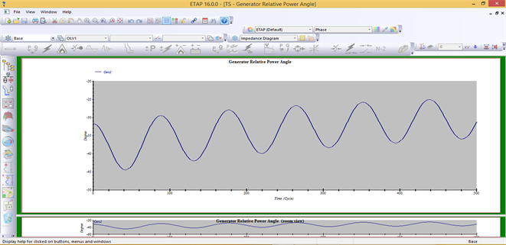
10.3.2.3.3 Dynamic and Transient Stability Analysis
If ERCOT determines that a proposed transmission improvement is feasible to resolve the identified instability, the TSP shall proceed with implementing the transmission improvement, in accordance with Protocol Section 3.11.4, Regional Planning Group Project Review Process, identified in paragraph
above after the requirements of Section 6.9 have been met for the proposed large load interconnection

Slide 19
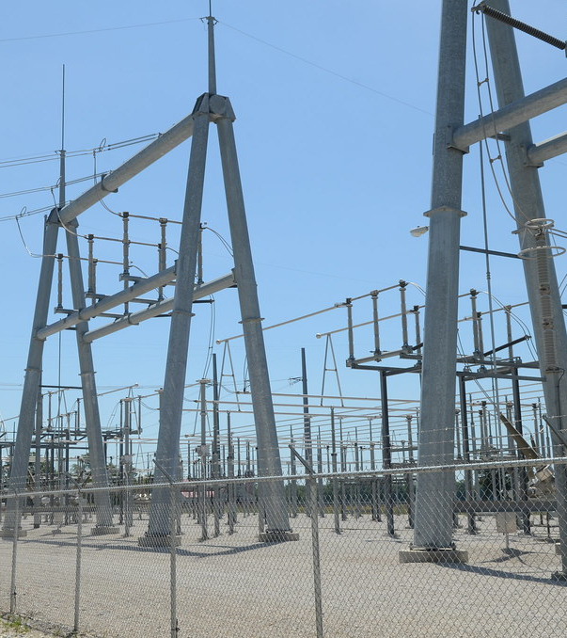
10.3.2.3.4 Facility Study

Slide 20
10.3.2.4 FIS Report and Follow-up
This Photo by Unknown author is licensed under CC BY-SA.

Slide 21
10.3.3 ERCOT Economic Study
For Gen and Load Interconnection
Notes:
May remove this and point this to the Gen Interconnection Process

Slide 22
10.3.4 Reviews and Approval to Submit Model Information

