Slide 1
FFR Advancement
Workshop Training
Nathan Smith
July 25, 2022

Slide 2
New RRS Subtypes – FFR Advancement
RRS – Primary Frequency Response (RRSPF)
  Analogous to previous RRSGN + RRSLD
RRS – Load Resources controlled by high-set under-frequency relays (RRSUF)
  Analogous to previous RRSNC
RRS - Fast Frequency Response (RRSFF)
  Responds within 15 cycles after frequency meets or drops below a preset threshold (59.85 HZ)
  Sustained for at least 15 minutes
  Recovers in 15 minutes
  Can be offered by qualifying Energy Storage (ESR) GEN and CLR, GEN (non ESR), CLR (non ESR), and NCLR.

Slide 3
RRS Limits with New Subtypes
Limit of RRSUF + RRSFF is <= 60% depending on RRS Plan
Required 1240 MW minimum for RRSPF
  1240 MW is based on current RRS methodology. Minimum required RRSPF is subject to change depending on future RRS methodology changes.
RRSFF limited to 450 MW
Resource – AS type/subtype breakdown:
*NCLR will not be able to offer both FFR and UFR for same hour of same Operating Day as they will not be capable of carrying both simultaneously in Real-Time.
*
*

Slide 4
COP Submission Changes
COP AS Resource Responsibility “RRS” will be replaced by the new RRS subtypes:
  RRSPF
  RRSFF
  RRSUF
Resource must be qualified for AS subtype if corresponding AS responsibility is greater than 0 MW.
RRS responsibility must not be greater than the Resource’s RRS qualification MW/Limit(%) for that AS subtype if it exists.

Slide 5
Self-Arranged Submission Changes
Previous RRS AS Self Arrangement types:
RRSGN, RRSLD, and RRSNC
Will be replaced by new RRS subtypes:
RRSPF, RRSFF, and RRSUF
RRSFF and RRSUF shall be limited to the QSE’s Load Ratio Share of the capacity allowed to be provided by Resources not providing PFR.
RRSFF shall be limited to the QSE’s Load Ratio Share of the system total capacity allowed to provide FFR.
Note: AS Obligation for RRS will continue being reported as “RRS” obligation, not by new subtypes.

Slide 6
AS Offer Changes
NCLR Flag option will be removed.
For Online Reserves (ONRES), RRS price will be removed and replaced a separate price column for each RRS Subtype. The price columns for ONRES will be as follows:
  REGUP Price (e.g. PRICE1_REGUP, PRICE2_REGUP…PRICE5_REGUP)
  RRSPF Price (e.g. PRICE1_RRSPF, PRICE2_RRSPF…PRICE5_RRSPF)
  RRSFF Price (e.g. PRICE1_RRSFF, PRICE2_RRSFF…PRICE5_RRSFF)
  RRSUF Price (e.g. PRICE1_RRSUF, PRICE2_RRSUF…PRICE5_RRSUF)
  ONNS Price (e.g. PRICE1_ONNS, PRICE2_ONNS…PRICE5_ONNS)
  The Market Submissions Validation Rules Document has been updated and posted to the FFR Advancement Workshop Calendar Event

Slide 7
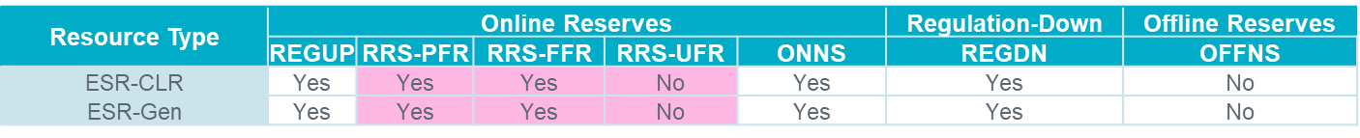
AS Offers from ESR
For any particular operating hour in the Day Ahead Market (DAM) and Supplementary Ancillary Service Market (SASM), an Energy Storage Resource (ESR) Generation Resource (ESR-Gen) and ESR Controllable Load Resource (ESR-CLR) will be able to offer Regulation, RRSPF, RRSFF and Non-Spin simultaneously*.
Similarly for any particular operating hour, DAM and SASM optimization may award an ESR-Gen or ESR-CLR Regulation, RRSPF, RRSFF and Non-Spin concurrently.*
  ESR-Gen and ESR-CLR will be able to carry RRS-PFR and RRS-FFR concurrently in Real Time.
*Assuming the ESR-Gen or ESR-CLR is qualified for the AS or AS subtype and is offering in DAM.

Slide 8
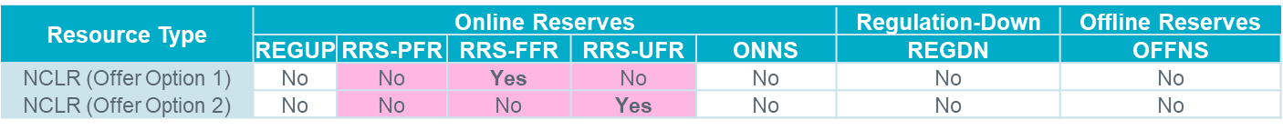
RRSUF and RRSFF Offers from Load Resources
For any particular operating hour in the DAM and SASM, a Non-Controllable Load Resource (NCLR) will be able to offer either RRSFF or RRSUF*.
For any particular operating hour, DAM optimization may award an NCLR per its offer, either RRSFF or RRSUF.
  NCLR will be not able to carry RRSFF and RRSUF concurrently in Real Time.
  *Assuming the NCLR is qualified for the AS subtype and is offering in DAM.
  ** NPRR1093 - NCLR may simultaneously offer RRS and Non-Spin in a DAM or SASM and be awarded RRS and Non-Spin for the same operating hour, but will not be allowed to provide RRS and Non-Spin on the same NCLR simultaneously in Real-Time.

Slide 9
AS Qualifications during FFR Advancement
  Resources* that are looking to submit AS Offers into DAM/SASM for each of the RRS subtypes will require the following qualifications:
  RRSPF : Resource is RRSPFR qualified; QSE is RRS qualified
  RRSFF : Resource is RRSFFR qualified; QSE is RRS qualified
  RRSUF : Resource is RRSUFR qualified; QSE is RRS qualified
  *For ESRs, both Gen and CLR need individual qualifications.

Slide 10
AS Awards Changes
DAM and SASM RRS awards will be limited by the Resource’s corresponding AS subtype qualification MW/limit(%)
DAM and SASM RRS awards will now be reported by subtype (RRSPF, RRSFF and RRSUF) instead of by RRS.
Note: RRS MCPC will remain as “RRS”.

Slide 11
What constraints are there for the new RRS subtypes?
RRSPF – AS Awards and Self-Arranged must cover at least 1240 MWs.
RRSUF + RRSFF – AS Awards and Self-Arranged AS must contribute no more than 60% of AS plan. Percentages to limit RRSUF + RRSFF can be found in the AS Methodology document on the MIS.
RRSFF – AS Awards and Self-Arranged AS must be less than or equal to 450 MWs.
RRS Plan
RRSPF
(min. 1240 MW)
RRSUF
+
RRSUF
+
RRSFF
60% limit
of RRS Plan
RRSFF
(max. 450 MW)

Slide 12
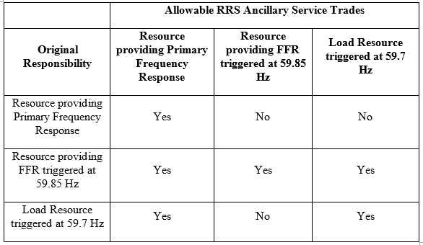
AS Trades in FFR Advancement
RRS AS Trade types RRSGN, RRSLD, and RRSNC will be replaced by RRSPF, RRSFF, and RRSUF.
The table below shows the RRS trades that are allowed for each new type of original responsibility:
RRSFF responsibility can be replaced by any other RRS subtype.
RRSUF responsibility can be replaced by RRSPF or RRSUF.
RRSPF responsibility can only be replaced with other RRSPF.
(RRSPF)
(RRSFF)
(RRSUF)
(RRSPF)
(RRSFF)
(RRSUF)

Slide 13
Wrap-Up and Q&A
October 13th, ERCOT systems will be updated to implement changes related to the Fast-Frequency Response (FFR) Advancement project.
More Market Notices will be sent closer to implementation.
MOTE testing environment is planned to be available beginning August 15th. A Market Notice will be sent when the environment is ready.
All QSEs that participate in the RRS market today should test their submissions in MOTE, as changes in the RRS offer structure effect all RRS offers.
Contact your Account Manager with any transition issues.

