Slide 1
Large Net Load Ramp on March 24, 2022
Jackson DuBro & Pengwei Du
07/20/2022

Slide 2
Event Summary - Overview
Large net load ramp on March 24, 2022 from 18:00-20:00
22,165 MW to 39,131 MW of net load
1-hour ramp during period reached 10,750 MW
Largest 1-hour ramp to date
76% increase over previous March net load ramp record (6,104 MW)
Ramp mostly due to change in IRR generation
 | Load | Wind | Solar
24-Mar-22 18:00:00 | 40,413 MW | 10,122 MW | 8,126 MW
24-Mar-22 20:00:00 | 41,128 MW | 1,943 MW | 54 MW
Change (MW) | +715 | -8,071 | -8,178

Slide 3
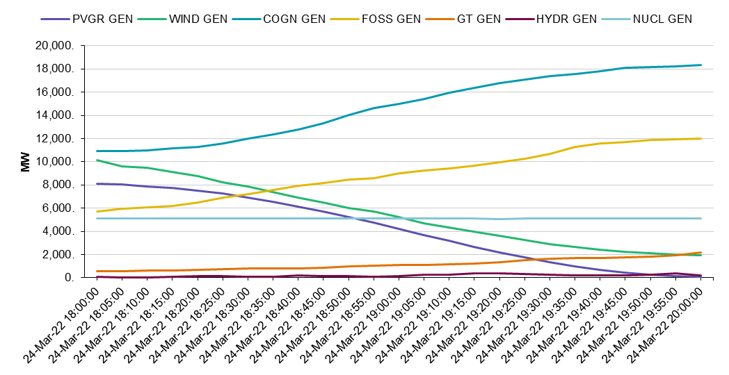
Event Summary - Generation
Conventional resources ramped up as IRRs ramped down
Co-gen and Fossil gen provided the majority of the increase
 | 24-Mar-22 18:00:00 | 24-Mar-22 20:00:00 | Change (MW)
PVGR GEN | 8,126 | 54 | -8,072
WIND GEN | 10,122 | 1,943 | -8,179
COGN GEN | 10,946 | 18,368 | 7,421
FOSS GEN | 5,731 | 11,994 | 6,262
GT GEN | 586 | 2,150 | 1,564
HYDR GEN | 52 | 214 | 162

Slide 4
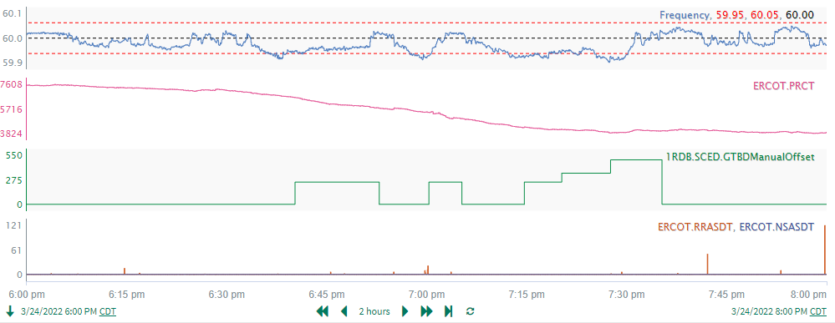
Reliability Impact
Frequency dropped as low as 59.92 Hz
Total PRC decreased during interval, but never fell lower than 3,824 MW
SCED manual offsets were necessary, reaching as large as 500 MW
RRS and offline Non-Spin were not deployed during this event

Slide 5
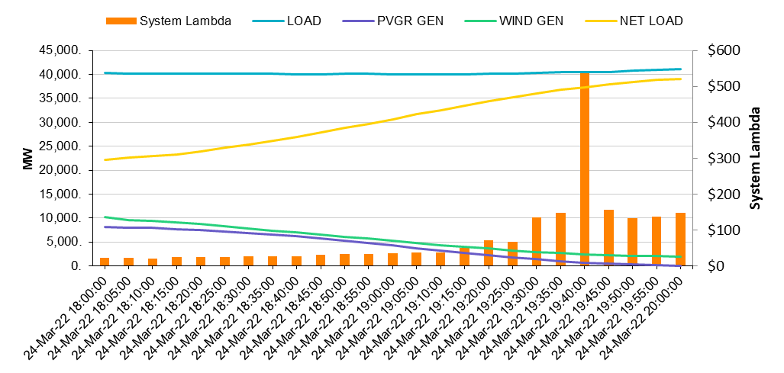
Market Impact
System Lambda was above $100/MWh for all intervals from 19:30-20:00
Lambda spiked to $540/MWh at 19:40
Notes:
Online ORDC adder maxed out at $21.41 at 19:55

Slide 6
Quick Re-Cap
Largest net load ramp to date
Conventional generation ramped up significantly during interval
No reliability problem experienced
One modest price spike during interval
System Lambda = $540/MWh for one SCED interval (19:40)

Slide 7
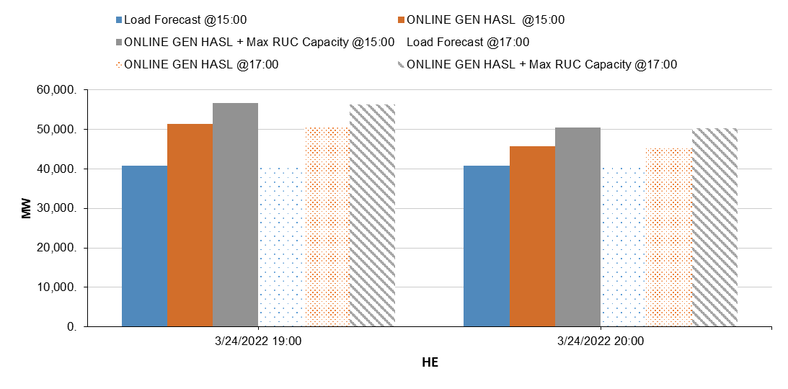
Ramping Capability
ERCOT uses internal tools to evaluate the ramp need for next 18 hours
Image below shows the capacity evaluated at 15:00 (filled) and 17:00 (striped) for HE 19 and HE 20
All intervals showed sufficient HASL margin (HASL – Load Forecast)
About 5,000 MW additional MW available through RUC
Notes:
~10k MW of HASL margin for HE 19
~5k MW of HASL margin for HE 20

Slide 8
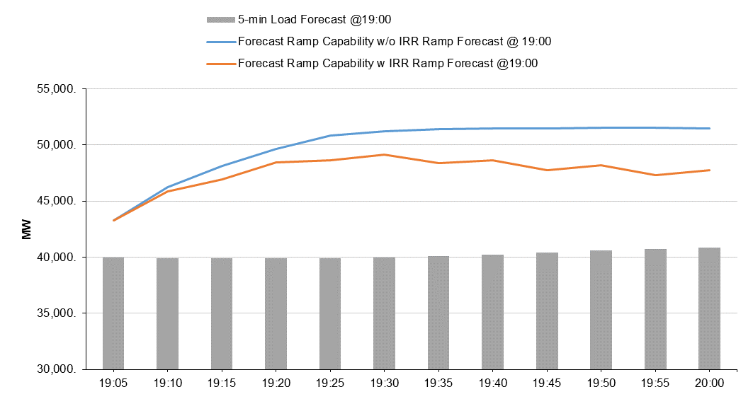
Short-Term Ramping Capability
ERCOT also is using internal tools to evaluate the ramp need for next 2 hours in 5-minute increments
At 19:00, at least 7,000 MW of ramp margin above the load forecast for HE 20 was predicted after IRR ramp forecast was considered

Slide 9
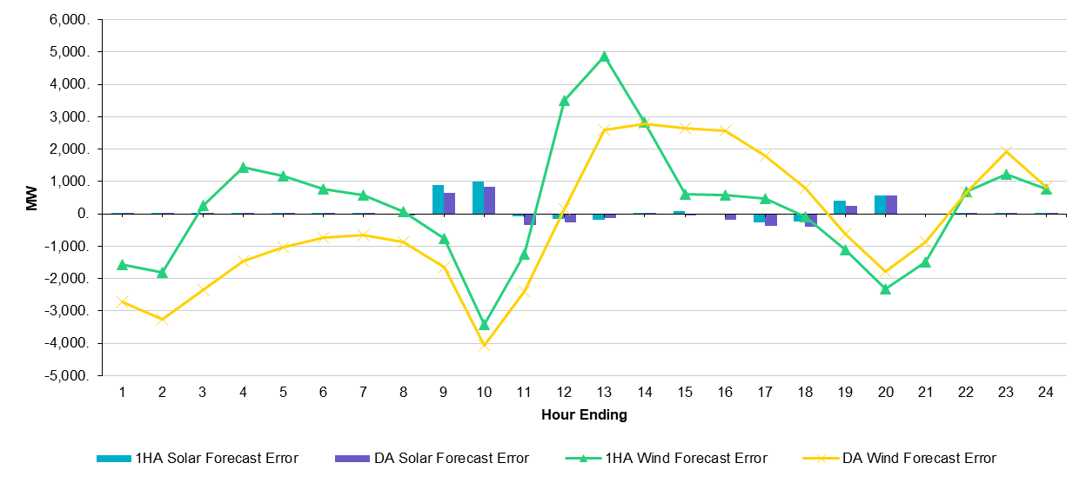
IRR Forecasting
IRR forecast predicted a large evening down ramp and performed well during 18:00-20:00 interval
For 1HA net IRR forecasts:
430 MW over-forecast for HE 19
1,668 MW over-forecast for HE 20

Slide 10
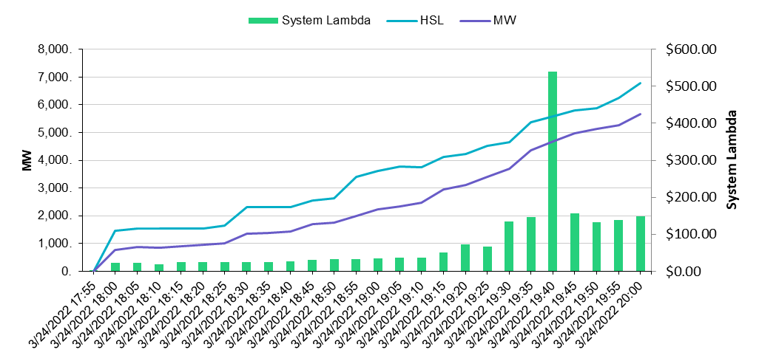
Generation Coming Online
At 20:00, there was 5,600 MW of generation that was not online at 18:00
Most scheduled their status change prior to the operation hour or were already in start up
Change to online was also reflected in COP status
Only accounted for a portion of the 17 GW ramp

Slide 11
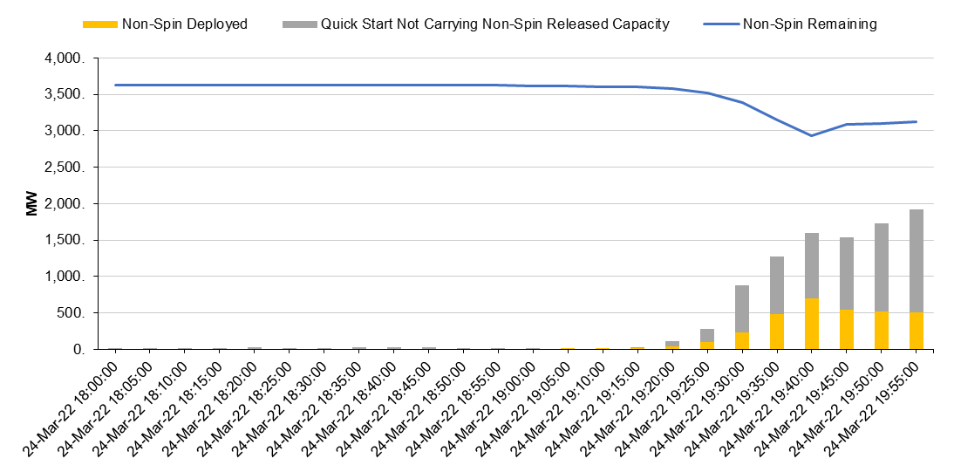
Online Non-Spin & Quick Start
As System Lambda increased from 19:00-20:00:
About 500 MW of online Non-Spin capacity was released to SCED
About 1,500 MW of Quick Start (not carrying Non-Spin) came online
By 20:00, ~3,000 MW of online Non-Spin capacity remained available

Slide 12
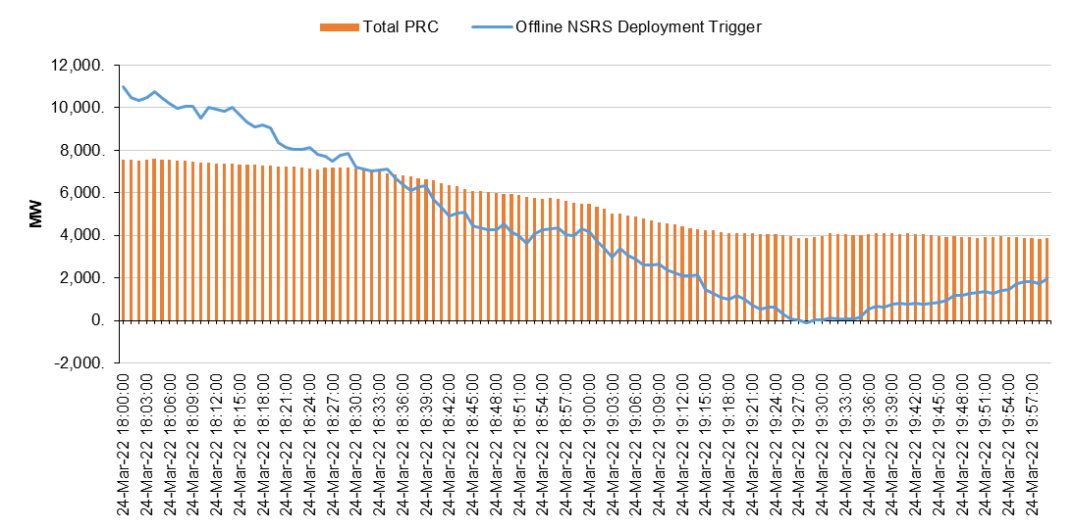
Offline Non-Spin
The projected offline Non-Spin deployment trigger dropped below 0 MW only for 1 minute around 19:28
Trigger = (HASL – (GTBD+Offset) – 30min Net Load Ramp – IRR Curtailment)
No offline Non-Spin was deployed

Slide 13
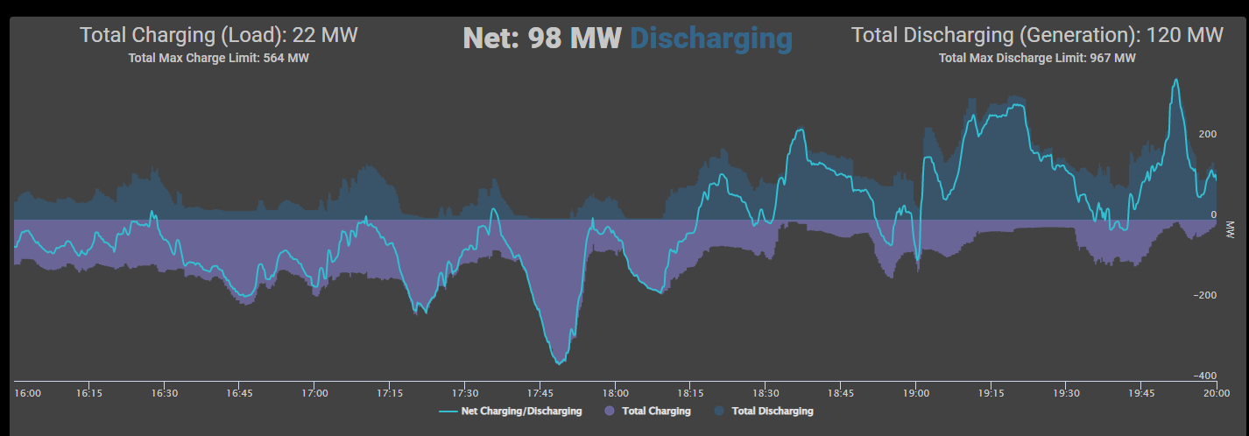
ESR Response
For most of the net load ramp from 18:00-20:00, the net ESR output was positive, or discharging, especially as system Lambda increased in the second hour
However, net ESR output was negative for a few minutes during the large ramp.
Some charging activity still occurred for some ESRs throughout the ramp period

Slide 14
Conclusion
ERCOT’s largest 1-hour net load ramp managed without issue
Wind and solar forecasting performed well during the event
Excessive additional generation capacity was available from quick-start units and units that planned to come online during the ramp interval
Large amount of Non-Spin reserve carried into ramp
Non-Spin was not exhausted; offline Non-Spin and RRS were not deployed

