Slide 1
ERCOT Frequency Control Report
June 2022
ERCOT
Operations Planning
PDCWG | July 20th, 2022

Slide 2
Summary of May 2022
CPS1: 172.96%
Current CPS1 12-Month Rolling Average: 172.67%
0 BAAL Exceedance(s)
2 hourly CPS1 score below 100%
BAAL-003 Events have updated through 2020
2020 BAAL-003 FRM Performance: -789.34
2022 RMS1 Statistics
  Mean: 15.43 mHz
  Min: 12.43 mHz
  Max: 19.12 mHz
Energy Statistics
  Total Energy: 42,088,672 MWh
  Wind Energy: 9,677,677 MWh
  Percent Energy from Wind: 22.99 %
  Solar Energy: 2,672,960 MWh
  Percent Energy from Solar: 6.35%
Minimum System Inertia
  Mean: 250,219 MW*s
  Max: 296,135 MW*s on June 28th
  Min: 206,265 MW*s on June 15th

Slide 3
Frequency Control
CPS1, BAAL, & RMS1

Slide 4
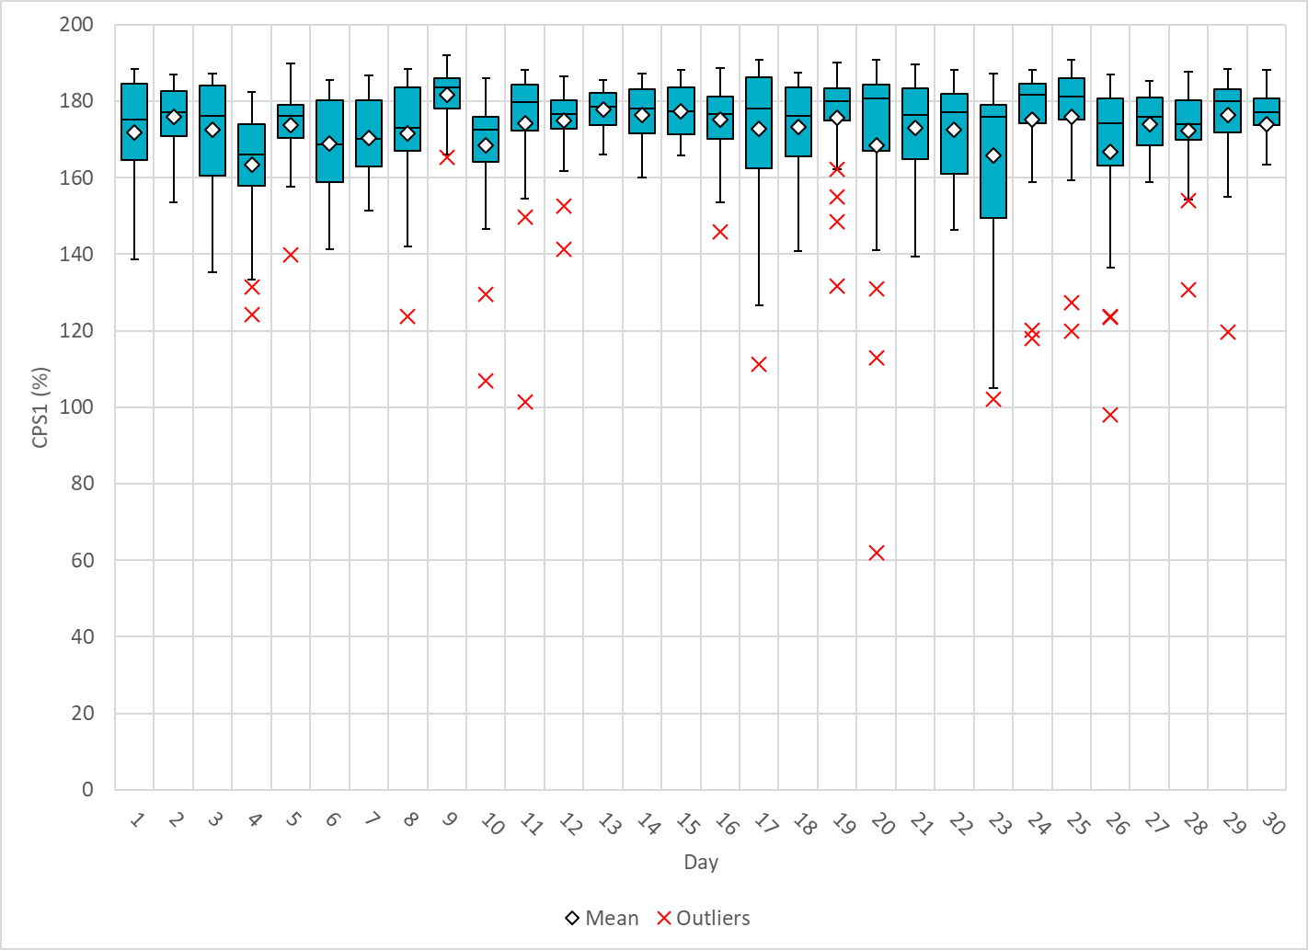
Hourly CPS1 by Day
June-22 CPS1 (%): 172.96
Notes:
1. 61.90%@ 6/20/2022 HE 20:00
Expected Generation Deviation
Between 19:00-20:00 the Expected gen dev remained negative. The largest expected gen dev was -2914MW @ 19:30 PM with signification contribution from solar and wind generation.
IRR Ramps
Between 19:00-20:00 solar ramped down by ~3400 MW
Between 19:00-20:00 wind ramped down by ~1400 MW
Regulation: Regulation up was exhausted during the later half of the hour. SCED was run multiple times and Multiple SCED offsets were applied and the largest being 500 MW at 7:30 PM
2. 97.97% @ 6/26/2022 HE 16:00
Expected Generation Deviation
Expected generation deviation remained negative during later part of the hour. The largest expected gen dev was -28642MW @ 3:49PM with significant contribution from solar generation.
IRR Ramps
Between 3:35pm to 3:50 pm solar ramped down by ~1000 MW.
Regulation: Regulation up was exhausted during the solar ramp duration. SCED was run multiple times and SCED offset of 300 MW was applied @3:47PM.

Slide 5
BAAL Exceedances & Violations
There are 0 BAAL exceedance(s) in June.

Slide 6
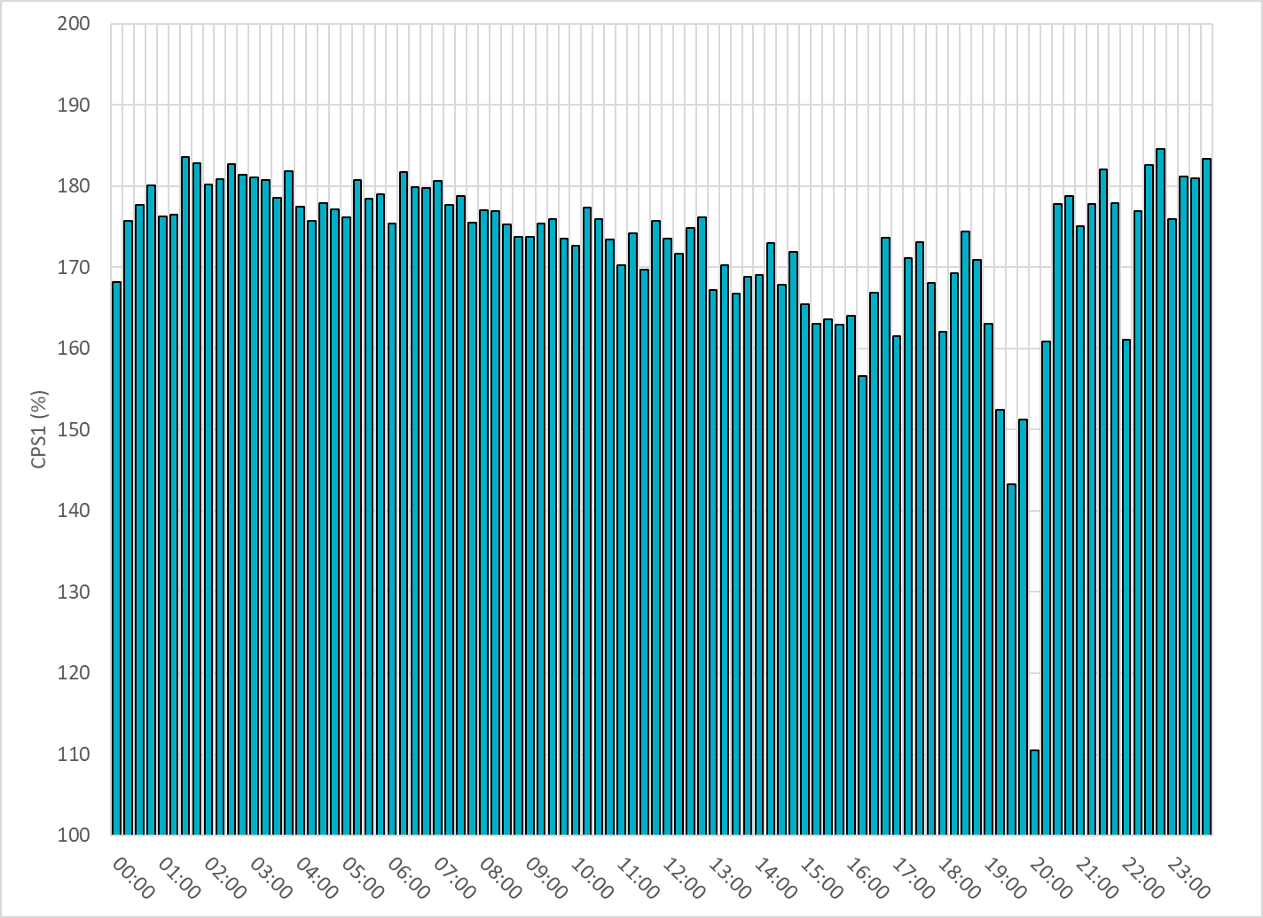
15-Minute Average CPS1%
June-22 CPS1 (%): 172.96
Notes:
Overall the 15 min CPS1 score is above 160, Between 19:00 and 20:00 ,the CPS1 is between 110 to 150 due to solar down ramps.
19:45 to 20:00 110 due to solar down ramps

Slide 7
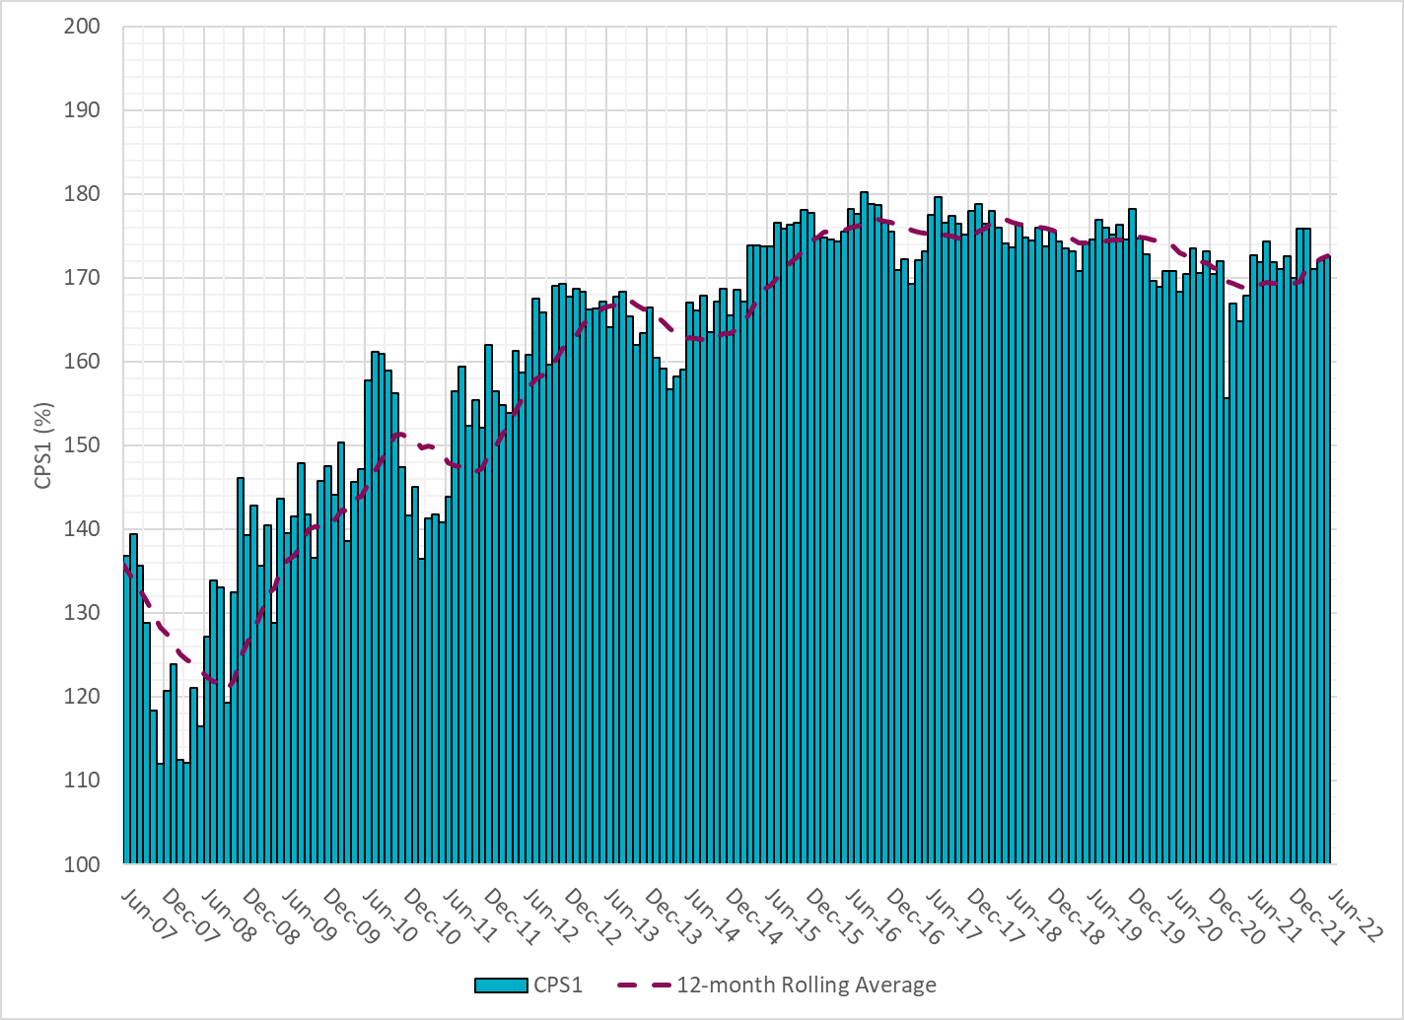
12-Month Rolling Average CPS1
Current 12-Month Rolling Average: 172.67%
Notes:
12 month rolling average CPS1 score is 172.67, which is good and CPS1 score for June is slightly higher than the last month.

Slide 8
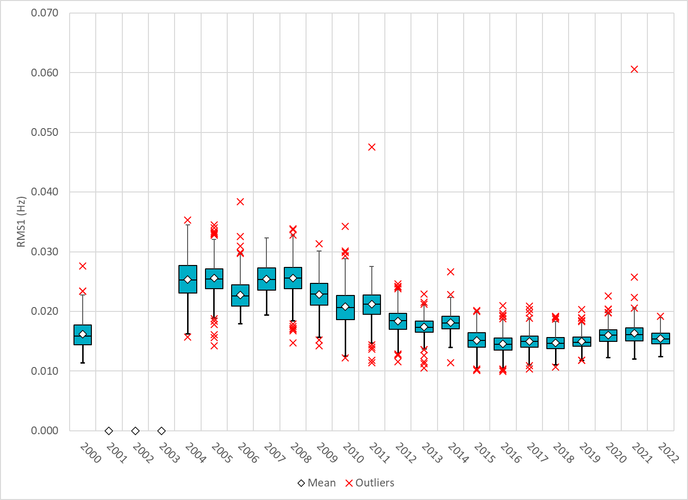
Daily RMS1 of ERCOT Frequency by Year
Notes:
Daily RMS1 frequency by year is so far slightly smaller overall compared with the 2021.
Mean: 15.43 mHz
Min: 12.43 mHz
Max: 19.12 mHz

Slide 9
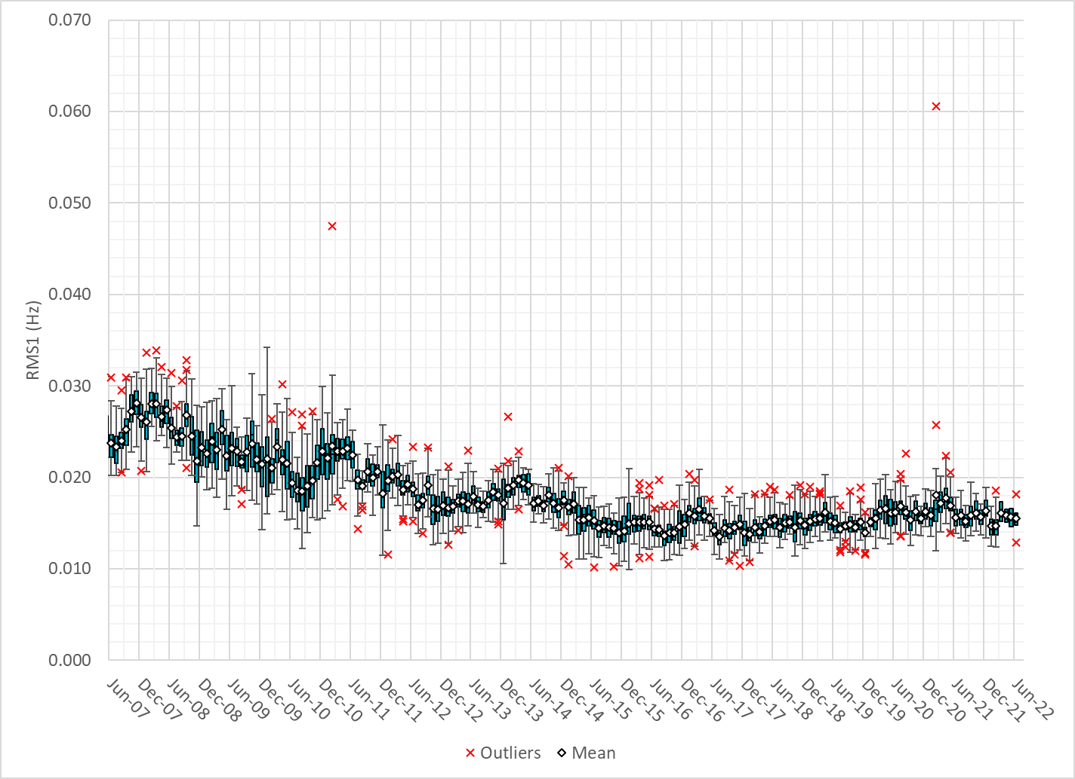
Daily RMS1 of ERCOT Frequency by Month
Notes:
A More granular look at last 15 years of RMS1 by month
15.56Mhz on avg for June 2022

Slide 10
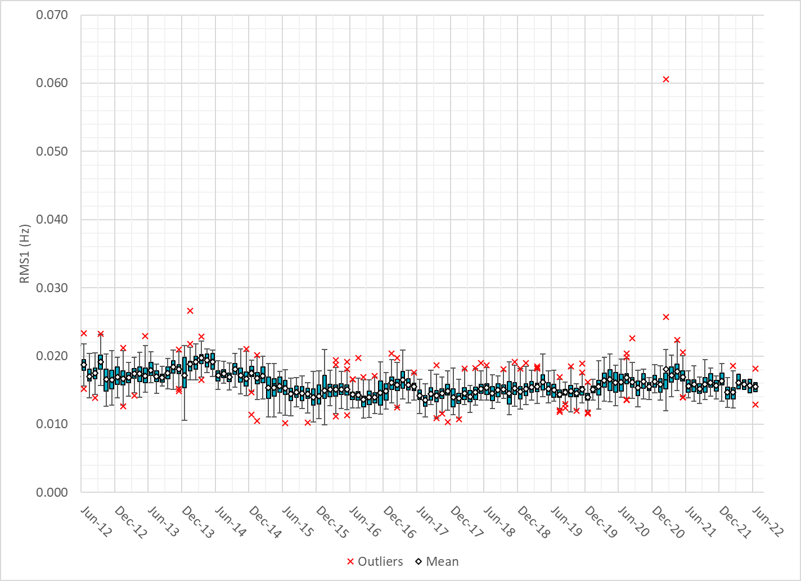
Daily RMS1 of ERCOT Frequency by Month
Notes:
Same data but only showing for the last 10 years

Slide 11
Frequency Profile Comparison

Slide 12
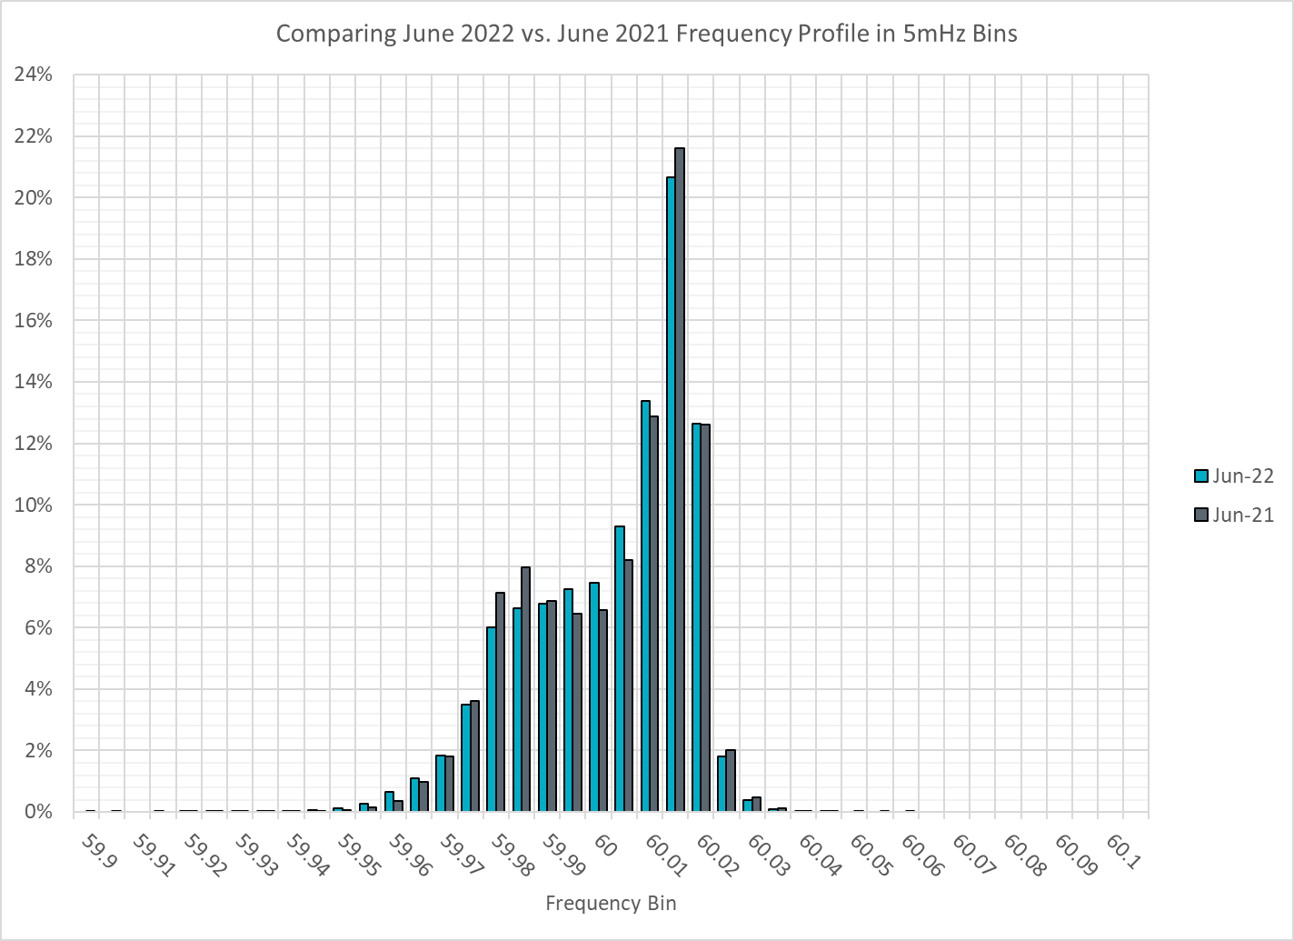
Frequency Profile Comparison
Notes:
Comparison of frequency profile for June 2021 and June 2022, Overall frequency profiles is are comparable to each other.

Slide 13

Frequency Profile Comparison
Notes:
Comparison of frequency profile for June 2020 and June 2022, very similar trend here. we see fewer instances of frequency hovering at or below the lower deadband in June 2022.

Slide 14
Time Error Correction

Slide 15
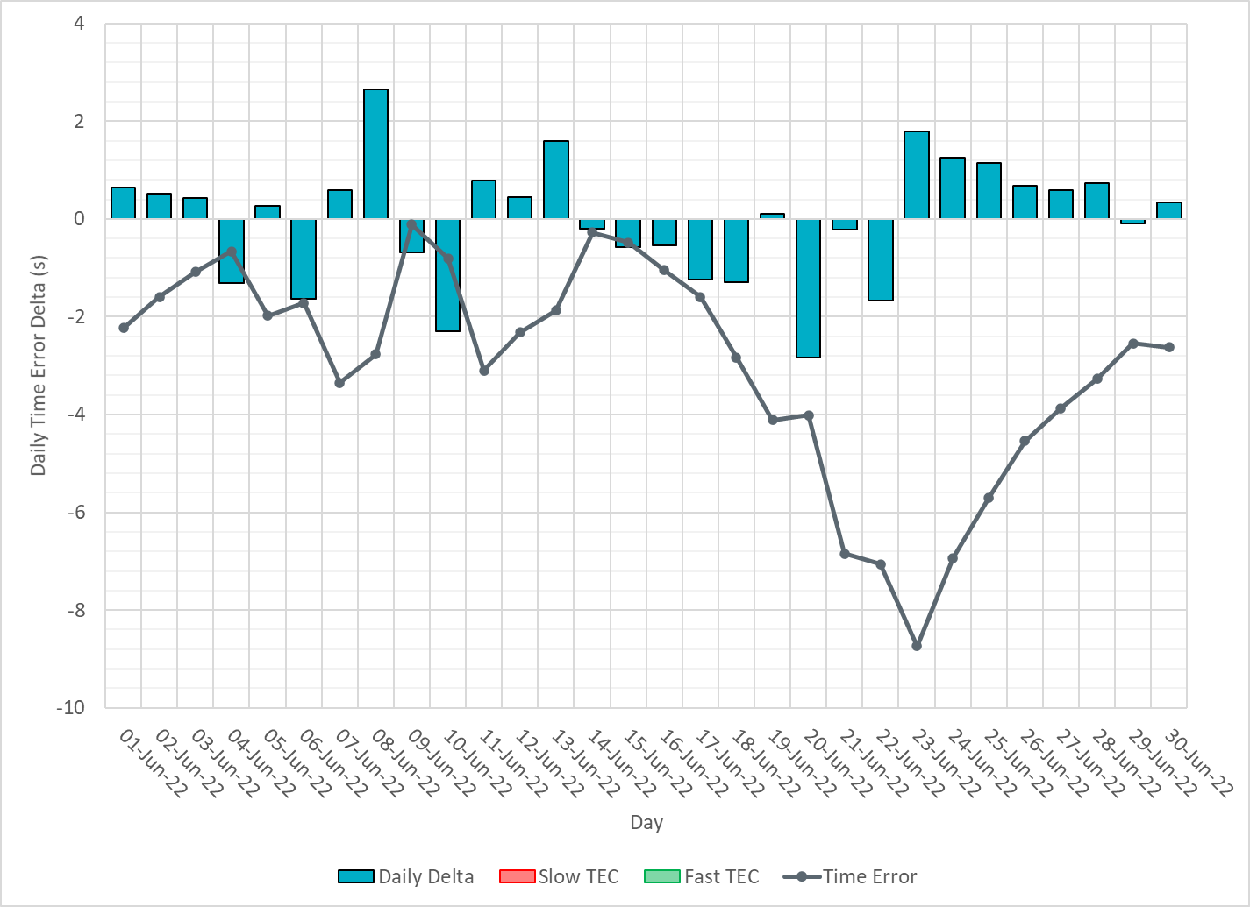
ERCOT Daily Time Error
Notes:
We did not make time error corrections. Time error started to go down around the 20th due to a significant solar and wind ramp coincided with each other. Also temperature picks up in late June.

Slide 16
Time Error Corrections Log Summary
There have been no time error corrections since December 2016

Slide 17
BAL-003 Performance

Slide 18
Op. Year 2020 BAL-003 Selected Events – Update
Notes:
BAL-003

Slide 19
Op. Year 2020 BAL-003 FRM Performance - Update
Notes:
OP2018: FRO = -381.0, FRM_median = -843.17, FRM_average = -959.7
OP2019: FRO = -381.0, FRM_median = -811.14, FRM_average = -892.5
OP2020: FRO = -425.0, FRM median = -789.34, FRM average = -879.0
OP2021: FRO =

Slide 20
ERCOT Energy Statistics

Slide 21
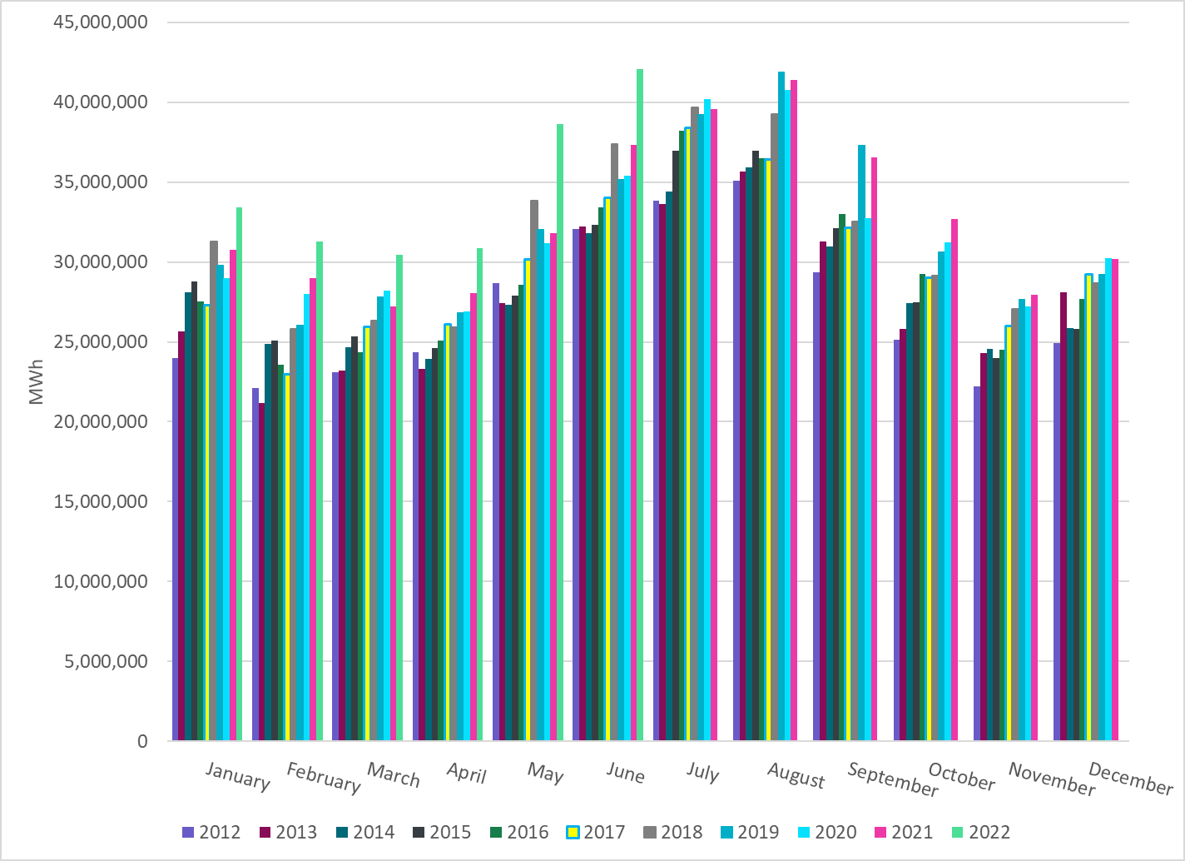
Total Energy
Notes:
42,088,672 MWh
There is an increase in total energy compared to last year

Slide 22
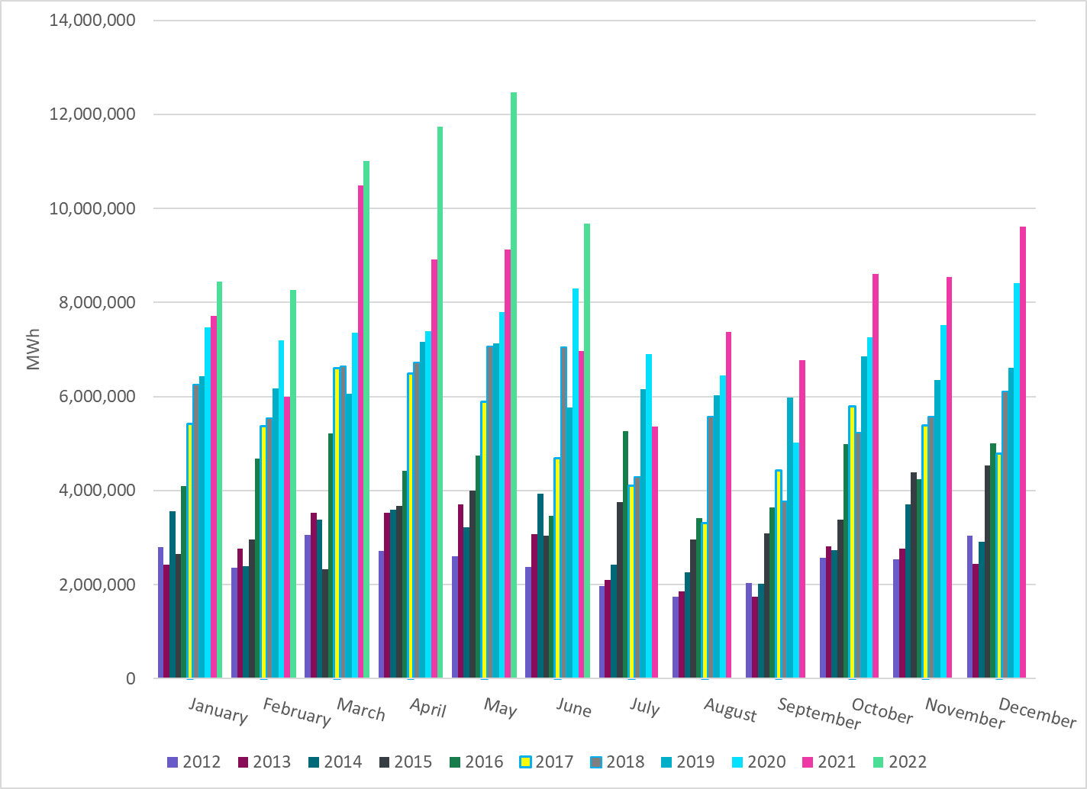
Total Energy from Wind Generation
Notes:
9,677,677 MWh
We see notable decrease in the wind energy production in June.

Slide 23
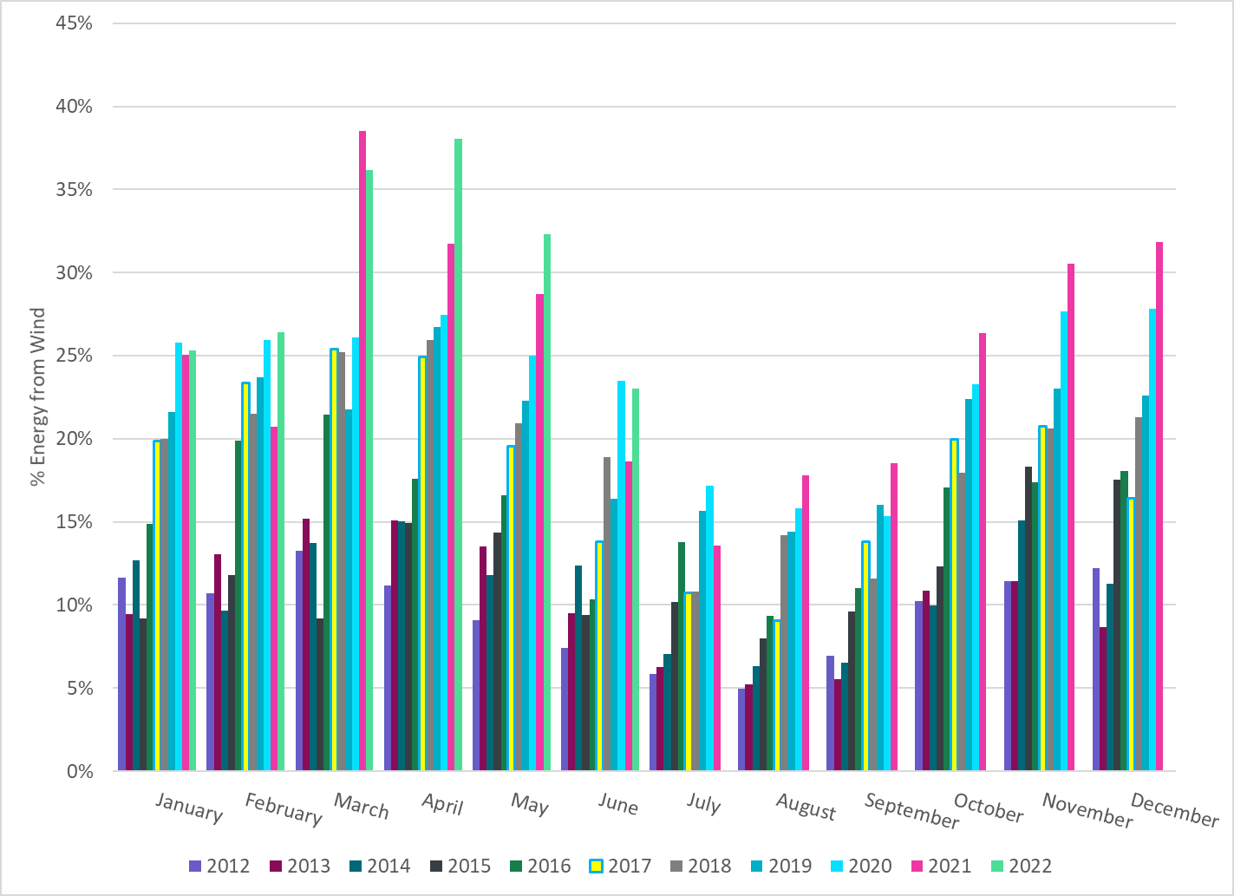
% Energy from Wind Generation
Notes:
22.99%
of total energy was provided by wind generation

Slide 24
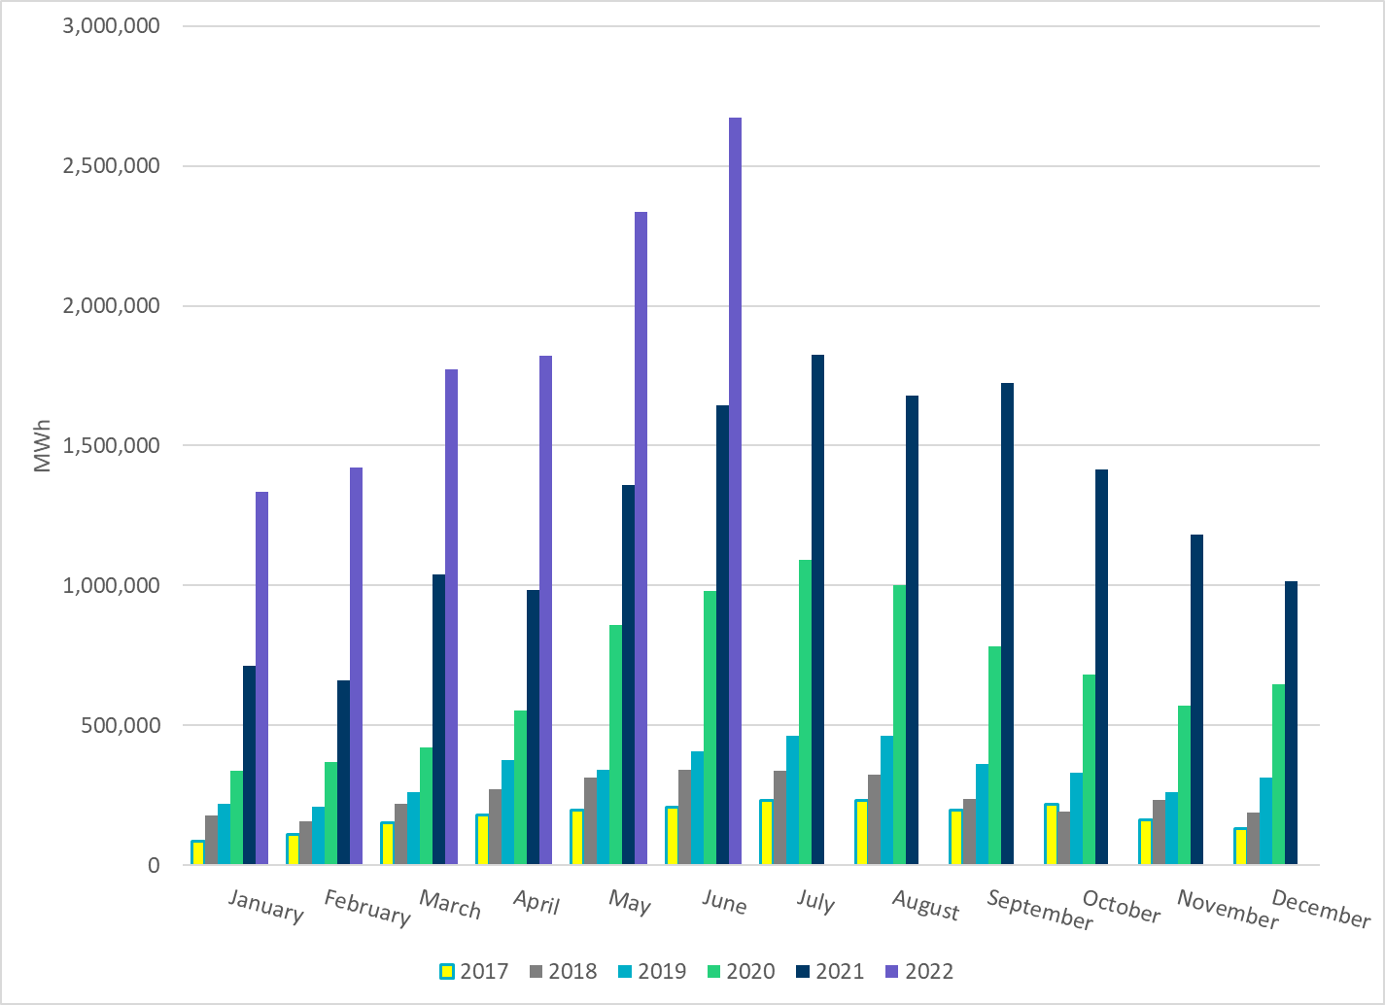
Total Energy From Solar Generation
Notes:
2,672,960 MWh
There is also a notable increase in solar energy production in May.

Slide 25
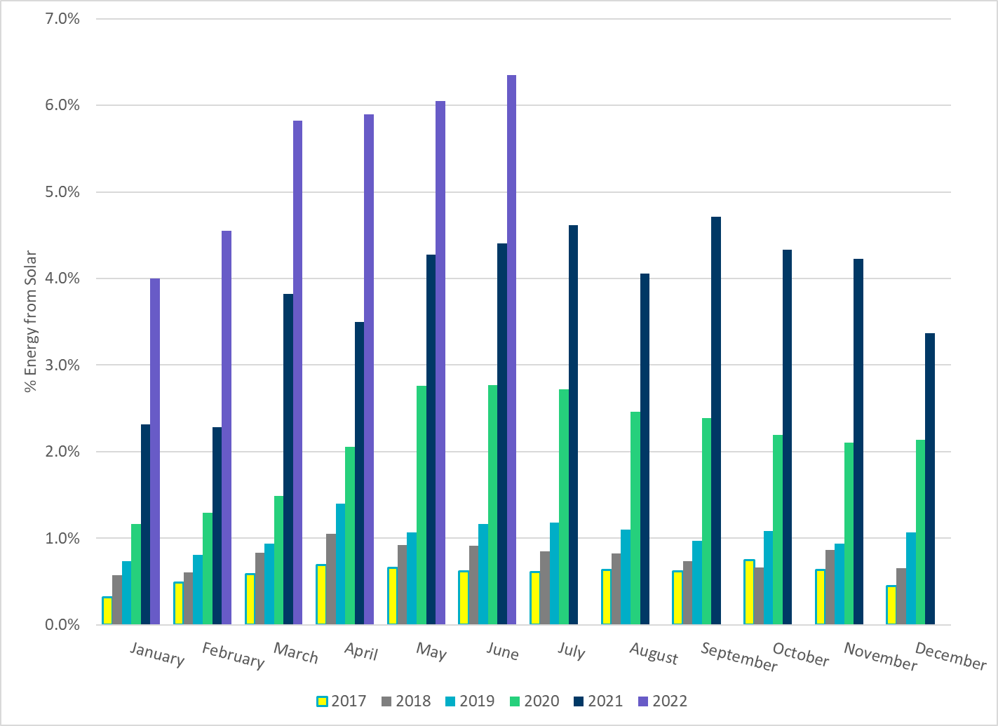
% Energy from Solar Generation
Notes:
6.35% of total energy was provided by soalr generation

Slide 26
ERCOT System Inertia

Slide 27
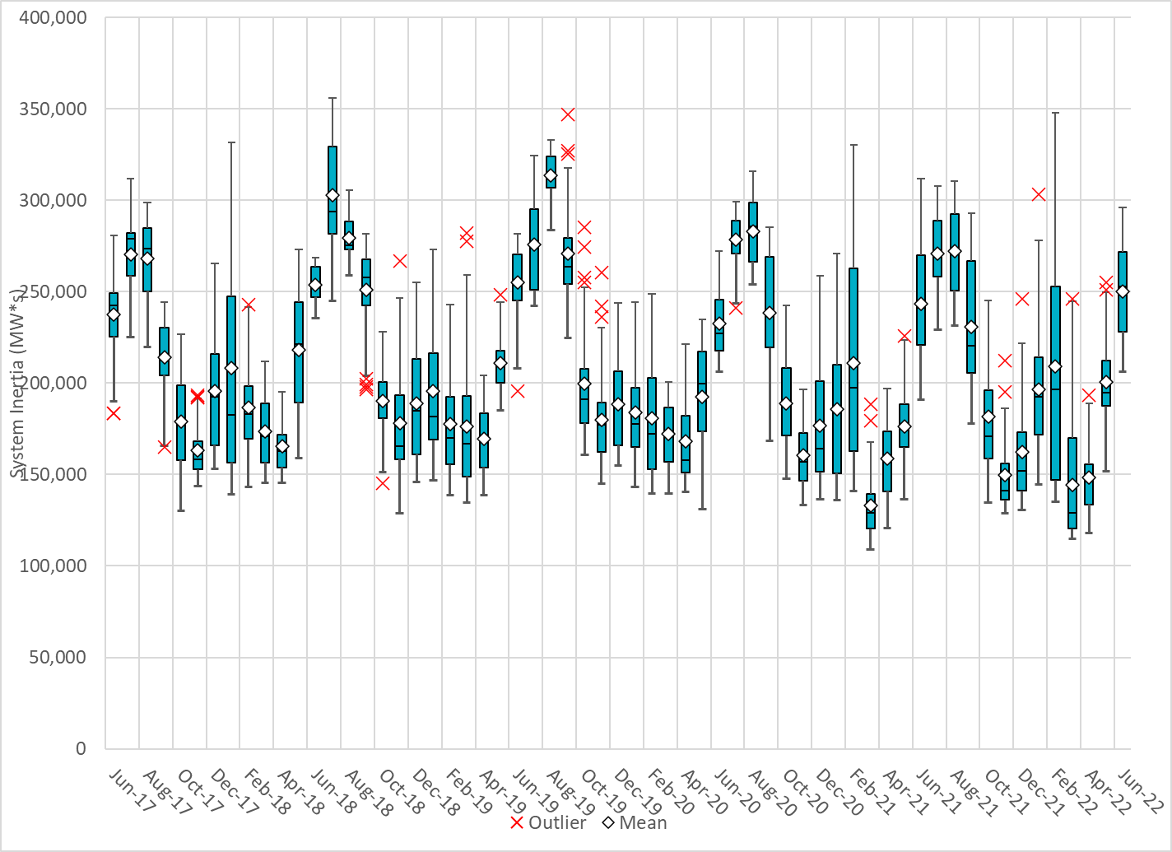
Daily Minimum System Inertia
Notes:
Minimum Inertia =206,265 MW*s on 06/15/2022
Previous Minimum was 109,029 MW*s on 3/22/2021
Data:
Mean: 250,219 MW*s
Max: 296,135 MW*s on June 28th
Min: 206,265 MW*s on June 15th

Slide 28
Questions?
Thank you!

