Slide 1
ERCOT Frequency Events
June 2022
ERCOT
Operations Planning
PDCWG | July 20, 2022

Slide 2
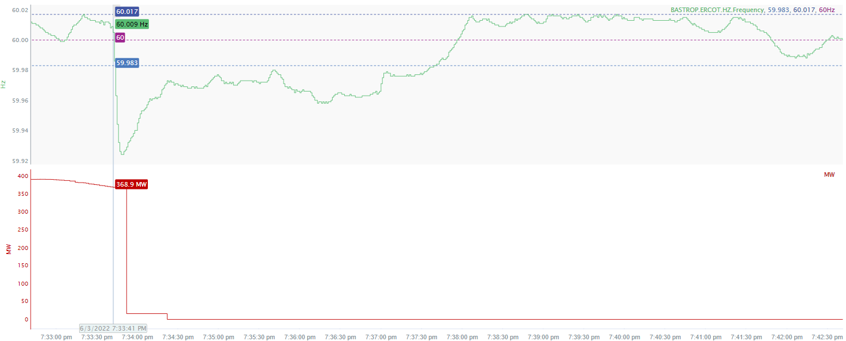
6/3/2022 19:33:41(Non-FME)
Notes:
The units experienced a runback and tripped offline while carrying approximately 369 MW.
Starting Frequency: 60.009 Hz
Minimum Frequency: 59.924 Hz
A-C Time : 7 seconds
Recovery Time(back to deadband): 4 minutes 27 seconds
RRS Released: 0 MW
Trip Reason: Low drum level
Contextual Information: A total of 205 MW of regulation up was deployed during the event.
No Selection Reason : The MW lost is only 369 MW (small event)

Slide 3
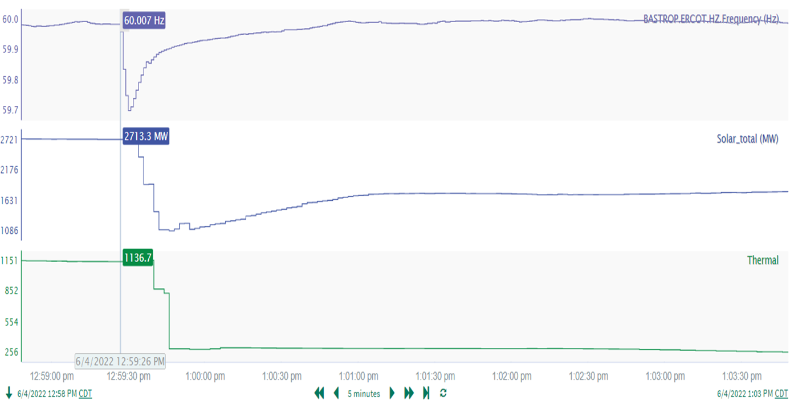
6/4/2022 12:25:26(Non-FME)
Notes:
At the 7/8/22 IBRTF meeting, ERCOT provided an update on this event :
https://www.ercot.com/files/docs/2022/07/07/Odessa%20Disturbance%202_July8Meeting.pptx
14 Solar facilities tripped offline or reduced their output for loss of approximately 1709 MW and Three combined cycles tripped offline for loss of approximately 851 MW. Approximately 2560 MW’s were lost during this event.
Starting Frequency: 60.007 Hz
Minimum Frequency: 59.706 Hz
A-C Time : 4 seconds
Recovery Time(back to deadband): 1 minute
RRS Released: 1227 MW
Load Resources Deployed : 1116 MW
Trip Reason: Lightning arrestor fault on 345 kV line
Contextual Information: A total of 264 MW of regulation Up was deployed during the event.
No Selection Reason: Deployment of load resources assisted the frequency recovery.
Categorized as NERC Event Analysis Category3 (Gen loss >2000 MW) and RFI’s were sent out.

Slide 4
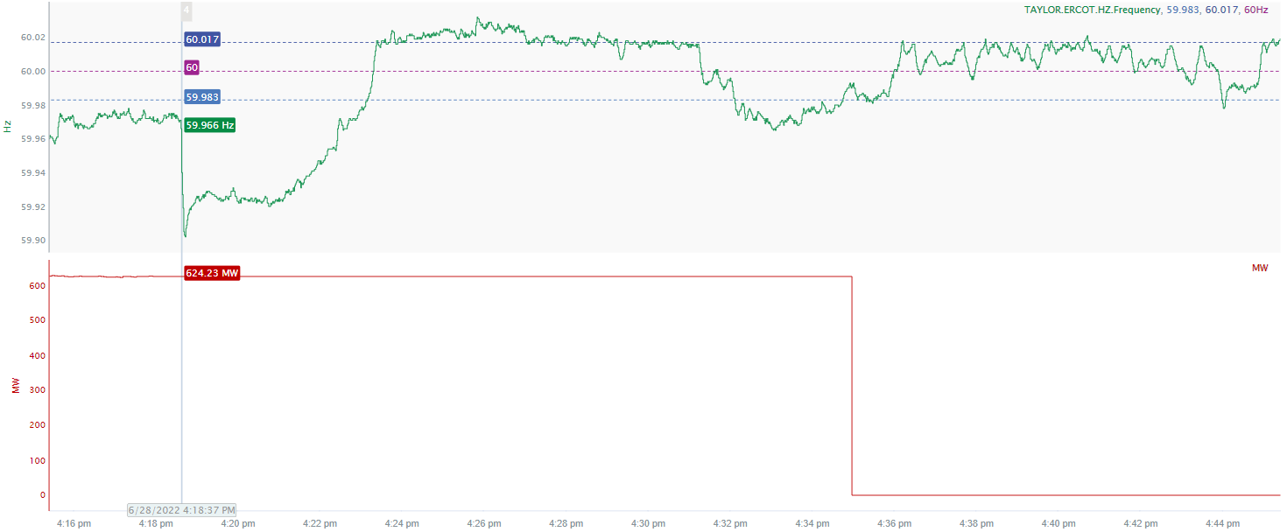
6/28/22 16:18:37(Non-FME)
Notes:
The units tripped offline while carrying approximately 624 MW.
Starting Frequency: 59.966 Hz
Minimum Frequency: 59.903 Hz
A-C Time: 5 seconds
Recovery Time (back to deadband): 4 minutes 25 seconds
RRS Released : 680 MW
Trip Reason: Unknown currently
Contextual Information: A total of 313 MW of Regulation Up was deployed and exhausted prior to the event. A manual SCED offset of 500 MW was applied during the event.
No Selection Reason: The starting frequency is too low.

Slide 5
Questions?
Thank you!

