Slide 1
Monthly Review of Reliability Unit Commitment Market Impacts - June 2022
Wholesale Market Working Group
ERCOT Staff
July 26, 2022

Slide 2
RUC Resource-Hours
June 2022 | Total | Opt-Out | Non-Opt-Out
Instructed Resource-Hours
Total Count | 638.0 | 108.0 | 530.0
Effective Resource-Hours*
Total Count | 618.9 | 107.9 | 510.9
Average LSL | 53.2 | 58.6 | 52.1
Average LDL | 83.4 | 224.2 | 53.8
Average BP | 87.7 | 245.9 | 54.3
Average HSL | 273.3 | 322.1 | 263.0
* The difference between “Instructed” and “Effective” values is a result of Resources starting up, shutting down, receiving partial hour instructions, or otherwise not being dispatchable by SCED.

Slide 3
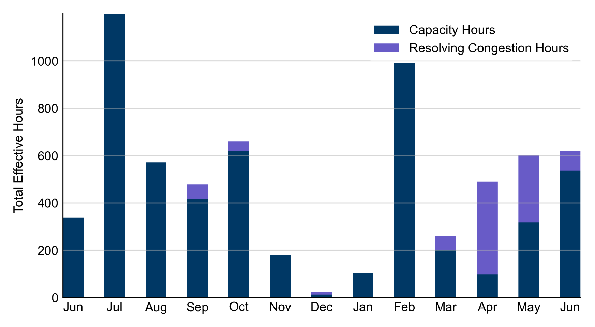
RUC Instruction Reasons: Last 13 Months RUCs in June 2022 were driven primarily by system-wide capacity concerns.

Slide 4
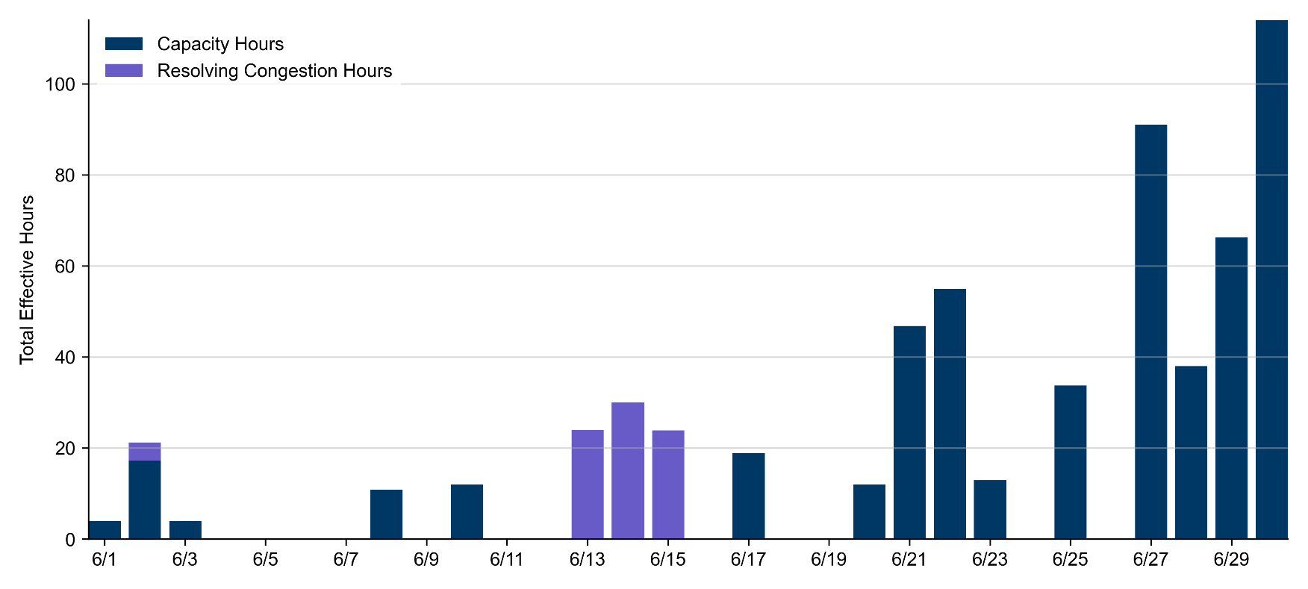
RUC Instruction Reasons
June 2022
618.9 effective RUC Resource-hours.
536.9 Resource-hours (86.76%) for capacity concerns.
81.9 Resource-hours (13.24%) for resolving congestion concerns.

Slide 5
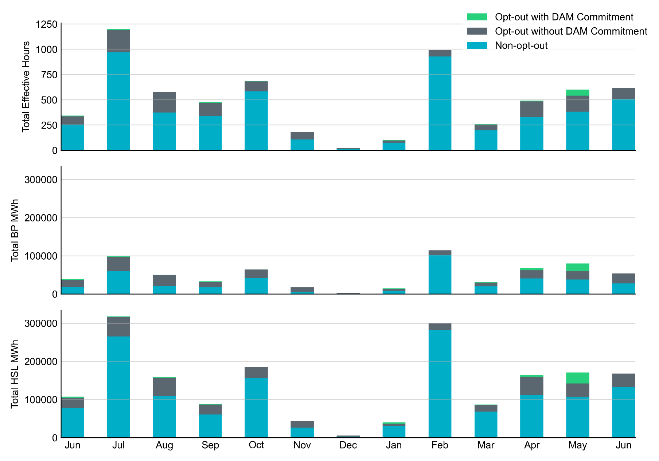
Non-opt-out and Opt-out Totals: Last 13 Months June 2022 had a total of 510.9 non-opt-out effective Resource-hours (82.6%) and 107.9 opt-out effective Resource-hours (17.4%).

Slide 6
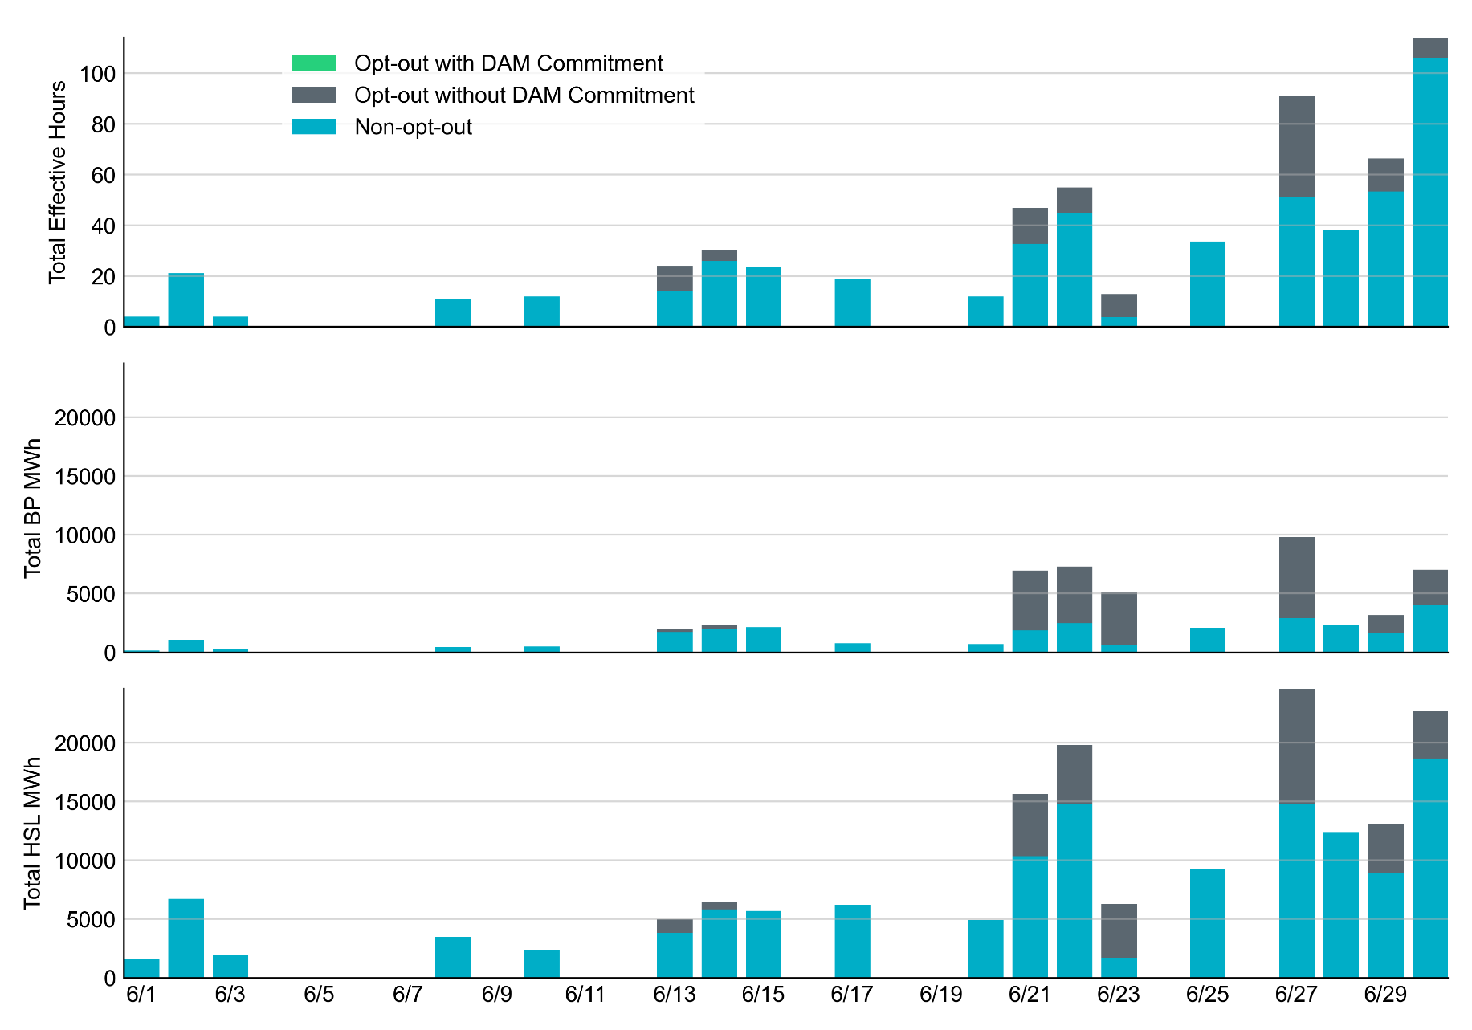
Non-opt-out and Opt-out Totals: June 2022

Slide 7
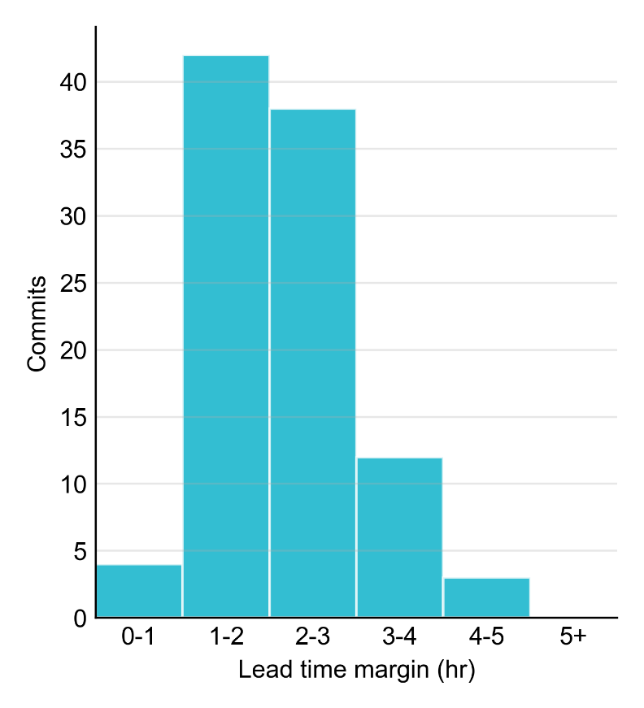
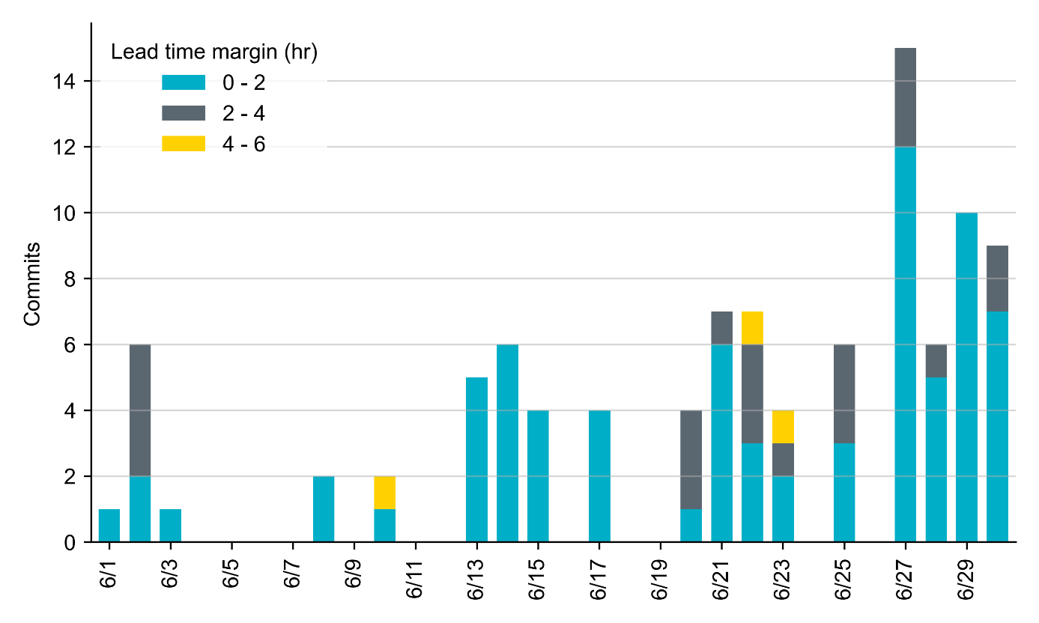
RUC Lead Time Margin: June 2022
Most RUC commit windows had lead time margin below 2 hours.
Lead time refers to the length of time between a RUC instruction and the start of the commitment window.
Lead time margin is the difference between lead time and the Resource’s startup time.
In cases where a Resource is committed for multiple back-to-back time blocks, lead time margin is calculated from the first instruction.

Slide 8
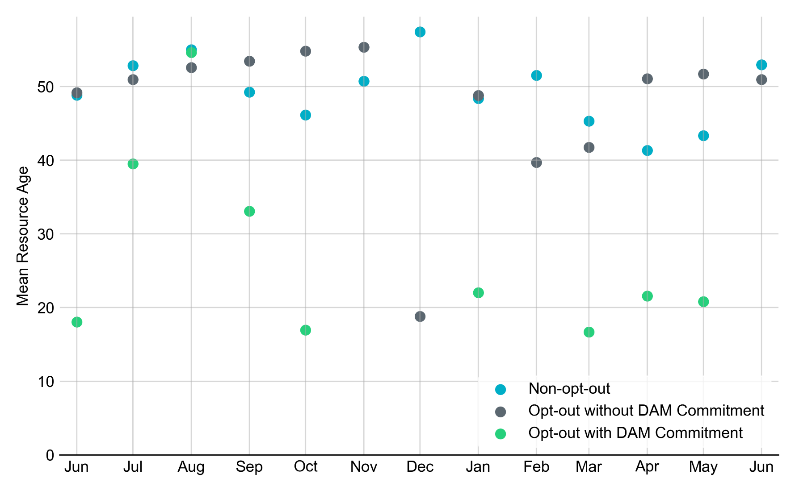
Average Resource Age In June 2022, mean opt-out Resource age for RUC-committed Resources was 53.0 years for Non-Opt-Out Resource-hours, and 51.0 years for Opt-Out Resource-hours. There were no Resource-hours for which an Opt-Out Resource was DAM-Committed.
Note: For Resource configurations with multiple physical generators, the age of the oldest generator is used.

Slide 9
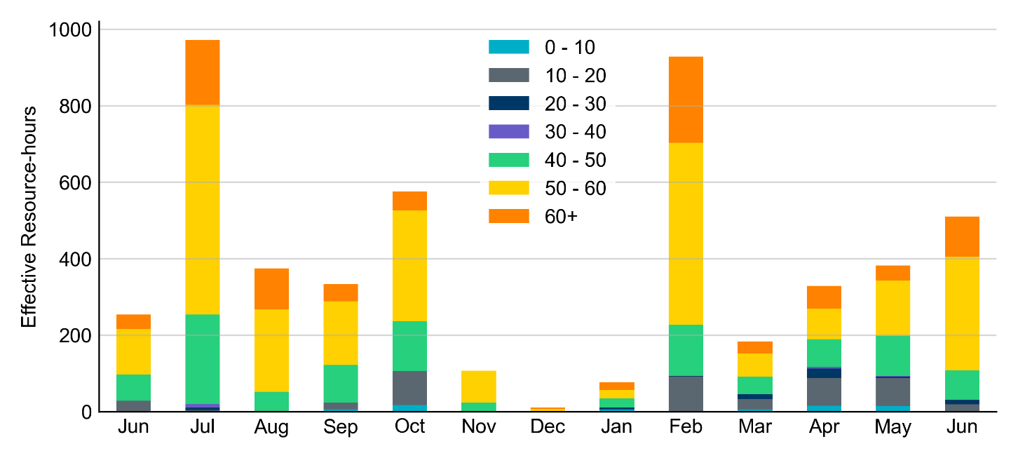
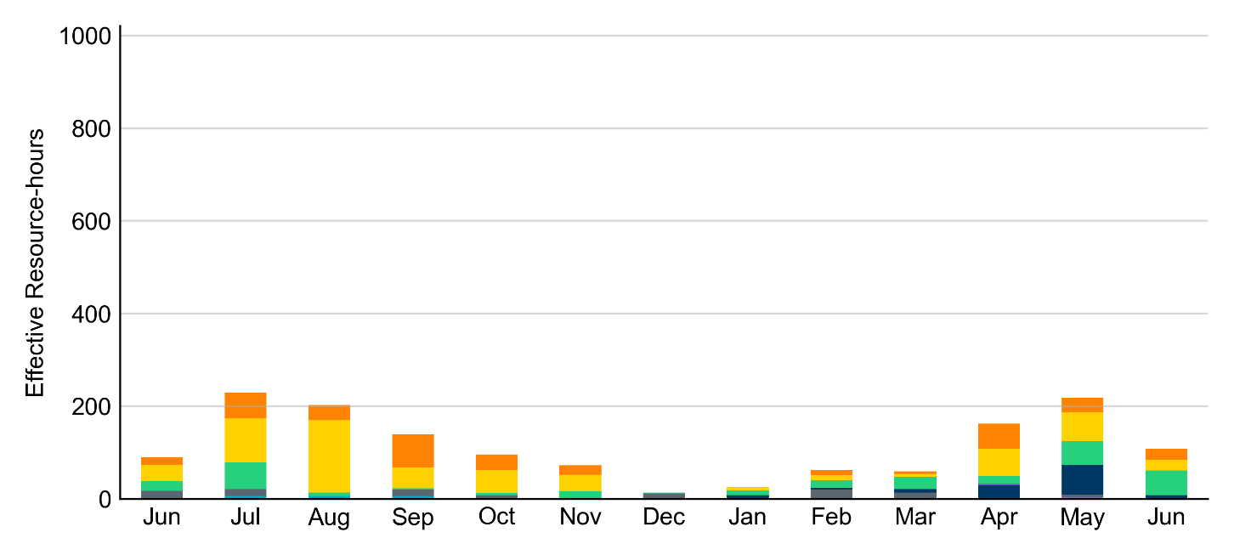
Age Category Most RUC-Committed Resources in June 2022 were older than 40 years.
Non-opt-out
Opt-out

Slide 10
RUC-Instructed Resource Dispatch above LDL
June 2022
When Resources did not successfully opt out, there were 8.5 effective Resource-hours for which the Resource was dispatched above its LDL.
For 0.9 of these Resource-hours, the LMP for the RUC-instructed Resource was above the RUC offer floor.
For 7.6 of these Resource-hours, the LMP for the RUC-instructed Resource was below the RUC offer floor.
For all these Resource-hours, the RUC-instructed Resource was mitigated.
There were no Exceptional Fuel Cost submissions for RUC-Committed Resources in June 2022.

Slide 11
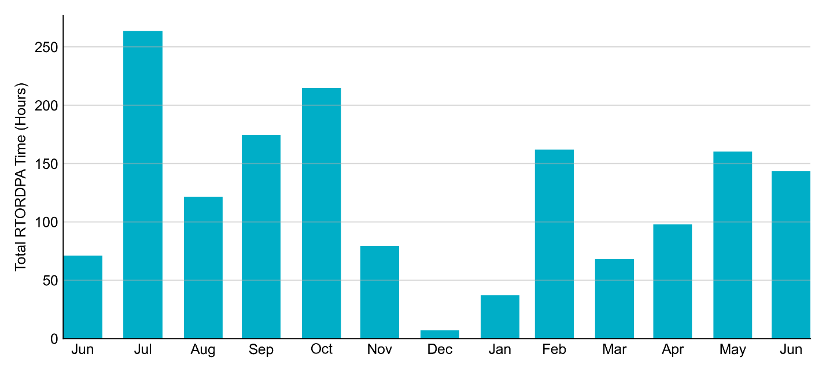
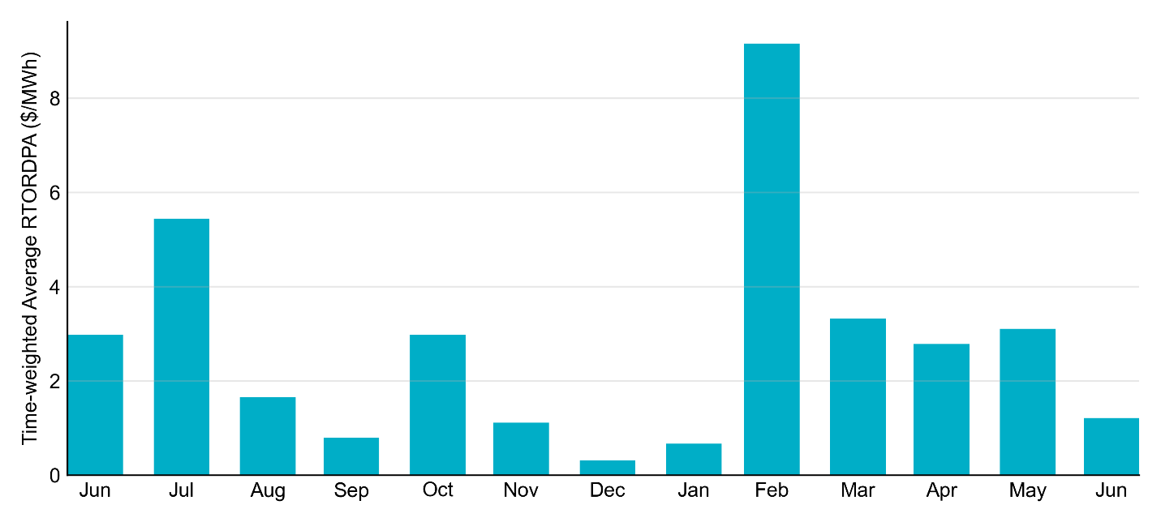
Reliability Deployment Price Adder: Last 13 Months June 2022 had a total of 143.4 RTORDPA hours with an average value of $1.21/MWh.

Slide 12
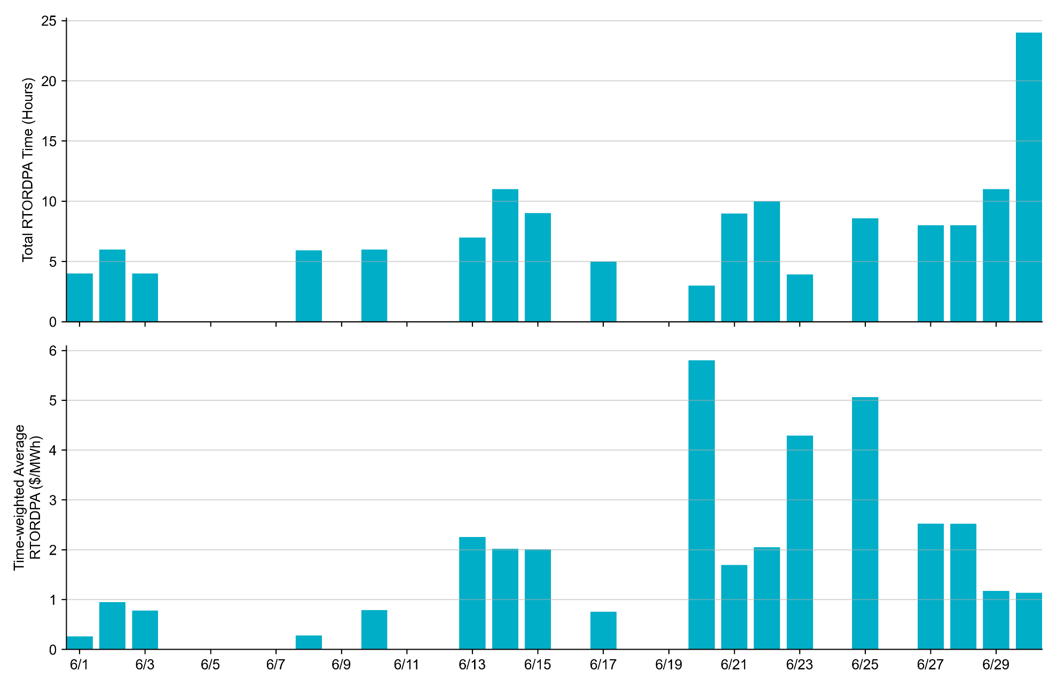
Reliability Deployment Price Adder: June 2022 OD 6/20 had the highest daily average RTORDPA: $5.80/MWh.

Slide 13
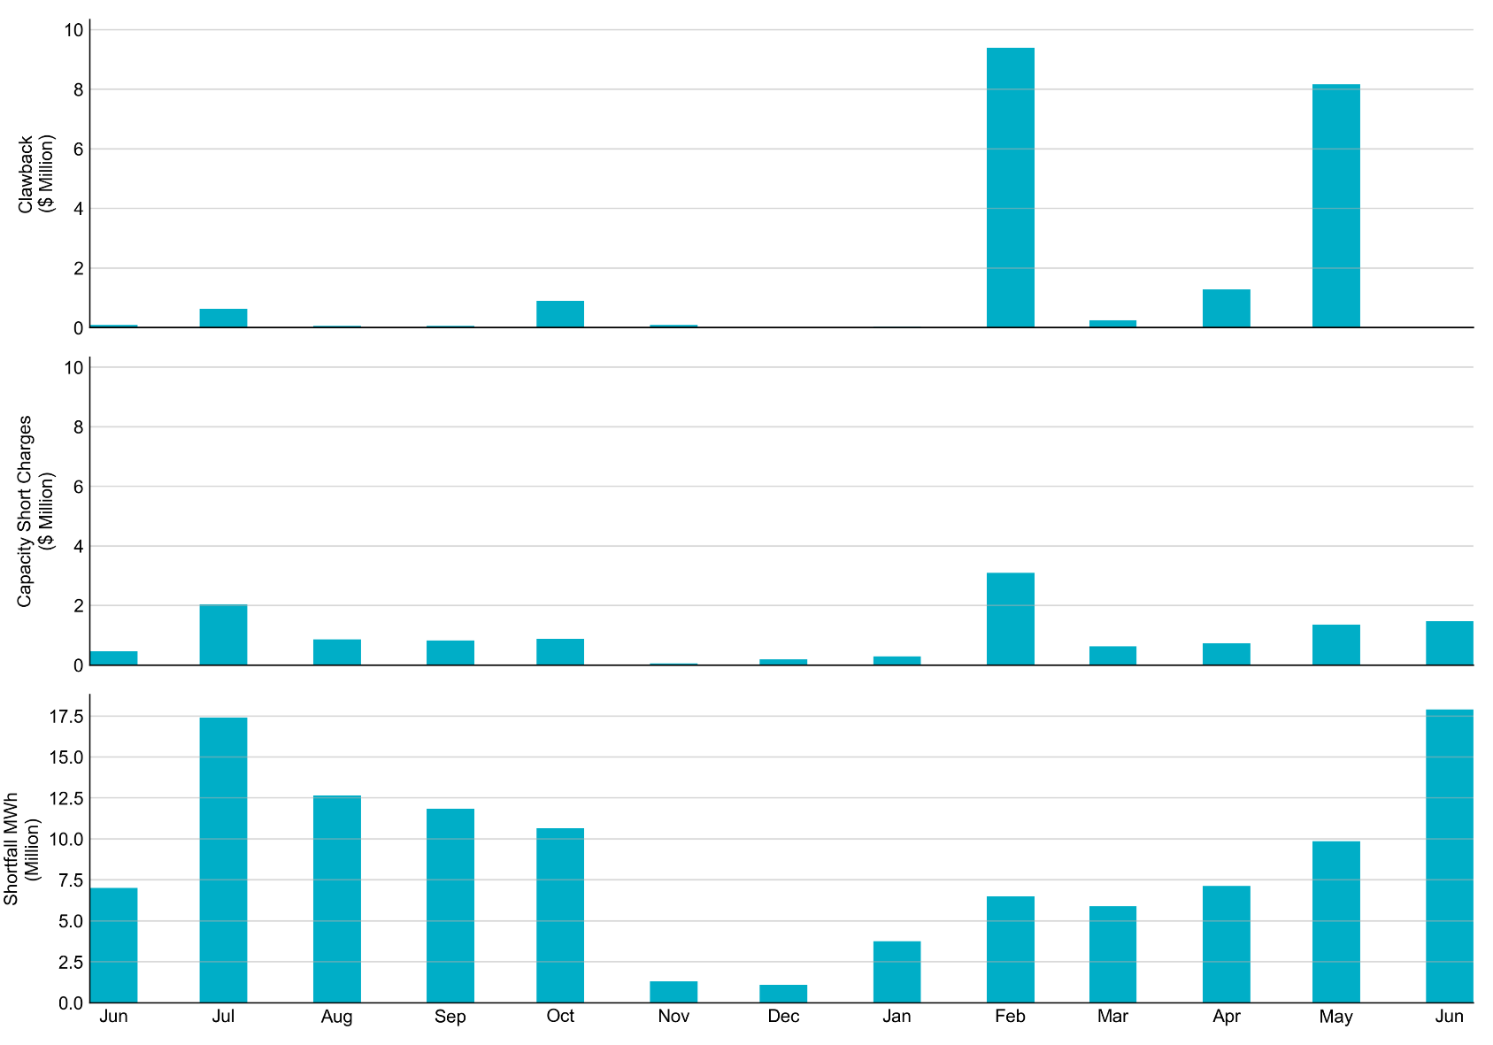
RUC Clawback, Capacity Short Charges, and Shortfall For June 2022, the total Clawback charge was $12,380. The total Make-Whole payment was $1.474M million, which was almost entirely covered through capacity-short charges.
In June 2022, $1.474M in Make-Whole was paid out. Only $4.40 was uplifted to load due to rounding.

